Slide 1
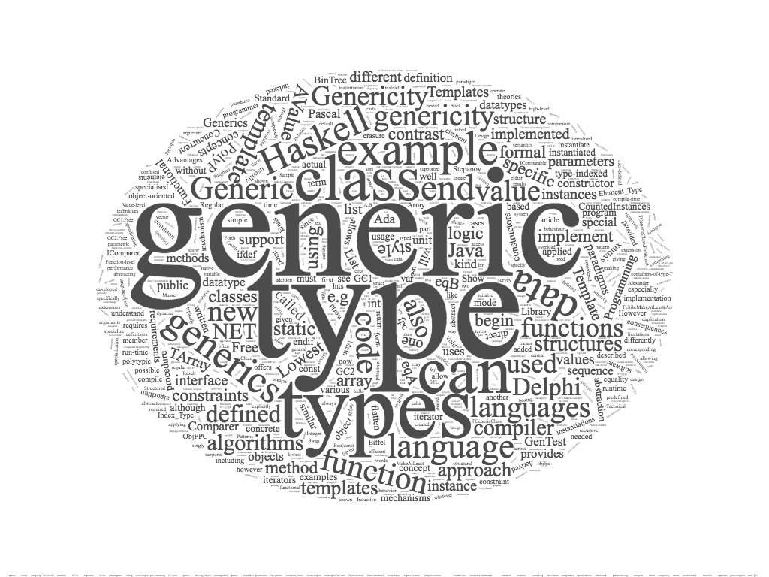
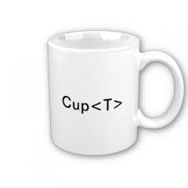
generic programming
alberto ferrari – university of parma

Slide 2
contents
generic programming
java generic programming
  methods & generic programming
  classes & generic programming
java with “generics”
  generic methods
  generic classes
java collections framework
  collections framework (pre JDK 5)
  collections framework with generics
references

Slide 3
generic programming
first definition of generic programming
  generic programming is a programming style in which algorithms are written at the most abstract possible level independent of the form of the data on which these algorithms will be carried out
the roots of generic programming
  David Musser and Alexander Stepanov, in the early 1970s
    the term ‘generic programming’ is coined in 1989
  the generic programming approach was pioneered by ML in 1973 (?)
  the generic programming approach was pioneered by ADA in 1983 (?)
different terms (& implementation) → similar concept
  generics
    Ada, Eiffel, Java, C#, VisualBasic.NET
  parametric polymorphism
    ML, Scala, Haskell
  templates
    C++

Slide 4
generic programming
generic programming
  functions (methods) or types (classes) that differ only in the set of types on which they operate
  ﻿generic programming is a way to make a language more expressive, while still maintaining full static type-safety
  reduce duplication of code
  algorithms are written in terms of generic types
    types are passed as parameters later when needed
generic function
  performs the same operation on different data types
generic type
  store values and perform operation on different data types
Java
  generics
C++
  templates
  (concepts)

Slide 5
generic programming in java
generics add a way to specify concrete types to general purpose classes and methods that operated on Object before
Java Specification Request 14, Add Generic Types To The Java Programming Language
Java Enhancements in JDK 5 (originally numbered 1.5) (2005)
    “Generics
    This long-awaited enhancement to the type system allows a type or method to operate on objects of various types while providing compile-time type safety. It adds compile-time type safety to the Collections Framework and eliminates the drudgery of casting”
docs.oracle.com

Slide 6
generic type
type variable
  is an unqualified identifier
generic class
  if it declares one or more type variables (type parameters of the class)
generic interface
  if it declares one or more type variables (type parameters of the interface)
generic method
  if it declares one or more type variables (formal type parameters of the method)
type parameters are used for the types of
  generic instance
  generic variables
  generic method
  generic parameters
  generics return values

Slide 7

java
methods & generic programming

Slide 8
java methods - overloading
a first possible solution: overloading
overloading
  set of methods all having the same name, but with a different arguments list (signature)
first example:
  get the central element of array

Slide 9
generic method - overloading
/**
* Generic method - Overloading
* @author SoWIDE lab
*/
public class ArrayUtil {
/**
Get the central element of array
@param a String array
@return central element
*/
public static String getCentral(String[] a) {
if (a == null || a.length == 0)
return null;
return (a[a.length/2]);
}
public static Character getCentral(Character[] a) {
if (a == null || a.length == 0)
return null;
return (a[a.length/2]);
}
public static Integer getCentral(Integer[] a) {
if (a == null || a.length == 0)
return null;
return (a[a.length/2]);
}
}
Notes:
Overloading:
3 metodi getCentral con lo stesso nome differiscono solo per I parametri

Slide 10
generic method - overloading
public class Main {
public static void main(String[] args) {
String[] s = {"alpha","beta","charlie"};
Character[] c = {'h', 'a', 'l'}; // autoboxing
Integer[] i = {4 , 8 , 15 , 16 , 23 , 42};
String sc = ArrayUtil.getCentral(s);
assert sc.equals("beta");
Character cc = ArrayUtil.getCentral(c);
assert cc == 'a';
int ic = ArrayUtil.getCentral(i); // unboxing
assert ic == 16;
Double[] d = {1.1, 2.3, 5.8, 13.21};
Double dc = ArrayUtil.getCentral(d); // compile time error:
// no suitable method found for getCentral(Double[])
assert dc == 5.8;
}
}
autoboxing is the automatic conversion that the Java compiler makes between the primitive types and their corresponding object wrapper classes
unboxing is the conversion converting of an object of a wrapper type to its corresponding primitive value.
The Java compiler applies unboxing when an object of a wrapper class is:
- passed as a parameter to a method that expects a value of the corresponding primitive type
- assigned to a variable of the corresponding primitive type
Notes:
Errore compile-time: non è definito il metodo getCentral(Double[])
Notare:
Autoboxing in inizializzazione array costanti char vengono convertite nel tipo wrapper Character. Analogo per int
Autounboxing: int ic = ArrayUtil.getCentral(i); Il valore Integer viene convertito nella classe base int

Slide 11
generic method – inheritance & polymorphism
/**
* Generic method - Inheritance
* @author SoWIDE lab
*/
public class ArrayUtil {
/**
Get the central element of the array
@param a Object array
@return central element
*/
public static Object getCentral(Object[] a)
{
if (a == null || a.length == 0)
return null;
return (a[a.length/2]);
}
}
We can write a method that takes a base class (or interface) as an argument, and then use that method with any class derived from that base class.
This method is more general and can be used in more places.

Slide 12
generic method – inheritance & polymorphism
public class Main {
public static void main(String[] args) {
String[] s = {"alpha","beta","charlie"};
Character[] c = {'h', 'a', 'l'};
Integer[] i = {4 , 8 , 15 , 16 , 23 , 42};
String sc = (String) ArrayUtil.getCentral(s); //downcast from Objet to String
assert sc.equals("beta");
Character cc = (Character) ArrayUtil.getCentral(c);
assert cc == 'a';
int ic = (int) ArrayUtil.getCentral(i); //downcast & unboxing
assert ic == 16;
Double[] d = {1.1, 2.3, 5.8, 13.21};
Double dc = (Double) ArrayUtil.getCentral(d);
assert dc == 5.8;
Integer iVar = (Integer) ArrayUtil.getCentral(c); // no compile-time error -> // run-time exception
// Exception in thread ... java.lang.ClassCastException: java.lang.Character //cannot be cast to java.lang.Integer ...
}
}
Downcasting from base class can generate no type-safe code
Run-time exception occurs in wrong cast operations

Slide 13
java – generic method - (generics)
a generic method (with generics) is a method with a type parameter.
you can think of it as a template for a set of methods that differ only by one or more types
when you call the generic method, you need not specify which type to use for the type parameter. Simply call the method with appropriate parameters, and the compiler will match up the type parameters with the parameter types
as with generic classes, you cannot replace type parameters with primitive types
syntax
modifiers <TypeVariable1, TypeVariable2 ...> returnType methodName(parametrs) {
body
}

Slide 14
java generics
the example:
  get the central element of an array
public static <T> T getCentral(T[] a) {
if (a == null || a.length == 0)
return null;
return (a[a.length/2]);
}
...
String[] s = { "alpha", "beta", "charlie" };
String sc = ArrayUtil.getCentral(s); // implicit type (String)parameter

Slide 15
generic method - (generics)
public class ArrayUtil {
public static <T> T getCentral( T[] a)
{
if (a == null || a.length == 0)
return null;
return (a[a.length/2]);
}
}
public class Main {
public static void main(String[] args) {
String[] s = { "alpha", "beta", "charlie" };
Character[] c = { 'h', 'a', 'l' };
Integer[] i = { 4, 8, 15, 16, 23, 42 };
Double[] d = { 1.1, 2.3, 5.8, 13.21 };
String sc = ArrayUtil.getCentral(s); // implicit type (String) parameter
assert sc.equals("beta");
Character cc = ArrayUtil.<Character> getCentral(c); // esplicit type (Character) parameter
assert cc == 'a';
int ic = ArrayUtil.getCentral(i); // implicit type parameter & unboxing
assert ic == 16;
Double dc = (Double) ArrayUtil.getCentral(d);
assert dc == 5.8;
// Integer iVar = ArrayUtil.getCentral(c); // compile-time error: incompatible types
}
}

Slide 16
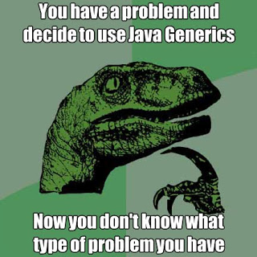
java
generic classes

Slide 17

generic class
a class that hold elements of various type
for example a simple generic class Pair that stores pairs of objects, each of which can have an arbitrary type

Slide 18
Pair
public class Pair {
private Object first;
private Object second;
/**
* Constructs a pair containing two given elements
* @param firstElement the first element
* @param secondElement the second element
*/
public Pair(Object firstElement, Object secondElement) {
first = firstElement;
second = secondElement;
}
/**
* Gets the first element of this pair
* @return the first element
*/
public Object getFirst() {
return first;
}
/**
* Gets the second element of this pair
* @return the second element
*/
public Object getSecond() {
return second;
}
public String toString() {
return "(" + first + ", " + second + ")";
}
}

Slide 19
test Pair
public class Main {
public static void main(String[] args) {
Pair p1 = new Pair("alpha", 1);
// String & Integer (autoboxing) - Implicit upcasting to Object
String name = (String) p1.getFirst();
// esplicit downcasting from Object to String
Integer value = (Integer) p1.getSecond();
System.out.println("Name: "+name+" Value: "+value);
Pair p2 = new Pair(3.2,5.5); // Double & Double (autoboxing)
Double x = (Double) p2.getFirst();
double y = (double) p2.getSecond(); // unboxing
System.out.println("x: "+x+" y: "+y);
x = (Double) p1.getFirst(); // run-time error
// Exception in thread "main" java.lang.ClassCastException: java.lang.String
// cannot be cast to java.lang.Double
}
}

Slide 20

generic class - syntax
accessSpecifier class GenericClassName <TypeVariable1 , TypeVariable2 , ...> {
instance variables
constructors
methods
}

Slide 21
Pair – generic class
public class Pair<T, S> {
private T first;
private S second;
/**
* Constructs a pair containing two given elements.
* @param firstElement the first element
* @param secondElement the second element
*/
public Pair(T firstElement, S secondElement) {
first = firstElement;
second = secondElement;
}
/**
* Gets the first element of this pair.
* @return the first element
*/
public T getFirst() {
return first;
}
/**
* Gets the second element of this pair.
* @return the second element
*/
public S getSecond() {
return second;
}
public String toString() {
return "(" + first + ", " + second + ")";
}
}

Slide 22
Pair – generic class
// explicit actual type paramethers
Pair<String, Integer> p1 = new Pair<String, Integer>("alpha", 1);
String name = p1.getFirst();
Integer value = p1.getSecond();
System.out.println("Name: "+name+" Value: "+value);
// implicit actual type paramethers
Pair<Double, Double> p2 = new Pair(3.2,5.5);
Double x = p2.getFirst();
double y = p2.getSecond();
System.out.println("x: "+x+" y: "+y);
x = p1.getFirst();
// Compile-time error: Type mismatch: cannot convert from String to Double

Slide 23
conventions
type Variable Meaning
  E Element type in a collection
  K Key type in a map
  V Value type in a map
  T General type
  S , U Additional general types

Slide 24

bounds
type parameters can be constrained with bounds
it is often necessary to specify what types can be used in a generic class or method

Slide 25
wildcard types
it is often necessary to formulate constraints of type parameters
there are three kinds of wildcard types:
name | syntax | meaning
wildcard with upper bound | ? extends B | any subtype of B
wildcard with lower bound | ? super B | any supertype of B
unbounded | ? | any type

Slide 26
upper bounded wildcards
you can use an upper bounded wildcard to relax the restrictions on a variable
  for example, if you want to write a method that works on List<Integer>, List<Double>, and List<Number>; you can achieve this by using an upper bounded wildcard
to declare an upper-bounded wildcard, use the wildcard character ('?'), followed by the extends keyword, followed by its upper bound. Note that, in this context, extends is used in a general sense to mean either "extends" (as in classes) or "implements" (as in interfaces).
to write the method that works on lists of Number and the subtypes of Number, such as Integer, Double, and Float, you would specify List<? extends Number>
the term List<Number> is more restrictive than List<? extends Number> because the former matches a list of type Number only, whereas the latter matches a list of type Number or any of its subclasses.

Slide 27
upper bounded wildcards
import java.util.Arrays;
import java.util.List;
public class Main {
public static double sumOfList(List<? extends Number> list) {
double s = 0.0;
for (Number n : list)
s += n.doubleValue();
return s;
}
public static double productOfList(List<? extends Number> list) {
double p = 1.0;
for (Number n : list)
p *= n.doubleValue();
return p;
}
public static void main(String[] args) {
List<Integer> li = Arrays.asList(1, 2, 3);
System.out.println("sum = " + sumOfList(li)); // output sum = 6
System.out.println("product = " + productOfList(li));
List<String> sli =Arrays.asList("alpha","beta","charlie");
System.out.println("sum = " + sumOfList(sli));
// Compile time error: The method sumOfList(List<? extends Number>) in the type Main
// is not applicable for the arguments (List<String>) …
List gli = Arrays.asList("alpha","beta","charlie");;
System.out.println("sum = " + sumOfList(gli));
// Exception in thread "main" java.lang.ClassCastException:
// java.lang.String cannot be cast to java.lang.Number
}

Slide 28
unbounded wildcards
the unbounded wildcard type is specified using the wildcard character (?), for example, List<?>. this is called a list of unknown type
there are two scenarios where an unbounded wildcard is a useful approach:
  if you are writing a method that can be implemented using functionality provided in the Object class
  when the code is using methods in the generic class that don't depend on the type parameter
public static void printList(List<?> list) {
for (Object elem: list)
System.out.print(elem + " ");
System.out.println();
}

Slide 29

java generics
under the hood

Slide 30

erasure
generics in Java provide compile-time safety for type-correctness, but is partially considered as a run-time feature and it is somewhat similar to inheritance-polymorphism in practice
in Java, there is a process called type erasure, through which, type information is removed during compilation and there is no way to tell what was the type of a generic when it was instantiated during run-time
this is considered as a restriction and many programmers are dissatisfied with it
any algorithm that requires to know the original type cannot be implemented through generics in Java

Slide 31
generic method - (erasure)
Source code
public class ArrayUtil {
public static <T> T getCentral(T[] a){
if (a == null || a.length == 0)
return null;
return (a[a.length/2]);
}
}
Code after erasure
public class ArrayUtil {
public static Object getCentral(Object a[]) {
if (a == null || a.length == 0)
return null;
else
return a[a.length / 2];
}
}

Slide 32
erasure
the Java compiler erases type parameters, replacing them with their bounds or Objects
because the Java compiler erases all type parameters in generic code, you cannot verify which parameterized type for a generic type is being used at runtime
the term erasure is a slight misnomer, since the process erases type parameters but adds casts
knowing about type erasure helps you understand limitations of Java generics.
  for example, you cannot construct new objects of a generic type.
Example
public static <E> void fillWithDefaults(E[] a) {
private E[] elements;
elements = new E[10]; // error
for (int i = 0; i < a.length; i++)
a[i] = new E(); // error
}

Slide 33
Main (after erasure)
public class Main {
public Main() {
}
public static void main(String args[]) {
String s[] = { "alpha", "beta", "charlie" };
Character c[] = { Character.valueOf('h'), Character.valueOf('a'),
Character.valueOf('l') };
Integer i[] = { Integer.valueOf(4), Integer.valueOf(8),
Integer.valueOf(15), Integer.valueOf(16), Integer.valueOf(23),
Integer.valueOf(42) };
Double d[] = { Double.valueOf(1.1000000000000001D),
Double.valueOf(2.2999999999999998D),
Double.valueOf(5.7999999999999998D),
Double.valueOf(13.210000000000001D) };
String sc = (String) ArrayUtil.getCentral(s);
if (!$assertionsDisabled && !sc.equals("beta"))
throw new AssertionError();
Character cc = (Character) ArrayUtil.getCentral(c);
if (!$assertionsDisabled && cc.charValue() != 'a')
throw new AssertionError();
int ic = ((Integer) ArrayUtil.getCentral(i)).intValue();
if (!$assertionsDisabled && ic != 16)
throw new AssertionError();
Double dc = (Double) ArrayUtil.getCentral(d);
if (!$assertionsDisabled && dc.doubleValue() != 5.7999999999999998D)
throw new AssertionError();
else
return;
}
static final boolean $assertionsDisabled = false;
}

Slide 34

syntactic sugar?
are Java Generics just syntactic sugar?

Slide 35
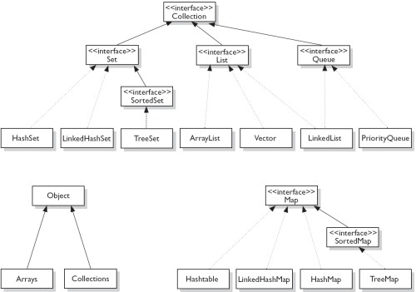
java collections framework

Slide 36
java collections framework
Java Collection Framework is a unified architecture for representing and manipulating collections, enabling collections to be manipulated independently of implementation details
  reduces programming effort by providing data structures and algorithms so you don't have to write them yourself
  increases performance by providing high-performance implementations of data structures and algorithms
  fosters software reuse by providing a standard interface for collections and algorithms with which to manipulate them

Slide 37
java collections framework (pre JDK 5)
import java.util.ArrayList;
import java.util.Iterator;
public class ArrayListPreJDK5Test {
public static void main(String[] args) {
ArrayList lst = new ArrayList(); // ArrayList contains instances of Object
lst.add("alpha"); // add() takes Object. String upcast to Object implicitly
lst.add("beta");
lst.add("charlie");
lst.add(new Integer(10)); //Integer upcast to Object implicitly
System.out.println(lst); // [alpha, beta, charlie, 10]
Iterator iter = lst.iterator();
while (iter.hasNext()) {
//explicitly downcast from Object to String
String str = (String)iter.next(); // ERROR
System.out.println(str);
}
}
}
pre-JDK5 Collections are not type-safe
the upcasting to java.lang.Object is done implicitly by the compiler
the programmer has to explicitly downcast the Object retrieved back to their original class
the compiler is not able to check whether the downcasting is valid at compile-time
incorrect downcasting will show up only at runtime, as a ClassCastException

Slide 38
java collections framework (post JDK 5)
// Post-JDK 1.5 with Generics
import java.util.ArrayList;
import java.util.Iterator;
public class ArrayListPostJDK15Test {
public static void main(String[] args) {
ArrayList<String> lst = new ArrayList<String>(); //Inform compiler about type
lst.add("alpha"); // compiler checks if argument's type is String
lst.add("beta");
lst.add("charlie");
System.out.println(lst); // [alpha, beta, charlie]
Iterator<String> iter = lst.iterator(); // Iterator of Strings
while (iter.hasNext()) {
String str = iter.next(); // compiler inserts downcast operator
System.out.println(str);
}
lst.add(new Integer(1234)); // ERROR: compiler can detect wrong type
error: no suitable method found for add(Integer)
Integer intObj = lst.get(0); // ERROR: compiler can detect wrong type
error: incompatible types: String cannot be converted to Integer
// Enhanced for-loop (JDK 1.5)
for (String str : lst) {
System.out.println(str);
}
}
}
the compiler can perform all the necessary type-check during compilation to ensure type-safety at runtime.

Slide 39
implementing by erasure: effects
it keeps things simple, in that generics do not add anything fundamentally new
it keeps things small, in that there is exactly one implementation of List, not one version for each type
it eases evolution, since the same library can be accessed in both nongeneric and generic forms.
  you don’t get problems due to maintaining two versions of the libraries:
    a nongeneric legacy version that works with Java 1.4 or earlier
    a generic version that works with Java 5 or next
cast-iron guarantee: the implicit casts added by the compilation of generics never fail

Slide 40
references
Musser, D.A. and Stepanov, A.A., Generic Program ming, Proceeding of International Symposium on Symbolic and Algebraic Computation, vol. 358: Lecture Notes in Computer Science, Rome, Italy, 1988, pp. 13–25
Giovannelli, D. (2013). Programming in Algorithms: Generic Programming and its Implementation.
Naftalin, M., Philip Wadler, P.. Java Generics and Collections. Speed Up the Java Development Process. O'Reilly Media (2006)
Jaime Niño. 2007. The cost of erasure in Java generics type system. J. Comput. Sci. Coll. 22, 5 (May 2007), 2-11

