Slide 1
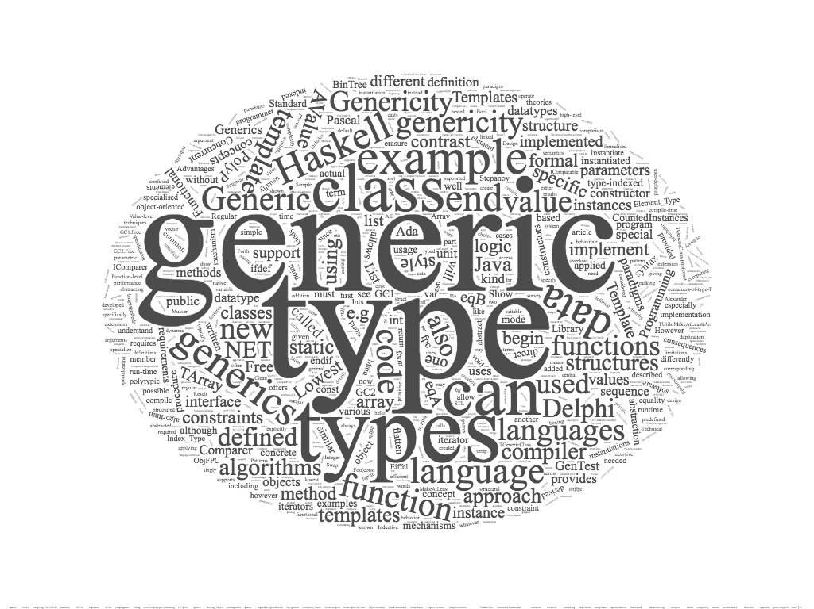


generic programming
alberto ferrari – university of parma

Slide 2
three approaches to generics
C approach -> leave them out
  slows programmers
  adds no complexity to the language
C++ approach -> compile-time specialization or macro expansion
  slows compilation
  generates a lot of code, much of it redundant, and needs a good linker to eliminate duplicate copies
  the individual specializations may be efficient but the program as a whole can suffer due to poor use of the instruction cache. “I have heard of simple libraries having text segments shrink from megabytes to tens of kilobytes by revising or eliminating the use of templates”
Java approach -> box everything implicitly
  slows execution
  compared to the implementations the C programmer would have written or the C++ compiler would have generated, the Java code is smaller but less efficient in both time and space, because of all the implicit boxing and unboxing

Slide 3
generics vs templates
syntax
  the syntax is deliberately similar
  <angle brackets>
semantics
  the semantics are deliberately different
  C++ templates are defined by expansion
    in C++ templates, each instance of a template at a new type is compiled separately. If you use a list of integers, a list of strings, and a list of lists of string, there will be three versions of the code. If you use lists of a hundred different types, there will be a hundred versions of the code (a problem known as code bloat)
    code bloat is the production of code that is perceived as unnecessarily long, slow, or otherwise wasteful of resources
  Java generics are defined by erasure
    in Java there is always one version of the code, so bloat does not occur
expansion may lead to more efficient implementation than erasure, since it offers more opportunities for optimization, particularly for primitive types such as int
  for code that is manipulating large amounts of data (for instance, large arrays in scientific computing) this difference may be significant

Slide 4
parametric polymorphism
Java has parametric polymorphism as found in functional languages such as ML and Haskell
parametric polymorphism is a way to make a language more expressive, while still maintaining full static type-safety. Using parametric polymorphism, a function or a data type can be written generically so that it can handle values identically without depending on their type. Such functions and data types are called generic functions and generic datatypes respectively and form the basis of generic programming.
parametric polymorphism may be contrasted with ad hoc polymorphism, in which a single polymorphic function can have a number of distinct and potentially heterogeneous implementations depending on the type of argument(s) to which it is applied. Thus, ad hoc polymorphism can generally only support a limited number of such distinct types, since a separate implementation has to be provided for each type. It is also known as function overloading or operator overloading
early binding - ad hoc polymorphism is a dispatch mechanism: control moving through one named function is dispatched to various other functions without having to specify the exact function being called. Overloading allows multiple functions taking different types to be defined with the same name; the compiler or interpreter automatically ensures that the right function is called.
using overloading, it is possible to have a function perform two completely different things based on the type of input passed to it (each optimized for the particular data types); this is not possible with parametric polymorphism.
late binding - in Smalltalk, the overloading is done at run time, as the methods for each overloaded message are resolved when they are about to be executed. This happens at run time, after the program is compiled. Therefore, polymorphism is given by subtyping polymorphism as in other languages, and it is also extended in functionality by ad hoc polymorphism at run time.

Slide 5
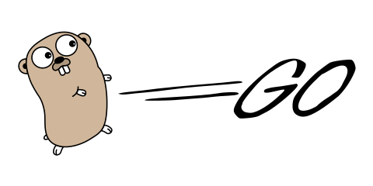
Go
Generics & Go

Slide 6
Go group discussion
arguments in favor of generics
  people can write code once, saving coding time
  people can fix a bug in one instance without having to remember to fix it in others
  generics avoid boilerplate: less coding by copying and editing
  generics save time testing code: they increase the amount of code that can be type checked at compile time rather than at run time

Slide 7
Go & generics
Go already supports a form of generic programming via interfaces
People can write an abstract algorithm that works with any type that implements the interface
  However, interfaces are limited because the methods must use specific types
  There is no way to write an interface with a method that takes an argument of type T, for any T, and returns a value of the same type
  There is no way to write an interface with a method that compares two values of the same type T, for any T

Slide 8
arguments in favor of generics in Go
generics permit type-safe polymorphic containers
Go currently has a very limited set of such containers: slices, and maps of most but not all types. Not every program can be written using a slice or map.
look at the functions SortInts, SortFloats, SortStrings in the sort package. Or SearchInts, SearchFloats, SearchStrings. Or the Len, Less, and Swap methods of byName in package io/ioutil. Pure boilerplate copying

Slide 9
“what we want from generics in Go”
define generic types based on types that are not known until they are instantiated
write algorithms to operate on values of these types
name generic types and name specific instantiations of generic types
restrict the set of types that may be used to instantiate a generic type, to ensure that the generic type is only instantiated with types that support the required operations
do not require an explicit relationship between the definition of a generic type or function and its use. That is, programs should not have to explicitly say type T implements generic G
do not require explicit instantiation of generic types or functions; they should be instantiated as needed

Slide 10
the downsides of generics
generics affect the whole language
  it is necessary to evaluate every single language construct to see how it will work with generics
generics affect the whole standard library
  it is desirable to have the standard library make effective use of generics
  every existing package should be reconsidered to see whether it would benefit from using generics
generics are a trade off between programmer time, compilation time, and execution time
  Go is currently optimizing compilation time and execution time at the expense of programmer time
  Compilation time is a significant benefit of Go
  Can we retain compilation time benefits without sacrificing too much execution time?
Go has a lightweight type system. Adding generic types inevitably makes the type system more complex. It is essential that the result remain lightweight

Slide 11
Conclusion
generics will make the language
  safer
  more efficient to use
  more powerful
these advantages are harder to quantify than the disadvantages, but they are real
examples of potential uses of generics in Go
  containers
    user-written hash tables that are compile-time type-safe, rather than converting slice keys to string and using maps
    sorted maps
    ...
  generic algorithms that work with these containers in a type-safe way
    union/intersection
    sort, find
    ...

Slide 12

Haskell
Generics & Haskell

Slide 13
Haskell: generic & type construcor
Haskell (refer to Tomaiuolo slides)
Nullary type constructor has zero arguments
  data Bool = True | False
A type constructor may have arguments
  Example with one argument:
  data Tree a = Tip | Node a (Tree a) (Tree a)
The data type is polymorphic (and a is a type variable that is to be substituted by a specific type).
  So when used, the values will have types like Tree Int or Tree (Tree Boolean)

