Slide 1
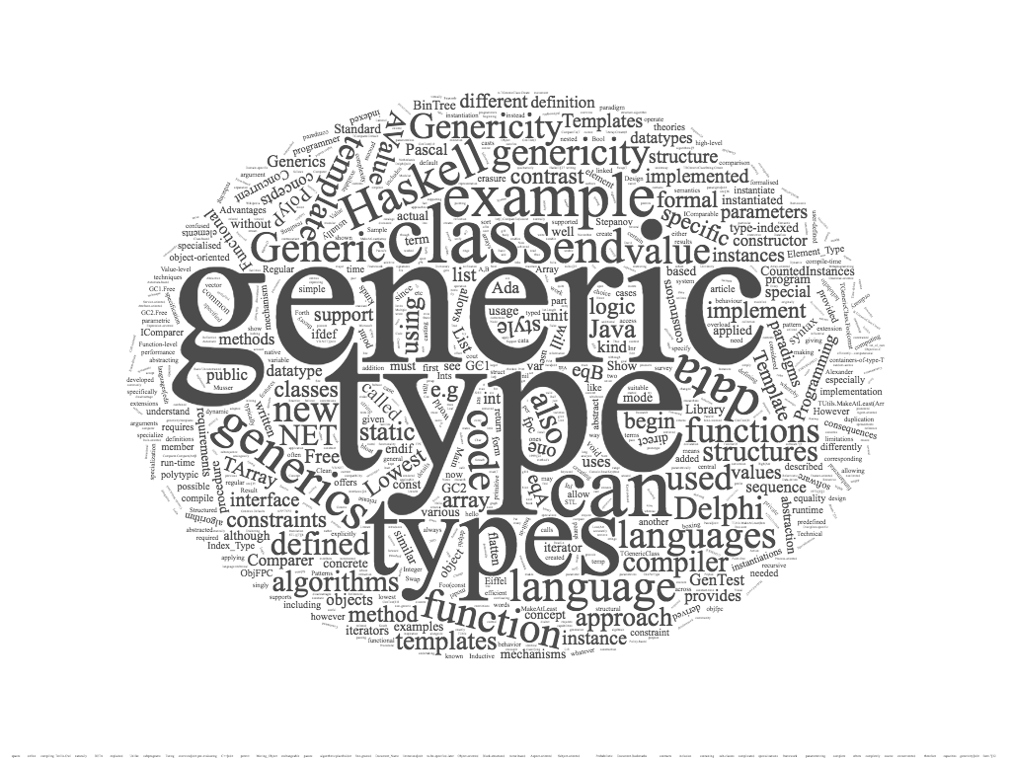
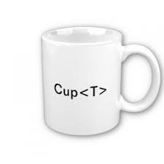
generic programming - java

Slide 2
contents
generic programming
java generic programming
methods & generic programming
classes & generic programming
java with “generics”
generic methods
generic classes
java collections framework
collections framework (pre JDK 5)
collections framework with generics
references

Slide 3
generic programming
definitions of generic programming
generic programming is a programming style in which algorithms are written at the most abstract possible level independent of the form of the data on which these algorithms will be carried out
generic programming is a style of computer programming in which algorithms are written in terms of types to-be-specified-later that are then instantiated when needed for specific types provided as parameters

Slide 4
the roots of generic programming
David Musser and Alexander Stepanov, in the early 1970s
the term ‘generic programming’ is coined in 1989
the generic programming approach was pioneered by ML in 1973 (?)
the generic programming approach was pioneered by ADA in 1983 (?)
different terms (& implementation) → similar concept
generics
Ada, Eiffel, Java, C#, VisualBasic.NET
parametric polymorphism
ML, Scala, Haskell
templates
C++

Slide 5
generic programming
functions (methods) or types (classes) that differ only in the set of types on which they operate
﻿generic programming is a way to make a language more expressive, while still maintaining full static type-safety
reduce duplication of code
algorithms are written in terms of generic types
types are passed as parameters later when needed

Slide 6
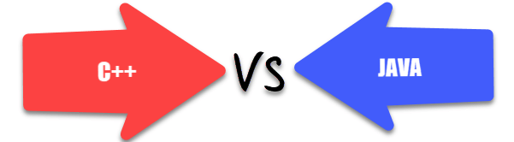
java & c++
generic function
performs the same operation on different data types
generic type (class)
store values and perform operation on different data types
java
generics
c++
templates
(concepts)

Slide 7
generic programming in java
generics add a way to specify concrete types to general purpose classes and methods that operated on Object before
Java Specification Request 14 (2004)
add generic types to the java programming language
generics in JDK 5 (originally numbered 1.5) (2005)
“This long-awaited enhancement to the type system allows a type or method to operate on objects of various types while providing compile-time type safety. It adds compile-time type safety to the Collections Framework and eliminates the drudgery of casting” [docs.oracle.com]

Slide 8
generic type
type variable
is an unqualified identifier
generic class
if it declares one or more type variables (type parameters of the class)
generic interface
if it declares one or more type variables (type parameters of the interface)
generic method
if it declares one or more type variables (formal type parameters of the method)

Slide 9

methods & generic programming
step back
overloading
inheritance & polymorphism
step forward
generics

Slide 10
java - methods
a first possible solution: overloading
overloading
set of methods all having the same name, but with a different arguments list (signature)
first example:
get the central element of array

Slide 11
/** * Generic method - Overloading * @author SoWIDE lab */ public class ArrayUtil { /** Get the central element of array @param a String array @return central element */ public static String getCentral(String[] a) { if (a == null || a.length == 0) return null; return (a[a.length/2]); } public static Character getCentral(Character[] a) { if (a == null || a.length == 0) return null; return (a[a.length/2]); } public static Integer getCentral(Integer[] a) { if (a == null || a.length == 0) return null; return (a[a.length/2]); } }

Slide 12
public class Main { public static void main(String[] args) { String[] s = {"alpha","beta","charlie"}; Character[] c = {'h', 'a', 'l'}; // autoboxing Integer[] i = {4 , 8 , 15 , 16 , 23 , 42}; String sc = ArrayUtil.getCentral(s); assert sc.equals("beta"); Character cc = ArrayUtil.getCentral(c); assert cc == 'a'; int ic = ArrayUtil.getCentral(i); // unboxing assert ic == 16; Double[] d = {1.1, 2.3, 5.8, 13.21}; Double dc = ArrayUtil.getCentral(d); // compile time error: // no suitable method found for getCentral(Double[]) assert dc == 5.8; } }

Slide 13
assertion – autoboxing - unboxing
assertion
an assertion is a statement in the Java programming language that enables you to test you’re assumptions about your program
autoboxing
autoboxing is the automatic conversion that the Java compiler makes between the primitive types and their corresponding object wrapper classes
unboxing
unboxing is the conversion of an object of a wrapper type to its corresponding primitive value
the Java compiler applies unboxing when an object of a wrapper class is:
passed as a parameter to a method that expects a value of the corresponding primitive type
assigned to a variable of the corresponding primitive type

Slide 14
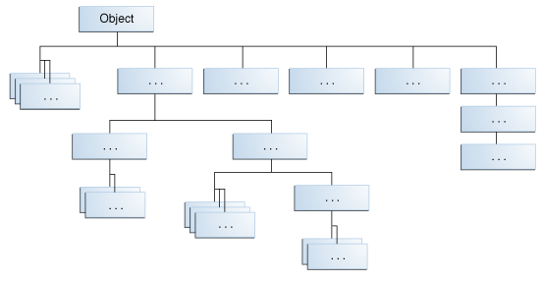
generic method inheritance & polymorphism
we can write a method that takes a base class (or interface) as an argument, and then use that method with any class derived from that base class
this method is more general and can be used in more places

Slide 15
/** * Generic method - Inheritance * @author SoWIDE lab */ public class ArrayUtil { /** Get the central element of the array @param a Object array @return central element */ public static Object getCentral(Object[] a) { if (a == null || a.length == 0) return null; return (a[a.length/2]); } }

Slide 16
public class Main { public static void main(String[] args) { String[] s = {"alpha","beta","charlie"}; Character[] c = {'h', 'a', 'l'}; Integer[] i = {4 , 8 , 15 , 16 , 23 , 42}; String sc = (String) ArrayUtil.getCentral(s); //downcast from Objet to String assert sc.equals("beta"); Character cc = (Character) ArrayUtil.getCentral(c); assert cc == 'a'; int ic = (int) ArrayUtil.getCentral(i); //downcast & unboxing assert ic == 16; Double[] d = {1.1, 2.3, 5.8, 13.21}; Double dc = (Double) ArrayUtil.getCentral(d); assert dc == 5.8; Integer iVar = (Integer) ArrayUtil.getCentral(c); // no compile-time error
// run-time exception // Exception in thread ... java.lang.ClassCastException: java.lang.Character //cannot be cast to java.lang.Integer ... } }

Slide 17
type safety
type safety
the compiler will validate types while compiling
throw an error if you try to assign the wrong type to a variable
downcasting from base class can generate no type-safe code
run-time exception occurs in wrong cast operations

Slide 18
java generic methods (generics)
a generic method (with generics) is a method with a type parameter
you can think of it as a template for a set of methods that differ only by one or more types
when you call the generic method, you need not specify which type to use for the type parameter
you call the method with appropriate parameters, and the compiler will match up the type parameters with the parameter types
as with generic classes, you cannot replace type parameters with primitive types

Slide 19
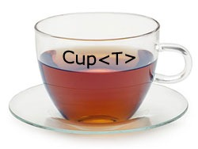
syntax
modifier <TypeVariable1, TypeVariable2 ...> returnType methodName(parameters) {
body
}

Slide 20
java generic methods (generics)
public static <T> T getCentral(T[] a) { if (a == null || a.length == 0) return null; return (a[a.length/2]); } ... String[] s = { "alpha", "beta", "charlie" }; String sc = ArrayUtil.getCentral(s); // implicit type(String)parameter

Slide 21
public class Main { public static void main(String[] args) { String[] s = { "alpha", "beta", "charlie" }; Character[] c = { 'h', 'a', 'l' }; Integer[] i = { 4, 8, 15, 16, 23, 42 }; Double[] d = { 1.1, 2.3, 5.8, 13.21 }; String sc = ArrayUtil.getCentral(s); // implicit type (String) parameter assert sc.equals("beta"); Character cc = ArrayUtil.<Character> getCentral(c); // esplicit type parameter assert cc == 'a'; int ic = ArrayUtil.getCentral(i); // implicit type parameter & unboxing assert ic == 16; Double dc = ArrayUtil.getCentral(d); assert dc == 5.8; Integer iVar = ArrayUtil.getCentral(c); // compile-time error: incompatible types } }

Slide 22
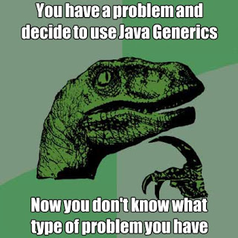
java – generic classes

Slide 23

generic class
a class that hold elements of various type
for example a simple generic class Pair that stores pairs of objects, each of which can have an arbitrary type

Slide 24
public class Pair { private Object first; private Object second; /** * Constructs a pair containing two given elements * @param firstElement the first element * @param secondElement the second element */ public Pair(Object firstElement, Object secondElement) { first = firstElement; second = secondElement; } /** * Gets the first element of this pair * @return the first element */ public Object getFirst() { return first; } /** * Gets the second element of this pair * @return the second element */ public Object getSecond() { return second; } public String toString() { return "(" + first + ", " + second + ")"; } }

Slide 25
test Pair
public class Main { public static void main(String[] args) { Pair p1 = new Pair("alpha", 1); // String & Integer (autoboxing) - Implicit upcasting to Object String name = (String) p1.getFirst(); // esplicit downcasting from Object to String Integer value = (Integer) p1.getSecond(); System.out.println("Name: "+name+" Value: "+value); Pair p2 = new Pair(3.2,5.5); // Double & Double (autoboxing) Double x = (Double) p2.getFirst(); double y = (double) p2.getSecond(); // unboxing System.out.println("x: "+x+" y: "+y); x = (Double) p1.getFirst(); // run-time error // Exception in thread "main" java.lang.ClassCastException: java.lang.String // cannot be cast to java.lang.Double } }

Slide 26

generic class - syntax
accessSpecifier class GenericClassName <TypeVariable1 , TypeVariable2 , ...> {
instance variables
constructors
methods
}

Slide 27
Pair - generic class
public class Pair<T, S> { private T first; private S second; public Pair(T firstElement, S secondElement) { first = firstElement; second = secondElement; } public T getFirst() { return first; } public S getSecond() { return second; } public String toString() { return "(" + first + ", " + second + ")"; } }

Slide 28
Pair - test class
// explicit actual type paramethers Pair<String, Integer> p1 = new Pair<String, Integer>("alpha", 1); String name = p1.getFirst(); Integer value = p1.getSecond(); System.out.println("Name: "+name+" Value: "+value); // implicit actual type paramethers Pair<Double, Double> p2 = new Pair(3.2,5.5); Double x = p2.getFirst(); double y = p2.getSecond(); System.out.println("x: "+x+" y: "+y); x = p1.getFirst(); // Compile-time error: Type mismatch: cannot convert from String to Double

Slide 29
conventions
type variable meaning
E Element type in a collection
K Key type in a map
V Value type in a map
T General type
S , U Additional general types

Slide 30

bounds
type parameters can be constrained with bounds
it is often necessary to specify what types can be used in a generic class or method

Slide 31
wildcard types
it is often necessary to formulate constraints of type parameters
there are three kinds of wildcard types:
name | syntax | meaning
wildcard with upper bound | ? extends B | any subtype of B
wildcard with lower bound | ? super B | any supertype of B
unbounded | ? | any type

Slide 32
upper bounded wildcards
example: if you want to write a method that works on List<Integer>, List<Double>, and List<Number> you can achieve this by using an upper bounded wildcard
to write the method that works on lists of Number and the subtypes of Number, such as Integer, Double, and Float, you would specify List<? extends Number>
the term List<Number> is more restrictive than List<? extends Number>
the former matches a list of type Number only
the latter matches a list of type Number or any of its subclasses

Slide 33
collections & generic
public static double sumOfList(List<? extends Number> list) { double s = 0.0; for (Number n : list) s += n.doubleValue(); return s; } public static double productOfList(List<? extends Number> list) { double p = 1.0; for (Number n : list) p *= n.doubleValue(); return p; }

Slide 34
collections & generic
public static void main(String[] args) { List<Integer> li = Arrays.asList(1, 2, 3); System.out.println("sum = " + sumOfList(li)); // output sum = 6 System.out.println("product = " + productOfList(li)); List<String> sli =Arrays.asList("alpha","beta","charlie"); System.out.println("sum = " + sumOfList(sli)); // Compile time error: The method sumOfList(List<? extends Number>) … // is not applicable for the arguments (List<String>) … List gli = Arrays.asList("alpha","beta","charlie");; System.out.println("sum = " + sumOfList(gli)); // Exception in thread "main" java.lang.ClassCastException: // java.lang.String cannot be cast to java.lang.Number }

Slide 35
unbounded wildcards
the unbounded wildcard type is specified using the wildcard character (?), for example, List<?>. this is called a list of unknown type
there are two scenarios where an unbounded wildcard is a useful approach:
if you are writing a method that can be implemented using functionality provided in the Object class
when the code is using methods in the generic class that don't depend on the type parameter

Slide 36

under the hood

Slide 37

erasure
generics in Java provide compile-time safety for type-correctness
but is partially considered as a run-time feature and it is somewhat similar to inheritance-polymorphism in practice
there is a process called type erasure
type information is removed during compilation and there is no way to tell what was the type of a generic when it was instantiated during run-time
any algorithm that requires to know the original type cannot be implemented through generics

Slide 38
source code
code after erasure
public static <T> T getCentral(T[] a)
{ if (a == null || a.length == 0) return null; return (a[a.length/2]);
}
public static Object getCentral(Object[] a
{ if (a == null || a.length == 0) return null; return a[a.length / 2]; }

Slide 39
erasure
the Java compiler erases type parameters, replacing them with their bounds or Objects
because the Java compiler erases all type parameters in generic code, you cannot verify which parameterized type for a generic type is being used at runtime
the process erases type parameters but adds casts
knowing about type erasure helps you understand limitations of Java generics
for example, you cannot construct new objects of a generic type

Slide 40
public static <E> void fillWithDefaults(E[] a){ private E[] elements; elements = new E[10]; // error for (int i = 0; i < a.length; i++) a[i] = new E(); // error }

Slide 41
Main (after erasure)
public static void main(String args[]) { String s[] = { "alpha", "beta", "charlie" }; Character c[] = { Character.valueOf('h'), Character.valueOf('a’), …}; Integer i[] = { Integer.valueOf(4), Integer.valueOf(8),…}; Double d[] = { Double.valueOf(1.1000000000000001D),…}; String sc = (String) ArrayUtil.getCentral(s); if (!$assertionsDisabled && !sc.equals("beta")) throw new AssertionError(); Character cc = (Character) ArrayUtil.getCentral(c); if (!$assertionsDisabled && cc.charValue() != 'a') throw new AssertionError(); int ic = ((Integer) ArrayUtil.getCentral(i)).intValue(); if (!$assertionsDisabled && ic != 16) throw new AssertionError(); Double dc = (Double) ArrayUtil.getCentral(d); if (!$assertionsDisabled && dc.doubleValue() != 5.7999999999999998D) throw new AssertionError(); else return; }

Slide 42

syntactic sugar?
are Java Generics just syntactic sugar?

Slide 43
implementing by erasure: effects
it keeps things simple, in that generics do not add anything fundamentally new
it keeps things small, in that there is exactly one implementation of List, not one version for each type
it eases evolution, since the same library can be accessed in both nongeneric and generic forms
cast-iron guarantee: the implicit casts added by the compilation of generics never fail

Slide 44
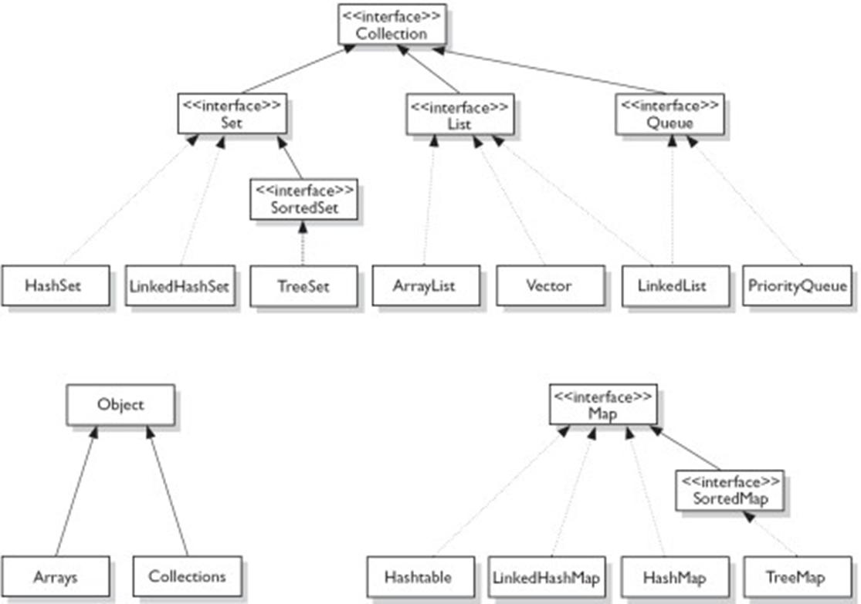
java collections framework

Slide 45
java collection framework
is a unified architecture for representing and manipulating collections, enabling collections to be manipulated independently of implementation details
pre-JDK5 collections are not type-safe
the upcasting to java.lang.Object is done implicitly by the compiler
the programmer has to explicitly downcast the Object retrieved back to their original class
the compiler is not able to check whether the downcasting is valid at compile-time
incorrect downcasting will show up only at runtime, as a ClassCastException
post-JDK5
the compiler can perform all the necessary type-check during compilation to ensure type-safety at runtime

Slide 46
java collections framework (pre JDK 5)
import java.util.ArrayList; import java.util.Iterator; public class ArrayListPreJDK5Test { public static void main(String[] args) { ArrayList lst = new ArrayList(); // ArrayList contains instances of Object lst.add("alpha"); // add() takes Object. String upcast to Object implicitly lst.add("beta"); lst.add("charlie"); lst.add(new Integer(10)); //Integer upcast to Object implicitly System.out.println(lst); // [alpha, beta, charlie, 10] Iterator iter = lst.iterator(); while (iter.hasNext()) { //explicitly downcast from Object to String String str = (String)iter.next(); // ERROR System.out.println(str); } } }

Slide 47
java collections framework (post JDK 5)
public class ArrayListPostJDK15Test { public static void main(String[] args) { ArrayList<String> lst = new ArrayList<String>(); //Inform compiler about type lst.add("alpha"); // compiler checks if argument's type is String … Iterator<String> iter = lst.iterator(); // Iterator of Strings while (iter.hasNext()) { String str = iter.next(); // compiler inserts downcast operator System.out.println(str); } lst.add(new Integer(1234)); // ERROR: compiler can detect wrong type // error: no suitable method found for add(Integer) Integer intObj = lst.get(0); // ERROR: compiler can detect wrong type // error: incompatible types: String cannot be converted to Integer // Enhanced for-loop (JDK 1.5) for (String str : lst) { System.out.println(str); } } }

Slide 48
references
Musser, D.A. and Stepanov, A.A., Generic Programming, Proceeding of International Symposium on Symbolic and Algebraic Computation, vol. 358: Lecture Notes in Computer Science, Rome, Italy, 1988, pp. 13–25
Giovannelli, D. (2013). Programming in Algorithms: Generic Programming and its Implementation.
Naftalin, M., Philip Wadler, P.. Java Generics and Collections. Speed Up the Java Development Process. O'Reilly Media (2006)
Jaime Niño. 2007. The cost of erasure in Java generics type system. J. Comput. Sci. Coll. 22, 5 (May 2007), 2-11

