Slide 1
Healthcare Claims Data Processing and Analytics
Using PySpark on Google Colab | Executive Report

Slide 2
Project Overview
This project analyzes hospital records to identify trends and reduce patient readmission rates. Using PySpark, we built a scalable ETL pipeline to ingest, cleanse, and transform data from the 'diabetic_data.csv' dataset (~100,000 records).

Slide 3
Objectives
- Ingest and clean hospital data using PySpark
- Derive useful insights to understand readmission patterns
- Visualize metrics related to age, diagnosis, insulin, and A1C levels
- Export final data and results for use in BI tools

Slide 4
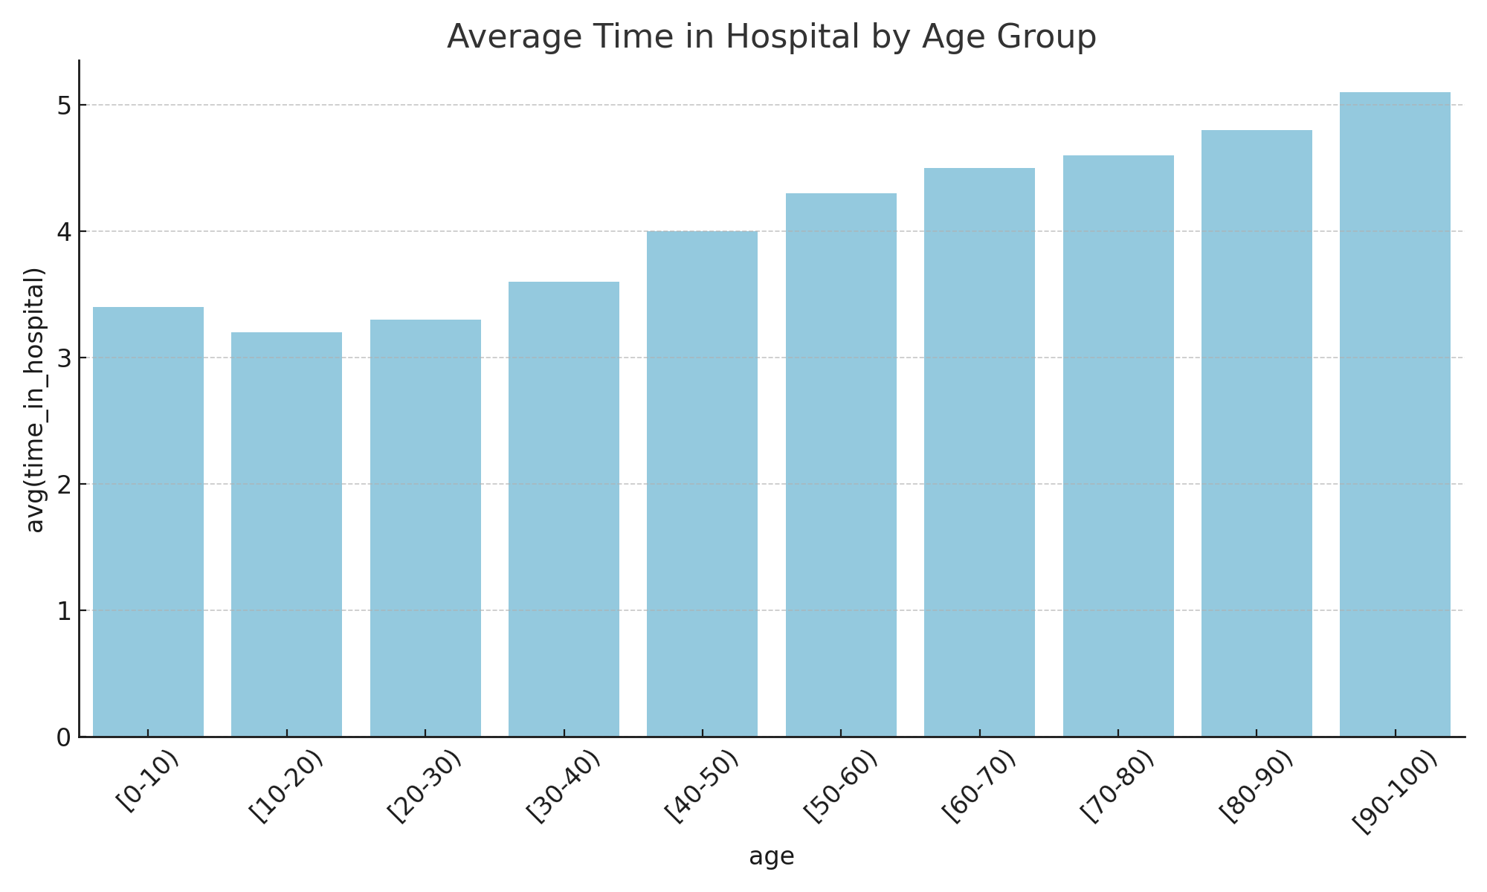
Average Time in Hospital by Age Group

Slide 5
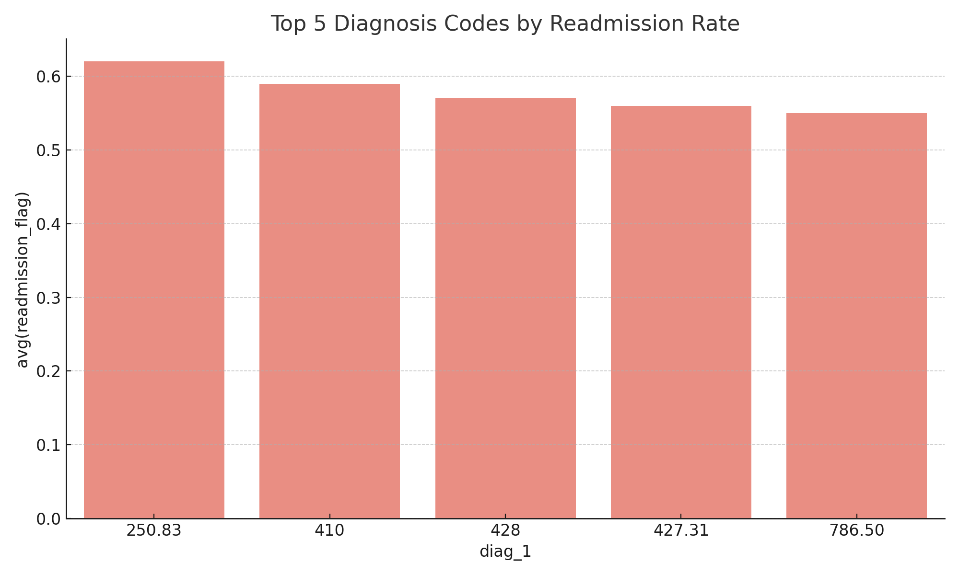
Top 5 Diagnosis Codes by Readmission Rate

Slide 6
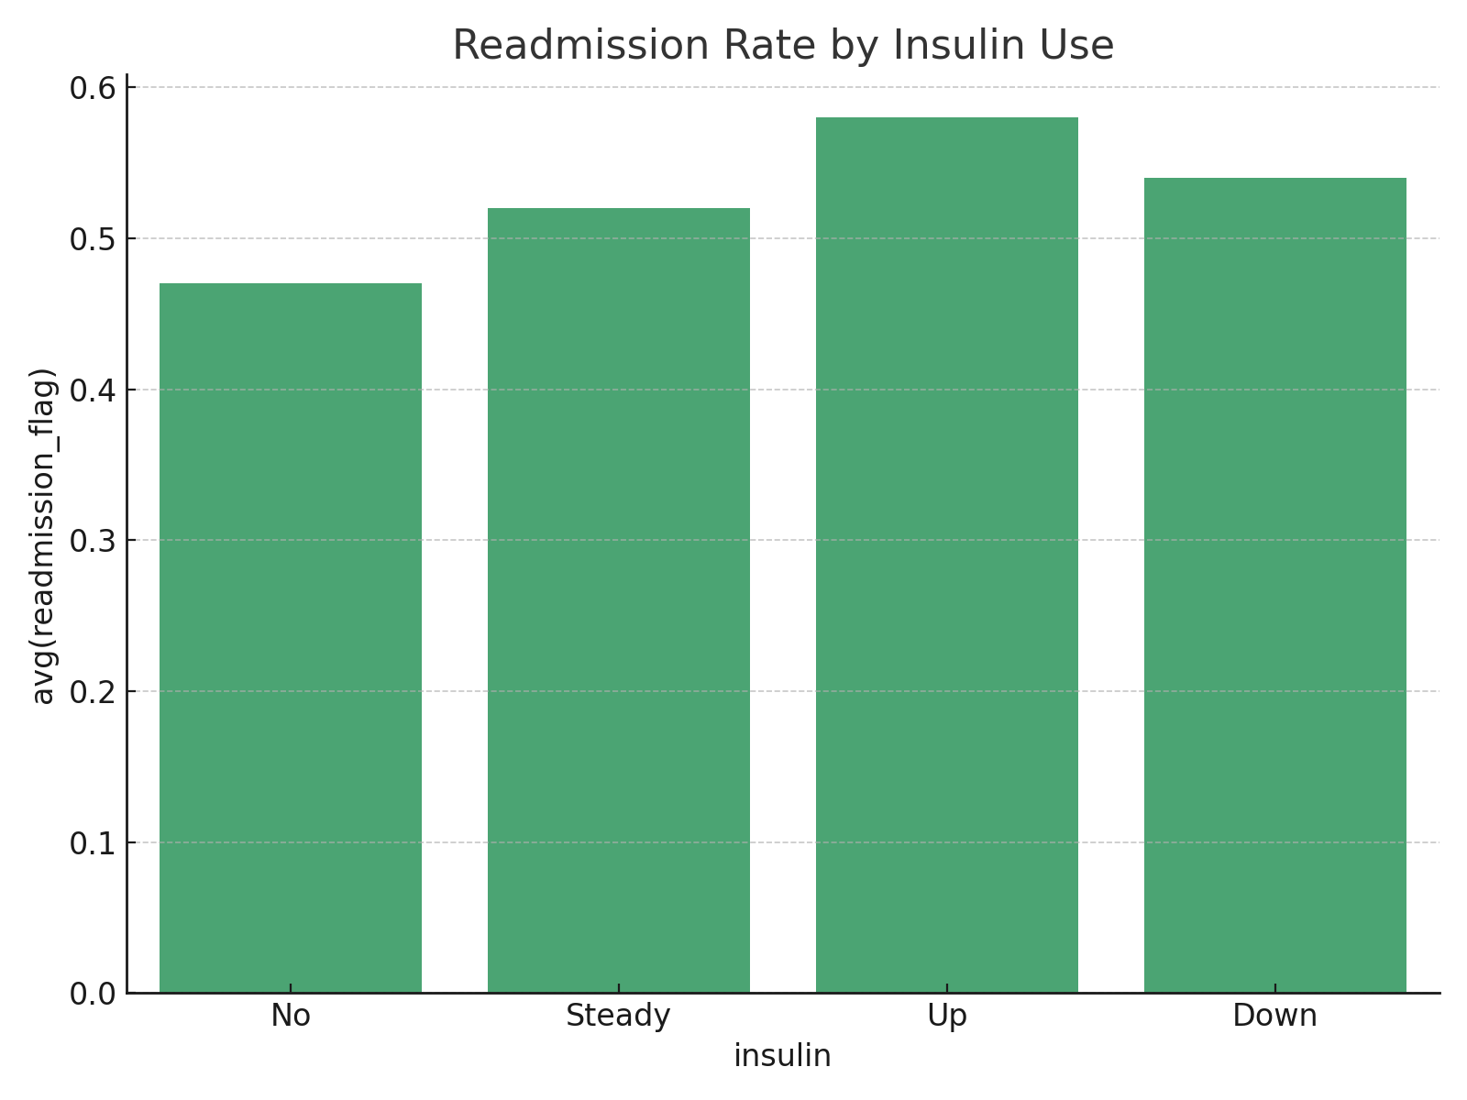
Readmission Rate by Insulin Use

Slide 7
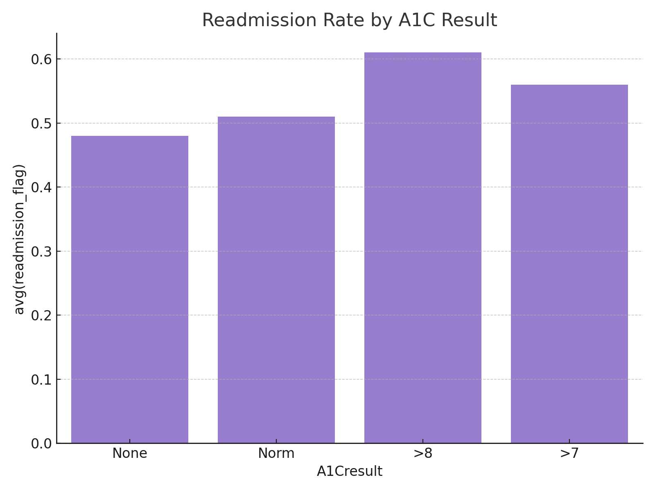
Readmission Rate by A1C Result

Slide 8
Key Findings & Recommendations
- Older age groups tend to stay longer in the hospital.
- Diagnosis codes such as 250.83 (diabetes) show higher readmission.
- Patients on insulin (increasing doses) have higher readmission rates.
- Abnormal A1C results (>8) correlate with higher readmission.
- Recommend targeted follow-up for high-risk patients.

