Slide 1
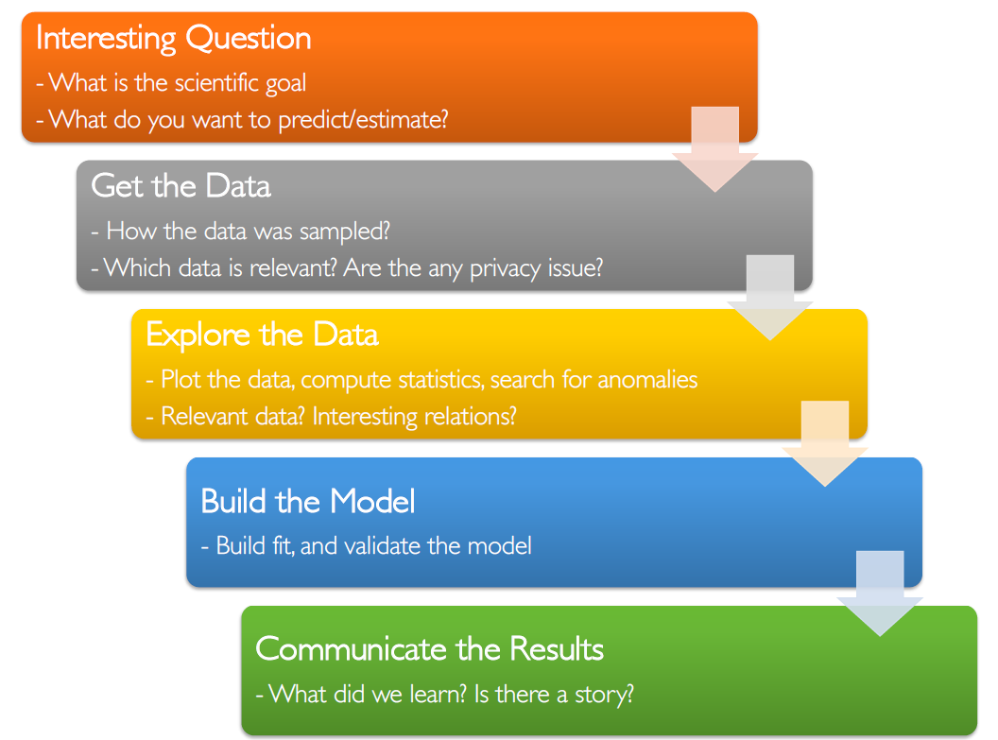
Data Mining and Text Mining Course Project BIP xTech 2020
Team Members: Francesco Fulco Gonzales, Francesco Govigli, Alberto Latino
Our goal is to predict the faults on air conditioning equipment installed in mobile network transmission sites in a 14 days forecast window.
Since the target class is unbalanced we need to use recall, precision and F1 scores instead of accuracy
Here is the pipeline we followed for the project

Slide 2
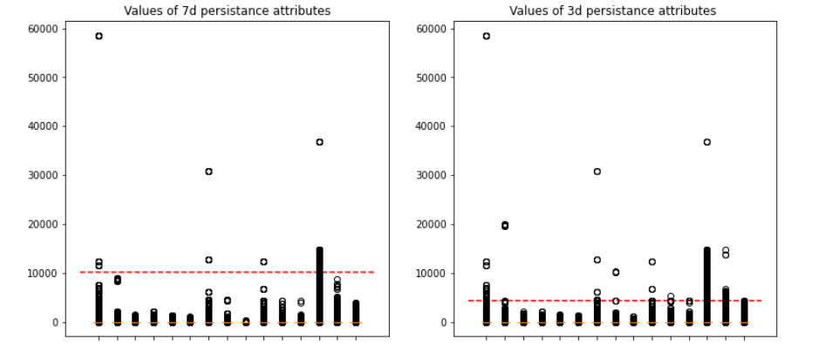
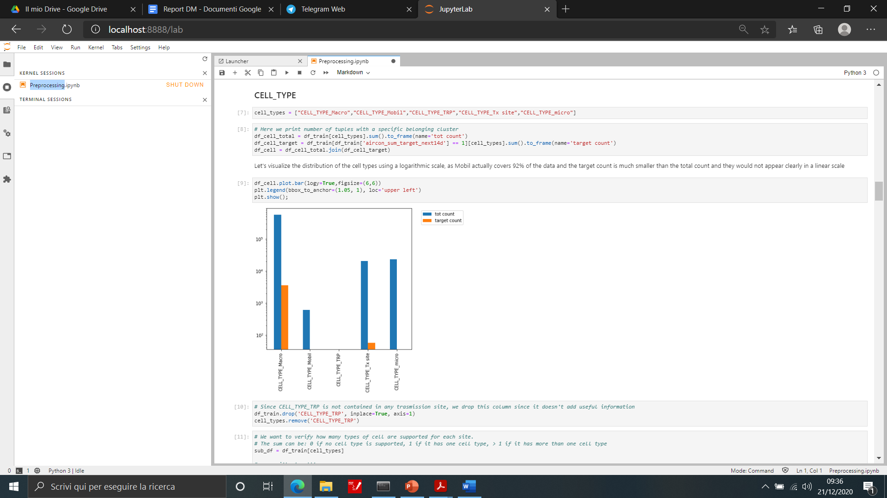
Exploring the Data
Check for missing values
Visualize the distribution of the cell types using a logarithmic scale and drop constant columns
Visualize the distribution of the Geographic_cluster using a logarithmic scale and drop constant columns
Check for potential outliers

Slide 3
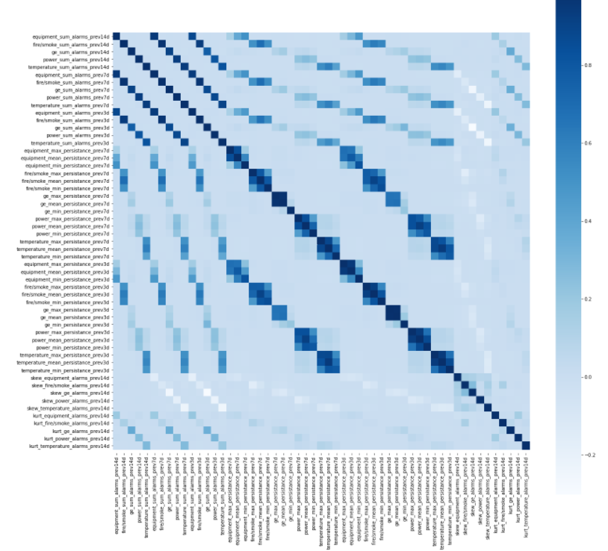
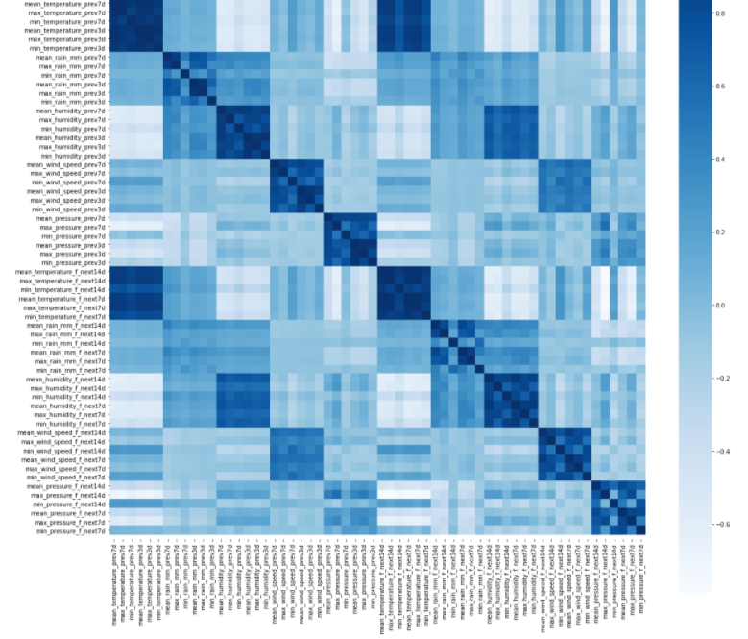
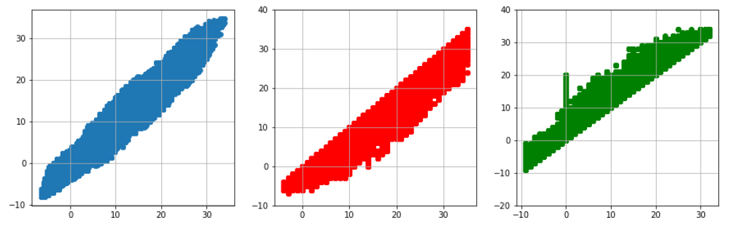
CORRELATION MATRIX
Are there interesting relations?
We tried to find some correlation between attributes:
Weather: High correlation among min, max, mean for both prev3 and prev7 attributes, as well as for next_f_14 and next_f_7 attributes.
Alarms: correlation among temporal data. time periods are overlapping, and the 14 day period comprises the both 7 and 3 day periods.
WEATHER MATRIX
ALARMS MATRIX
In the example above the scatter plots certify high correlation of previous 7 days and 3 days attributes.

Slide 4
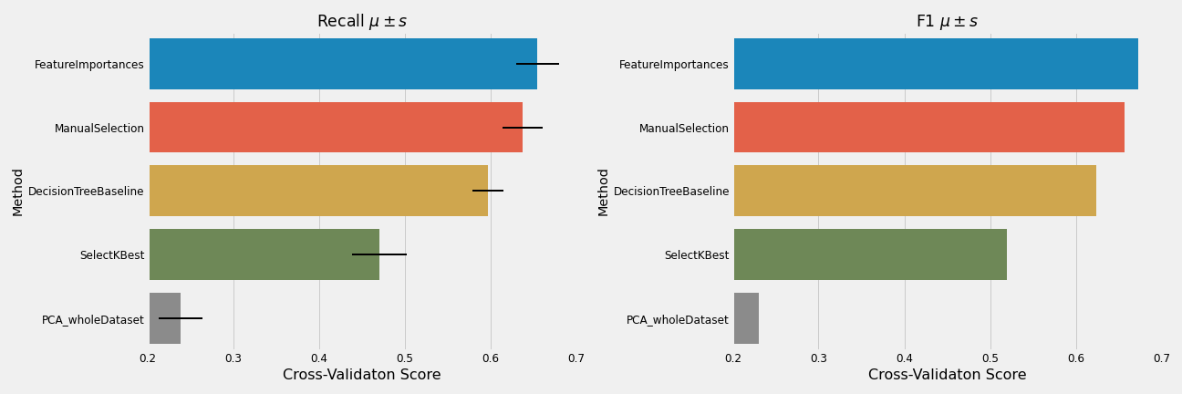
Feature Selection
The issue of dimensionality
Cross-validation score of the baseline
We tried different techniques to increase the baseline cross-validation score
The plots show there are 2 most high performance methods we can use
Use of t-test to see if the difference is statistically significant
Since we have no significant difference we evaluate the model with both feature selection methods

Slide 5
Selecting & Building the Model
Final Model:
Random Forest
We use the Random Forest algorithm since it could improve our baseline results. This is because this ensemble method has uncorrelated and unpruned trees and doesn’t lose generalization with an increase of its parameters’ values.
Possible classifiers :
LogisticRegression : requires categorical variables to be One-Hot encoded. Since we already have high dimensionality, it would lead to the creation of a very large sparse matrix, which will slow down the training and harm the overall performance of the model.
KNN : it is subject to the curse of dimensionality, is computationally expensive (scan of whole database) and assumes attributes are equally important (not our case).
Naive Bayes, Bayesian Belief Networks : Since this model assumes attributes are equally important and statistically independent, we cannot choose this model for our type of problem.
Final Performance:
Recall: 0.825
Precision: 0.731
F1: 0.775
Weighted Recall: 0.85

