Slide 1



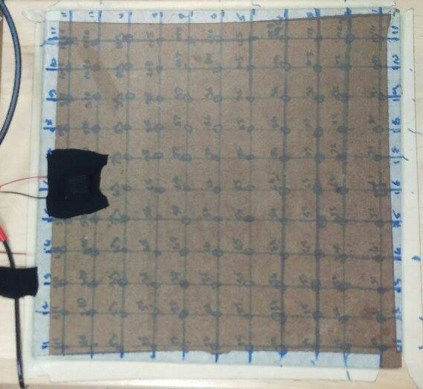
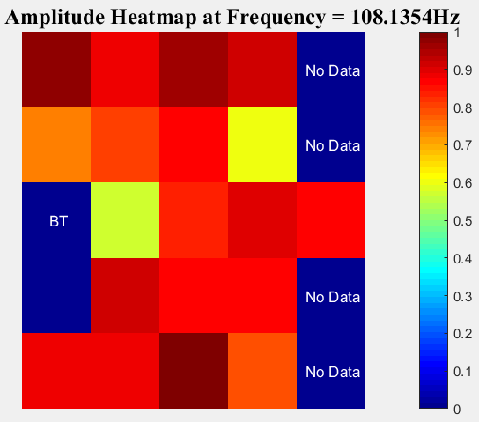
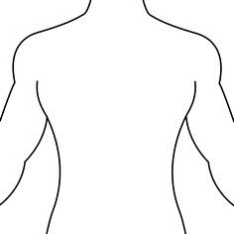
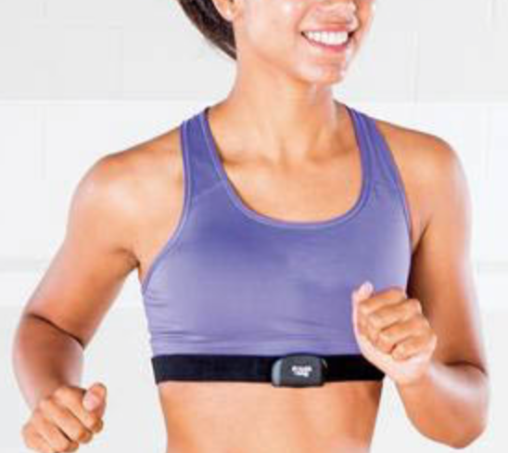
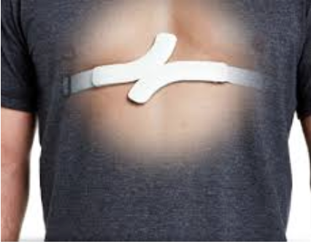
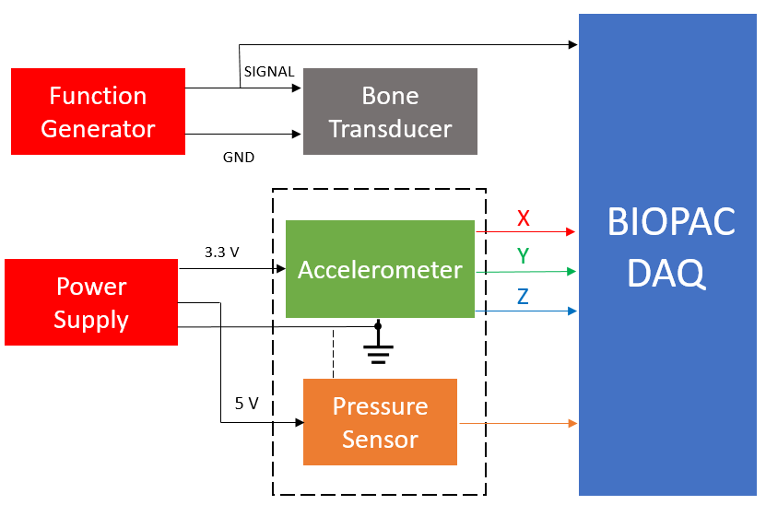
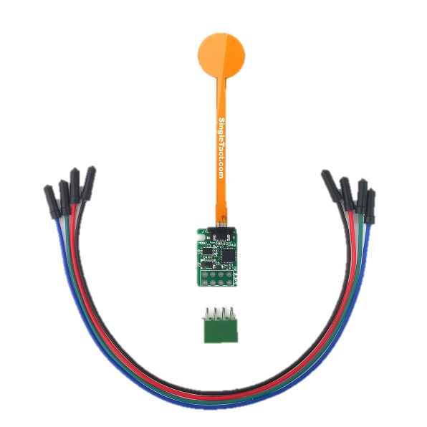
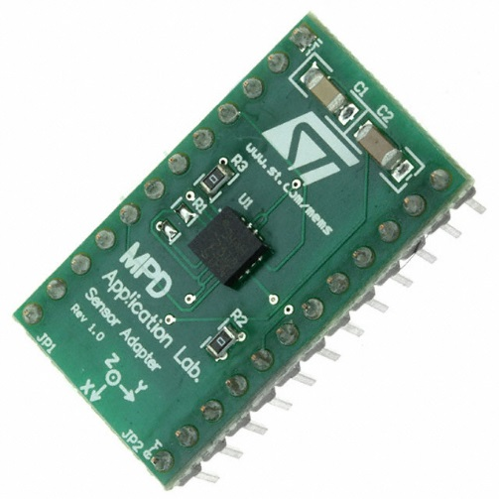
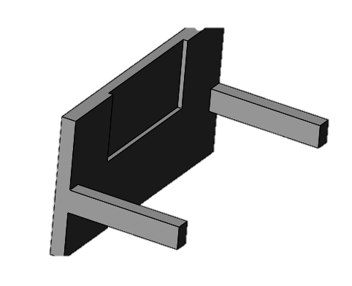
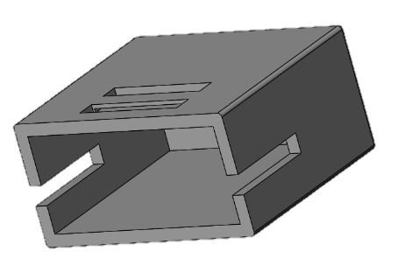
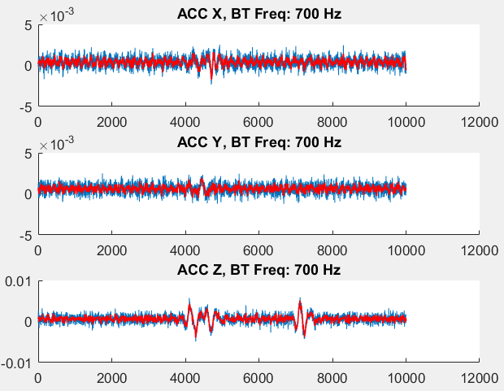
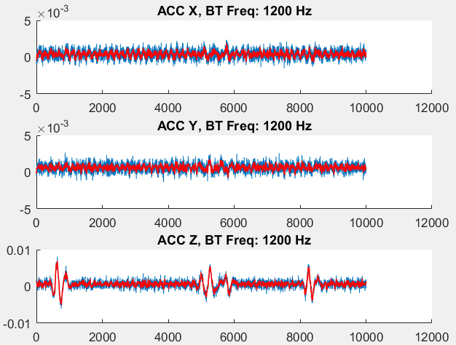
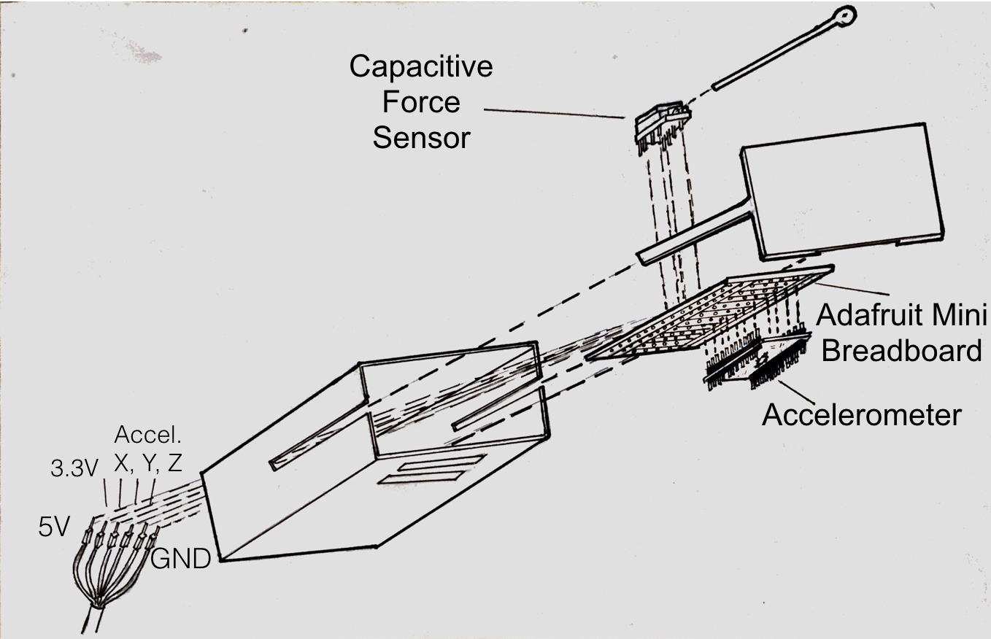


Jeremia Bezner, Alberto Li, Jack Novack, and Andrew Shutzberg
Mentor: Caitlin Teague, Faculty Advisor: Omer Inan
Introduction
Experiment
Conclusions
In the past decade alone, the emergence of wearable medical devices has become deeply ingrained in the new paradigm of healthcare delivery, representing a shift from disease treatment, to disease prevention. Sensors incorporated into jewelry and accessories are now able to provide unbiased and quantitative health information, at the ease and convenience of the user. However, in order for such systems to be utilized effectively, they must accurately measure and interpret biological signals, even in non-ideal locations or placements on the body.
Location Sensing Proof of Concept
Designed and created a functional sensor package that includes a capacitive force sensor and an accelerometer
Validated location sensing through proof of concept experiment using gridded stool
Determine the location of the sensor box relative to the bone transducer with a heat map by:
Place sensor box in 20 different locations on stool relative to bone transducer
Test accelerometer in the direction normal to the surface at each location by activating the bone transducer (BT) at frequencies between 1 Hz to 2000 Hz
Use normalized amplitudes of the transfer function to create heat map by mapping them to a color value
Future Work
Conduct location sensing experiment on human body
Determine if location sensing concept will work on human chest
Begin feature extraction from SCG data
Optimize the sensor box design
Motivation
Existing wearable medical sensing devices such as heart monitors may be enhanced with additional sensing platforms in order to improve both precision and accuracy.
Figure 4. Creating a reference of BT location sensing that translates into a heat map at 108.14 Hz
BT
Chest Strap
Human Testing System Setup
Sensor Box - SCG
Determine the location of the sensor box relative to the bone transducer with a heat map:
Place BT on chest using necklace
Test accelerometer and force sensor outputs at five predetermined locations on chest vibrating BT at 100 Hz to 1200 Hz
Figure 1. Examples of wearable cardiac devices.
b)
ECG
Packaging
a)
BT
Figure 7. The BT, sensor box, and electrodes attached to a human chest to measure ECG and SCG signals.
4
2
1
3
References
5
Z
S. Hu, H. Wei, Y. Chen, and J. Tan, "A real-time cardiac arrhythmia classification system with wearable sensor networks," Sensors (Basel, Switzerland), vol. 12, pp. 12844-12869, 2012.
A. Pentland, "Healthwear: medical technology becomes wearable," Studies In Health Technology And Informatics, vol. 118, pp. 55-65, 2005.
L. Giddens, E. Gonzalez, and D. Leidner, "I Track, Therefore I Am: Exploring the Impact of Wearable Fitness Devices on Employee Identity and Well-being," 2016.
http://www.gophersport.com/assessment/hrm/polar-h7-heart-rate-monitor-chest-straps
https://www.getqardio.com/qardiocore-wearable-ecg-ekg-monitor-iphone/
http://www.digikey.com/product-detail/en/stmicroelectronics/STEVAL-MKI015V1/497-8199-ND/1886615
https://www.singletact.com/micro-force-sensor/calibrated-sensors/15mm-450-newton/
SingleTact Capacitive Sensor with Calibration Board
LIS344ALH Triple-Axis Accelerometer with Breakout Board
3D Printed Box with Lid and Slot for Sensor
X
Y
Figure 2. The components of the sensor box.
Figure 5. a) Block diagram of data acquisition configuration. b) Locations of trials and BT on human chest.
Figure 3. Exploded view of the deconstructed sensor box.
Figure 6. Plots of accelerometer data at different frequencies when placed at location 5 on a human chest demonstrating intended functionality as the sensor box measures chest movements from x, y, and z directions.

