Slide 1


Final Project Pacman
Advanced Programming
Obed Nehemías Muñoz Reynoso

Slide 2

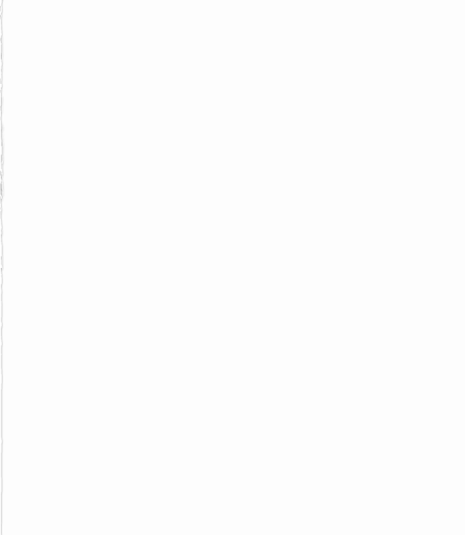
Team
Andres Salas Villareal
Oscar E. Rios Macriz
Alberto Rodriguez Lopez

Slide 3
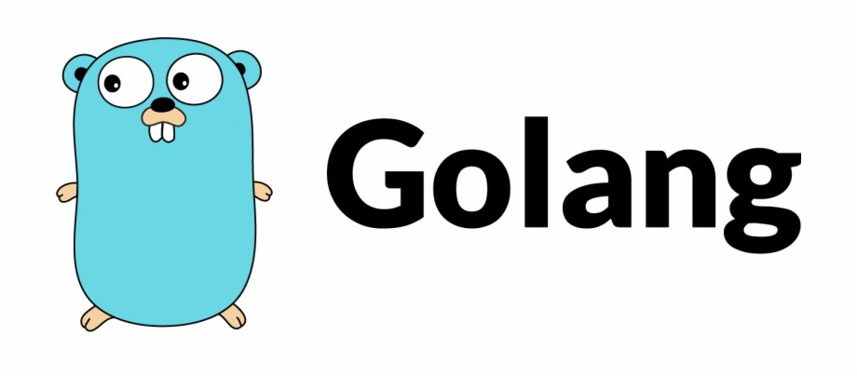
What is our project composed of? - Multithreaded - Optimal resources for processor and memory - OS: Unix - Golang - Console

Slide 4
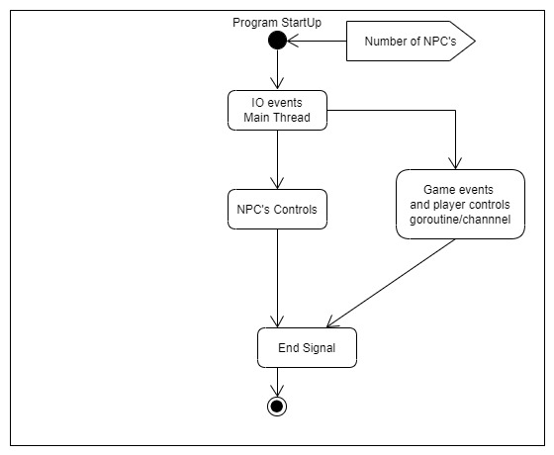
Task Flow

Slide 5
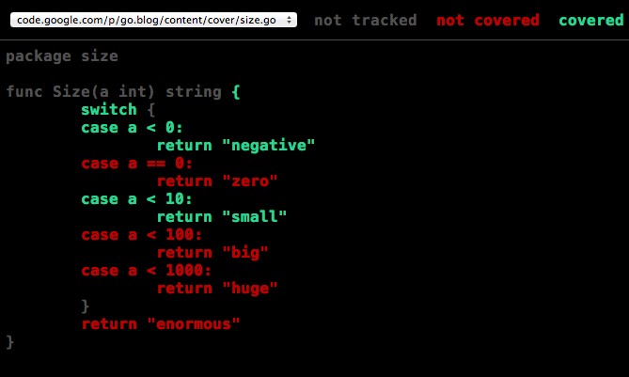
Let us proceed to our Code

Slide 6
Key Learnings
Go-Routines
Channels
I/O while using Go
Managing Events
Use of maps in Go

Slide 7
References
DataDrivenInvestor. (s.f.). Golang. June 6, 2021, de DataDrivenInvestor Sitio web: https://miro.medium.com/max/920/1*CdjOgfolLt_GNJYBzI-1QQ.jpeg
Go Blog - Golang. (s.f.). The Cover Story. June 6, 2021, de Go Blog - Golang Sitio web: https://blog.golang.org/cover/set.png

