Slide 1
Predicting Revenue
Alberto Lovell

Slide 2
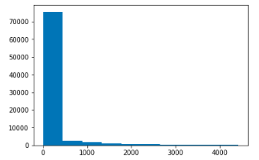
A first look at the data:
Let’s look at a histogram of all revenue quantities. Looks like a large majority of these null values are users who didn’t convert. We should keep this in mind as we select a suitable model

Slide 3
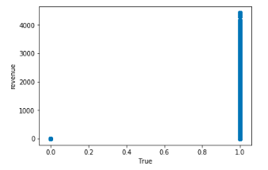
How do categorical values relate to revenue?
As we see in the data, most users who did not convert (False) did not significantly contribute to revenue values and vice versa

Slide 4
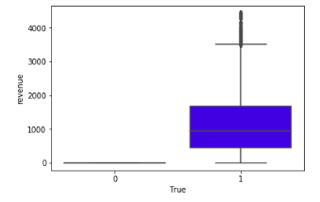
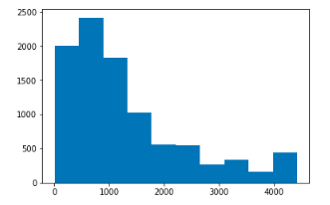
How do categorical values relate to revenue?
Also note the spread of revenue values of only users who converted lies around $1000

Slide 5
Baseline Model:
If we predict all output revenue values from our model to be the mean, the mean absolute error is $156, this will be our baseline scoring metric.
Model metrics:
Linear Regression MAE = $109.45
KNN MAE = $69.38
Random Forest MAE = 31.01
Our Random Forest regressor is the best approach and shows the largest increase in prediction efficiency.

