Slide 1
CNNs vs Vision Transformers for Skin-Lesion Classification
A controlled comparison of ResNet-50, EfficientNet-B0 and Swin-T on ISIC 2019
José Alberto Martínez Navarro · Aprendizaje Profundo · Final project, October 2026
Notes:
Hello. My project compares three ImageNet-pretrained backbones on the ISIC 2019 dermoscopy dataset under one identical protocol, and looks at cost and interpretability, not only accuracy.

Slide 2
Problem and objective
• Dermoscopic classification of 8 skin-lesion diagnoses (melanoma, nevus, BCC, AK, BKL, DF, vascular, SCC)
• Practical question: CNN or Transformer for a clinical prototype, and at what computational price?
• Published ISIC results are hard to compare: different splits, resolutions, ensembles, metadata
• Objective: hold everything fixed and compare ResNet-50, EfficientNet-B0 and Swin-T on
  – accuracy, balanced accuracy, macro-F1, AUC, per-class F1
  – parameters, FLOPs, VRAM, training time, convergence, inference latency
  – Grad-CAM evidence maps and a soft-voting ensemble (creativity)
Notes:
The motivation is practical: a deployment decision depends on cost as much as on accuracy, and the literature rarely reports both under the same protocol.

Slide 3
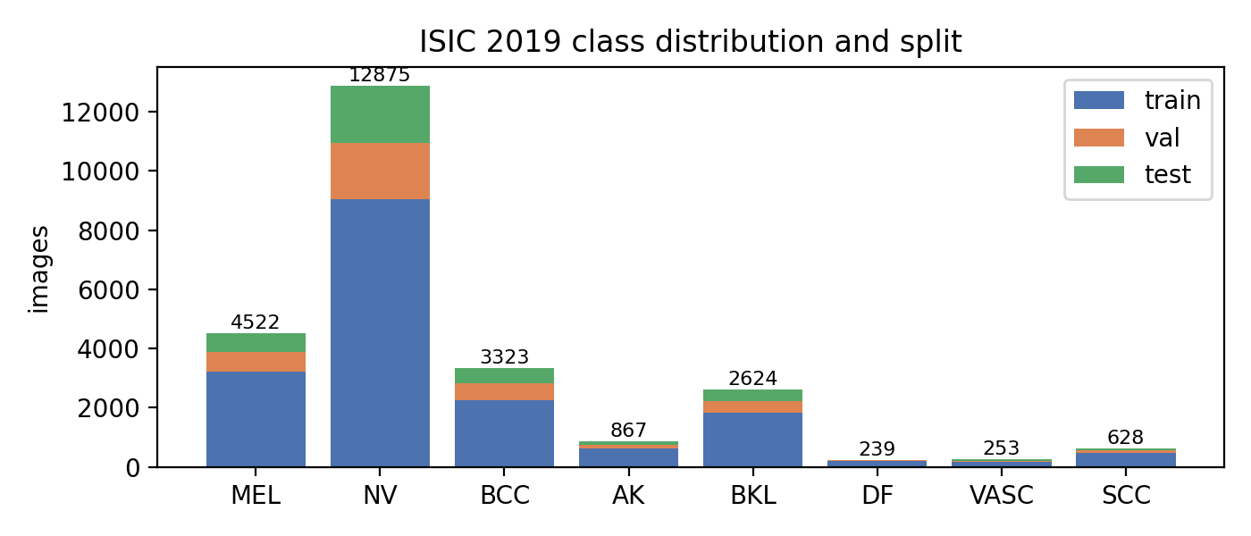
Dataset: ISIC 2019
25,331 dermoscopic images · 8 classes · strong imbalance (NV ≈ 50 %)
• Lesion-grouped, class-stratified split: 17,727 train / 3,844 val / 3,760 test
• Same lesion never appears in two splits (lesion_id metadata) → no leakage
• Pre-resize to 256 px, train on random 224 crops + flips, rotation, colour jitter
• Eval on centre 224 crop; ImageNet normalisation
Notes:
ISIC 2019 merges HAM10000, BCN20000 and MSK. I split by lesion id so that repeated images of the same lesion cannot leak from train to test, which inflates scores in many papers.

Slide 4
Models and shared protocol
• ResNet-50 (CNN, 23.5 M params) · EfficientNet-B0 (efficient CNN, 4.0 M) · Swin-T (hierarchical Transformer, 27.5 M)
• All ImageNet-1k pretrained (timm), new 8-way head, full fine-tuning
• Identical recipe: batch 32 · AdamW lr 1e-4, wd 0.05 · 1 warm-up + cosine · ≤12 epochs, early stop on val macro-F1
• Class-weighted cross-entropy (inverse √frequency) + label smoothing 0.1 · AMP fp16 · seed 42
• Single RTX 4070 Laptop GPU (8 GB) · best-val checkpoint evaluated once on test
• Swin-T chosen over ViT-B so that cost is comparable to ResNet-50 (fair comparison)
Notes:
Everything that is not the architecture is identical, so differences can be attributed to the backbone.

Slide 5
Results on the test split
Accuracy and cost side by side
Model | Acc | Bal. acc | Macro-F1 | AUC | Params (M) | GFLOPs | Latency b1 (ms) | Train (min) | VRAM (MB) | Ep. to 95 %
ResNet-50 | 0.711 | 0.601 | 0.551 | 0.918 | 23.5 | 8.17 | 29.1 | 20 | 1807 | 6
EfficientNet-B0 | 0.738 | 0.610 | 0.578 | 0.906 | 4.0 | 0.77 | 36.9 | 14 | 1500 | 5
Swin-T | 0.761 | 0.639 | 0.641 | 0.900 | 27.5 | 8.98 | 71.2 | 23 | 2667 | 6
Ensemble (soft voting) | 0.778 | 0.680 | 0.665 | 0.942 | 55.1 | 17.92 | 137.1 | – | – | –
• Best single model: Swin-T (64.1 % macro-F1)
• Ensemble of 3: 66.5 % macro-F1, AUC 0.942
Notes:
Read the table from left to right: the accuracy columns are close, the cost columns are not.

Slide 6
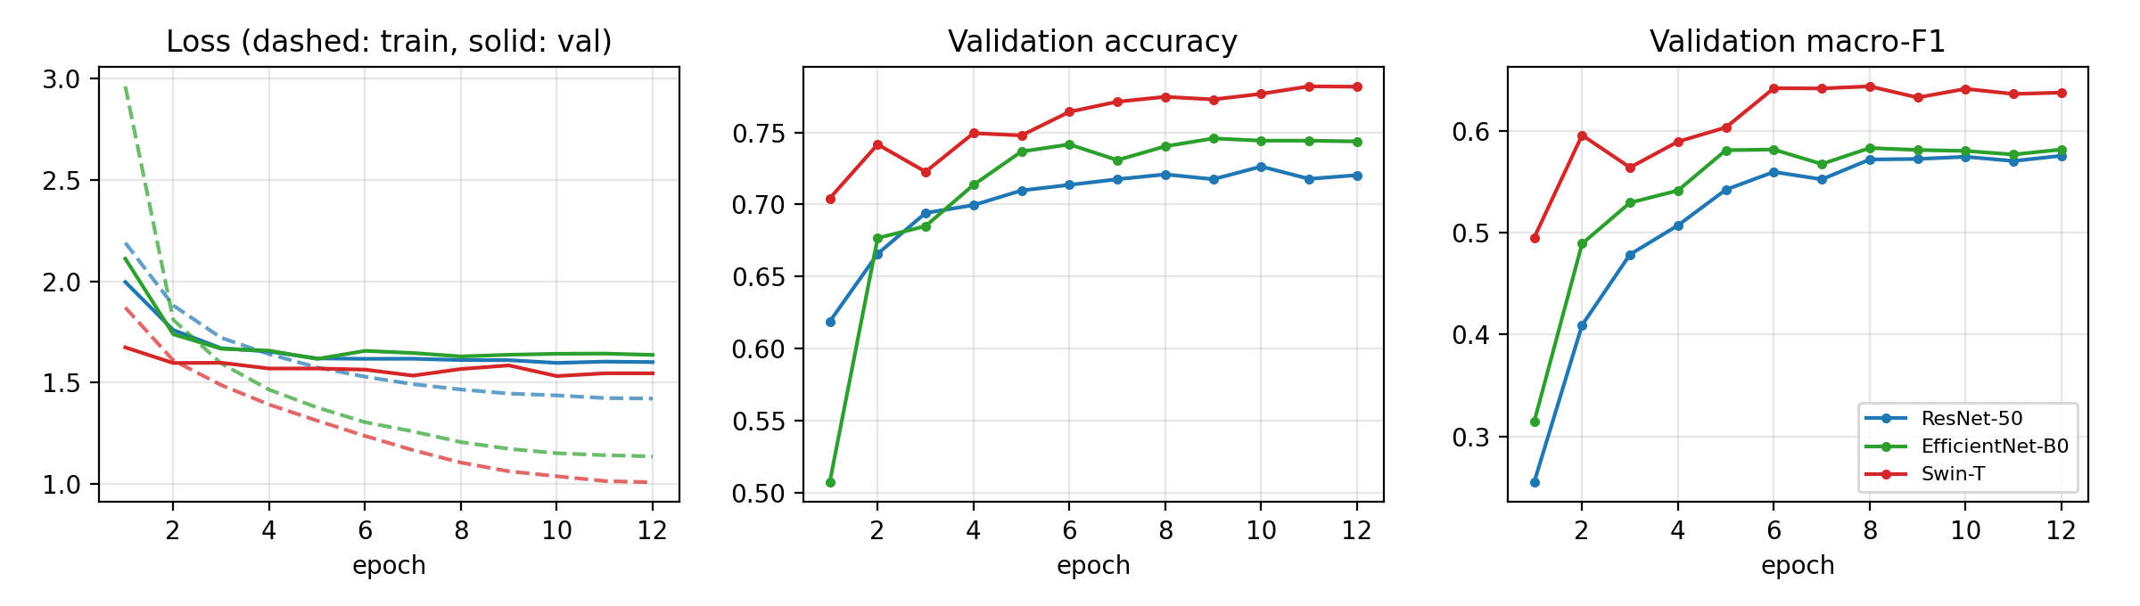
Convergence under the same schedule
• ResNet-50: best epoch 12, 95 % of best F1 at epoch 6, 85 s/epoch
• EfficientNet-B0: best epoch 8, 95 % of best F1 at epoch 5, 61 s/epoch
• Swin-T: best epoch 8, 95 % of best F1 at epoch 6, 105 s/epoch
Notes:
All three converge within the 12-epoch budget thanks to ImageNet pre-training; note which one gets there first and how the validation loss behaves.

Slide 7
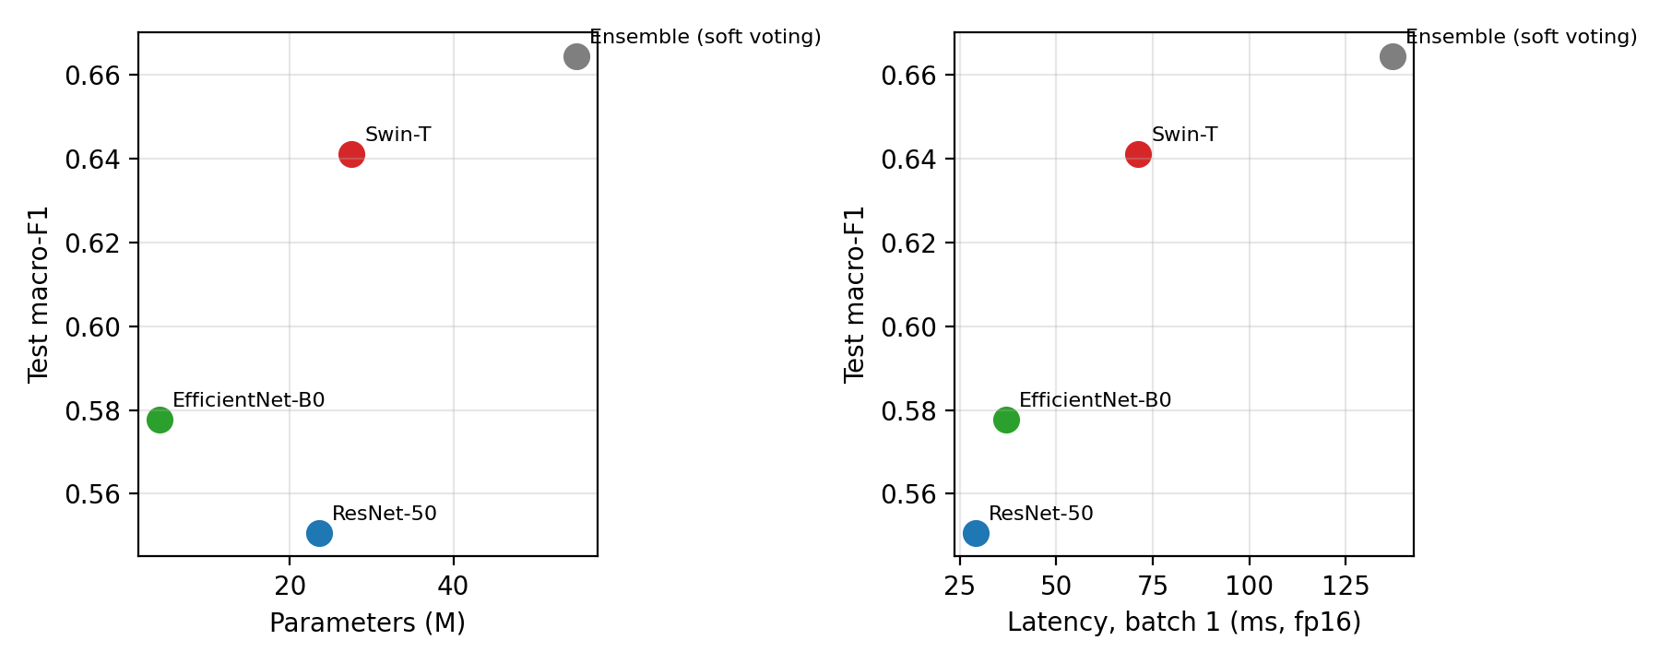
Accuracy vs computational cost
• x-axis: parameters / batch-1 fp16 latency; y-axis: test macro-F1
• Top-left is the sweet spot (accurate and cheap)
• Cost gap between models is much larger than the accuracy gap
Notes:
This is the figure I would show to an engineering manager: the choice is a budget decision.

Slide 8
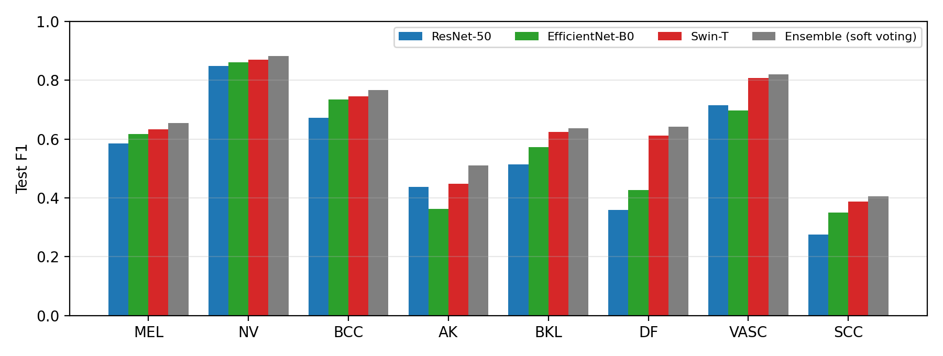
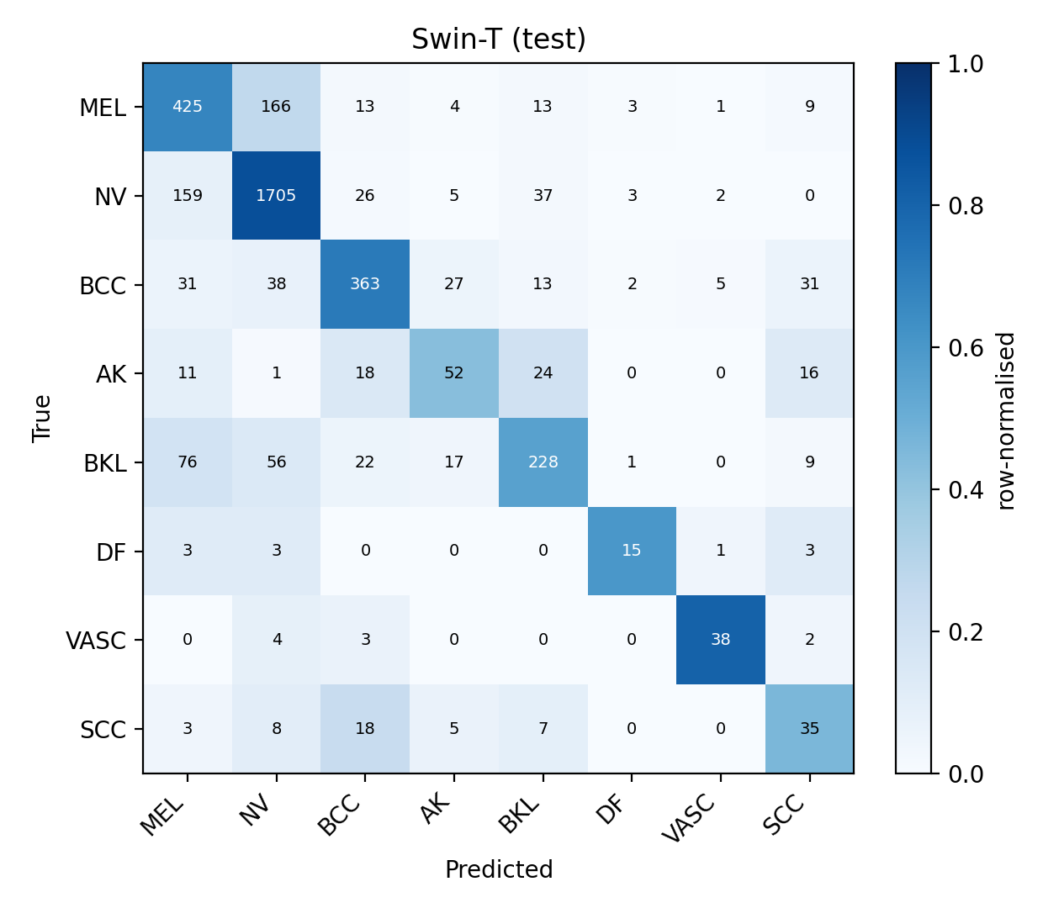
Where the models differ: per-class F1 and confusions
• Rare classes (DF, VASC, SCC) and MEL↔NV, AK↔BKL↔SCC confusions drive the macro-F1
• Right: confusion matrix of Swin-T
Notes:
Macro-F1 is dominated by the rare classes; class weighting helps but does not remove the MEL/NV and keratosis confusions that are also hard for dermatologists.

Slide 9
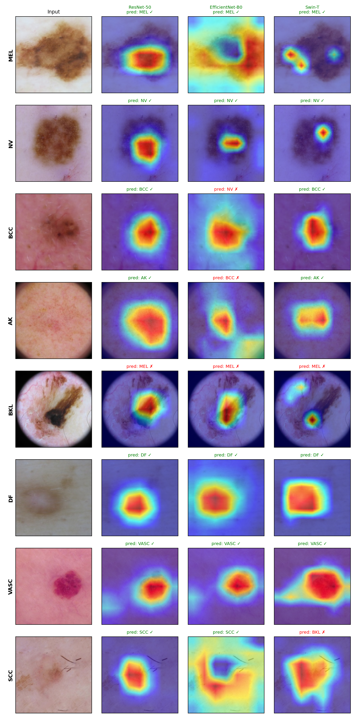
Interpretability: Grad-CAM (target = true class)
Notes:
The CNNs focus on compact lesion regions; Swin spreads attention over wider context. Failures often correspond to evidence on hair, ruler marks or borders.

Slide 10
Discussion
• Accuracy: Swin-T is the best single backbone, but the spread across families is small
• Cost: EfficientNet-B0 is the cheapest to train and serve; Swin-T and ResNet-50 cost similar FLOPs but differ in latency and VRAM
• Generalisation: balanced accuracy and per-class F1 show the imbalance problem is only partly solved by loss weighting
• Ensemble: 66.5 % macro-F1 vs 64.1 % — the families are complementary, at 3× inference cost
• Pre-training matters more than architecture family on 25k images (consistent with Raghu et al. 2019, Matsoukas et al. 2021)
Notes:
Go beyond 'which is best': cost, interpretability and generalisation each tell a different story.

Slide 11
Conclusions and future work
• Under an identical, leakage-free protocol the CNN/Transformer gap on ISIC 2019 is small; the cost gap is large
• Recommendation: EfficientNet-B0 for edge/latency budgets, Swin-T or ResNet-50 when VRAM/latency allow, ensemble when accuracy is paramount
• Future work: higher resolution and multi-resolution ensembles (Gessert et al.), patient metadata, self-supervised pre-training on dermoscopy (DINO/MAE), test-time augmentation, calibration and external validation (official ISIC test set, PAD-UFES-20)
• Everything is reproducible: run_all.ps1 regenerates every number and figure
Notes:
Close with the recommendation and the reproducibility statement.

