Slide 1
C++11 Multithreading

Slide 2
Contents
First block: Declaring and managing threads
Debugging
Second block: Sharing data among threads
Third block: Synchronization among threads
Samples for all topics
Extra samples for thread safe data structures
Extra samples for parallel find algorithms

Slide 3

Book
C++ Concurrency in Action: Practical Multithreading
(Anthony Williams)

Slide 4
Declaring and managing threads
std::thread
thread.join()
thread.detach()
thread_guard class. Auto joinable thread for safety.
Passing arguments by copy, std::ref and std::move
Transfering ownership
scoped_thread class. Auto joinable thread with ownership.
std::thread::hardware_concurrency

Slide 5
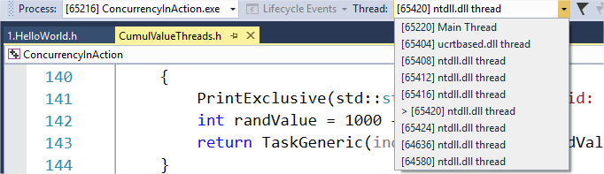
Debugging in Visual Studio
Thread selector on toolbar

Slide 6
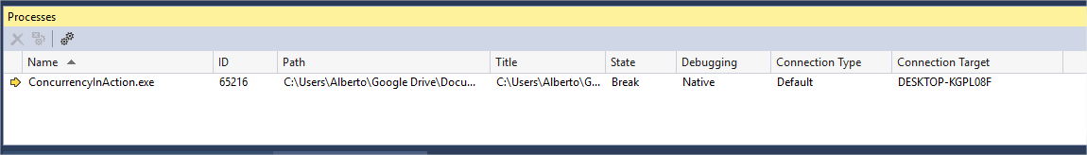
Debugging in Visual Studio
Processes window. Debug / Window / Processes

Slide 7
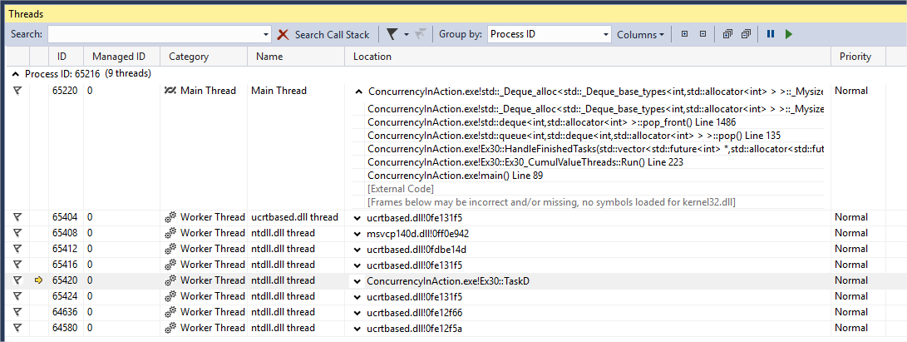
Debugging in Visual Studio
Threads window. Debug / Window / Threads

Slide 8
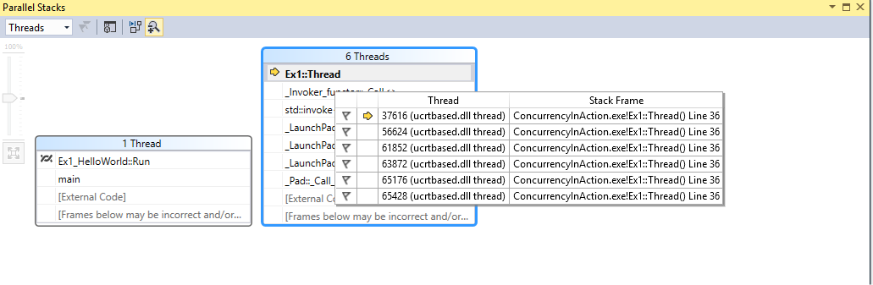
Debugging in Visual Studio
Parallel stacks window. Debug / Window / Parallel Stacks

Slide 9
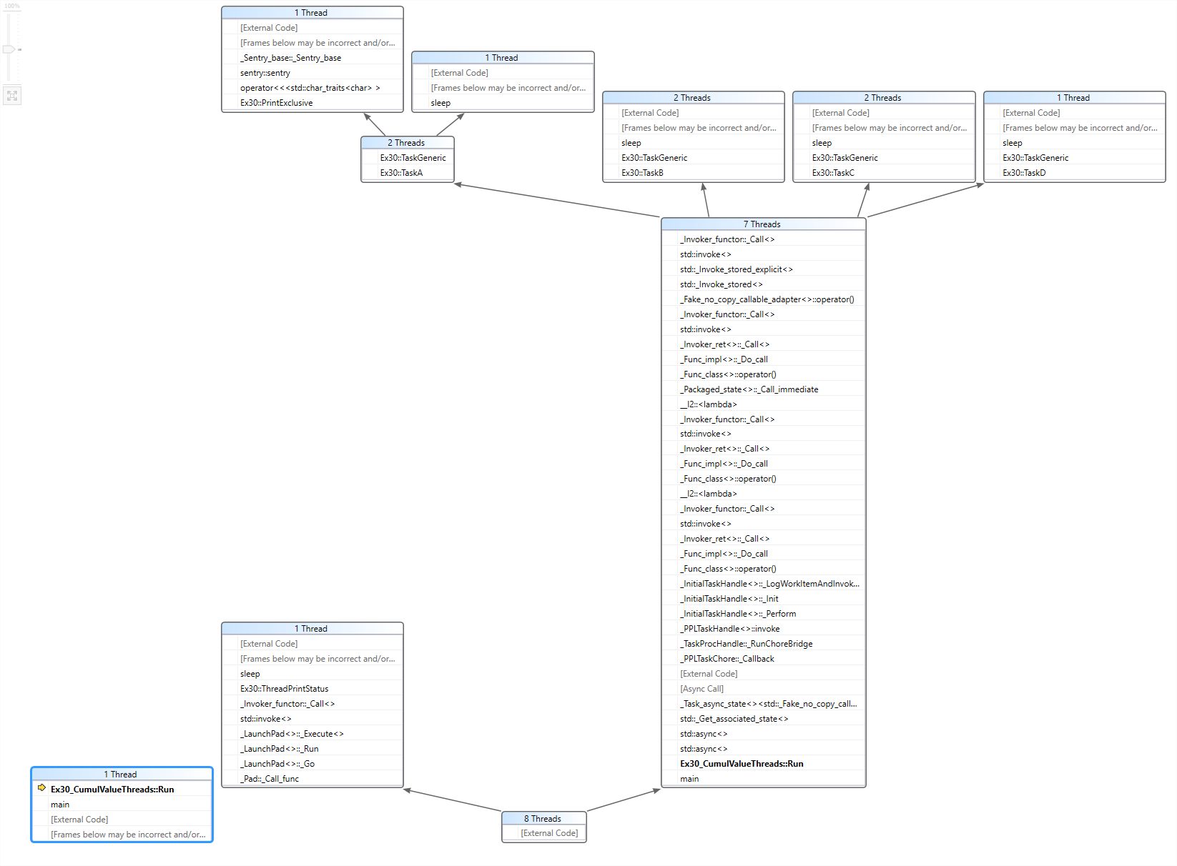

Slide 10
Sharing data
std::mutex
std::lock_guard<std::mutex>
Producer & consumer
Thread safe stack
std::lock to solve deadlock
hierarchical_mutex
std::unique_lock<std::mutex>
std::call_once
Static class initialization is thread safe
semaphore
std::atomic<T>

Slide 11
Synchronizing
std::condition_variable
Thread safe queue with std::condition_variable
std::async
std::future<T>. T is return data.
std::packaged_task<T(args)>. T is return data.
std::promise<T>. T is return data.
std::shared_future<T>. T is return data.

Slide 12
std::condition_variable
It is a lock mechanism with a condition associated, if the condition is true the thread locked is unlocked.
Thread B waits
Thread A notifies
Data condition evaluates
Thread A continues if

Slide 13
std::condition_variable
Thread A
Thread B
std::unique_lock
Wait
std::condition_variable
Condition function

Slide 14
std::condition_variable
Thread A
Thread B
Notify
std::condition_variable
Condition function
Evaluate condition

Slide 15
std::condition_variable
Thread A
Thread B
continue
std::condition_variable

Slide 16
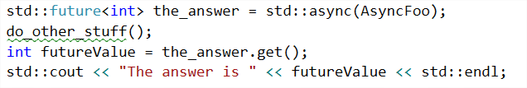
std::future<T>
It is a lock mechanism where where a main thread waits another thread by retrieving its return value.
T is return value of the new thread.

Slide 17
std::future<T>
Thread A
Thread B
returns int
future<int> = std::async(threadB)
std::future<int>

Slide 18
std::future<T>
Thread A
Thread B
Thread B is running
future.get()
Thread A is locked
std::future<int>

Slide 19
std::future<T>
Thread A
Thread B
int returnValue = future.get()
Thread A is unlocked
Thread B is finished
std::future<int>

Slide 20
std::package_task<T(args)>
It encapsulates a task to be triggered on demand later on.
T is the return value of the task.
Args are the arguments to trigger the task.

Slide 21
std::package_task<T(args)>
Thread A
Thread B
returns int
std::packateTask pt(threadB)
future<int> = pt.get_future()
future.get()
Contains thread B
Not started yet
Thread A is locked
std::package_task<int()>
std::future<int>

Slide 22
std::package_task<T(args)>
Thread A
Thread C
Thread B
returns int
packageTask()
future.get()
std::package_task<int()>
Thread A is locked
std::future<int>

Slide 23
std::package_task<T(args)>
Thread A
Thread B
int returnValue = future.get()
Thread A is unlocked
Thread B is finished
std::future<int>

Slide 24
std::promise<T>
It is a lock mechanism based on the promise that the data T Will be modified.
When modified the thread is unlocked
T is the data.

Slide 25
std::promise<T>
Thread A
Thread B
std::promise<int> promise;
future<int> = promise.get_future()
future.get()
Thread A is locked
std::promise<int>
std::future<int>

Slide 26
std::promise<T>
Thread A
Thread B
int returnValue = future.get()
Thread A is unlocked
promise.set_value(99)
std::promise<int>
std::future<int>

Slide 27
std::shared_future<T>
It is a lock mechanism where where a many thread waits another thread by retrieving its return value.
T is return value of the new thread.

Slide 28
std::shared_future<T>
Thread A
Thread D
returns int
future<int> f = std::async(threadB)
Thread B
std::future<int>
Thread C
shared_future<int> sf = f.share()
std::shared_future<int>

Slide 29
std::shared_future<T>
Thread A
Thread C
returns int
sharedfuture.get();
Thread is locked
Thread B
sharedfuture.get();
Thread is locked
std::shared_future<int>
Thread C
sharedfuture.get();
Thread is locked

Slide 30
std::shared_future<T>
Thread A
int value = sharedfuture.get();
Thread is unlocked
Thread C
returns int
Thread B
int value = sharedfuture.get();
Thread is unlocked
Thread C is finished
std::shared_future<int>
Thread C
int value = sharedfuture.get();
Thread is unlocked

