Slide 1


GeoMedia
A Mobile Platform for Location-Aware and Time-Sensitive Social Content
Alberto Morini, Lorenzo Perinello, Claudio Enrico Palazzi

Slide 2
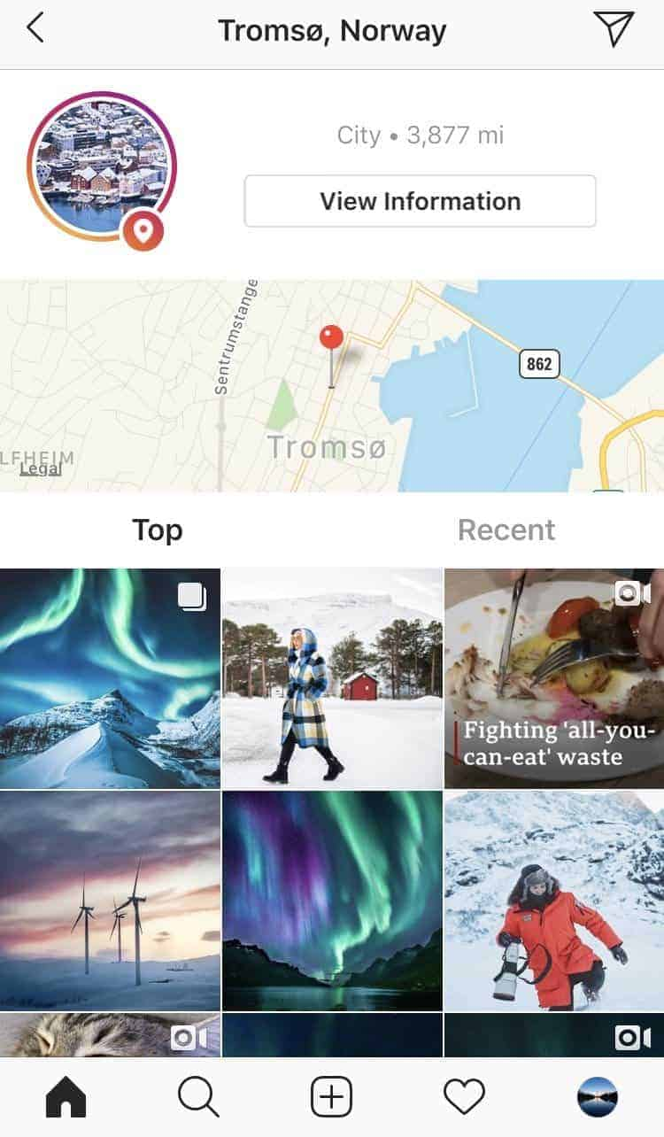
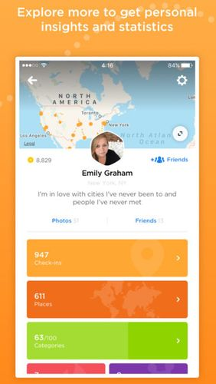
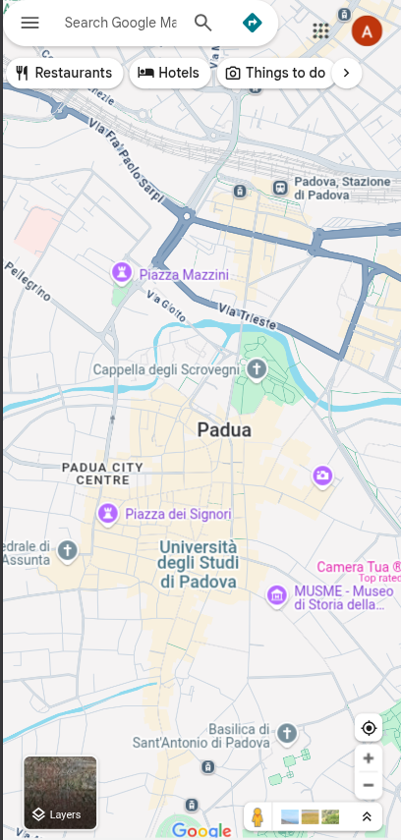
Location based Applications
Instagram
Foursquare swarm
Google Maps

Slide 3
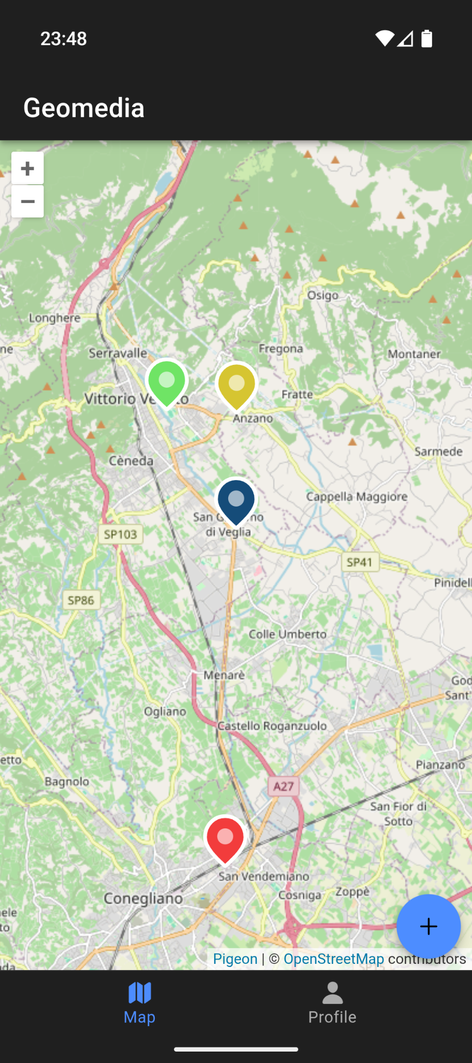




GeoMedia
GeoMedia
A mobile application and social network that anchors multimedia to real-world geographic locations and time
The user current position
Post with just text
Post with media attachment (photos, videos, audio)
Exclusive content (by time or geographical area)

Slide 4
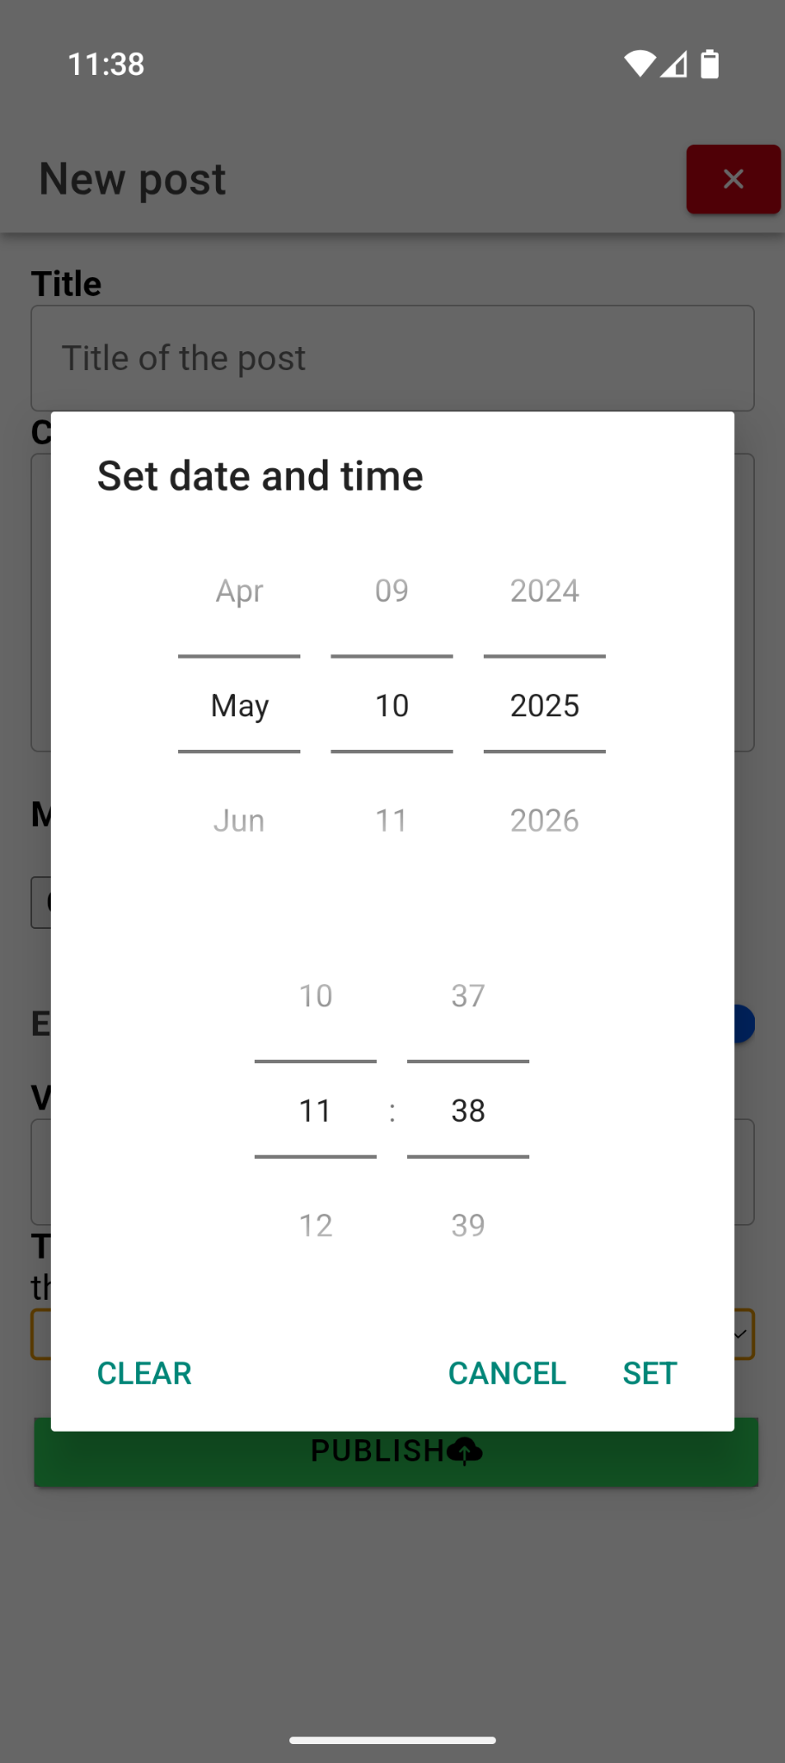
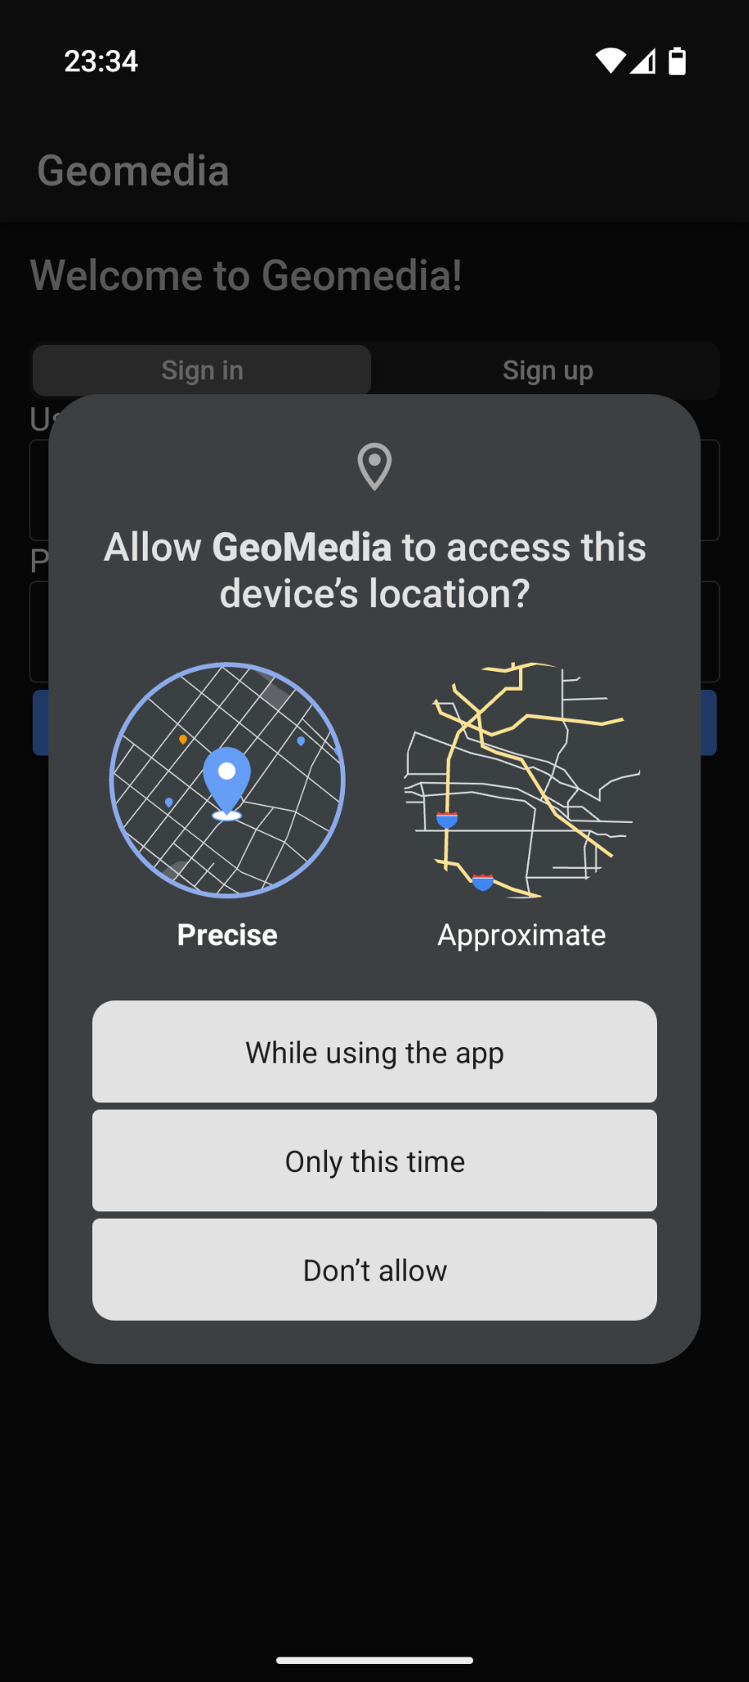




GeoMedia Options
An application layer can be created by a user and can accept posts by 1 or more creators
Posts can be accessed…
by anyone, by a group, by a single
when closer than a predefined distance
always, for a limited period, periodically
randomly, after having consumed others
Notes:
Temporized posts will be reachable until the expiration date set by the publisher
The retrieving of the posts is made server side, which will compare the current datetime with the limit date of each temporized post
Exclusive content based on location area is computed on real time within the actual end-user location
Users when publishing can choose an exclusive area in km from their position in order to geographically limit the access

Slide 5
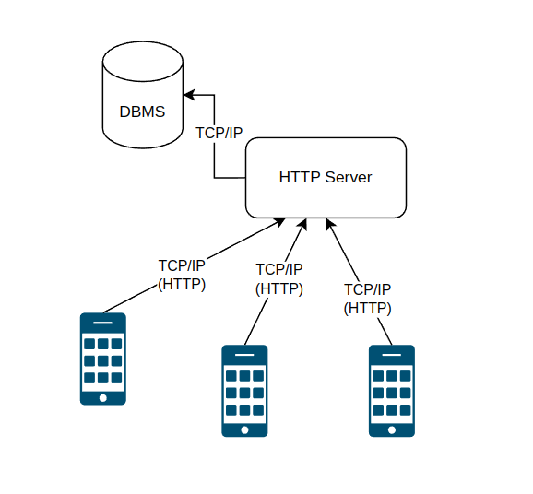
Architecture
Monolithic client-server (currently)
Mobile app developed with Flutter (cross-platform)
Firebase backend services
Open-source on GitHub

Slide 6




Use Cases
Interactive experiences
Educational or cultural virtual guides/tours
Location based games
Digital scavenger hunts or role-play games
Virtual mural/graffiti
Digital artwork anchored to a real-world location even created collaboratively
Personalized messages
One-to-one posts only visible to a specific recipient near a designated location (surprise message, memento picture, intimate storytelling)
Notes:
You can build different applications on top of GeoMedia

Slide 7
Conclusion
GeoMedia enhances location-based engagement
Empowers users to link content with real space and generate new services
Preliminary user feedback positive
Lays foundation for further research & innovation
  Flexible framework to integrate other ideas and more features (VR/AR, NFC, BT…)
  Future Work
  Battery & data consumption from GPS
  Scalability of backend
  Ensuring content moderation
Thank you!
Questions?

Slide 8
Thank you!
Questions?

Slide 9
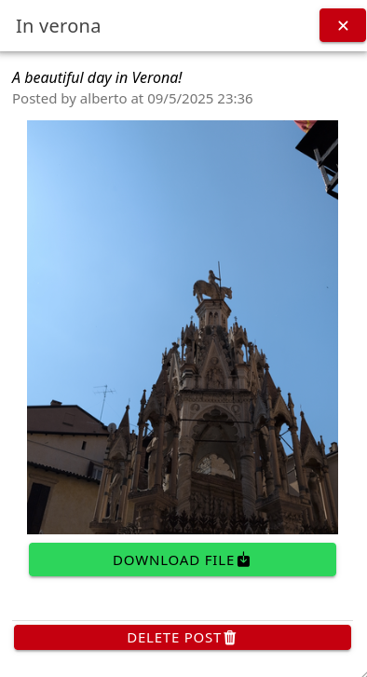
Panoramic of GeoMedia
GeoMedia
a mobile application and social network that anchors multimedia posts to real-world geographic location and time intervals
The user current position
Post with just text
Post with media attachment (photos, videos, audio)
Exclusive content (by time or geographical area)

Slide 10
Temporized post
Temporized posts will be reachable until the expiration date set by the publisher
The retrieving of the posts is made server side, which will compare the current datetime with the limit date of each temporized post

Slide 11


Mobile application
Made with Ionic Framework and React
Using Ionic Capacitor as interface to physical sensors such as GPS and file system
Main purposes
Provide UI and interact with users
Get the current location of the end-users as coordinate
Render posts in a map as markers
Provide a profile section for users in order to see their post and settings (i.e. change server)
Publish new content
Fetch server with HTTP requests

Slide 12

Server side
Made with NodeJS
Using HTTP native library to create a server
Using Tedious in order to connect to a Microsoft SQL Server database.
Main purposes
Create an HTTP Server
Retrieve and store data through the relative DataBase Management System
Implement the Vincenty’s formulae for distance computation of geographical exclusive posts

Slide 13

DataBase Management System
Made with Microsoft SQL Server
Main purposes
Provide a relational database to store data in well defined tables
Manage data with stored procedure and functions in order to preserve the single responsibility principle

