Slide 1




Project Bike Sharing Service
Alberto Navas Rubio
Iván Revilla Hernández
Natalia Sobrino
Juan Benavente
Nommon Team
September, 2024

Slide 2
Contents
01
Introduction
04
DT development
Team
Project Definition
Project Definition
02
Objectives
05
Results
Main Objectives
Technical objectives
Analysis of DT
03
Methodology
06
Conclusions
Project Phases
Tools Selection
Planning
Summary

Slide 3
Introduction

Slide 4
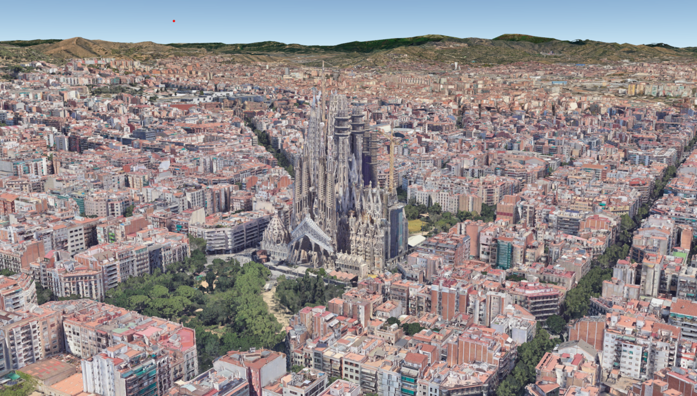






Team
Alberto Navas
Iván Revilla
Company Supervisors
Academic Supervisors
Natalia Sobrino
Juan Benavente
Oliva García
Javier Burrieza

Slide 5

Bike Sharing Project
Develop an analytical module able to optimise the performance of the system operations through data-driven vehicle relocation or maintenance recommendations.
WiseRide
Planning and managing shared mobility services through AI-powered demand modelling

Slide 6
Objectives

Slide 7
Main Objectives
Bike Availability
Cost Reduction
User Satisfaction
Sustainable Urban Mobility

Slide 8
Technical Objectives
To define a prediction model as accurate as possible.
To achieve an optimization model based on the prediction model and the KPIs in order to minimize the non-rided movements.

Slide 9
Methodology

Slide 10






Project Phases
Evaluation of Algorithms
First Implementation of Algorithms
Tool Implementation for Visual Evaluation of Algorithms
Addition of Functionality to the Visual Tool
Final Evaluation
Correction/Adaptation of Algorithm Parameters

Slide 11
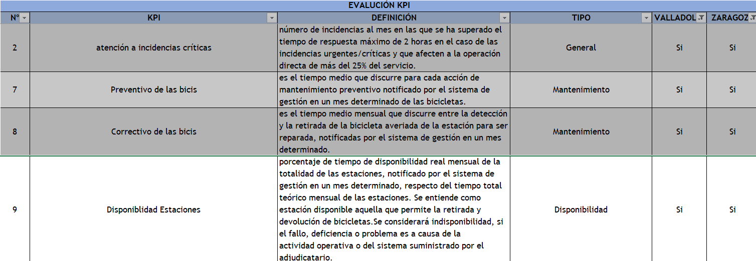
Existing Tenders Research

Slide 12
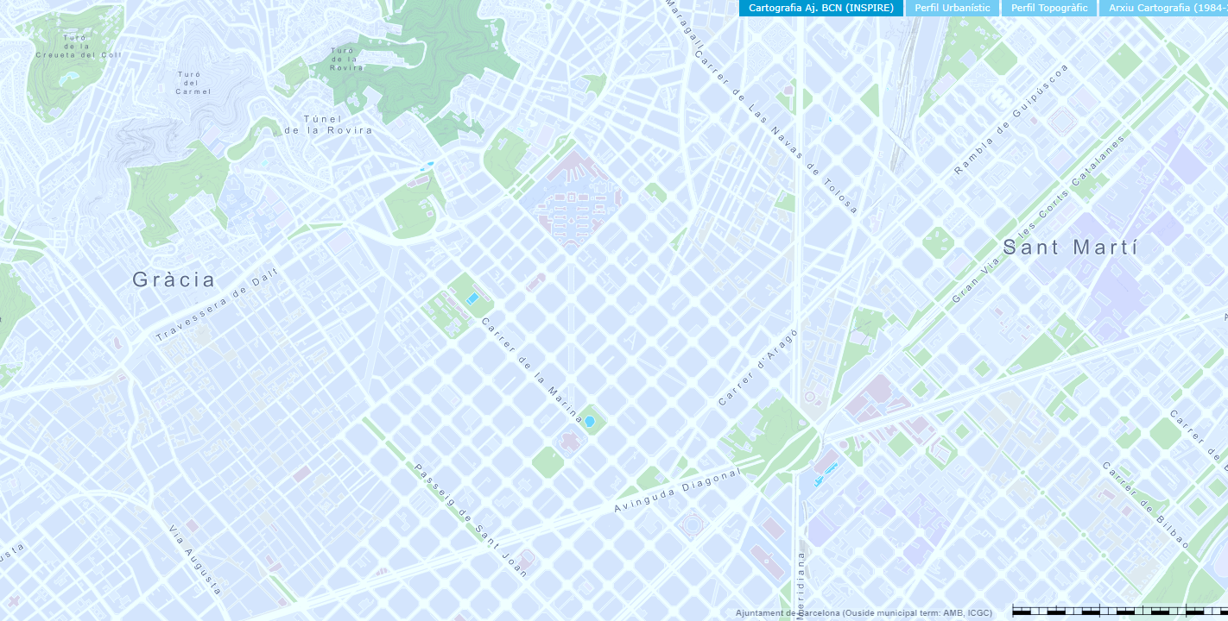











KPIs Selection
RING III
LOS
DESTINATION
RING II
B
RING I
Y
LOS
ORIGIN
A
X
BIKES ANCHORED

Slide 13





Selection of Tools

Slide 14
Schedule
Existing Tenders Research
Requirements
Optimization
KPIs
selection
Prediction
Delivery
July 2024

Slide 15
DT development

Slide 16


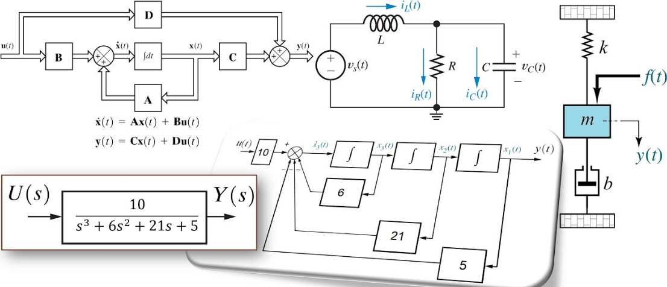
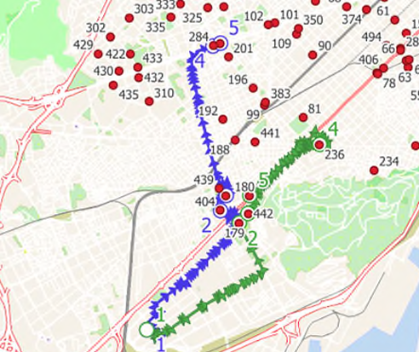




Development Phases
1. Data collection and processing
2. Modelling of the physical system
3. Simulation implementation
4. Validation & Verification of DT
5. Prototype of DT (MVP)

Slide 17

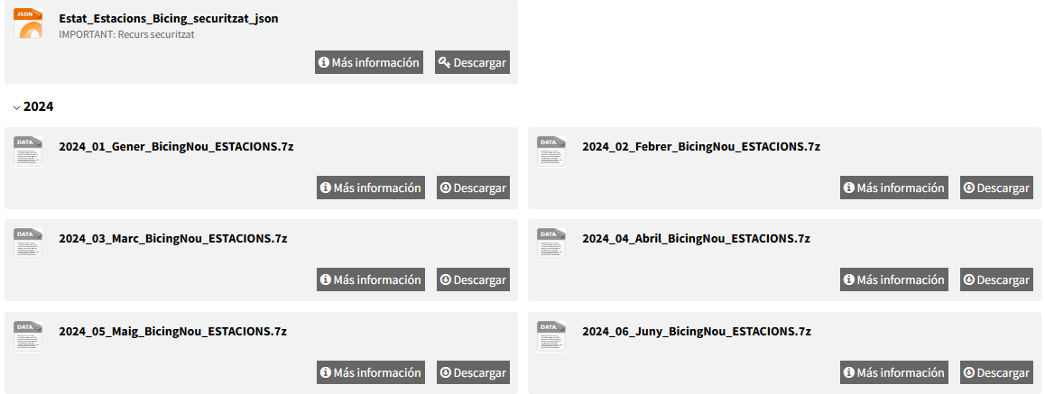
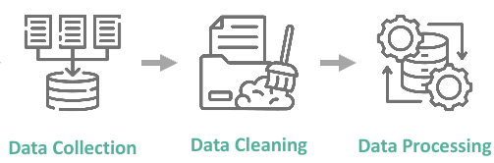
Data collection and processing
Historic data: csv in a 7z compress file/month → Open Data BaCN .
Data used for prediction and evaluation: register each 5’ (3,5 GB for a Year)
TimeStamp / Unique Station Id / Total free decks / Total available Bikes
Inventory data:
Unique Station Id / Name (Address) / Sataion X,Y Position /Total decks
Check Data
Erase Data
Stations with NO Data
Aggregate data to 1h

Slide 18
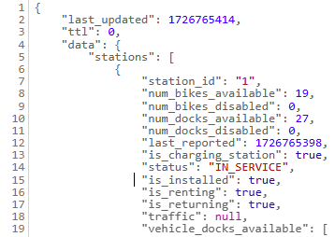
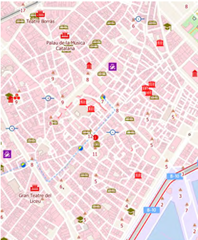
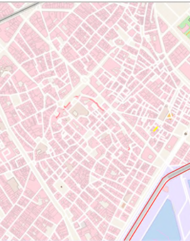
Data collection and processing
data concerning status: standard GBFS Json file → Barcelona Public Bike System .
GBFS (https://gbfs.org/) provides a common language for shared mobility operators to share information about services available to travellers. GBFS includes information about vehicles, stations, pricing and more. It is used by trip planning and Mobility as a Service (MaaS) applications
https://barcelona.publicbikesystem.net/customer/gbfs/v2/en/station_status
background map : Vectorial tiles maps services → Topographical Map Base (BTN) of the National Institute of Geography
VTL advantages from raster tiles:
• Style is defined on the client side – not in the provider • Allowing to have multiple maps with only one tile information service.
• Over zoom keeps resolution
• Cache takes up much less space. (maximum 500Kb) appropriate for temporal offline situations
• Native access to object information (attributes and geometry)
Raster
VTL

Slide 19
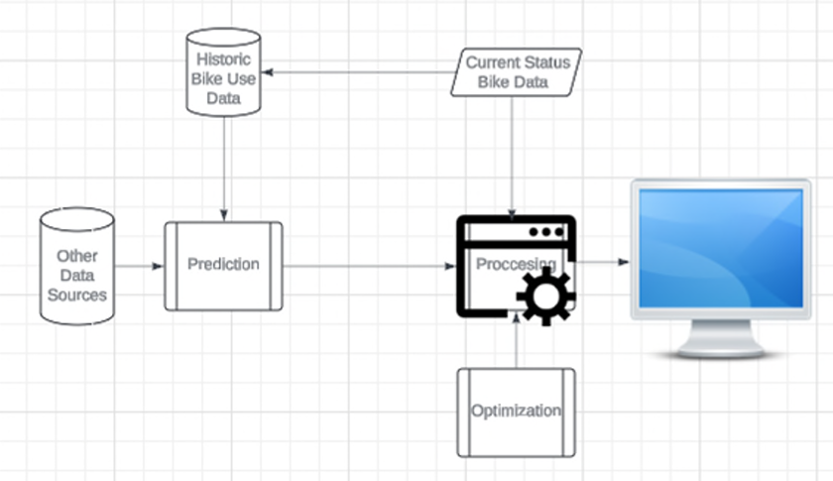
Modelling of the physical system
The elements of the physical system that need to be modelled are:
The stations.
The vehicles for relocating
The stations have fixed position, and some attributes we want to predict:
Number of bikes available
Number of available docks
The vehicles have variable position, and each needs to perform a route that we want to Optimize.

Slide 20




Modelling of the physical system
Modules and their functionality
• Prediction Module: Takes historic data an predict scenarios for similar characterized conditions (day of week / month / hour/ meteorology / etc)
• Optimization Module: Lauch the OR-Tools algorithms for obtain the proposed routes for the vehicles-teams
• Presentation Module: Necessary to interact with the user and show the results in map.
• Bach analyses Module: For programming and launch more than one single optimization on the background as a batch process for deep analysis and studies porpoises .
• Auxiliary Modules: For doing some inner tasks shared between the different modules.

Slide 21

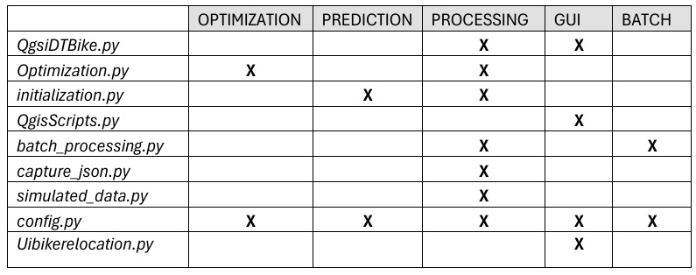
Modelling of the physical system
https://github.com/albertonavasrubio/DTBikeRelocation
Correlation between the functional modules and the python physical files

Slide 22
Modelling of the physical system
Prediction Module
If no predictive data is found in the appropriate folder that fits the current data-time a simplified predictive task is performed according to the predictive strategy fixed for Real Mode in the configy.py, among the followings:
CONSTANT_DEMAND: The differences found between the status data obtained between two consecutives queries (as found in the storage file container) are taken as the parameter prediction for the current period of analysis.
MINUS_2_BIKE_PREDICTION: The prediction is generated aggregating a delta of -2 bikes (decrease) in each station PLUS_2_BIKE_PREDICTION: The prediction is generated aggregating a delta of 2 bikes (increases) in each station PESIMISTIC_2_PREDICTION: The stations where number of bikes are less than number of available docks are reduce in 2 bikes. The stations where number of free docks are less than the number of available bikes are incremented in 2 bikes. OPTIMISTIC_2_PREDICTION: The stations where number of bikes are less than number of available docks are increased in 2 bikes. The stations where number of free docks are less than the number of available bikes are decremented in 2 bikes.

Slide 23

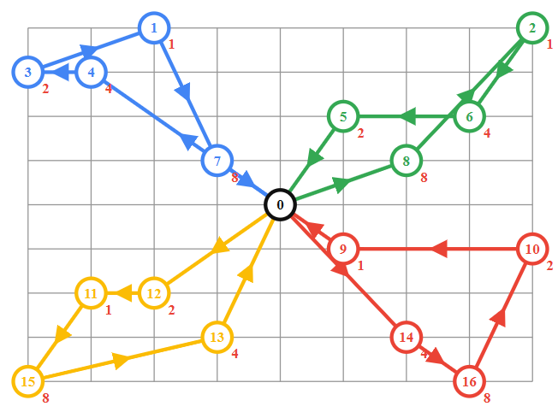
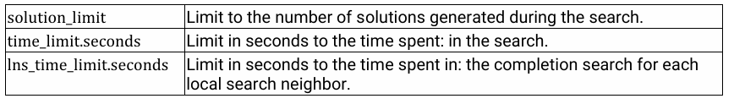
Modelling of the physical system
Optimization Module
The problem of relocation bikes in stations in routing terminology is equivalent to a VRP (Vehicle Routing Problem) with Capacity Constraints ( where the vehicles need to pick up items at each location they visit, but have a maximum carrying capacity ) and penalties for dropping visit (to allow the solver change a visit for a penalisation-cost in case no solution for all station is found in the established time)
The Optimisation is made taken OR-Tools algorithms as core.
PATH_CHEAPEST_ARC
SAVINGS
SWEEP
CHRISTOFIDES
ALL_UNPERFORMED
BEST_INSERTION
PARALLEL_CHEAPEST_INSERTION
LOCAL_CHEAPEST_INSERTION
PARALLEL_CHEAPEST_INSERTIONGLOBAL_CHEAPEST_ARC
LOCAL_CHEAPEST_ARC
FIRST_UNBOUND_MIN_VALUE

Slide 24

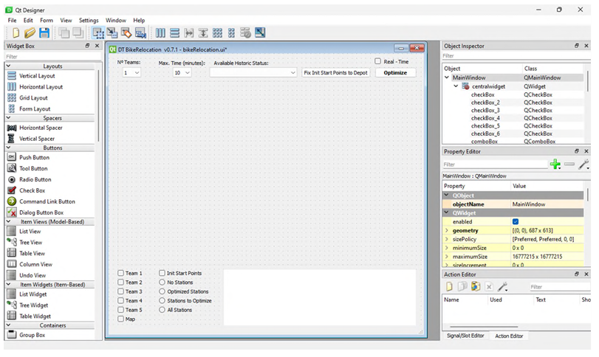
Modelling of the physical system
Presentation Module
OSGeo4W distribution
PyQGIS
QT Dessigner tool

Slide 25
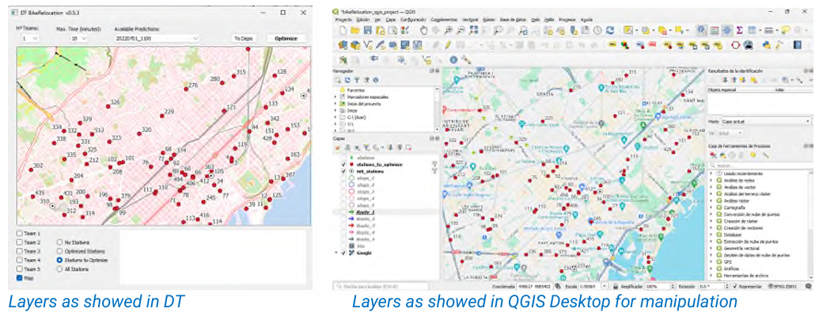
Modelling of the physical system
Presentation Module
ESRI shapefile format (.shp)

Slide 26
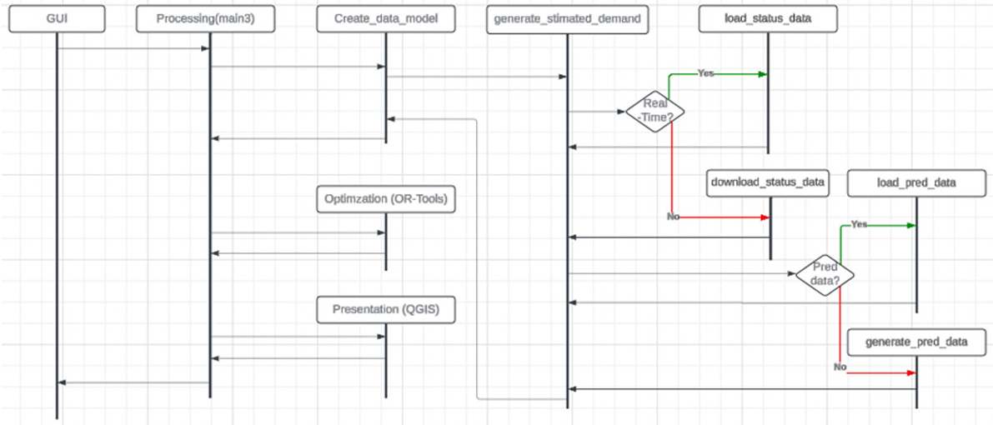
Modelling of the physical system
Processing Module

Slide 27
Modelling of the physical system
Bach Processing Module
Operational Level Optimization
Tactical Level Optimization
Optimizaion Simulation
Hstoric Data
Strategic Level Optimization
-Increase/decrease the number of docks
-Adjust the most profitable number of teams at any kind of day or ats specific hours
-Set the best location for a depot as a start teams point

Slide 28
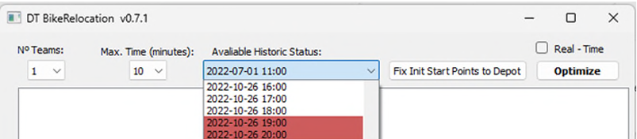
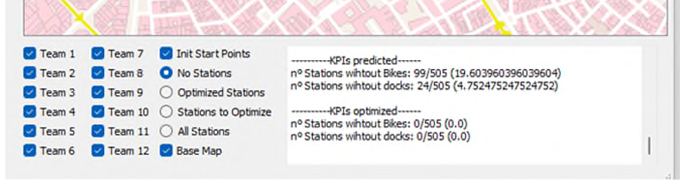
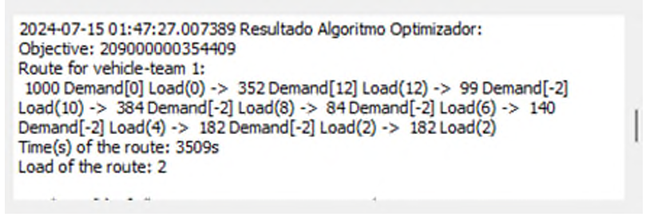
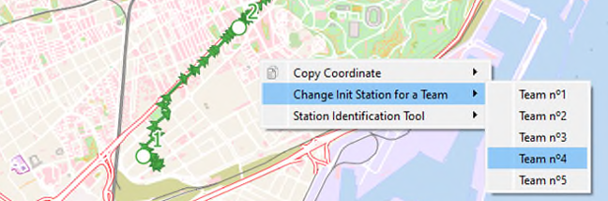
Simulation implementation
Simulation Process
1. Number of Simultaneous Teams
2. Change Init Station for a Team
3. Fix Maximum Time Available
4. Select Real-Time / Historiic Data
5. Select Historic Data Avaliable
6. Run for Optimization results
7. View results

Slide 29
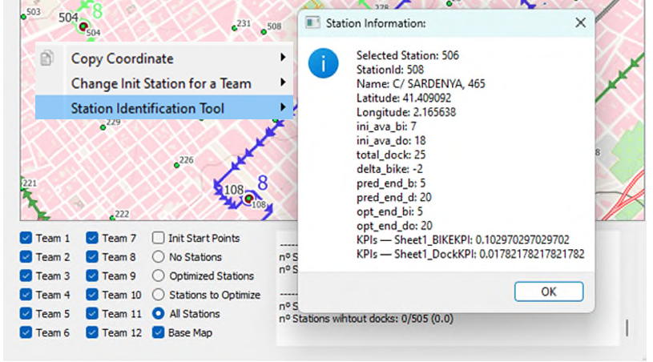
Simulation implementation
Simulation Process
1. Number of Simultaneous Teams
2. Change Init Station for a Team
3. Fix Maximum Time Available
4. Select Real-Time / Historiic Data
5. Select Historic Data Avaliable
6. Run for Optimization results
7. View results
8. Select Layers To Show
9. Use Station Identification Tool

Slide 30
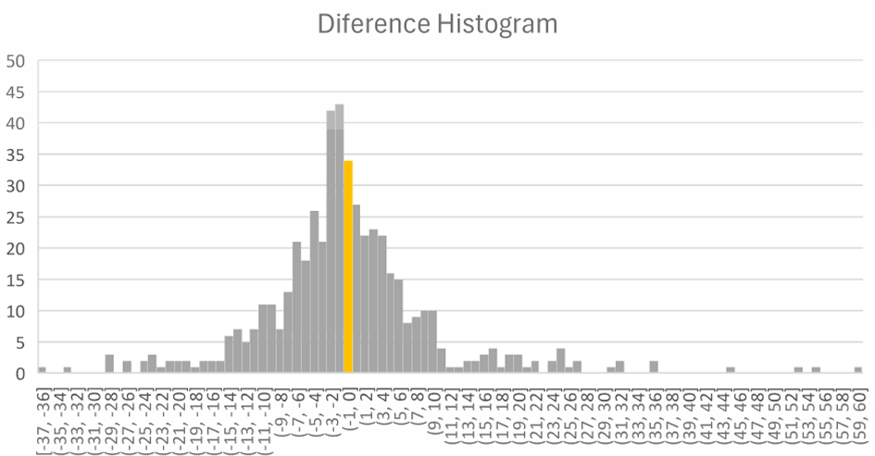
Validation and verification of the DT
To test and validate the prediction stage, we have compared predicted data of historic periods with the real data of those period.
Data From 26/10/2022
Interval 19:00-20:00:
Real historic data, total increase of bikes in docks (406)
Predicted historic data, total increase of bikes in docks (176)
Interval 20:00-21:00:
Real historic data, total increase of bikes in docks (-50)
Predicted historic data, total increase of bikes in docks (190)
Aggregating both period reduces the difference to only 10 bikes, but then we have a huge increment in differences in a station level. As we can see in this histogram of differences between predicted and real data. The number of stations perfectly estimated is 34 (6,73%) ,more than 3 times minor than the number of stations with a difference of 10 or more bikes , that is 117 (23,17%)

Slide 31
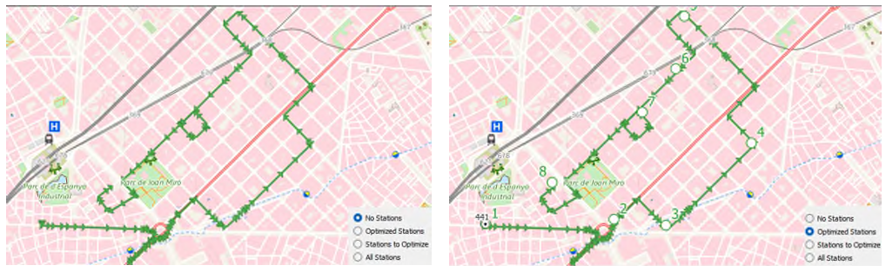
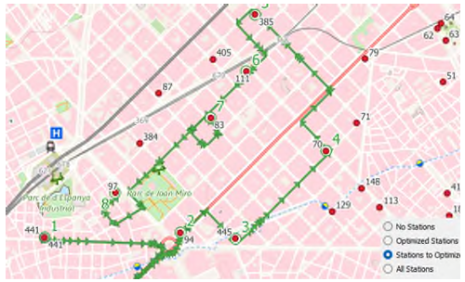
Validation and verification of the DT
To test the functionality of the DT in the Optimization stage
- Direct single test performing throw the GUI
- Indirect multiple tests doing though an evaluation of the bach module in python (batch_proccesin.py)
Test with the GUI -> VIDEO DEMO

Slide 32
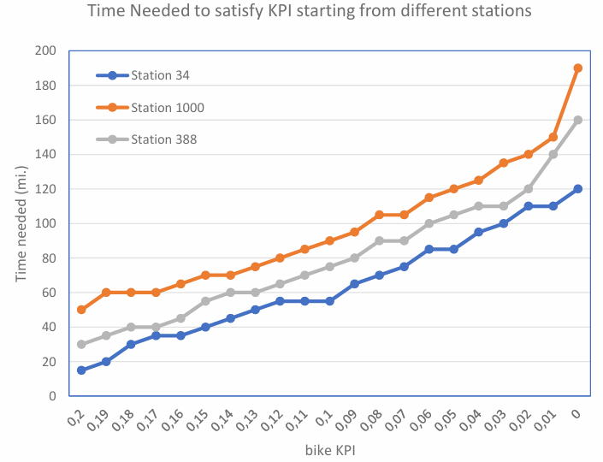
Validation and verification of the DT
Test with the Batch Processing Module
o Number of vehicles: 8 o Starting points for all vehicles: Station 34 / Station 1000 / Station 388
4 variables (FIX 2 -> Relation Between the other 2
o Complimentary KPIs value (docks KPI and Bikes KPI)
o Time Operation
o Number of vehicles
o Station Departure

Slide 33
Validation and verification of the DT
For a more in – deep validation is necessary to define a result (aggregate function) to manage the different situations of variables on the whole. For this reason we have adopted the following aggregated function:
o Number of Starting Points (Stations) that meets the requirements
Show the number of stations (aggregate function) that for the selected number of teams (constant) reach the required dock KPI (constant) in function of the operational time (independent variable)
Show the number of stations (aggregate function) that for the selected time operation (constant) reach the required dock KPI (constant) in function of the number of teams involved (independent variable)
Show the number of stations (aggregate function) that for the selected time operation (constant) and number of teams (constant) in function of the dock KPI fixed value (independent variable)

Slide 34
Results and Analysis

Slide 35
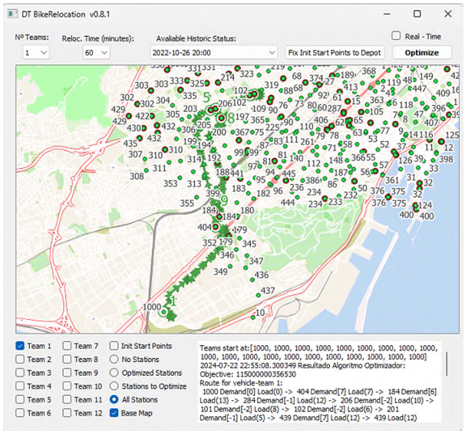
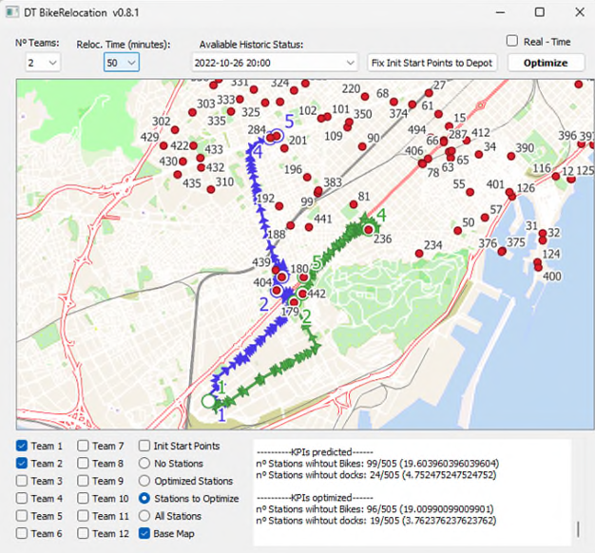
Results
1 vehicule– 60’ operation time – start from depot (id.station: 1000) showing all the stations(green) and the stations that needs relocations (red)
2 vehicule– 50’ operation time – start from depot (id.station: 1000) showing all the only the stations that needs relocations (red)

Slide 36
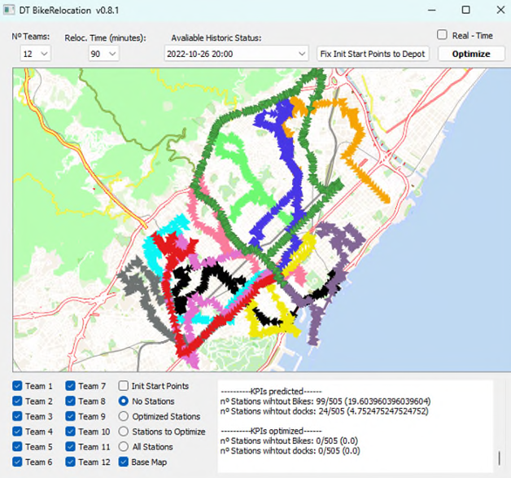
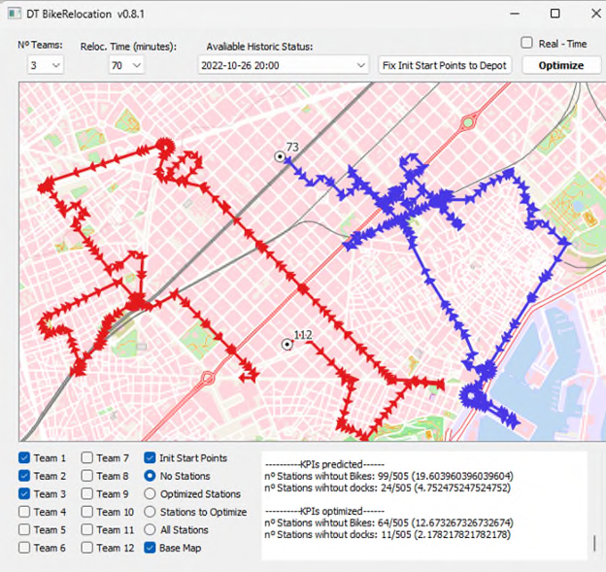
Results
3 vehicule– 70’ operation time – start from different points showing only routes and the starting point of each route (first vehicle out of the current zoo,)
12 vehicule– 90’ operation time – start from depot (id.station: 34) showing only the riutes (Complete Relocation: KPIs = 0)

Slide 37
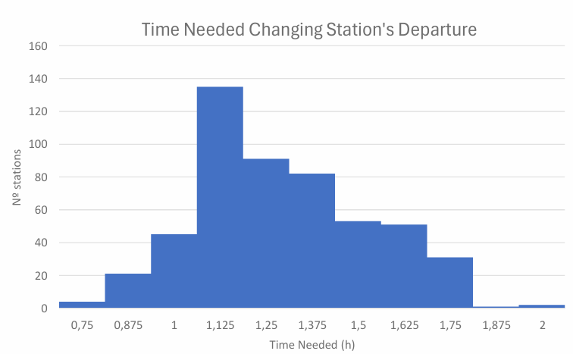
Analysis of the Results
1. Number of departure stations that require a specified operational time to reach the required dock KPI
The KPI chosen is that the number of stations without any available dock is at most 5 (1% of the total available stations).
The number of vehicles of eight has been taken

Slide 38
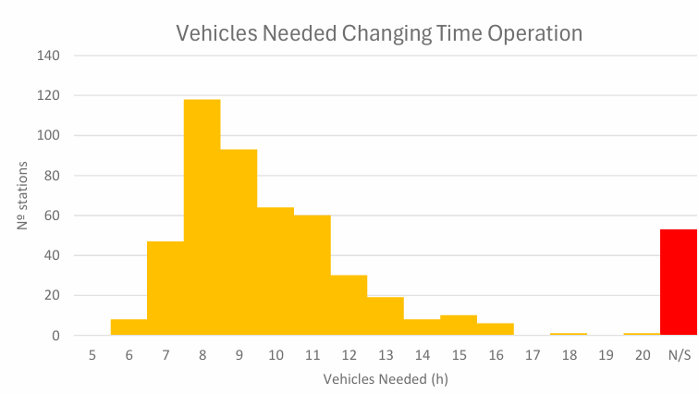
Analysis of the Results
2. Number of departure stations that for a given time operation reach the required dock KPI in function of the number of vehicles:
The KPI chosen is that the number of stations without any available dock is at most 5 (1% of the total available stations).
Vehicles Needed Changing Departure Station
The Time Operation is 4000 seconds

Slide 39
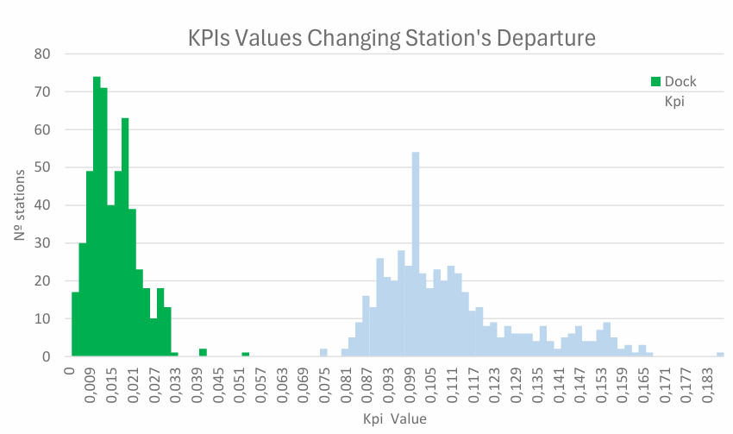
Analysis of the Results
3. Number of stations that for a given number of vehicles reach the required dock KPI in function of the operational time specified
The Time Operation is 4000 seconds
The number of vehicles of eight has been taken

Slide 40
Limitations
QGIS: DT has been developed as a standalone QGIS App, which allows a much more compact and problem-oriented integration in addition to being much lighter in load. On the other side, it lacks all the geoprocessing and presentation tools that are already incorporated into the QGIS Application. There is the option to propose the DT as an additional geoprocessing tool to the QGIS toolbox as a plugin.
OR-Tools: If the vehicles starts at a station that currently have a demand for bicycles, it never finds the solution because is not avoid a penalty for a station where the vehicle is currently and also cannot bring bikes to it because the vehicles doesn’t have bikes on the beginning of the route, so it must be forced that this station does not have a demand for bicycles.
Google API: Currently there are some limitations for obtain real time data use the Time Matrix Google API.
The first one is related to the simultaneous request we can do for cumpte time-distance matrix. For an initial station inventory of 500 stations a new one needs to compute 500 requests to the API (distance for the new station to each of the current stations) but the API is restricted to 100. So we need to make multiples request or use a static time distance matrix.
The second one is related to the cost of using the API, that is available as trial for a short period of time (90 days) and for a cost imited number of requests. This is OK for a business purpose but maybe not for academic one.
The third is related to the static time distance recorded. Since the time from one station to another differs from one hour to another and depends on the day of the week, and weather conditions. In a realist environment we would need to make a new OD-Time Matrix for any daytime involve in the analyses that means as related in the first limitation a matrix of 500x500 = 250.000 request. And if we take care of the second limitations, this could be a prohibitive one. The compromise solution is using a static OD- Time Matrix and estimate new time distances taken as an average of the nearest previous stations. For future development and with little more time we have planned change the Google API for the OpenStreetMap API together with the Open Source Routing Machine (Project OSRM · GitHub)

Slide 41
Limitations
DT Implementation: The DT makes a simplification by only taking stations that can be visited by vehicles that have a demand for either docks or bicycles. This is necessary since imposing a search for the entire set of stations, in many cases leads to non resolution of the problem. This simplification works in the sense that for the reduced number of stations it normally finds a solution, but on the other hand the solution found may not be the most efficient in the sense that the vehicles cannot visit stations without a shortage of bicycles or docks, and they can’t be used. as the closest bicycle collection or delivery points, in case it was necessary for the vehicle to avoid having to make greater trips in case the stations that they were allowed to visit were further away.
There is also no continuity between simulation cycles in the sense that the state of the vehicles in terms of the number of bicycles inside and the station where they finish the cycle are not incorporated into the next simulation cycle, but rather they begin the next cycle of simulation from the starting point defined for each vehicle and with its total capacity (that is, without bicycles inside). In real conditions, a calculation of the state of the vehicles at the end of the simulation would have to be developed in the processing module to take these variables as a starting point for the next cycle. The Real-Time mode can do an on-line transmission of the current state of the stations but do a very simple simulated prediction due to the time necessary to perform a complete prediction analysis. Is necessary to upload the files for the current day to have an input of real prediction data but this has not actually resulted for a real time development since the prediction stage take a lot of time.

Slide 42
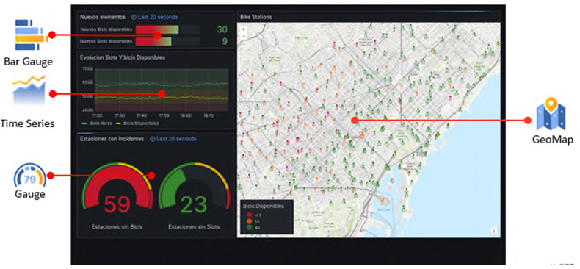

Potential Improvements
Adaptation of the DT for the Consumption of live data according to ‘mds’ specifications that is the standard for communication between operator and public administrators: https://www.openmobilityfoundation.org/about-mds/
Introduce parameters related to the costs associated with both the non compliance of KPIs (in terms of penalization) and the cost of the number of vehicles available for optimization (in terms of CAPEX and in terms of OPEX)
Adapt the Background Processing Module (Bach_processing.py) so it can be called directly through the command line with the appropriate specific parameters for by used for external scripts.
Integration with other platforms. An example of integration with mosquito broker(to capture and send direct station status data from the stations), telegraf (to consume data form mosquito and do the transformations require), influxDb as online database storage of the data and Grafana (to show online data on a dashboard operator panel) (Tested for the Big Data in Digital Twin Course).

Slide 43
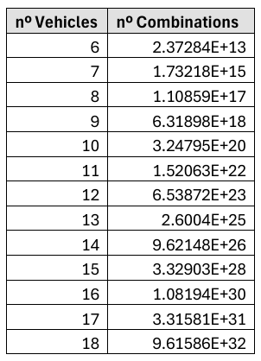



Other Posible Researchs
Possible AI integration for data mining from the thousand of files that can be generating from the batch processing module within all the possible combinations of the input parameters.
The treatment of more of one category of bike (mechanical and electrical) at the same time is also a research point. The current DT takes the total number of bikes in the station without analyses the category and thus the implication of this for the planification of the relocation task, like different vehicle types, different KPIs and penalizations.

Slide 44
Conclusions

Slide 45
Conclusions
Tool with great potential, escalable
To be standarized
Way to go to improve hourly predictions

Slide 46


Thank you!
contact@digitaltwins.eu
www.digitaltwins.eu

