Slide 1


Department of Information Engineering
Academic Year 2020/2021
Web Applications Project
"BOOKSTUDY"
Developers:
Alberto Piva
Gianmarco Prando
Matteo Candon
Matteo Cogato
Mario Giovanni Peloso

Slide 2
Project objectives
Developing a web application for a cultural association to:
  Efficiently manage the access to the library
  Improve the way of storage the data of the users
  Allow a single user to book seats
  Allow associations to book a conference room

Slide 3
Main features
Update in real time
Simple and intelligible interface
Accessible through different platforms (desktop and mobile)
Durability
Privacy and security

Slide 4
Back-end
The server uses a SQL database
Implemented the different java classes needed from scratch:
  DAO
  Filter
  Resource
  Rest
  Servlet

Slide 5
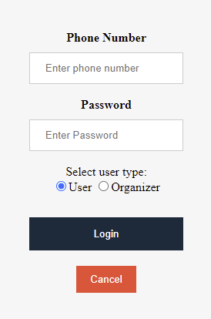
Authentication
To authenticate the user must provide the password
The password is mixed with a 10 characters salt
Therefore there is no clear password saved in the database, this allows to increase the safety

Slide 6

Application filters
When the user login a session is created
The session is used by the application filters to validate the access to the protected pages
There are different filters, each for every possible user role in the web application

Slide 7
Dao
The DAO classes are used to access the database and perform the different operations
The methods are implemented using the Prepared Statement to avoid SQL injection and increase safety

Slide 8
Resource
The resources classes are used by the REST services
The Resource abstract class set up the JSON factory to create the JSON generators and parsers
Each resource class has a fromJSON and toJSON method, in order to be used by the Javascript scripts

Slide 9
Rest
The services that are implemented using REST are:
  manage of members
  manage of conferences
  reservation of the seats
All the REST requests are served by the RestDispatcherServlet

Slide 10
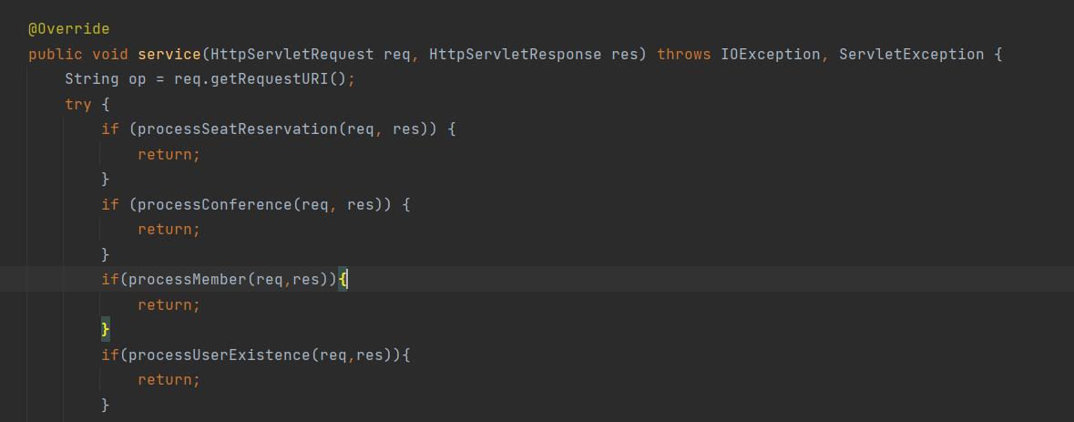
Rest
The RestDispatcherServlet service method:

Slide 11
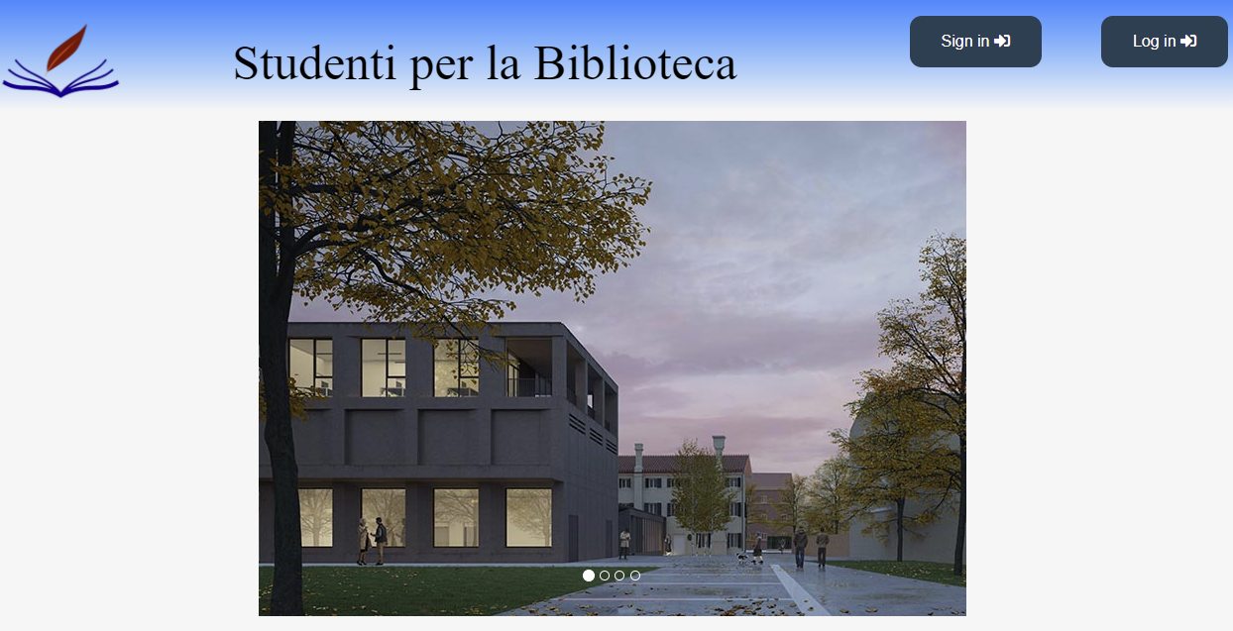
Front-end
The client side has a common homepage for all the users
Then the user can login or register

Slide 12
Layout
Each page has a common header and footer
Based on the previliges of the user, under the header there is a navigation bar with the links to the different pages
For the layout, we have used as external library FontAwesome and as framework Bootstrap

Slide 13
JavaScript
In the html and jsp pages we use many Javascripts scripts
Scripts, combined with Ajax, are useful for REST but also for autocomplete fields

Slide 14
Template
The template is common for all pages and is defined in an external file with css
The template is recalled in every page since it contains the format of both the header and the footer
The body template is contained in another file, which is recalled in almost all the pages

Slide 15
Header
The header contains the logo and the title of the project, together with the Login and Sign in buttons. The logo also operate as homepage button
Once the user has logged in, it appears a personalized welcome message together with a Logout button
The header also contains the navigation bar, which is accessible only after the user's login

Slide 16

Navigation bar
The navigation bar is set to be right at the bottom of the header
The navbar is personalized for each kind of user's role, showing different links
The mobile version is provided with a button, that enable the user to show/hide the navigation bar at will

Slide 17

Footer
The footer is composed of two columns, providing general information about the project and a few useful library links
As the header, the footer also have a responsive layout that stack the two columns on top of each other

Slide 18
Demo
Now let’s see a demo

