Slide 1
Talking to Hardware
Using Websockets for
realtime hardware interaction in
Rails

Slide 2
The worst insult in the English language is “Channel Partner”...

Slide 3
...followed closely by “Vendor”.

Slide 4
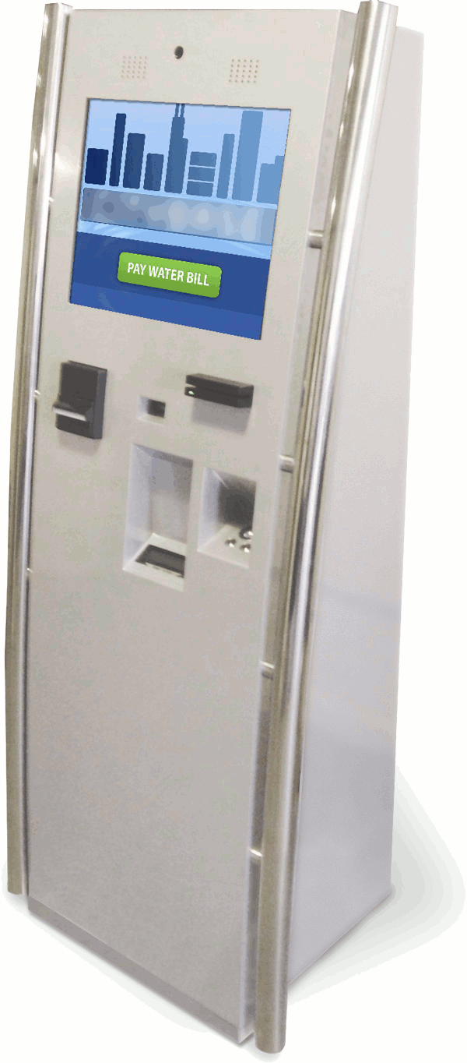
This spring I got a new client
Automated payment kiosks.

Slide 5
The Problem
The existing software stack has unmaintainable levels of technical debt.

Slide 6
The Problem
The existing software stack has unmaintainable levels of technical debt.
It's potentially salvageable with enough work, but...

Slide 7
“I ain't touching this for any amount of money.”

Slide 8
So then comes the question...
“Could you build me a new platform in 3 months?”

Slide 9
But there's a catch
Need to support many different clients
  Flexible interaction flows
  Easy to brand
  In short, need to drastically lower the marginal cost of adding a new client

Slide 10
How about a Rails stack on a kiosk?
Web browser in kiosk mode
Build the UI on top of Backbone
And life is good

Slide 11
But what about all this custom hardware?
Cash acceptor/banknote recycler
MICR code (check) reader
Magnet stripe (credit card) reader
Bar code scanner
Receipt printer

Slide 12
It boils down to two core issues
I need to push asynchronous events from hardware to the browser
Proprietary API's galore...

Slide 13
“So are you guys using Java or .NET?”

Slide 14
We're actually using Ruby here...

Slide 15
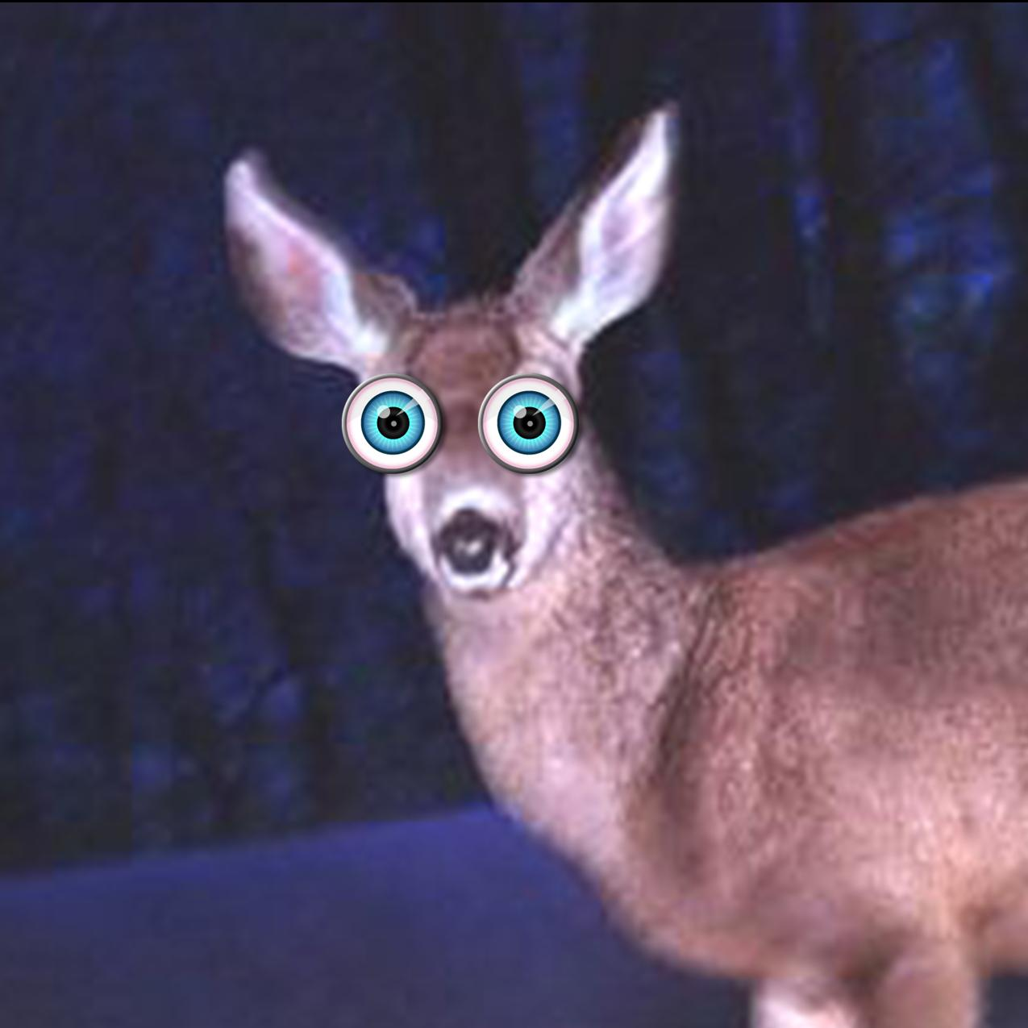
We're actually using Ruby here...

Slide 16
What to do?
Problem 2 is actually easy enough to solve; Run the kiosk stack on JRuby.
Problem 1 is more fundamental

Slide 17
What to do?
Problem 2 is actually easy enough to solve; Run the kiosk stack on JRuby.
Problem 1 is more fundamental – Websockets to the rescue!

Slide 18
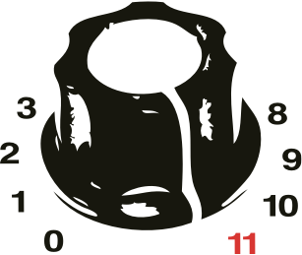
Torquebox – http://torquebox.org/

Slide 19
Torquebox has STOMP baked in
Simple Text Orientated Messaging Protocol
http://stomp.github.io/
Text messaging over Websockets
Pretty much solved my architectural problems in one fell swoop
Thing to note – completely bypasses Rack

Slide 20
Example: Serial bar code scanner
require 'torquebox-stomp'
class BarCodeScannerStomplet
def initialize
@subscribers = []
@mutex = Mutex.new
end
def on_subscribe(subscriber)
@mutex.synchronize { @subscribers << subscriber }
end
def on_unsubscribe(subscriber)
@mutex.synchronize{ @subscribers.delete( subscriber ) }
end
end

Slide 21
Example: Serial port listener
# We're implementing jssc.SerialPortEventListener in Ruby
class ScannerEventListener
include Java::Jssc::SerialPortEventListener
def initialize(stomplet)
@stomplet = stomplet
end
java_signature 'void serialEvent(jssc.SerialPortEvent event)'
def serialEvent(event)
@stomplet.process_serial_port_event(event)
end
end

Slide 22
Example: Configure serial port
def configure(config)
com_port = '/dev/tty.usbmodem1411'
if File.exists? com_port
Rails.logger.debug "Opening serial port #{com_port}"
@serial_port = Java::Jssc::SerialPort.new(com_port)
@serial_port.openPort
@serial_port.setParams(115200, 8, 1, 0)
mask = Java::Jssc::SerialPort::MASK_RXCHAR +
Java::Jssc::SerialPort::MASK_CTS +
Java::Jssc::SerialPort::MASK_DSR
@serial_port.setEventsMask(mask)
@serial_port.addEventListener( ScannerEventListener.new(self) )
end
end

Slide 23
Example: Process event
def process_serial_port_event(event)
if event.isRXCHAR && event.getEventValue > 0
begin
buffer = @serial_port.readBytes(event.getEventValue)
message_string = Java::JavaLang::String.new(buffer).to_s
send_to_subscribers(message_string)
rescue Exception => e
Rails.logger.error "Failed to process bar code data: #{e}"
end
end
end

Slide 24
Example: Send to subscribers
def send_to_subscribers(message_string)
@mutex.synchronize do
@subscribers.each do |sub|
begin
message = org.projectodd.stilts.stomp.DefaultStompMessage.new
message.setContentAsString(message_string)
sub.send(message)
rescue Exception => e
Rails.logger.error "Failed to send to subscriber #{sub}: #{e}"
end
end
end # mutex.synchronize
end

Slide 25
Example: JavaScript
$(document).ready(function() {
var scanner_stomp_client = new Stomp.Client();
scanner_stomp_client.connect(function () {
scanner_stomp_client.subscribe("/bar_code_scanner", function (message) {
$("#scanner_output").text(message.body);
});
});
});

Slide 26
Slides and sample application going up on
www.github.com/albertosaurus

