Slide 1
Refresher on Neural Networks and Philosophy of pytorch
Alberto TONDA, Ph.D. (Senior permanent researcher, DR)
UMR 518 MIA-PS, INRAE, AgroParisTech, Université Paris-Saclay UAR 3611, Institut des Systèmes Complexes de Paris Île-de-France

Slide 2
This is a new thing
Ciao
Ciaooooooooooooooo

Slide 3
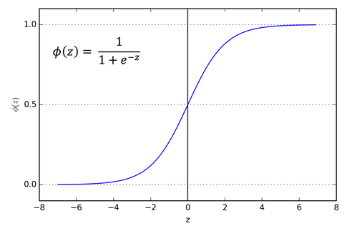

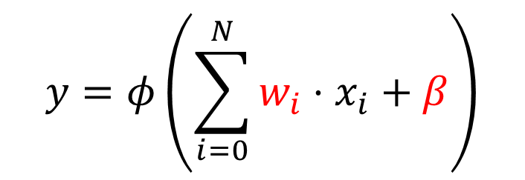



What is a neural network?
Everything starts from the (wrong) model of a neuron
$$x_{0}$$
$$x_{1}$$
$$y∈[0,1]$$
…
$$x_{N}$$
$$y=φ\left(\sum_{i=0}^{N}{w_{i}⋅x_{i}}+β\right)$$

Slide 4
What is a neural network?
Everything starts from the (wrong) model of a neuron
$$x_{0}$$
$$x_{1}$$
$$y∈[0,1]$$
…
$$x_{N}$$
$$y=φ\left(\sum_{i=0}^{N}{w_{i}⋅x_{i}}+β\right)$$
This part inside is a linear model (a weighted sum)

Slide 5
What is a neural network?
Everything starts from the (wrong) model of a neuron
$$x_{0}$$
$$x_{1}$$
$$y∈[0,1]$$
…
$$x_{N}$$
$$y=φ\left(\sum_{i=0}^{N}{w_{i}⋅x_{i}}+β\right)$$
This part inside is a linear model (a weighted sum)
Weights and bias can be learned, depending on application
The weights can be learned, depending on application

Slide 6
What is a neural network?
Everything starts from the (wrong) model of a neuron
$$x_{0}$$
$$x_{1}$$
$$y∈[0,1]$$
…
$$x_{N}$$
$$y=φ\left(\sum_{i=0}^{N}{w_{i}⋅x_{i}}+β\right)$$
This part inside is a linear model (a weighted sum)
Weights and bias can be optimized, depending on application
The weights can be learned, depending on application

Slide 7
What is a neural network?
Everything starts from the (wrong) model of a neuron
$$x_{0}$$
$$x_{1}$$
$$y∈[0,1]$$
…
$$x_{N}$$
This is a non-linearity, increases capacity
$$y=φ\left(\sum_{i=0}^{N}{w_{i}⋅x_{i}}+β\right)$$
This part inside is a linear model (a weighted sum)
Weights and bias can be optimized, depending on application
The weights can be learned, depending on application

Slide 8
What is a neural network?
Neurons are used in subsequent sets, called layers
…
…
Input layer
Output layer
Hidden layer

Slide 9
What is a neural network?
Neurons are used in subsequent sets, called layers
…
Input layer does not really have neurons, just feature values (inputs)
…
Input layer
Output layer
Hidden layer

Slide 10
What is a neural network?
Neurons are used in subsequent sets, called layers
…
Input layer does not really have neurons, just feature values (inputs)
Values in output of the output layer are interpreted as predictions for the target(s)
…
Input layer
Output layer
Hidden layer

Slide 11
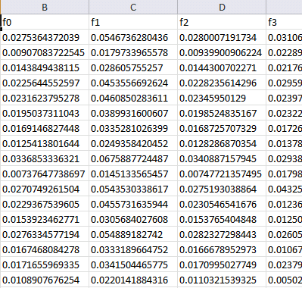

Machine learning (supervised)
Training data
Features
Training...
Predictions
Prediction 1
Prediction 2
Prediction 3
Prediction 4
…
Ground truth
Truth 1
Truth 2
Truth 3
Truth 4
…
ML algorithm (model+optimizer)
Samples
Internal parameters (to be optimized)
In the case of a neural network, what are the parameters to be optimized?

Slide 12
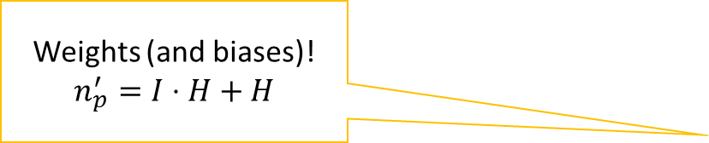
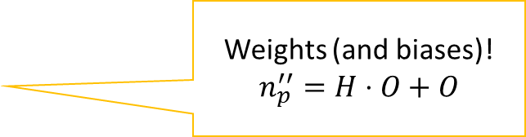
What is a neural network?
Neurons are used in subsequent sets, called layers
Weights (and biases)!
$$n_{p}^{′}=I⋅H+H$$
Weights (and biases)!
$$n_{p}^{′′}=H⋅O+O$$
…
Input layer does not really have neurons, just feature values (inputs)
Values in output of the output layer are interpreted as predictions for the target(s)
…
Input layer
Output layer
Hidden layer

Slide 13
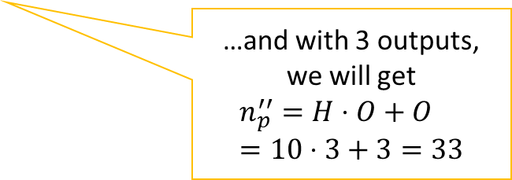
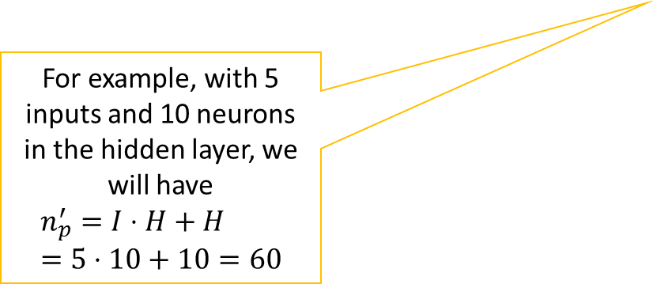
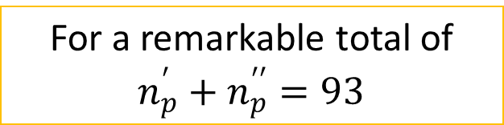
What is a neural network?
Neurons are used in subsequent sets, called layers
Weights (and biases)!
$$n_{p}^{′}=I⋅H+H$$
Weights (and biases)!
$$n_{p}^{′′}=H⋅O+O$$
…
For example, with 5 inputs and 10 neurons in the hidden layer, we will have
$$n_{p}^{′}=I⋅H+H=5⋅10+10=60$$
…and with 3 outputs, we will get
$$n_{p}^{′′}=H⋅O+O=10⋅3+3=33$$
…
Input layer
Output layer
Hidden layer
For a remarkable total of $n_{p}^{′}+n_{p}^{′′}=93$

Slide 14
Predictions (forward pass)
Input layer
Hidden layer
Output layer

Slide 15



Predictions (forward pass)
$$w_{0}^{0}=0.0 \\ w_{1}^{0}=0.1 \\ w_{2}^{0}=0.2 \\ β^{0}=0.0$$
0.2
$$w_{0}^{out}=0.6 \\ w_{1}^{out}=0.7 \\ β^{out}=0.0$$
0.9
$$w_{0}^{1}=0.3 \\ w_{1}^{1}=0.4 \\ w_{2}^{1}=0.5 \\ β^{1}=0.2$$
-1.1

Slide 16
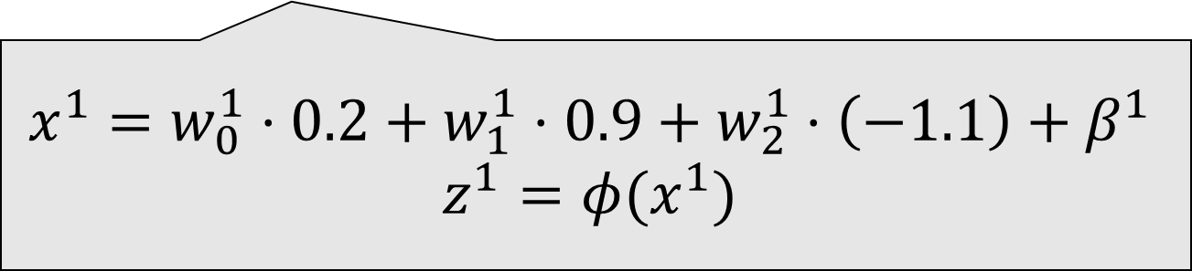
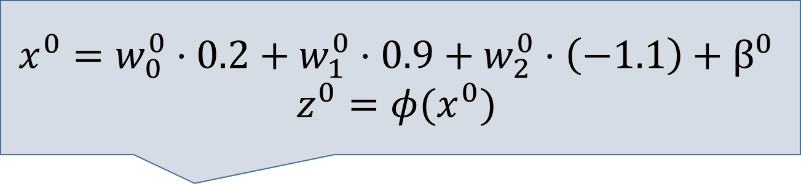
Predictions (forward pass)
$$x^{0}=w_{0}^{0}⋅0.2+w_{1}^{0}⋅0.9+w_{2}^{0}⋅\left(−1.1\right)+β^{0}$$
$$z^{0}=φ(x^{0})$$
0.2
0.9
$$x^{1}=w_{0}^{1}⋅0.2+w_{1}^{1}⋅0.9+w_{2}^{1}⋅\left(−1.1\right)+β^{1}$$
$$z^{1}=φ(x^{1})$$
-1.1

Slide 17
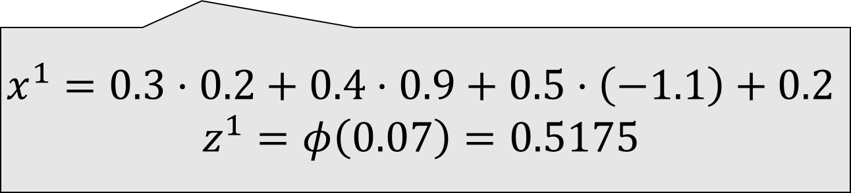
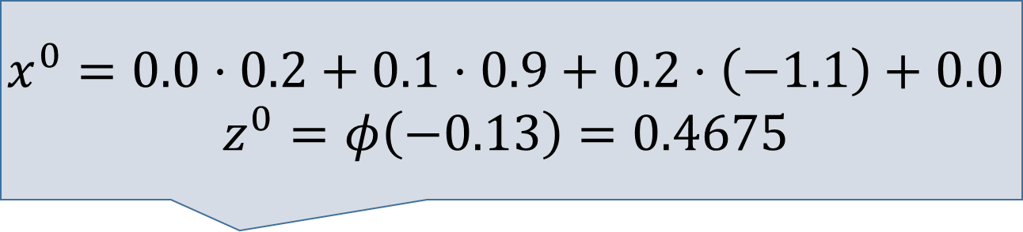
Predictions (forward pass)
$$x^{0}=0.0⋅0.2+0.1⋅0.9+0.2⋅\left(−1.1\right)+0.0$$
$$z^{0}=φ\left(−0.13\right)=0.4675$$
0.2
0.9
$$x^{1}=0.3⋅0.2+0.4⋅0.9+0.5⋅\left(−1.1\right)+0.2$$
$$z^{1}=φ\left(0.07\right)=0.5175$$
-1.1

Slide 18
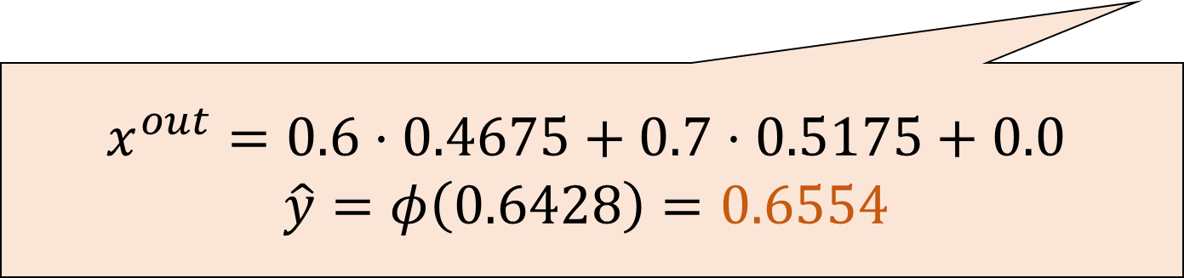
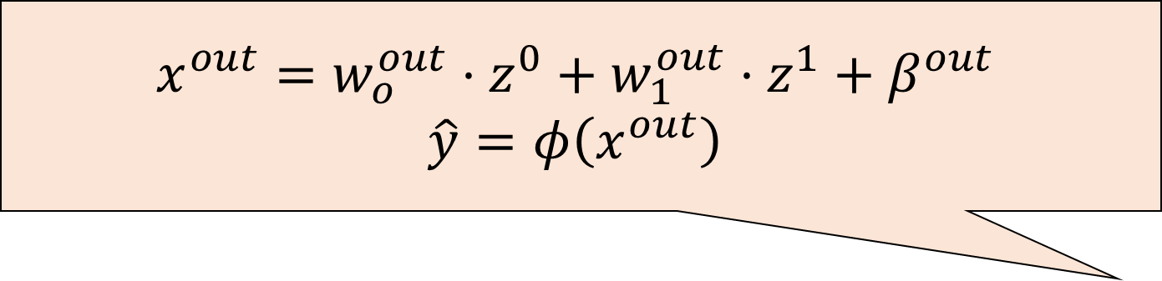
Predictions (forward pass)
$$x^{out}=w_{o}^{out}⋅z^{0}+w_{1}^{out}⋅z^{1}+β^{out}$$
$$\hat{y}=φ\left(x^{out}\right)$$
0.2
0.9
$$x^{out}=0.6⋅0.4675+0.7⋅0.5175+0.0$$
$$\hat{y}=φ\left(0.6428\right)=0.6554$$
-1.1

Slide 19
Predictions (forward pass)
$$w_{0}^{0}=0.0 \\ w_{1}^{0}=0.1 \\ w_{2}^{0}=0.2 \\ β^{0}=0.0$$
0.2
$$w_{0}^{out}=0.6 \\ w_{1}^{out}=0.7 \\ β^{out}=0.0$$
0.9
$$w_{0}^{1}=0.3 \\ w_{1}^{1}=0.4 \\ w_{2}^{1}=0.5 \\ β^{1}=0.2$$
-1.1
Notes:
Let’s go back to the original network, and let’s reorganize it as matrices.

Slide 20

Predictions (forward pass)
$$w_{0}^{0}=0.0 \\ w_{1}^{0}=0.1 \\ w_{2}^{0}=0.2 \\ β^{0}=0.0$$
$$\left(\begin{matrix}0.2 \\ 0.9 \\ −1.1\end{matrix}\right)$$
$$w_{0}^{out}=0.6 \\ w_{1}^{out}=0.7 \\ β^{out}=0.0$$
$$w_{0}^{1}=0.3 \\ w_{1}^{1}=0.4 \\ w_{2}^{1}=0.5 \\ β^{1}=0.2$$
Notes:
Let’s go back to the original network, and let’s reorganize it as matrices.

Slide 21
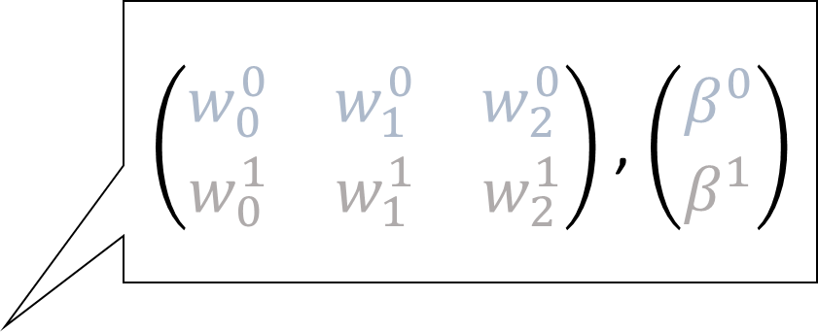
Predictions (forward pass)
$\left(\begin{matrix}w_{0}^{0} & w_{1}^{0} & w_{2}^{0} \\ w_{0}^{1} & w_{1}^{1} & w_{2}^{1}\end{matrix}\right)$ , $\left(\begin{matrix}β^{0} \\ β^{1}\end{matrix}\right)$
$$\left(\begin{matrix}0.2 \\ 0.9 \\ −1.1\end{matrix}\right)$$
$$w_{0}^{out}=0.6 \\ w_{1}^{out}=0.7 \\ β^{out}=0.0$$
Notes:
Let’s go back to the original network, and let’s reorganize it as matrices.

Slide 22
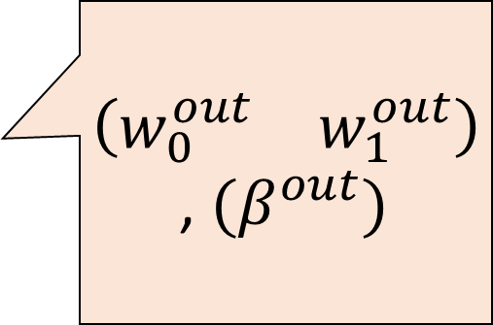
Predictions (forward pass)
$\left(\begin{matrix}w_{0}^{0} & w_{1}^{0} & w_{2}^{0} \\ w_{0}^{1} & w_{1}^{1} & w_{2}^{1}\end{matrix}\right)$ , $\left(\begin{matrix}β^{0} \\ β^{1}\end{matrix}\right)$
$\left(\begin{matrix}w_{0}^{out} & w_{1}^{out}\end{matrix}\right)$, ${(β}^{out})$
$$\left(\begin{matrix}0.2 \\ 0.9 \\ −1.1\end{matrix}\right)$$
Notes:
Let’s go back to the original network, and let’s reorganize it as matrices.

Slide 23
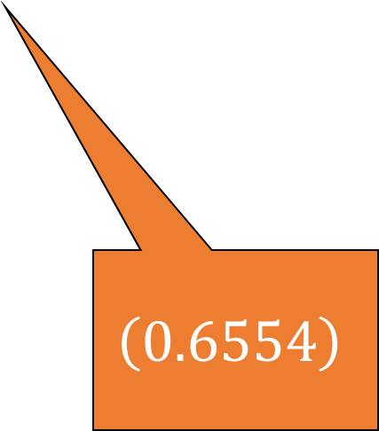
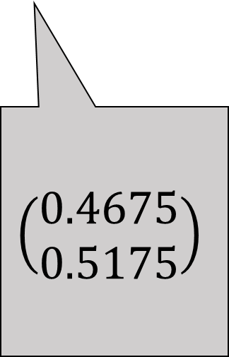
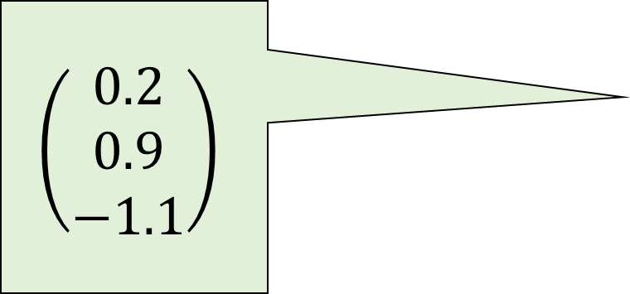
Predictions (forward pass)
$\left(\begin{matrix}w_{0}^{0} & w_{1}^{0} & w_{2}^{0} \\ w_{0}^{1} & w_{1}^{1} & w_{2}^{1}\end{matrix}\right)$ , $\left(\begin{matrix}β^{0} \\ β^{1}\end{matrix}\right)$
$\left(\begin{matrix}w_{0}^{out} & w_{1}^{out}\end{matrix}\right)$, ${(β}^{out})$
$$\left(\begin{matrix}0.2 \\ 0.9 \\ −1.1\end{matrix}\right)$$
$$\left(\begin{matrix}0.4675 \\ 0.5175\end{matrix}\right)$$
$$\left(0.6554\right)$$
Notes:
Let’s go back to the original network, and let’s reorganize it as matrices.

Slide 24
Predictions (forward pass)
$\left(\begin{matrix}w_{0}^{0} & w_{1}^{0} & w_{2}^{0} \\ w_{0}^{1} & w_{1}^{1} & w_{2}^{1}\end{matrix}\right)$ , $\left(\begin{matrix}β^{0} \\ β^{1}\end{matrix}\right)$
Matrix multiplications (and additions)
with several possible notations!
$\left(\begin{matrix}w_{0}^{out} & w_{1}^{out}\end{matrix}\right)$, ${(β}^{out})$
$$\left(\begin{matrix}0.2 \\ 0.9 \\ −1.1\end{matrix}\right)$$
$$\left(\begin{matrix}0.4675 \\ 0.5175\end{matrix}\right)$$
$$\left(0.6554\right)$$
Notes:
Let’s go back to the original network, and let’s reorganize it as matrices.

Slide 25
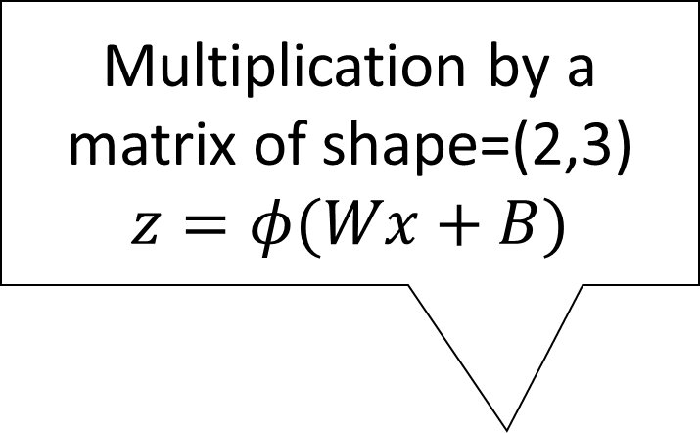
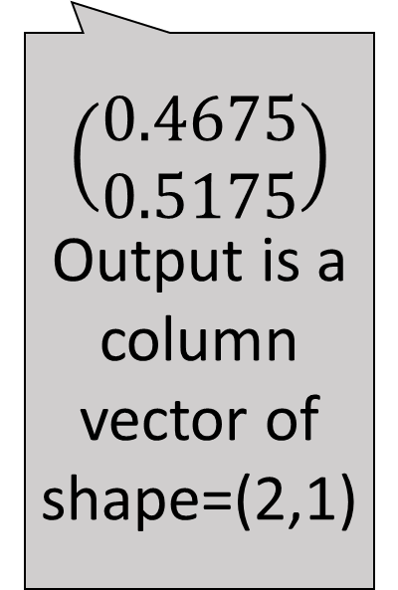
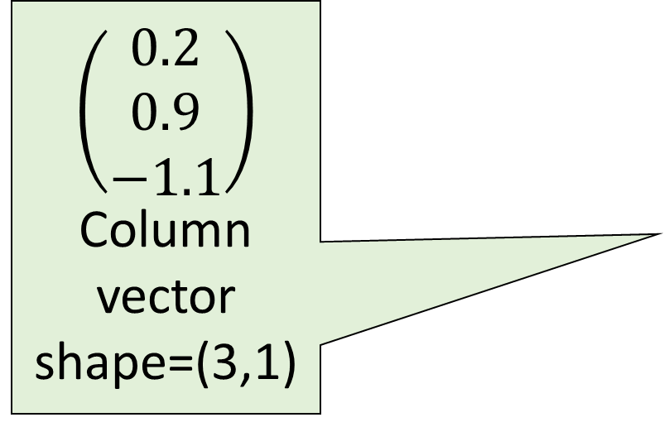
Predictions (forward pass)
Multiplication by a matrix of shape=(2,3)
$$z=φ(Wx+B)$$
$\left(\begin{matrix}w_{0}^{0} & w_{1}^{0} & w_{2}^{0} \\ w_{0}^{1} & w_{1}^{1} & w_{2}^{1}\end{matrix}\right)$ , $\left(\begin{matrix}β^{0} \\ β^{1}\end{matrix}\right)$
$$\left(\begin{matrix}0.2 \\ 0.9 \\ −1.1\end{matrix}\right)$$
Column vector shape=(3,1)
$\left(\begin{matrix}w_{0}^{out} & w_{1}^{out}\end{matrix}\right)$, ${(β}^{out})$
$$\left(\begin{matrix}0.4675 \\ 0.5175\end{matrix}\right)$$
Output is a column vector of shape=(2,1)
$$\left(0.6554\right)$$
Notes:
Let’s go back to the original network, and let’s reorganize it as matrices.

Slide 26
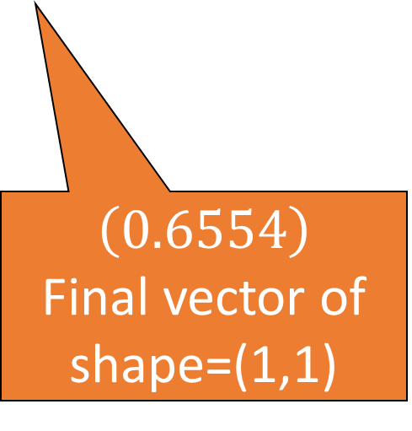

Predictions (forward pass)
Multiplication by a matrix of shape=(2,3)
$$z=φ(Wx+B)$$
$\left(\begin{matrix}w_{0}^{0} & w_{1}^{0} & w_{2}^{0} \\ w_{0}^{1} & w_{1}^{1} & w_{2}^{1}\end{matrix}\right)$ , $\left(\begin{matrix}β^{0} \\ β^{1}\end{matrix}\right)$
Multiplication by a “matrix” of shape=(1,2)
$$\hat{y}={φ(W}_{out}⋅z+B_{out})$$
$$\left(\begin{matrix}0.2 \\ 0.9 \\ −1.1\end{matrix}\right)$$
Column vector shape=(3,1)
$\left(\begin{matrix}w_{0}^{out} & w_{1}^{out}\end{matrix}\right)$, ${(β}^{out})$
$$\left(\begin{matrix}0.4675 \\ 0.5175\end{matrix}\right)$$
Output is a column vector of shape=(2,1)
$$\left(0.6554\right)$$
Final vector of shape=(1,1)
Notes:
Let’s go back to the original network, and let’s reorganize it as matrices.

Slide 27
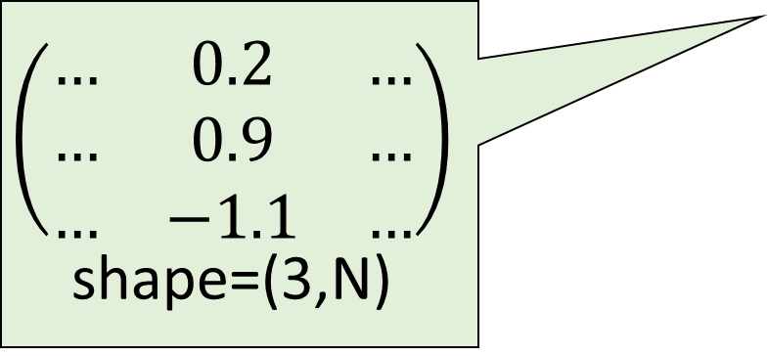
Predictions (forward pass)
What would happen if we had more samples?
$$\left(\begin{matrix}… & 0.2 & … \\ … & 0.9 & … \\ … & −1.1 & …\end{matrix}\right)$$
shape=(3,N)
Notes:
Let’s go back to the original network, and let’s reorganize it as matrices.

Slide 28
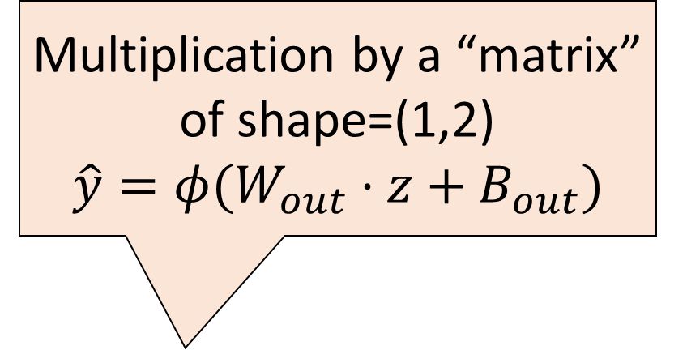

Predictions (forward pass)
Multiplication by a matrix of shape=(2,3)
$$z=φ(Wx+B)$$
Multiplication by a “matrix” of shape=(1,2)
$$\hat{y}={φ(W}_{out}⋅z+B_{out})$$
What would happen if we had more samples?
$$\left(\begin{matrix}… & 0.2 & … \\ … & 0.9 & … \\ … & −1.1 & …\end{matrix}\right)$$
shape=(3,N)
Notes:
Let’s go back to the original network, and let’s reorganize it as matrices.

Slide 29
Predictions (forward pass)
Multiplication by a matrix of shape=(2,3)
$$z=φ(Wx+B)$$
Multiplication by a “matrix” of shape=(1,2)
$$\hat{y}={φ(W}_{out}⋅z+B_{out})$$
What would happen if we had more samples?
$$\left(\begin{matrix}… & 0.2 & … \\ … & 0.9 & … \\ … & −1.1 & …\end{matrix}\right)$$
shape=(3,N)
Output is a column vector of shape=(2,N)
Output is a row vector, shape=(1,N)
Notes:
Let’s go back to the original network, and let’s reorganize it as matrices.

Slide 30

A flow of tensors through modules
The generic name for n-dimensional arrays is tensors
The high-level view of NNs (shared by multiple libraries)
Each network is a sequence of layers (or modules)
Input and output of each layer/module: tensors of a certain shape
The shape of the tensors is modified as data flows through NN
The output tensor is interpreted in a human-readable way

Slide 31
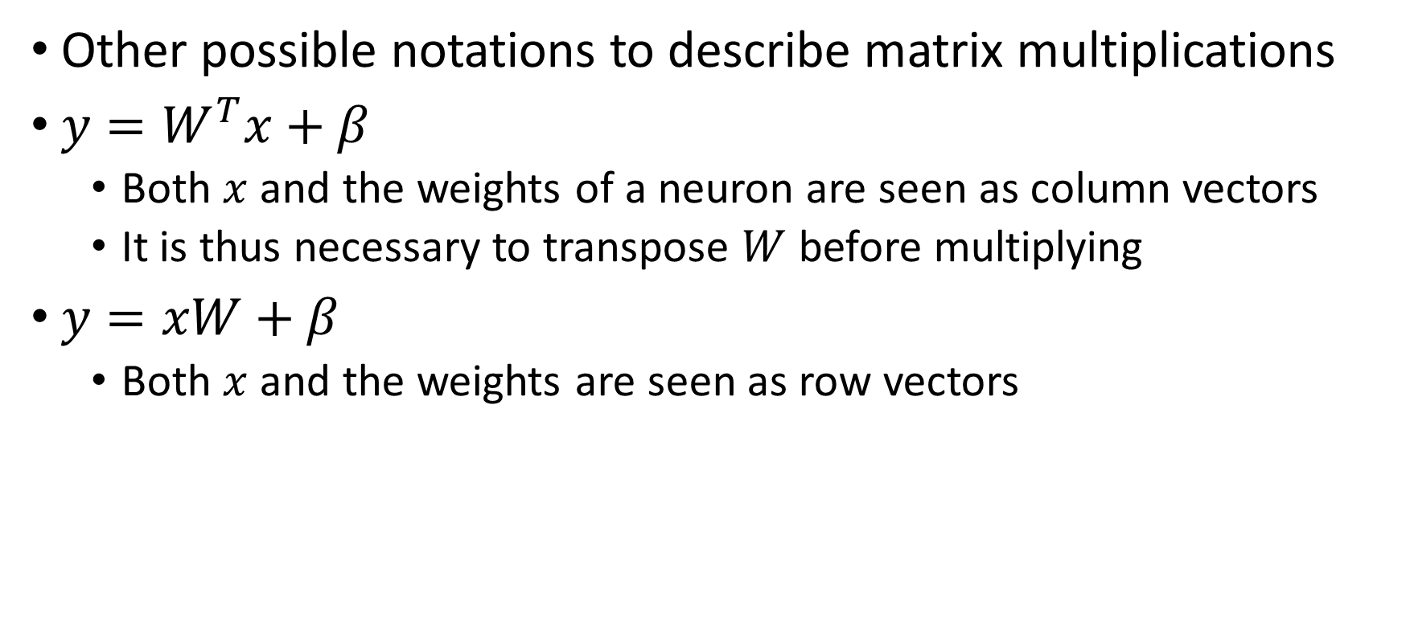
Notations?
Other possible notations to describe matrix multiplications
$y=W^{T}x+β$
Both $x$ and the weights of a neuron are seen as column vectors
It is thus necessary to transpose $W$ before multiplying
$y=xW+β$
Both $x$ and the weights are seen as row vectors

Slide 32
Machine learning (supervised)
Training data
Features
Training...
Predictions
Prediction 1
Prediction 2
Prediction 3
Prediction 4
…
Ground truth
Truth 1
Truth 2
Truth 3
Truth 4
…
ML algorithm (model+optimizer)
Samples
Internal parameters (to be optimized)
If we are learning, how do we get the feedback to optimize the parameters?

Slide 33
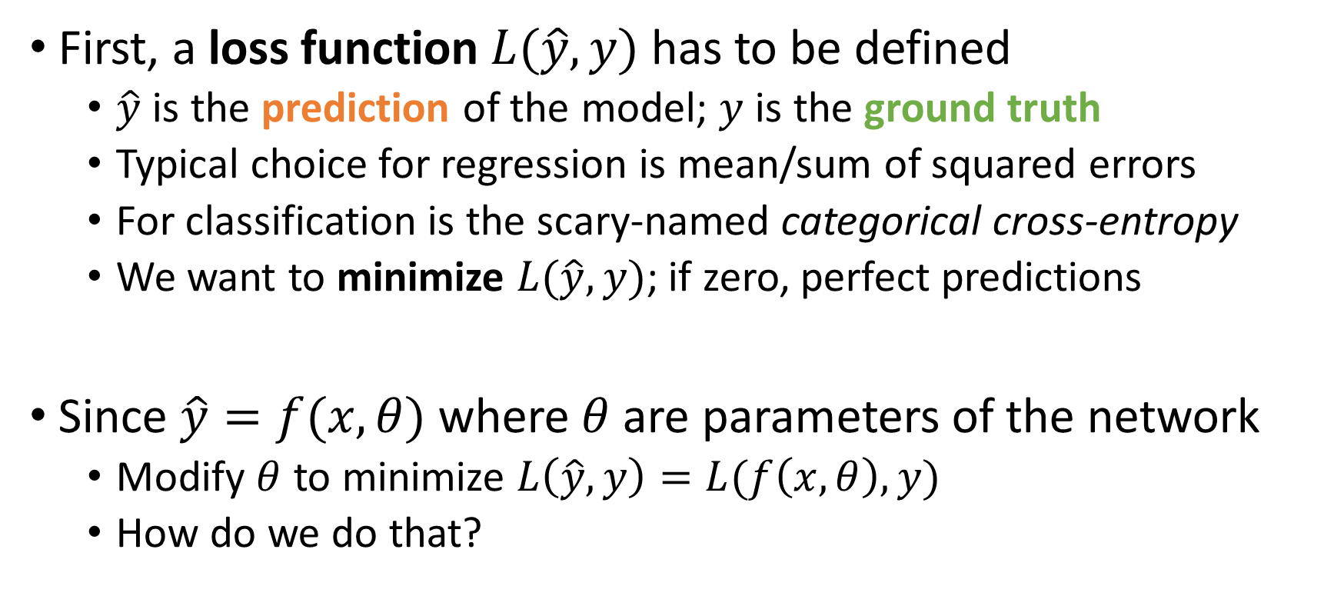
Machine learning with neural networks
First, a loss function $L(\hat{y},y)$ has to be defined
$\hat{y}$ is the prediction of the model; $y$ is the ground truth
Typical choice for regression is mean/sum of squared errors
For classification is the scary-named categorical cross-entropy
We want to minimize $L(\hat{y},y)$; if zero, perfect predictions
Since $\hat{y}=f(x,θ)$ where $θ$ are parameters of the network
Modify $θ$ to minimize $L\left(\hat{y},y\right)=L(f\left(x,θ\right),y)$
How do we do that?

Slide 34
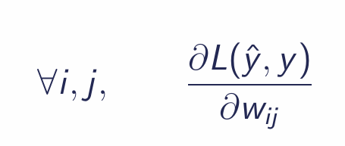
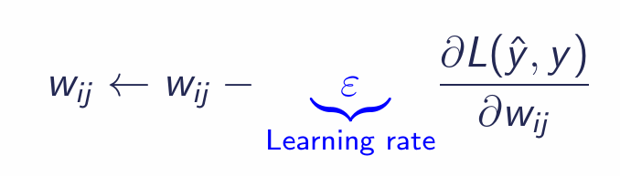
Gradient descent
A classic optimization algorithm is gradient descent
If the derivative of the target function can be computed
Compute partial derivative w.r.t. each weight
Push each weight in the “right direction” by a bit (learning rate)
Evaluate loss function again, compute derivative, iterate

Slide 35
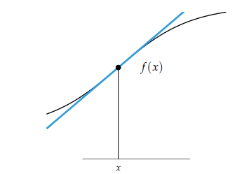
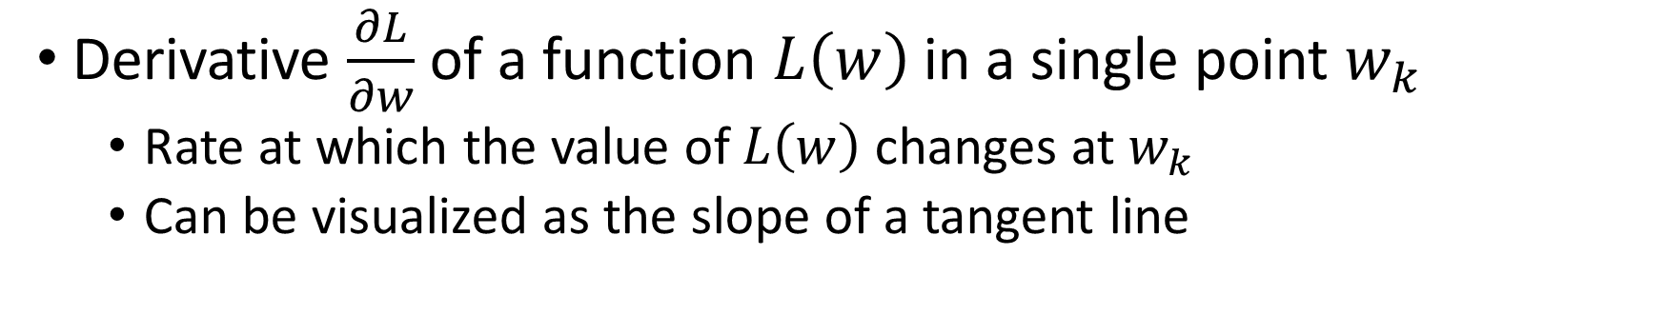


Gradient descent
Derivative $\frac{∂L}{∂w}$ of a function $L\left(w\right)$ in a single point $w_{k}$
Rate at which the value of $L\left(w\right)$ changes at $w_{k}$
Can be visualized as the slope of a tangent line
$$L\left(w\right)$$
$$w_{k}$$

Slide 36
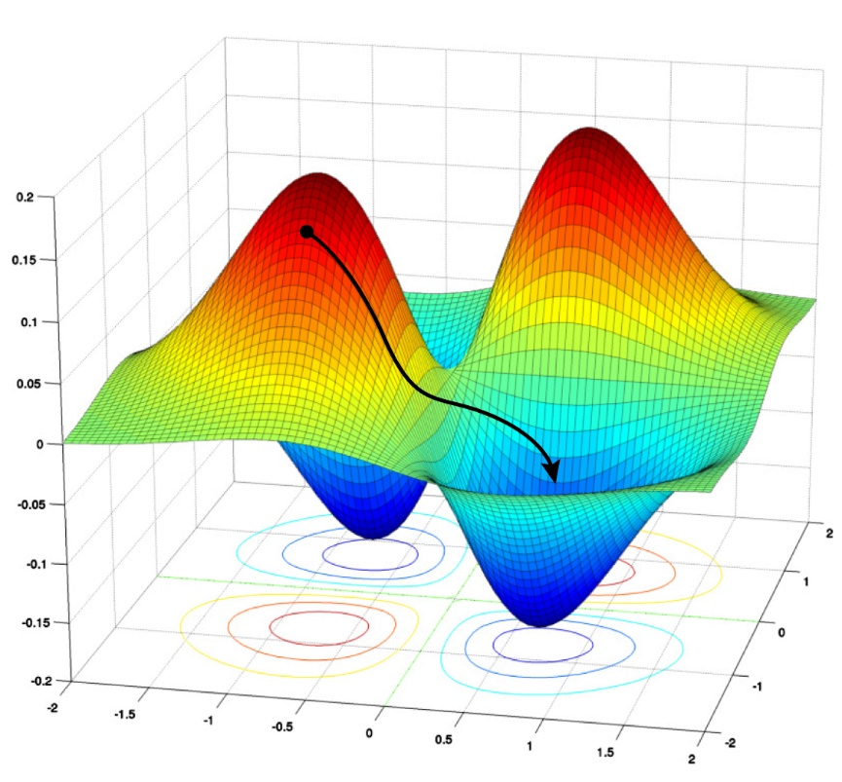
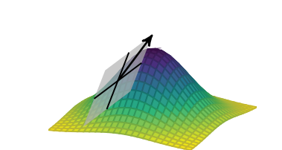

Gradient descent
Derivative in multiple dimensions is the gradient (Jacobian)
$$∇L(θ_{k})=\left(\frac{∂L(θ_{k})}{∂w_{0}},…,\frac{∂L(θ_{k})}{∂w_{N}}\right)$$

Slide 37
pytorch modules

Slide 38
General view, shared by multiple libraries
Sequence of modules
Flow of tensors in the network
Input and outputs are interpreted in human-readable way

Slide 39
Philosophy of pytorch
Every network is an instance of a torch.nn.Module object
Methods inside a Module:
__init__(self) : builder, used to set up layers (and other stuff)
forward(self, X) : forward pass of the network
forward() is called during training, so it’s necessary

Slide 40
Neural networks vs Deep learning
What is the difference?

Slide 41
Neural networks vs Deep learning
(1) Considerable improvements over classic Neural Networks
New (more effective!) algorithms to optimize parameters
New architectures to deal with structured data
Better software engineering
More computing power available, better results
(2) Rebranding
Interest for Neural Networks declined in the 1990s
At the time, considered less effective than other methods
Any network with more than one hidden layer is “deep”

Slide 42

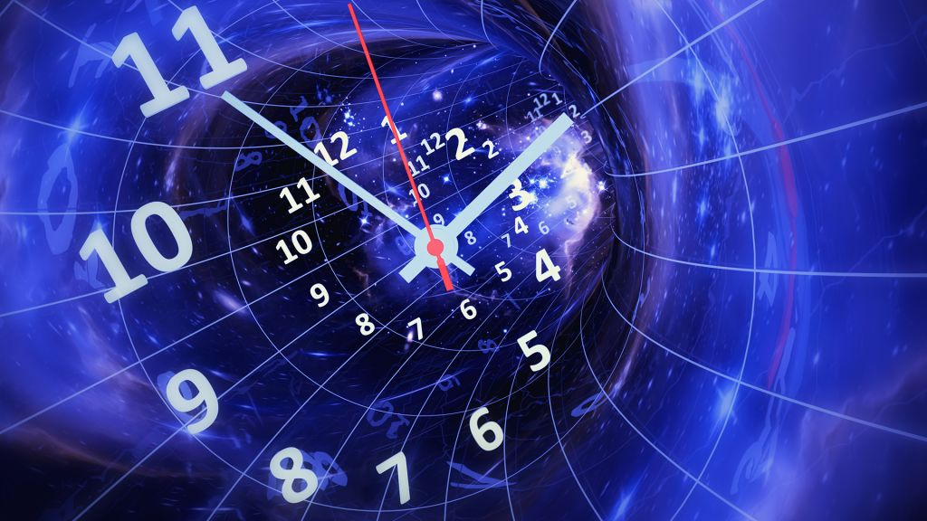


Worst enemies of DL (in this class, at least)
Space
Time

Slide 43
Worst enemies of DL (in this class, at least)
(Disk) Space
Modern DL models contain billions (10⁹) of parameters
GPT-4 has ~220 billion parameters
If a single parameter is a floating point represented on 32 bits…
…that is 220 * 10⁹ * 32 / 8 = 880 Giga Bytes (!!!)
They have to be stored on a hard drive and IN MEMORY!
During training, you’ll need to also store the gradient IN MEMORY!

Slide 44
Worst enemies of DL (in this class, at least)
(Training) Time
Training iterations take a lot of time

Slide 45
Practical issues with neural networks
Size of parameters (downcasting)

Slide 46
Why are neural networks winning?
Lots of competitors! Why is Deep Learning so dominant?

Slide 47
Why are neural networks winning?
On tabular data, they are not winning
Current consensus is that ensembles of boosted trees are better
See Grinsztajn et al. (2022) Why do tree-based models still outperform deep learning on tabular data?
On structured data, they are massively dominant
Remove the need for feature construction (and maybe selection)
Any type of structure: sequences, graphs, images, videos, …

Slide 48
Why are neural networks winning?
Generative models: how can a NNs output an image?

Slide 49
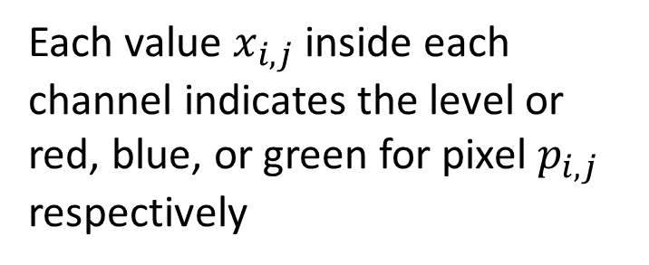
Why are neural networks winning?
Output tensors interpreted as (approximately) anything!
Example: image
Tensor (c * w * h)
Each value $x_{i,j}$ inside each channel indicates the level or red, blue, or green for pixel $p_{i,j}$ respectively
Image channel (w * h)

Slide 50
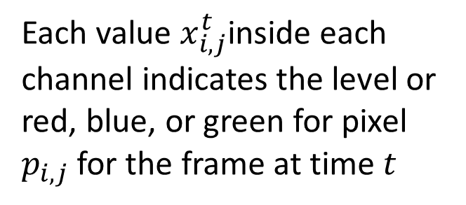
Why are neural networks winning?
Output tensors interpreted as (approximately) anything!
Example: video
Tensor (t*c*w*h)
Each value $x_{i,j}^{t}$inside each channel indicates the level or red, blue, or green for pixel $p_{i,j}$ for the frame at time $t$
Image channel (w * h)
Image channel (w * h)
…
t=0
t=T

Slide 51
Why are neural networks winning?
And when we have to choose between n discrete values?

Slide 52
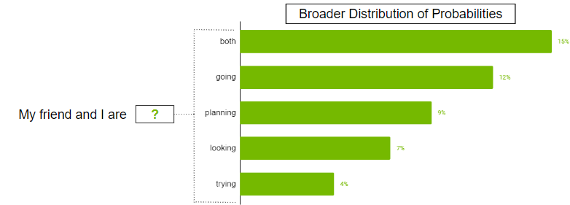
Why are neural networks winning?
Tensor is interpreted as a probability distribution
Each cell in output tensor is “probability” of picking element
Tensor (1 * n)

Slide 53
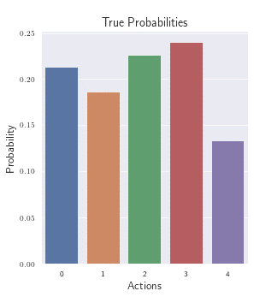
Why are neural networks winning?
Tensor is interpreted as a probability distribution
Each cell in output tensor is “probability” of picking element
Tensor (1 * n)

Slide 54
Why are neural networks winning?
Transfer learning
Somehow, using multiple layers

Slide 55
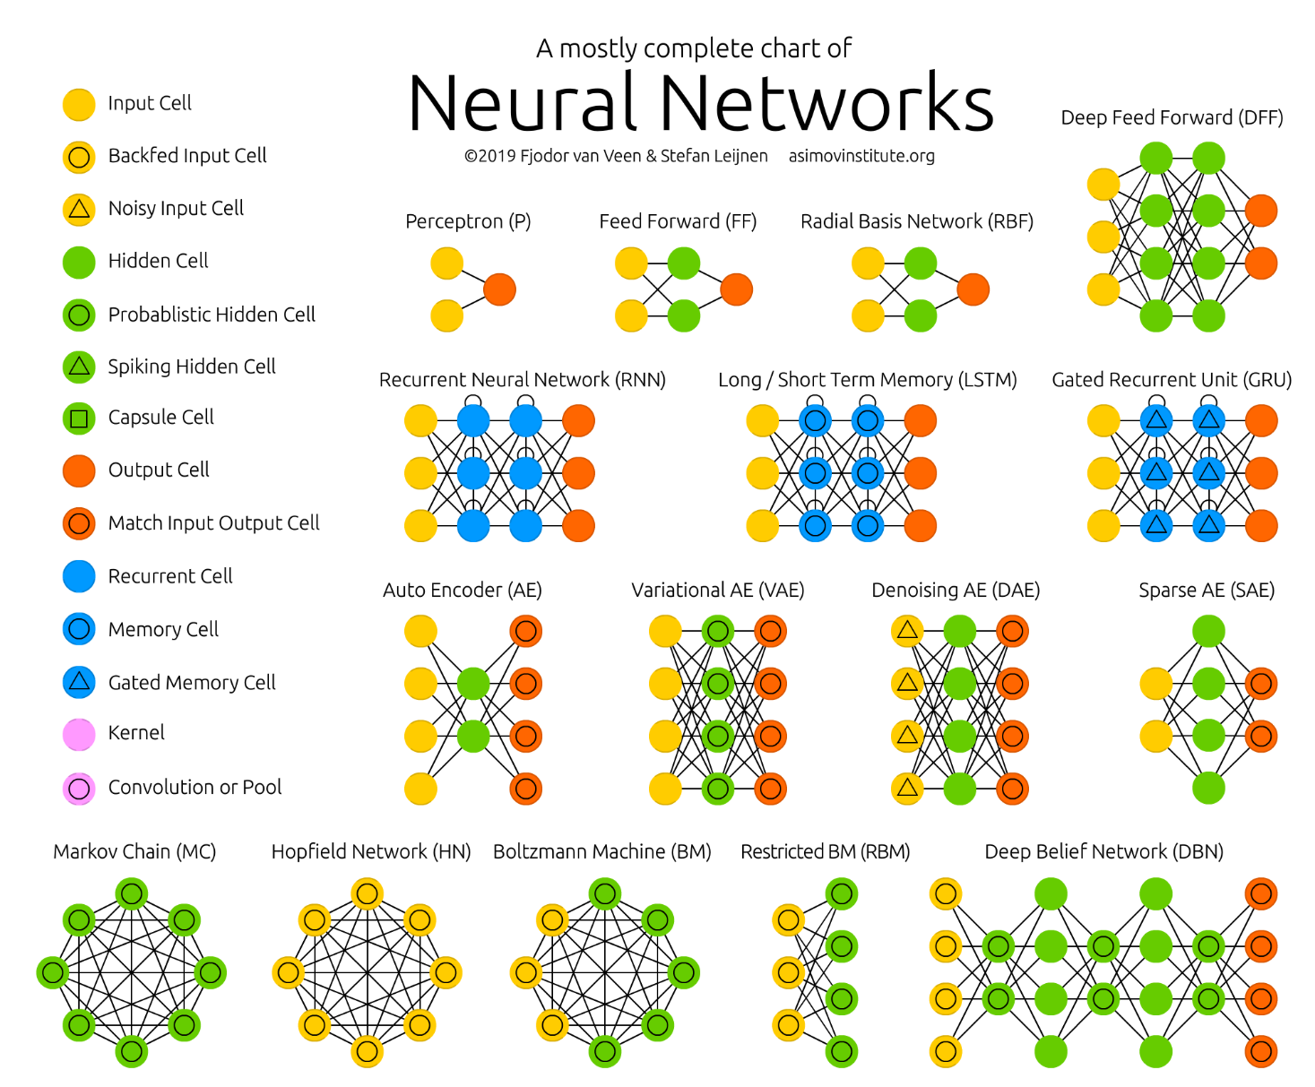
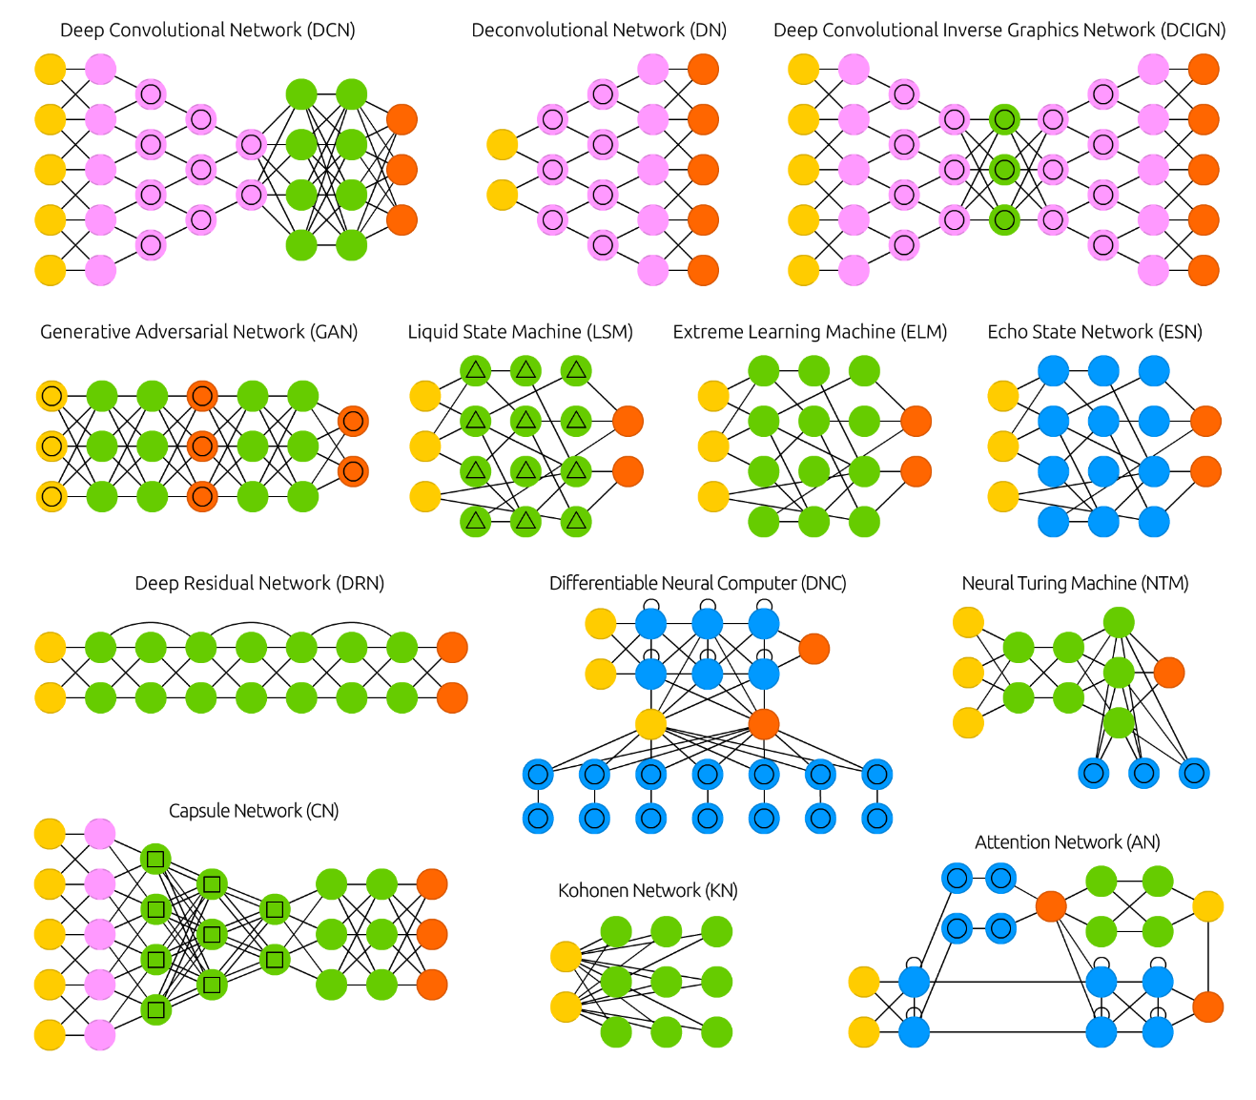
Multiple architectures!
https://www.asimovinstitute.org/neural-network-zoo/

Slide 56
Pseudo-random number generation in pytorch
Unfortunately, it’s not easy
Computing on GPUs makes consistent PRNG difficult
Libraries optimized for speed, not consistent behavior
Still, a few good practices:
https://pytorch.org/docs/stable/notes/randomness.html

Slide 57
pytorch FAQ
Excellent resource for most common issues
https://pytorch.org/docs/stable/notes/faq.html

