Slide 1
Refresher on Neural Networks and Philosophy of pytorch
Alberto TONDA, Ph.D. (Senior permanent researcher, DR)
UMR 518 MIA-PS, INRAE, AgroParisTech, Université Paris-Saclay UAR 3611, Institut des Systèmes Complexes de Paris Île-de-France

Slide 2
This is a new thing
Ciao
Ciaooooooooooooooo

Slide 3
What is a neural network?
Several ways of seeing a neural network
Classic view
Matrix multiplications
pytorch: sequence of functions

Slide 4
General view, shared by multiple libraries
Sequence of modules
Flow of tensors in the network
Input and outputs are interpreted in human-readable way

Slide 5
Philosophy of pytorch
Every network is an instance of a torch.nn.Module object
Methods inside a Module:
__init__(self) : builder, used to set up layers (and other stuff)
forward(self, X) : forward pass of the network
forward() is called during training, so it’s necessary

Slide 6
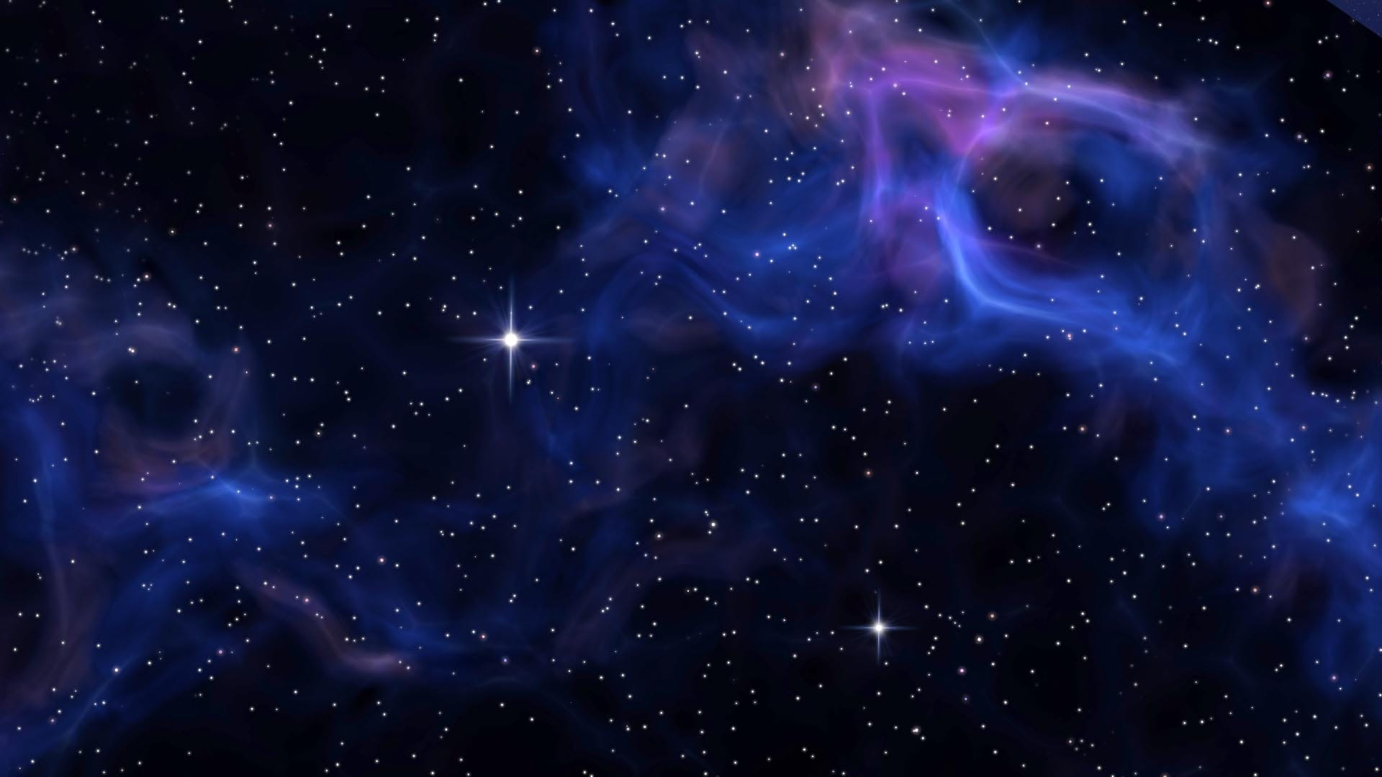
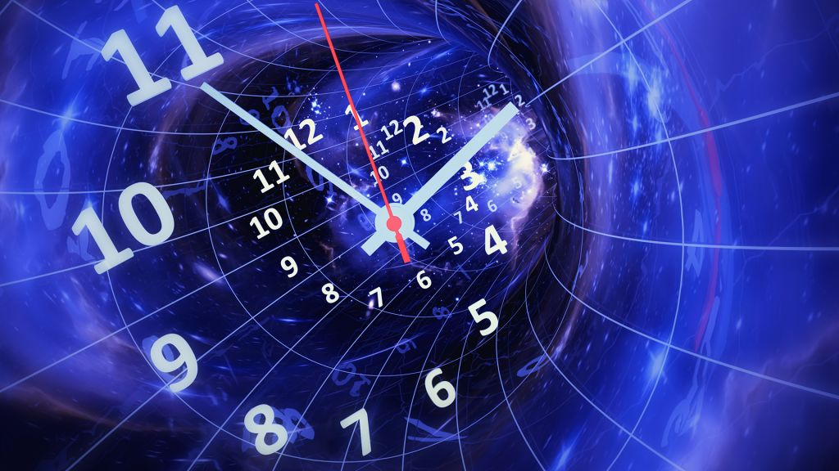


Worst enemies of DL (in this class, at least)
Space
Time

Slide 7
Worst enemies of DL (in this class, at least)
(Disk) Space
Modern DL models contain billions of parameters
GPT-4 has ~220 billion parameters
If a single parameter is a floating point represented on 32 bits…
…that is 220 * 10⁹ * 32 / 8 = 880 Giga Bytes (!!!)
They have to be stored on a hard drive and IN MEMORY!
During training, you’ll need to store the gradient IN MEMORY!

Slide 8
Worst enemies of DL (in this class, at least)
(Training) Time
Training iterations take a lot of time

Slide 9
Practical issues with neural networks
Size of parameters (downcasting)

Slide 10
pytorch FAQ
Excellent resource for most common issues
https://pytorch.org/docs/stable/notes/faq.html

