Slide 1
Case study: large-scale allocation of soybean crops
Alberto TONDA, Ph.D. (Senior permanent researcher, DR) <alberto.tonda@inrae.fr>
UMR 518 MIA-PS, INRAE, AgroParisTech, Université Paris-Saclay UAR 3611 Institut des Systèmes Complexes de Paris Île-de-France

Slide 2

Outline
Large-scale allocation of crops
Optimization problem
Possible approaches

Slide 3
Large-scale allocation of crops
Where should we plant crops to
Maximize crop yields
Minimize variance in production year-by-year
Minimize land use
This looks like an optimization problem!

Slide 4
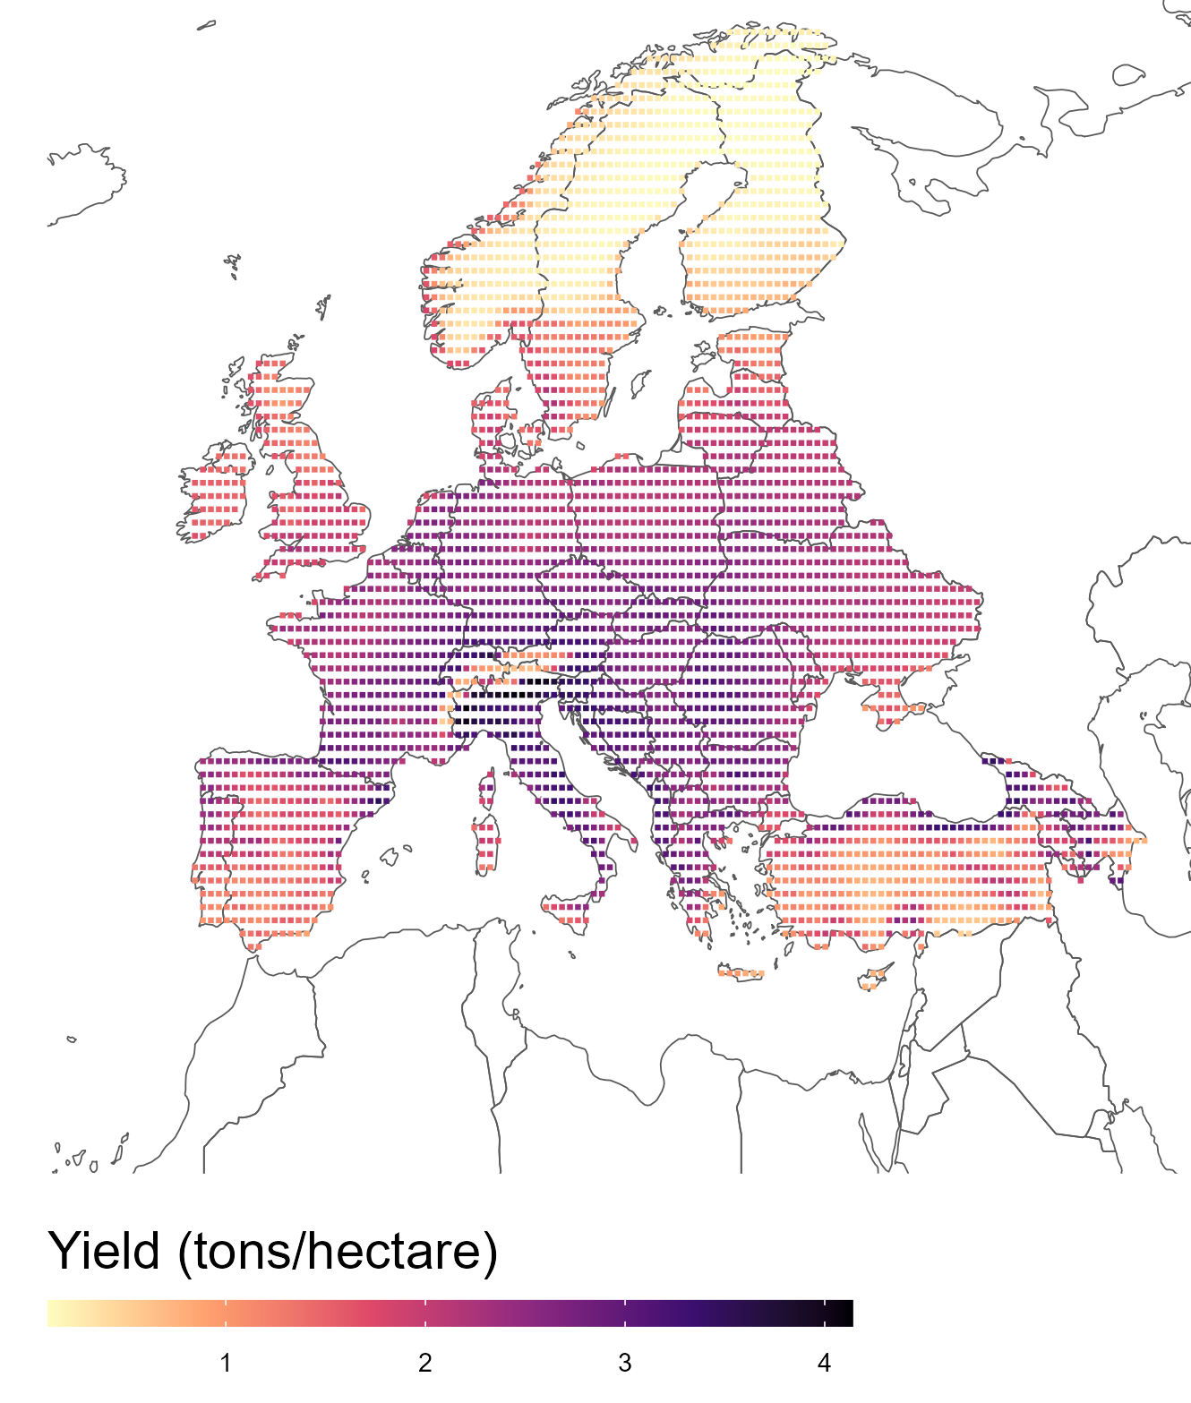
Optimization problem
Land is divided into pixels
Represent ~55km² surface
Maximum usable area for crops
Usually 1-5% of the total
Machine learning predictors
Trained on historical data
Predict crop yield
Weather, latitude, terrain…

Slide 5
Optimization problem
What could be a candidate solution to the problem?

Slide 6
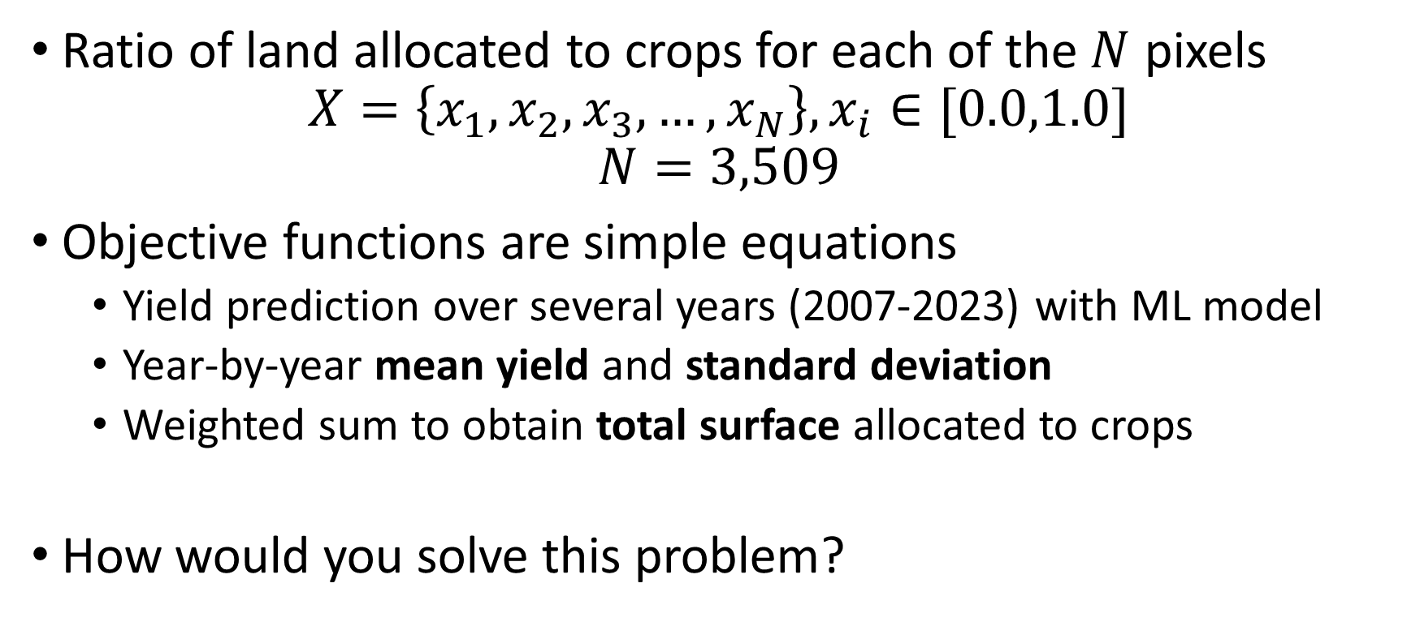
Optimization problem
Ratio of land allocated to crops for each of the $N$ pixels
$$X=\left\{x_{1},x_{2},x_{3},…,x_{N}\right\}, x_{i}∈[0.0,1.0]$$
$$N=3,509$$
Objective functions are simple equations
Yield prediction over several years (2007-2023) with ML model
Year-by-year mean yield and standard deviation
Weighted sum to obtain total surface allocated to crops
How would you solve this problem?

Slide 7
Optimization problem
Candidate solution is a vector of real values
Problem looks multi-objective
Conflicting objectives (maximize yield, minimize surface)
Objective functions are non-linear
Well, one of them is (standard deviation of year-by-year yield)
The other two are linear (weighted sums)
In this case, what algorithm(s) would you try?

Slide 8
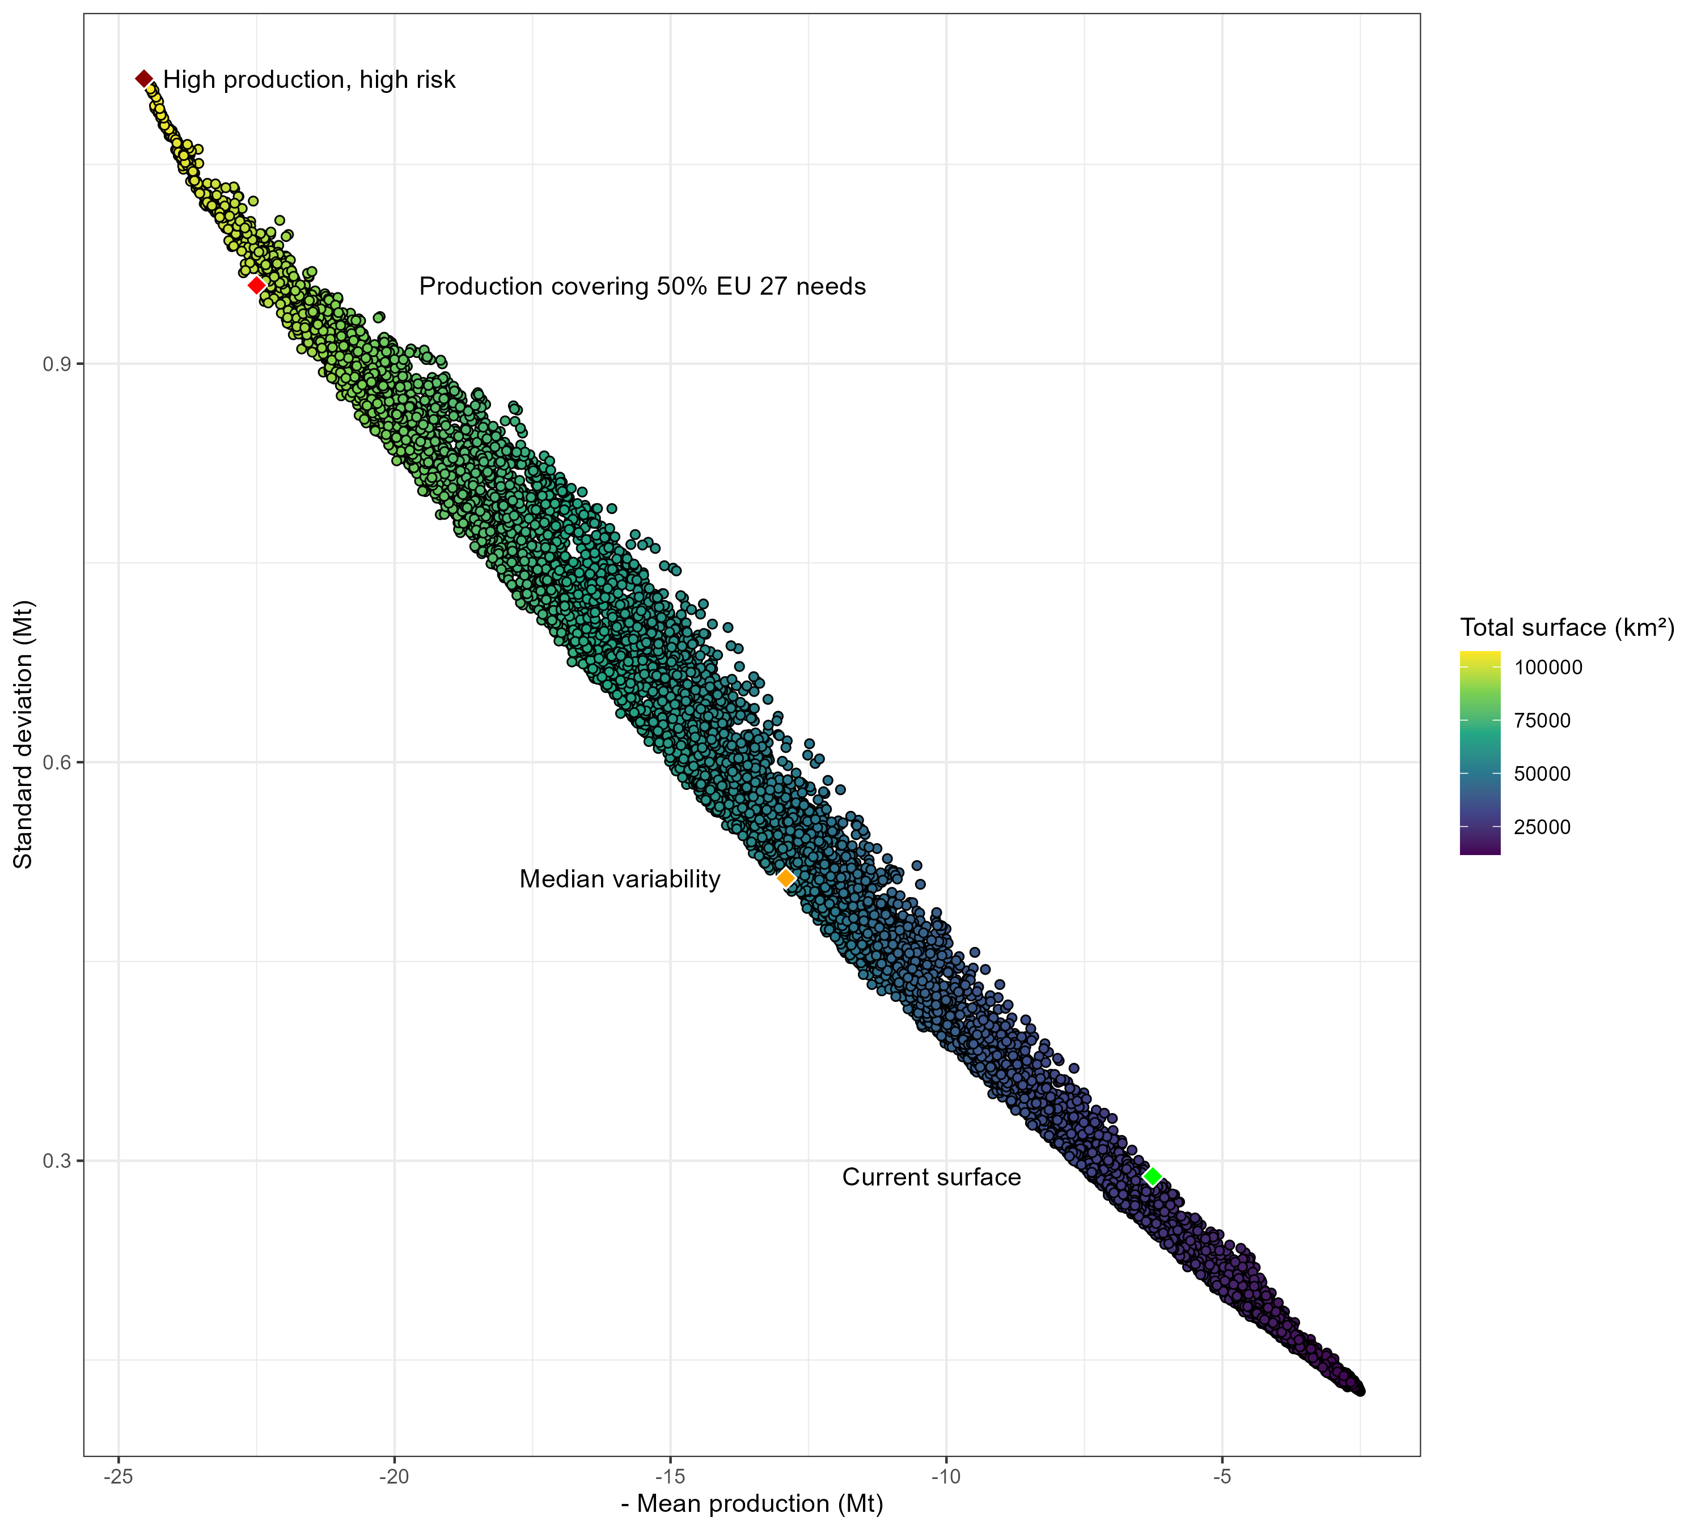
Possible approaches
We first tried with a multi-objective evolutionary algorithm
NSGA-II with default hyperparameters
All three objectives

Slide 9
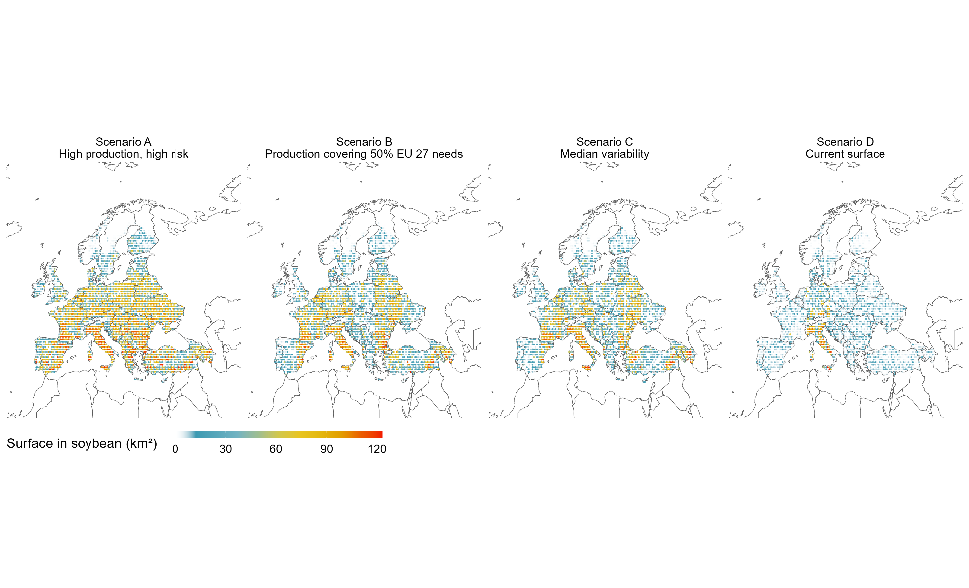
Possible approaches

Slide 10
Possible approaches
Issues with the MOEA
The algorithm places soybeans everywhere
Minimize number of pixels used? Add it to the objective?
Hyperparameter tuning matters (lots of hyperparameters)
A single run takes several hours
Since two of the objectives are linear, linear programming!
Use a single objective, weighted sum of the two real objectives
Change the weights, generate multiple Pareto-optimal points
Single run takes a few seconds

Slide 11
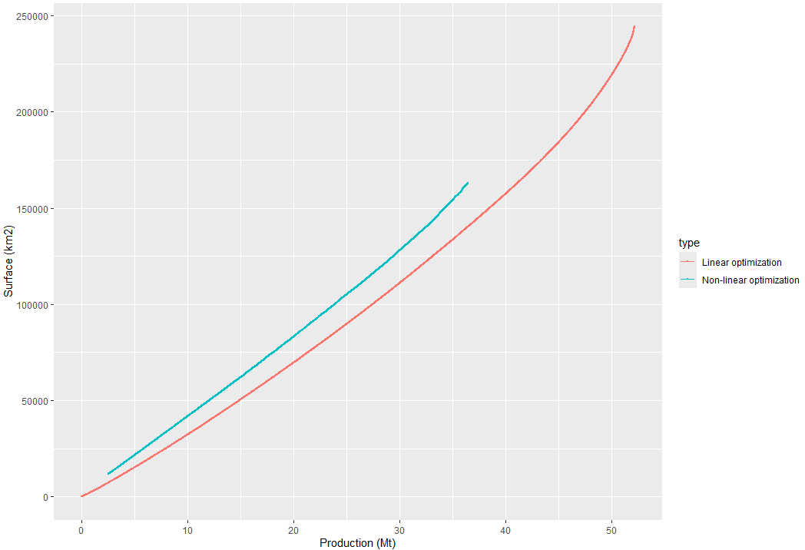
Possible approaches
Comparison
MOEA with 2 objectives
Linear programming
LP is clearly better!

Slide 12
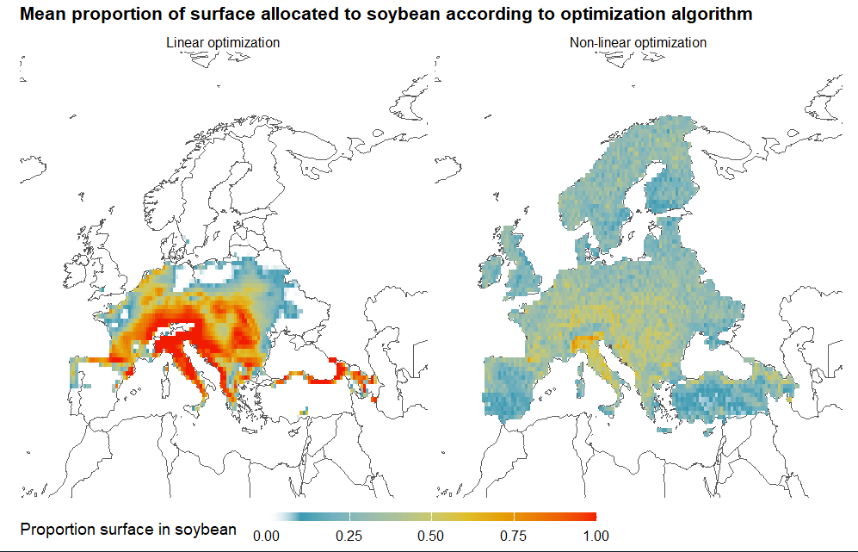
Possible approaches

Slide 13
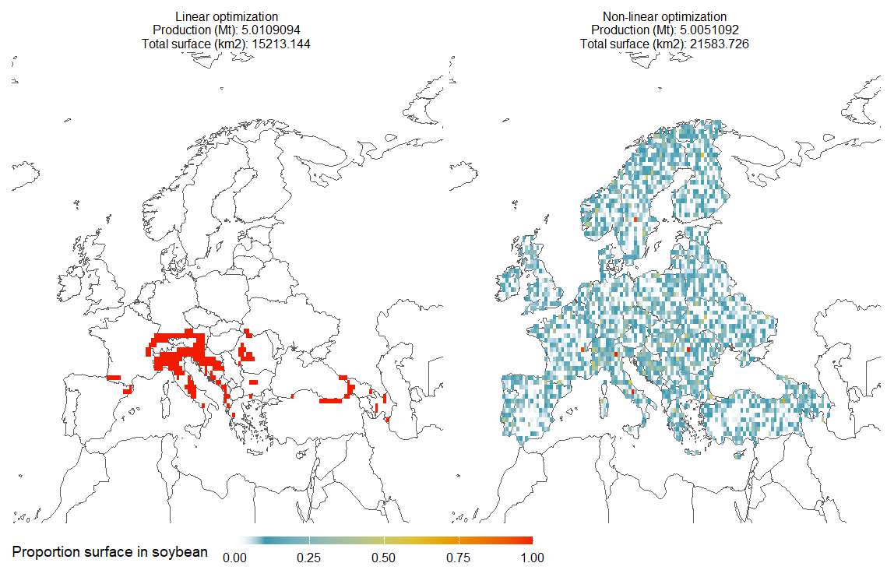
Possible approaches

Slide 14
Questions?
Bibliography - Chen M., Makowski D., Tonda A. 2024. Multi-Objective Optimization for Large-scale Allocation of Soybean Crops, In: Proceedings of the annual conference on Genetic and evolutionary computation (GECCO) 2024, DOI: 10.1145/3638529.3654026

