Slide 1
Hyperparameter optimization and AutoML
Alberto TONDA
UMR 518 MIA-PS, INRAE, AgroParisTech, Université Paris-Saclay UAR 3611, Institut des Systèmes Complexes de Paris Île-de-France

Slide 2
Outline
Hyperparameter optimization
Common strategies
Advanced strategies
AutoML
Auto...optimization?

Slide 3
Hyperparameter optimization
ML algorithms have hyperparameters
Number of trees in an ensemble
Number of layers in a neural network
Type of kernel in a support vector machine
…
Values of hyperparameters have influence on performance
How do we select the best values?

Slide 4
Hyperparameter optimization
Let’s frame it as an optimization problem
Mixed integer/floating point/categorical
Candidate solution: set of hyperparameter values
Objective function: performance (in a cross-validation)
Objective function is expensive to evaluate
What types of optimization algorithms could work here?

Slide 5
Common strategies
Grid (exhaustive) search
Select a few meaningful values of parameters
Try all possible combinations
sklearn.model_selection.GridSearchCV
Random search
Lists for discrete parameters and distributions for continuous
Makes a user-specified number of attempts and returns best
sklearn.model_selection.RandomizedSearchCV

Slide 6
Common strategies
Surrogate models
Evaluate candidate solutions on a few samples
Remove the ones that are clearly among the worst
sklearn.model_selection.HalvingGridSearchCV
sklearn.model_selection.HalvingRandomSearchCV
Luckily, some other people know optimization!

Slide 7
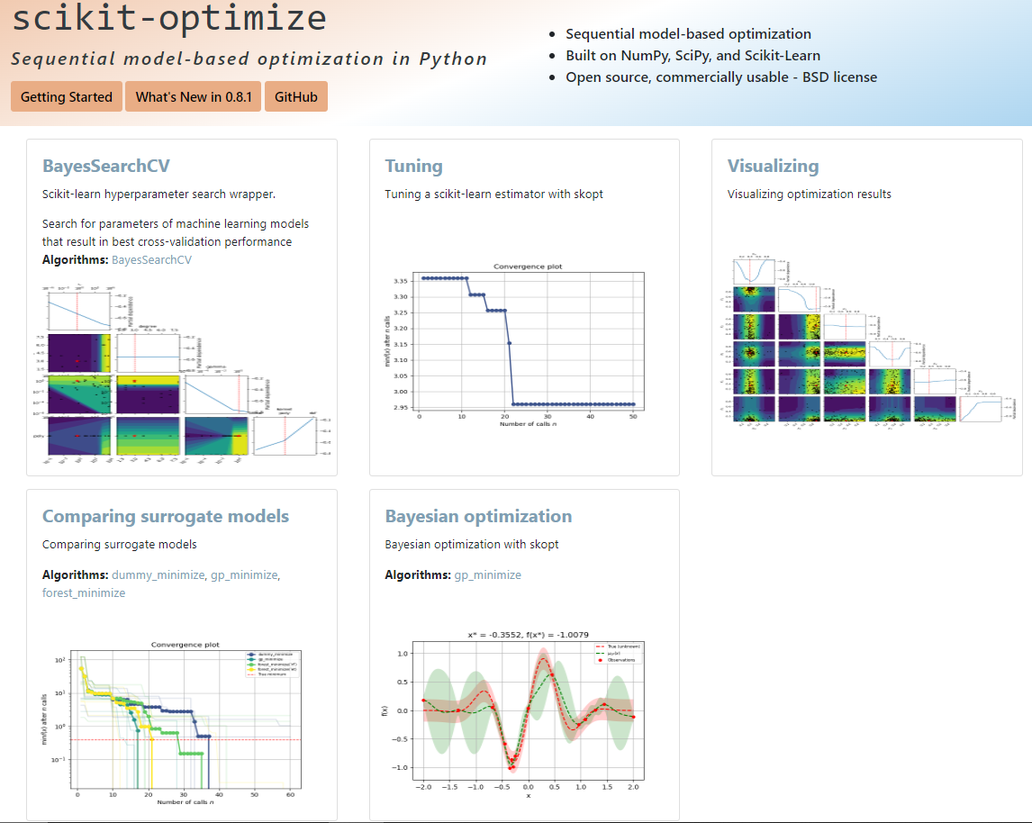
Advanced strategies
Bayesian Optimization!
Surrogate models!

Slide 8
Advanced strategies
Can we do better?
Here we are selecting best hyperparameters for a model…
…but we already chose a specific model/algorithm
Not to mention, preprocessing!
Dimensionality reduction
Feature construction (e.g. polynomial features)
Normalization (several different possibilities)
Can we optimize all this? If so, what kind of representation?

Slide 9
AutoML
The idea of optimizing all choices
Candidate solution: preprocessing, algorithm, hyperparameters…
Objective function: performance in a cross-validation
Several different approaches, budding field
Example: TPOT (and TPOT-2)
Tree-based Pipeline Optimization Tool
https://epistasislab.github.io/tpot/

Slide 10
AutoML
Structure of a candidate solution
Preprocessing 1 (and hyperparameters)
Training data
…
Feature selection (and hyperparameters)
ML algorithm (and hyperparameters)
Preprocessing N (and hyperparameters)

Slide 11
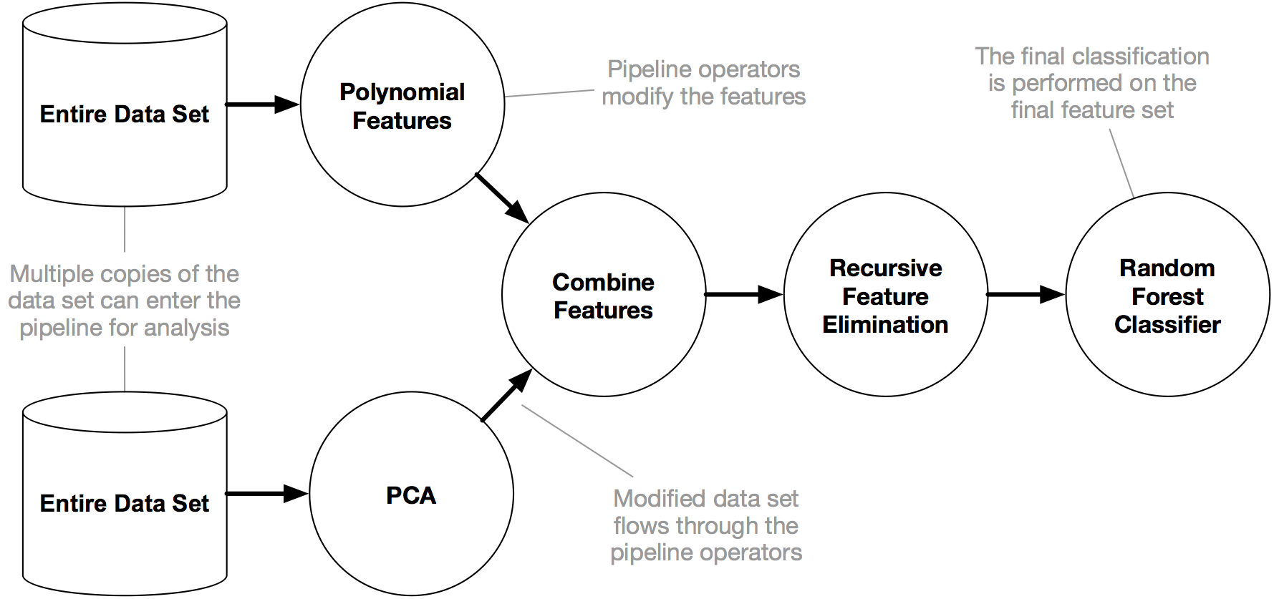
AutoML
It’s Genetic Programming!

Slide 12
AutoML
TPOT/TPOT-2 is just one example of AutoML
Auto-WEKA (Java)
Auto-sklearn (variants of Bayesian optimization)
DataRobot (company, offers an online service)
AutoGluon
H2O AutoML
…
Auto-Pytorch: Neural Architecture Search
Take a look at the bibliography to know more

Slide 13

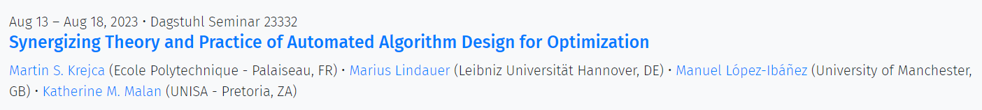
Auto…optimization?
Meta-optimization
“Algorithm selection”/ “Automated algorithm design”
Finding the best algorithm for the target optimization problem
Carola Doerr (CNRS) is one of the leading experts out there
Olivier Teytaud (Facebook) works on implementation
Dagstuhl seminars discuss the state of the art

Slide 14
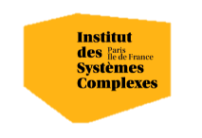

Questions?
Bibliography - James et al., An Introduction to Statistical Learning with Applications in Python, 2023 - Feurer et al., Efficient and Robust Automated Machine Learning, 2015 - Hutter et al., Automated Machine Learning, 2019
Images and videos: unless otherwise stated, I stole them from the Internet. I hope they are not copyrighted, or that their use falls under the Fair Use clause, and if not, I am sorry. Please don’t sue me.

