Slide 1
Neuroevolution and hyperparameter optimization for deep neural networks
Alberto TONDA, Team EKINOCS, UMR 518 MIA-PS

Slide 2
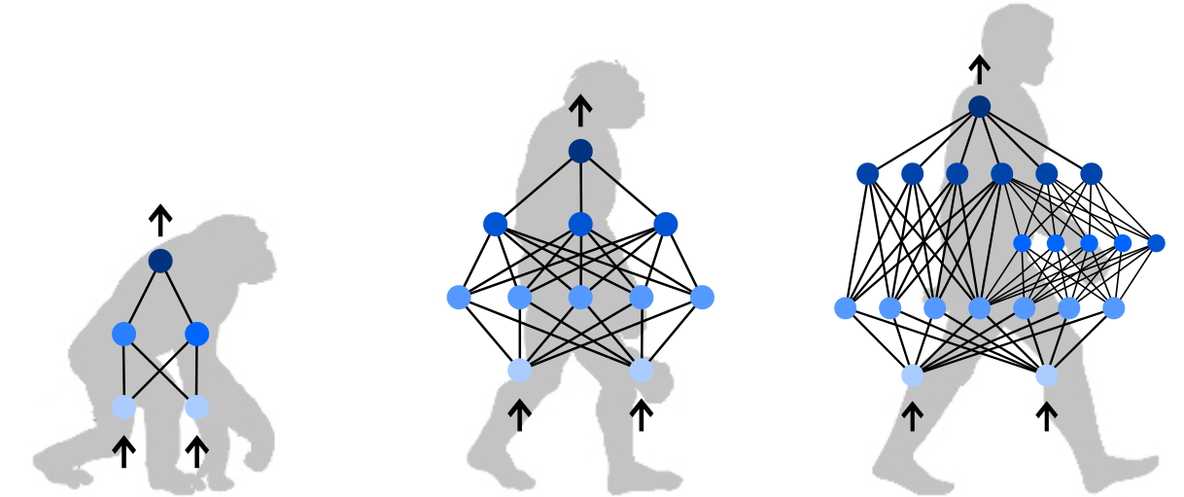
Outline
Defining a network topology
Classical approach
Reframing as an optimization problem
Evolutionary algorithms
Neuroevolution (NEAT, HyperNEAT, ...)
Hyperparameter optimization

Slide 3
Defining a network topology
Using a (deep) neural network for a task
Lots of (hyper-)parameters to decide:
Number of layers
Number of neurons/units per layer
Type of layers (Convolutional, MaxPooling, …)
Activation function (tanh, ReLu, Leaky ReLu, …)
Optimizer (ADAM, Adagrad, RMSprop, …)
Parameters (!) of the optimizer (learning rate, …)

Slide 4
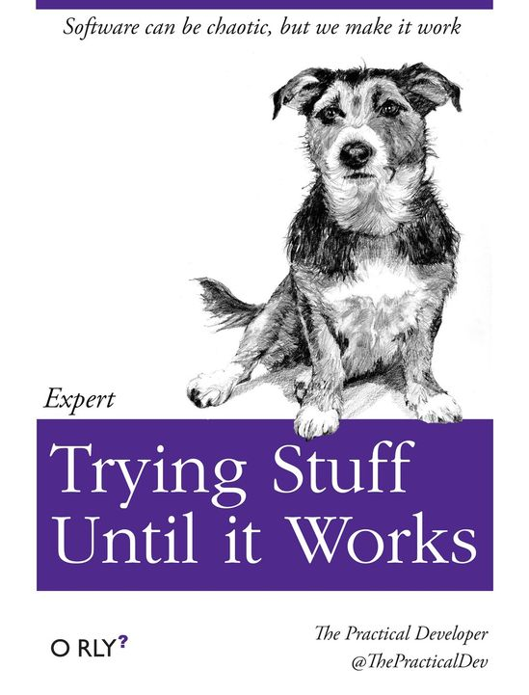
Classical approach
Read literature and copy a topology used for similar task
If it does not work, change it a bit until it works
Experiments take time, so limited amount of attempts

Slide 5
Reframing as an optimization problem
Search space: all possible combinations of hyperparameters
Objective: maximize performance on the task
Obvious issues:
Search space is Vast (cannot be explored exhaustively)
Search space is mixed integer/categorical/floating point
Search space is (very likely) not convex

Slide 6
Reframing as an optimization problem
Neural Architecture Search (NAS)
Gradient descent
Reinforcement learning
Bayesian optimization
Focus mostly on hyperparameter values (NOT TOPOLOGY)
References
Elsken et al., Neural Architecture Search: A Survey, 2019

Slide 7
Evolutionary algorithms
Evolutionary algorithms (EAs) can work well in this situation!
Better than random
Usable when other techniques fail (exact, gradient-based, …)
Can deal with extremely complex (mixed) search spaces
What EAs do, in a nutshell:
Stochastic exploration of the search space
Biased towards areas with better values of cost function
To get values of cost function, they evaluate candidate solutions

Slide 8
Neuroevolution
Basic idea: optimize network topology (and possibly weights)
Considerable amount of works since mid-1990s
Risto Miikkulainen (Finnish-American, U. of Texas)
Group at University of Coimbra (Portugal)
Research sped up considerably after 2012-2016
Better utils were available for deep learning

Slide 9
Neuroevolution: main issues
Return best solution(s)
Yes
Stop condition reached?
Generate and evaluate
initial population
Select parents and create offspring
Evaluate new solutions
Remove worst solutions
No

Slide 10
Neuroevolution: main issues
Evaluations are (VERY) COMPUTATIONALLY EXPENSIVE
Return best solution(s)
Yes
Stop condition reached?
Generate and evaluate
initial population
Select parents and create offspring
Evaluate new solutions
Remove worst solutions
No

Slide 11
Neuroevolution: main issues
Assess performance in a CROSS-VALIDATION
Evaluations are (VERY) COMPUTATIONALLY EXPENSIVE
Return best solution(s)
Yes
Stop condition reached?
Generate and evaluate
initial population
Select parents and create offspring
Evaluate new solutions
Remove worst solutions
No

Slide 12
Neuroevolution: main issues
Depending on the representation, PRINCIPLE OF LOCALITY might fail
Return best solution(s)
Yes
Stop condition reached?
Generate and evaluate
initial population
Select parents and create offspring
Evaluate new solutions
Remove worst solutions
No

Slide 13
Neuro-Evolution of Augmenting Topologies
Technique designed to address issues in neuroevolution
Initial generation of random solutions
Too random, might not have input/output connections
Long-term impact on network sizes
Solution: start from a minimal, uniform network size
Inputs directly connected to outputs
Genetic operators always add nodes/connections

Slide 14
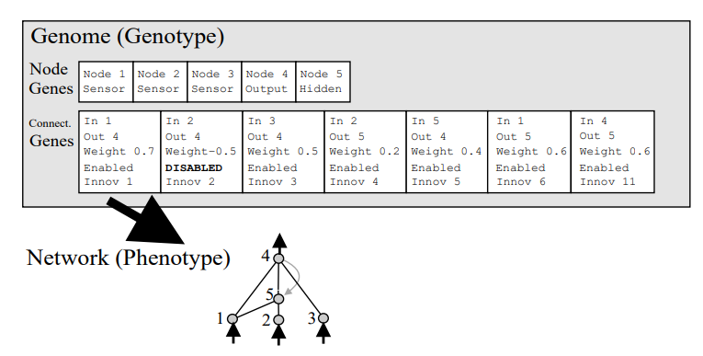
Neuro-Evolution of Augmenting Topologies
Genotype representation
List of all nodes
List of all connections and weights (some disabled)

Slide 15
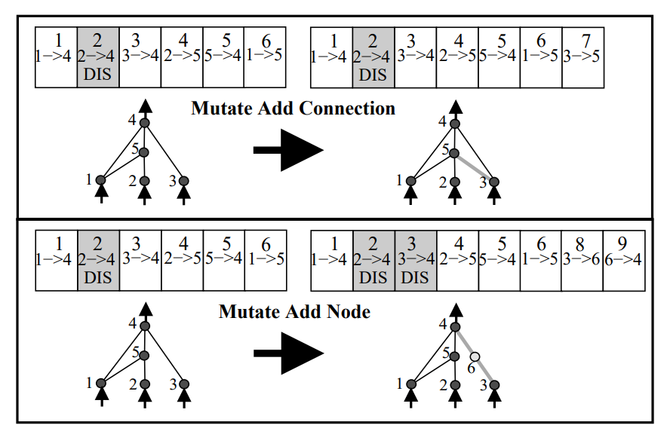
Neuro-Evolution of Augmenting Topologies
Mutations
Perturbation of a connection weight
Enable/disable a connection
Add nodes, add connections
Innovation number used to align different genomes

Slide 16
Neuro-Evolution of Augmenting Topologies
Mutations
Perturbation of a connection weight
Enable/disable a connection
Add nodes, add connections
Innovation number used to align different genomes
Same structural change, same innovation number

Slide 17
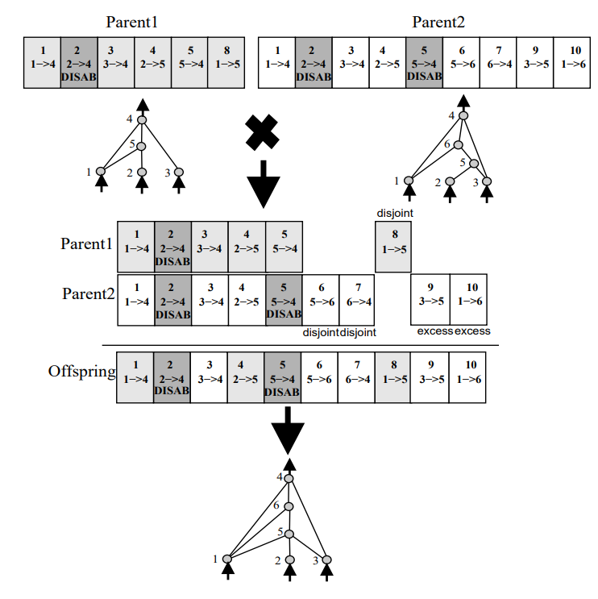
Neuro-Evolution of Augmenting Topologies
Cross-over
Matched genes
Disjointed genes
Excess genes

Slide 18

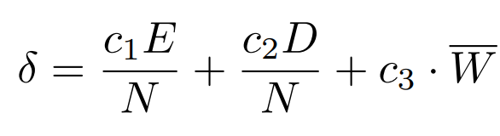
Neuro-Evolution of Augmenting Topologies
Issue: larger topologies optimize slower than smaller ones
Larger candidate solutions strive to survive
Solution: speciation (niching)
Divide population in sub-populations of similar topologies
Topologies are only in competition within sub-population
Sub-populations are organized by a distance that takes into account matching, disjoint, and excess genes

Slide 19
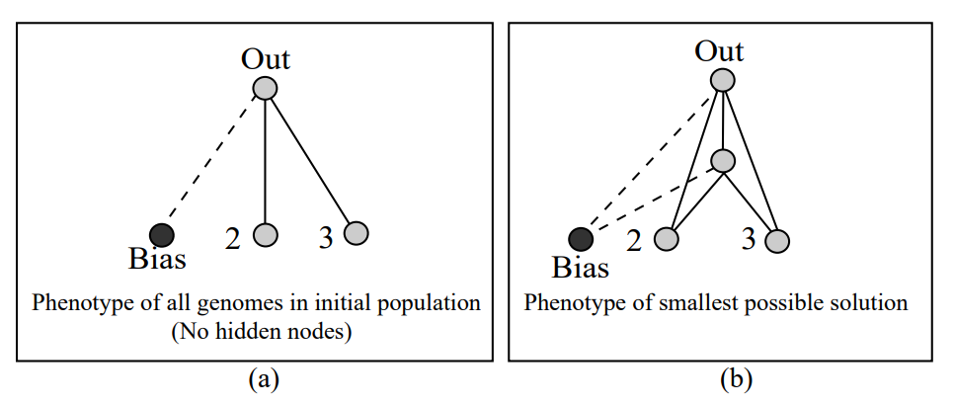
Neuro-Evolution of Augmenting Topologies
In the original 2002 paper, tested on toy benchmarks
XOR, Pole balancing, Double pole balancing with/out velocity
Results are better than other neuro-evolution approaches
XOR

Slide 20
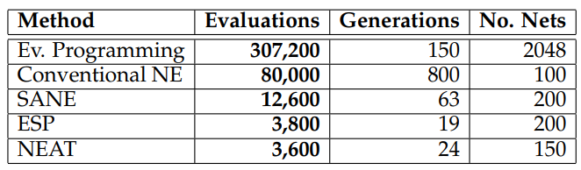
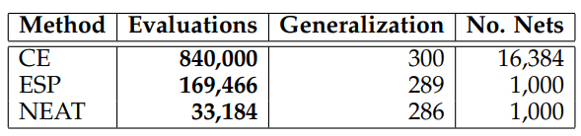
Neuro-Evolution of Augmenting Topologies
In the original 2002 paper, tested on toy benchmarks
XOR, Pole balancing, Double pole balancing with/out velocity
Results are better than other neuro-evolution approaches
DPV
DPNV
Out of 625

Slide 21
HyperNEAT
Scaling to large networks (1M+ parameters) is an issue
In nature, massive structures are compactly encoded in DNA
Evolution often uses repetition through reuse
Change genotype encoding, more indirect encoding?
Stanley et al., A Hypercube-Based Encoding for Evolving Large-Scale Neural Networks, 2009

Slide 22
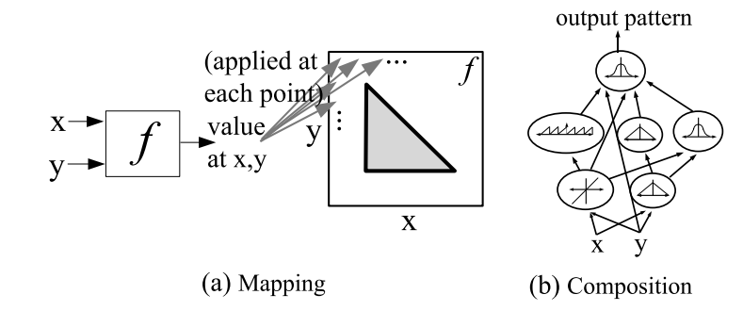
HyperNEAT
Compositional Pattern-Producing Networks (CPPN)
Consider a n x n grid of nodes (substrate)
CPPN(x₁,y₁, x₂,y₂) = w gives weight between nodes (x₁,y₁) (x₂,y₂)

Slide 23
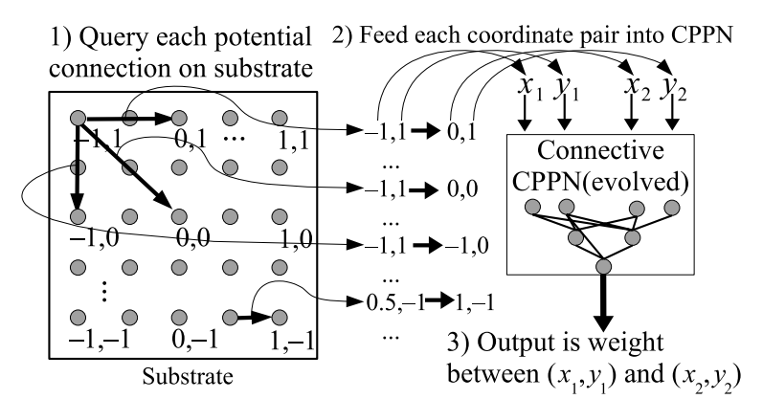
HyperNEAT
Compositional Pattern-Producing Networks (CPPN)
Consider a n x n grid of nodes (substrate)
CPPN(x₁,y₁, x₂,y₂) = w gives weight between nodes (x₁,y₁) (x₂,y₂)

Slide 24
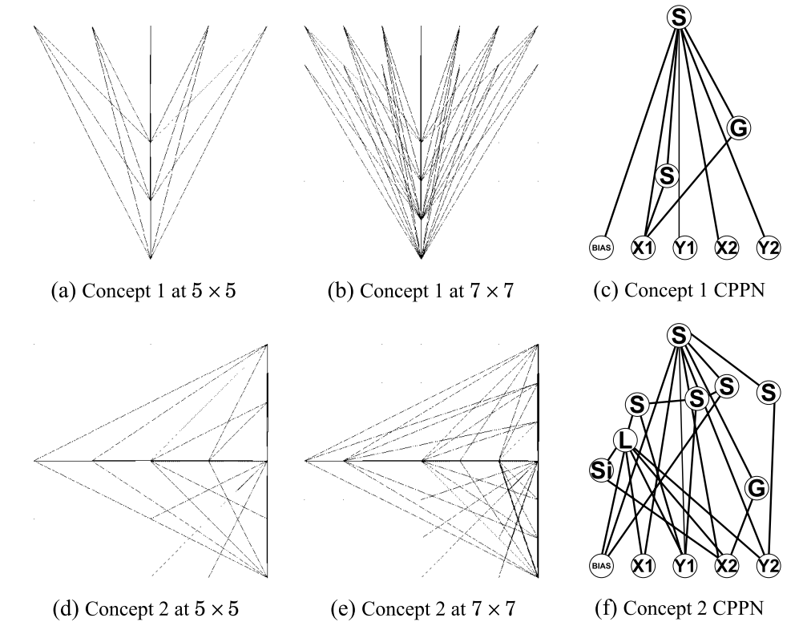
HyperNEAT
Substrate can potentially be in d dimensions
«Hypercube» comes from there
CPPNs are evolved using NEAT
CPPNs create ANN connections if output exceeds a threshold

Slide 25
Evolving deep neural networks
2012-2016: Deep learning enters the scene
New algorithms to quickly and effectively optimize weights
Easy-to-use implementations in C++/Python
EAs can now focus on just optimizing hyperparameters/topology
Lots of similar ideas
Jung and Reggia, Evolutionary Design of Neural Network Architectures Using a Descriptive Encoding Language, 2006 (!)
Miikkulainen et al., Evolving Deep Neural Networks, 2017
Assunção et al., DENSER: Deep Evolutionary Network Structured Representation, 2019

Slide 26
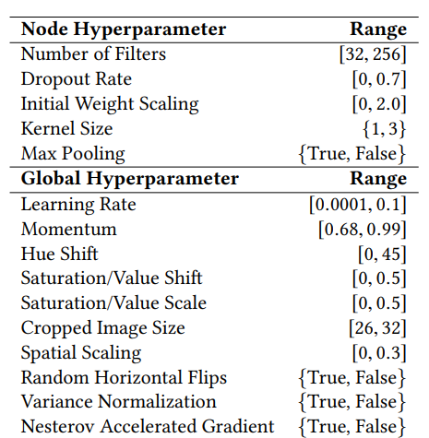
Evolving deep neural networks
Miikkaulinen et al., Evolving Deep Neural Networks, 2017
It’s basically NEAT, but each element in the genome is a layer, not a node
Each layer has its own (hyper-) parameters (binary/integers/float)
Weights of the network are optimized using classic Stochastic- Gradient-Descent-based techniques

Slide 27
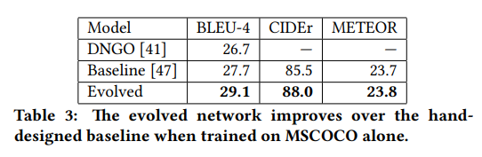

Evolving deep neural networks
This time, Miikkulainen is serious
CIFAR-10 (7.3% error, 92.7% accuracy)
Language modeling benchmark, LSTM, PTB dataset (5% error)
Image captioning, MSCOCO (better than hand-designed)

Slide 28
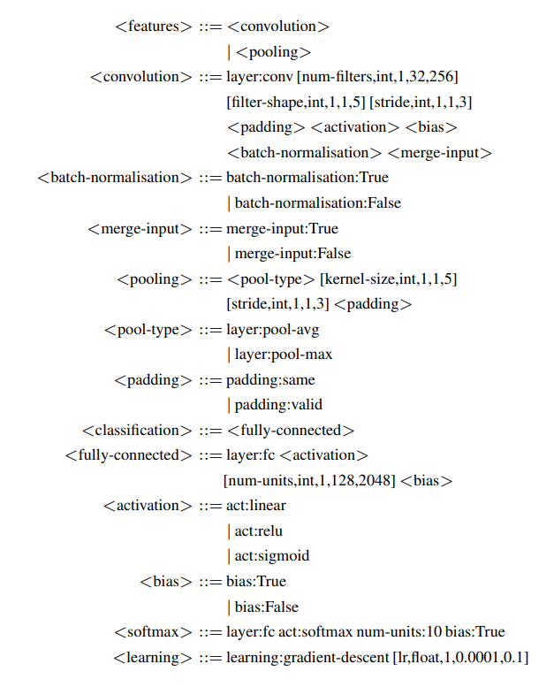
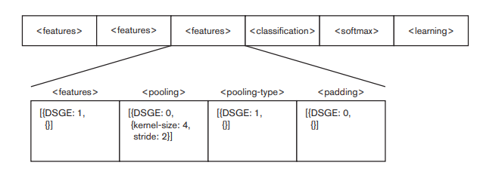
DENSER
Assunção et al., DENSER: Deep Evolutionary Network Structured Representation, 2019
NEAT-like structure for high-level genome, each gene a layer
Grammar-based approach for description of each layer

Slide 29
DENSER
Mutations for the high-level and grammatical genome
Add layer, replicate layer, remove layer (high-level)
Grammatical mutation, integer/float mutation
Results are the best among automatic methods (in 2019)
99.65% (99.70%) accuracy for MNIST
94.23% (94.70%) accuracy for Fashion-MNIST (same topology)
73.32% (74.94%) accuracy for CIFAR-100 (same topology)
Even better with an ensemble of the best two candidates
99.70%, 95.26%, and 78.75% respectively

Slide 30
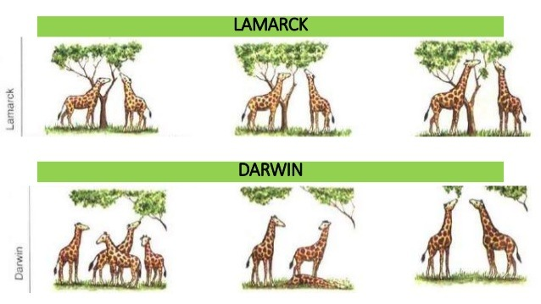
Lamarckian neuroevolution

Slide 31
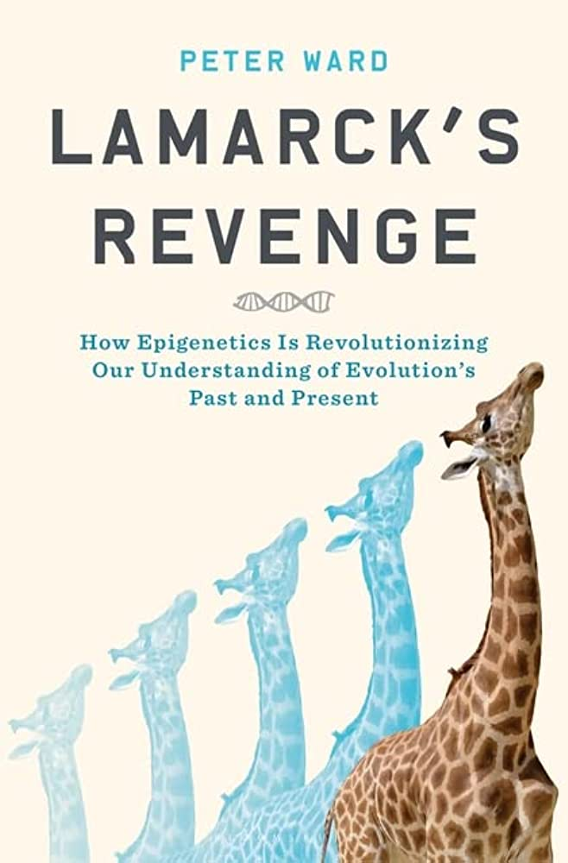
Lamarckian neuroevolution
Lamarck was wrong, his ideas are usable
Lamarckian evolutionary algorithms
In classic EAs, offspring inherits part of genome
In Lamarckian EAs, also inherits values obtained from local optimization/training
Neuroevolution: values of the weights

Slide 32
Lamarckian neuroevolution
EXAMM algorithm (Rochester Institute of Technology, US)
Ororbia et al., Investigating Recurrent Neural Network Memory Structures using Neuro-Evolution, 2019
Lyu et al., Neuroevolution of recurrent neural networks for time series forecasting of coal-fired power plant operating parameters, 2021
Evolving Recurrent Neural Networks (RNN) for time series
Evolutionary exploration of augmenting memory models (EXAMM)
Several different units (LSTM, GRU, MGU, …)
Networks train for a few epochs, transmit weights to offspring

Slide 33
Neuroevolution
But does it REALLY work?
In other words, is it competitive with human design?
There is some evidence that yes, it does work
HUMIES 2022 (Human-Competitive Awards)
https://human-competitive.org/
Miikkulainen et al., Evaluating Medical Aesthetics Treatments through Evolved Age-Estimation Models, GECCO 2021
Better results than human-designed neural network, Silver Medal

Slide 34
THANK YOU FOR YOUR TIME!
QUESTIONS?

