Slide 1
Refresher on Neural Networks and Philosophy of pytorch
Alberto TONDA, Ph.D. (Senior permanent researcher, DR)
UMR 518 MIA-PS, INRAE, AgroParisTech, Université Paris-Saclay UAR 3611, Institut des Systèmes Complexes de Paris Île-de-France

Slide 2
Outline
What is a neural network?
Forward pass
Backward pass
Philosophy of pytorch
Tensors
Modules
Optimizers

Slide 3
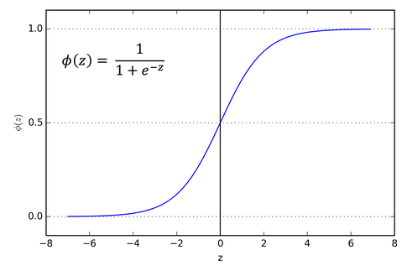

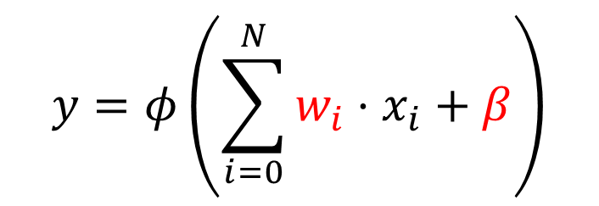



What is a neural network?
Everything starts from the (wrong) model of a neuron
$$x_{0}$$
$$x_{1}$$
$$y∈[0,1]$$
…
$$x_{N}$$
$$y=φ\left(\sum_{i=0}^{N}{w_{i}⋅x_{i}}+β\right)$$

Slide 4
What is a neural network?
Everything starts from the (wrong) model of a neuron
$$x_{0}$$
$$x_{1}$$
$$y∈[0,1]$$
…
$$x_{N}$$
$$y=φ\left(\sum_{i=0}^{N}{w_{i}⋅x_{i}}+β\right)$$
This part inside is a linear model (a weighted sum)

Slide 5
What is a neural network?
Everything starts from the (wrong) model of a neuron
$$x_{0}$$
$$x_{1}$$
$$y∈[0,1]$$
…
$$x_{N}$$
$$y=φ\left(\sum_{i=0}^{N}{w_{i}⋅x_{i}}+β\right)$$
This part inside is a linear model (a weighted sum)
Weights and bias can be learned, depending on application
The weights can be learned, depending on application

Slide 6
What is a neural network?
Everything starts from the (wrong) model of a neuron
$$x_{0}$$
$$x_{1}$$
$$y∈[0,1]$$
…
$$x_{N}$$
$$y=φ\left(\sum_{i=0}^{N}{w_{i}⋅x_{i}}+β\right)$$
This part inside is a linear model (a weighted sum)
Weights and bias can be optimized, depending on application
The weights can be learned, depending on application

Slide 7
What is a neural network?
Everything starts from the (wrong) model of a neuron
$$x_{0}$$
$$x_{1}$$
$$y∈[0,1]$$
…
$$x_{N}$$
This is a non-linearity, increases capacity
$$y=φ\left(\sum_{i=0}^{N}{w_{i}⋅x_{i}}+β\right)$$
This part inside is a linear model (a weighted sum)
Weights and bias can be optimized, depending on application
The weights can be learned, depending on application

Slide 8
What is a neural network?
Neurons are used in subsequent sets, called layers
…
…
Input layer
Output layer
Hidden layer

Slide 9
What is a neural network?
Neurons are used in subsequent sets, called layers
…
Input layer does not really have neurons, just feature values (inputs)
…
Input layer
Output layer
Hidden layer

Slide 10
What is a neural network?
Neurons are used in subsequent sets, called layers
…
Input layer does not really have neurons, just feature values (inputs)
Values in output of the output layer are interpreted as predictions for the target(s)
…
Input layer
Output layer
Hidden layer

Slide 11
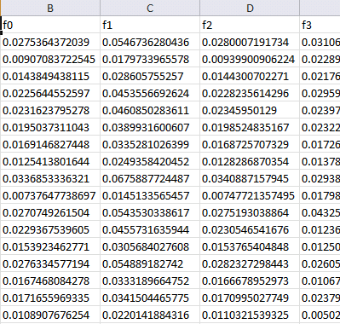

Machine learning (supervised)
Training data
Features
Training...
Predictions
Prediction 1
Prediction 2
Prediction 3
Prediction 4
…
Ground truth
Truth 1
Truth 2
Truth 3
Truth 4
…
ML algorithm (model+optimizer)
Samples
Internal parameters (to be optimized)
In the case of a neural network, what are the parameters to be optimized?

Slide 12
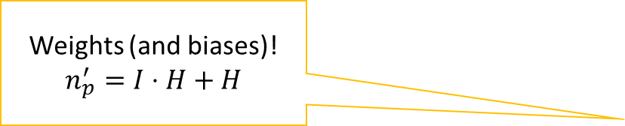
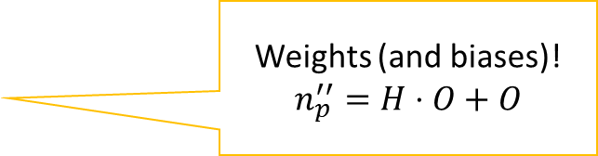
What is a neural network?
Neurons are used in subsequent sets, called layers
Weights (and biases)!
$$n_{p}^{′}=I⋅H+H$$
Weights (and biases)!
$$n_{p}^{′′}=H⋅O+O$$
…
Input layer does not really have neurons, just feature values (inputs)
Values in output of the output layer are interpreted as predictions for the target(s)
…
Input layer
Output layer
Hidden layer

Slide 13
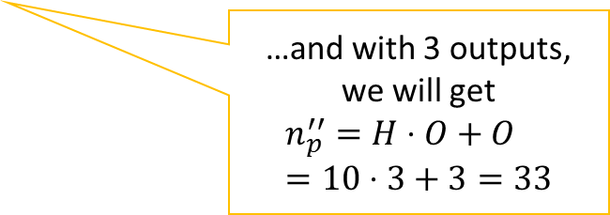
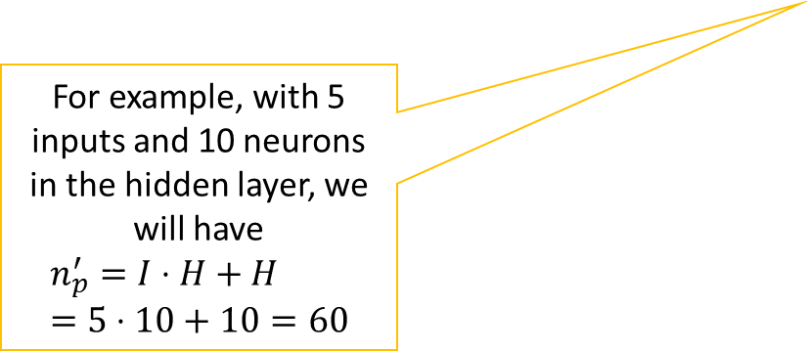
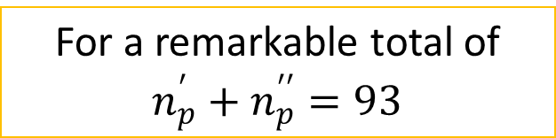
What is a neural network?
Neurons are used in subsequent sets, called layers
Weights (and biases)!
$$n_{p}^{′}=I⋅H+H$$
Weights (and biases)!
$$n_{p}^{′′}=H⋅O+O$$
…
For example, with 5 inputs and 10 neurons in the hidden layer, we will have
$$n_{p}^{′}=I⋅H+H=5⋅10+10=60$$
…and with 3 outputs, we will get
$$n_{p}^{′′}=H⋅O+O=10⋅3+3=33$$
…
Input layer
Output layer
Hidden layer
For a remarkable total of $n_{p}^{′}+n_{p}^{′′}=93$

Slide 14
What is a neural network?
Prediction is performed with a forward pass
…
…
Input layer
Output layer
Hidden layer

Slide 15
What is a neural network?
Learning is performed with a backward pass
…
…
Input layer
Output layer
Hidden layer

Slide 16
Predictions (forward pass)
Input layer
Hidden layer
Output layer

Slide 17



Predictions (forward pass)
$$w_{0}^{0}=0.0 \\ w_{1}^{0}=0.1 \\ w_{2}^{0}=0.2 \\ β^{0}=0.0$$
0.2
$$w_{0}^{out}=0.6 \\ w_{1}^{out}=0.7 \\ β^{out}=0.0$$
0.9
$$w_{0}^{1}=0.3 \\ w_{1}^{1}=0.4 \\ w_{2}^{1}=0.5 \\ β^{1}=0.2$$
-1.1

Slide 18
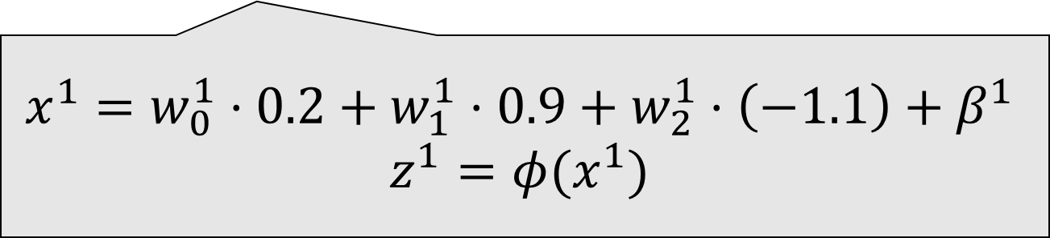
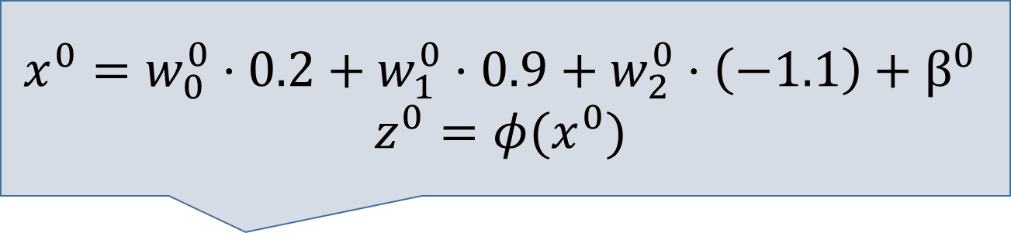
Predictions (forward pass)
$$x^{0}=w_{0}^{0}⋅0.2+w_{1}^{0}⋅0.9+w_{2}^{0}⋅\left(−1.1\right)+β^{0}$$
$$z^{0}=φ(x^{0})$$
0.2
0.9
$$x^{1}=w_{0}^{1}⋅0.2+w_{1}^{1}⋅0.9+w_{2}^{1}⋅\left(−1.1\right)+β^{1}$$
$$z^{1}=φ(x^{1})$$
-1.1

Slide 19
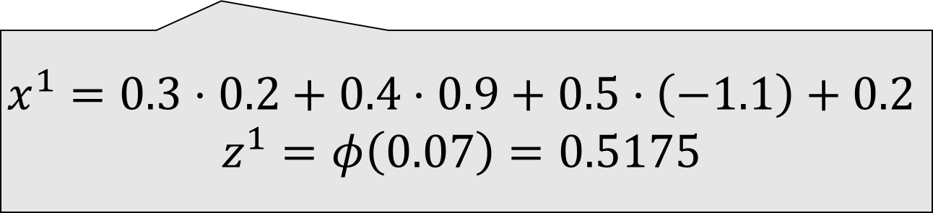
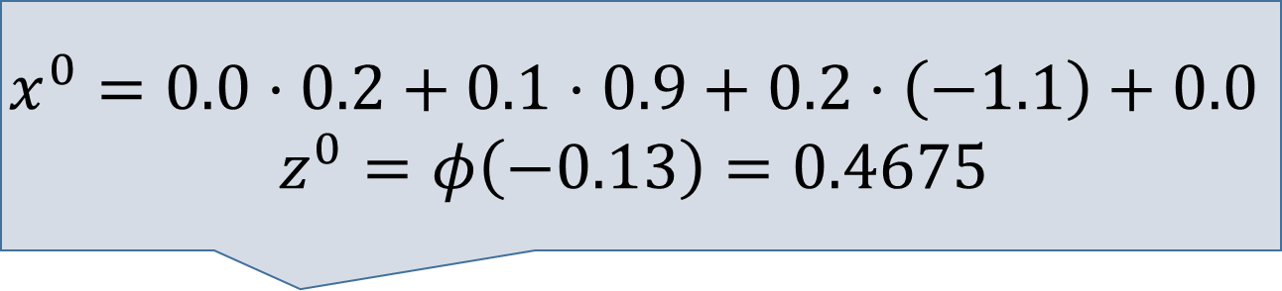
Predictions (forward pass)
$$x^{0}=0.0⋅0.2+0.1⋅0.9+0.2⋅\left(−1.1\right)+0.0$$
$$z^{0}=φ\left(−0.13\right)=0.4675$$
0.2
0.9
$$x^{1}=0.3⋅0.2+0.4⋅0.9+0.5⋅\left(−1.1\right)+0.2$$
$$z^{1}=φ\left(0.07\right)=0.5175$$
-1.1

Slide 20
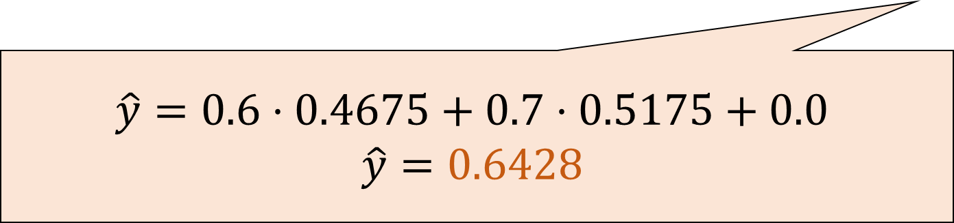
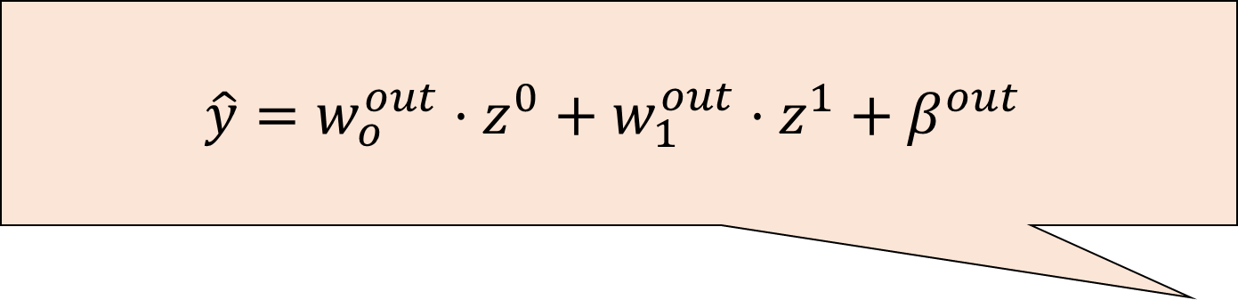
Predictions (forward pass)
$$\hat{y}=w_{o}^{out}⋅z^{0}+w_{1}^{out}⋅z^{1}+β^{out}$$
0.2
0.9
$$\hat{y}=0.6⋅0.4675+0.7⋅0.5175+0.0$$
$$\hat{y}=0.6428$$
-1.1

Slide 21
Predictions (forward pass)
$$w_{0}^{0}=0.0 \\ w_{1}^{0}=0.1 \\ w_{2}^{0}=0.2 \\ β^{0}=0.0$$
0.2
$$w_{0}^{out}=0.6 \\ w_{1}^{out}=0.7 \\ β^{out}=0.0$$
0.9
$$w_{0}^{1}=0.3 \\ w_{1}^{1}=0.4 \\ w_{2}^{1}=0.5 \\ β^{1}=0.2$$
-1.1
Notes:
Let’s go back to the original network, and let’s reorganize it as matrices.

Slide 22

Predictions (forward pass)
$$w_{0}^{0}=0.0 \\ w_{1}^{0}=0.1 \\ w_{2}^{0}=0.2 \\ β^{0}=0.0$$
$$\left(\begin{matrix}0.2 \\ 0.9 \\ −1.1\end{matrix}\right)$$
$$w_{0}^{out}=0.6 \\ w_{1}^{out}=0.7 \\ β^{out}=0.0$$
$$w_{0}^{1}=0.3 \\ w_{1}^{1}=0.4 \\ w_{2}^{1}=0.5 \\ β^{1}=0.2$$
Notes:
Let’s go back to the original network, and let’s reorganize it as matrices.

Slide 23
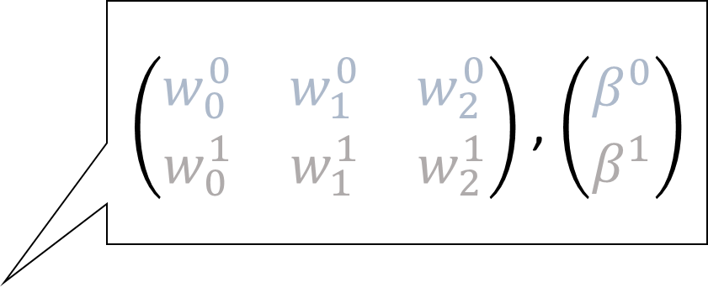
Predictions (forward pass)
$\left(\begin{matrix}w_{0}^{0} & w_{1}^{0} & w_{2}^{0} \\ w_{0}^{1} & w_{1}^{1} & w_{2}^{1}\end{matrix}\right)$ , $\left(\begin{matrix}β^{0} \\ β^{1}\end{matrix}\right)$
$$\left(\begin{matrix}0.2 \\ 0.9 \\ −1.1\end{matrix}\right)$$
$$w_{0}^{out}=0.6 \\ w_{1}^{out}=0.7 \\ β^{out}=0.0$$
Notes:
Let’s go back to the original network, and let’s reorganize it as matrices.

Slide 24
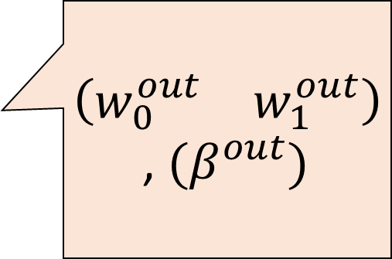
Predictions (forward pass)
$\left(\begin{matrix}w_{0}^{0} & w_{1}^{0} & w_{2}^{0} \\ w_{0}^{1} & w_{1}^{1} & w_{2}^{1}\end{matrix}\right)$ , $\left(\begin{matrix}β^{0} \\ β^{1}\end{matrix}\right)$
$\left(\begin{matrix}w_{0}^{out} & w_{1}^{out}\end{matrix}\right)$, ${(β}^{out})$
$$\left(\begin{matrix}0.2 \\ 0.9 \\ −1.1\end{matrix}\right)$$
Notes:
Let’s go back to the original network, and let’s reorganize it as matrices.

Slide 25
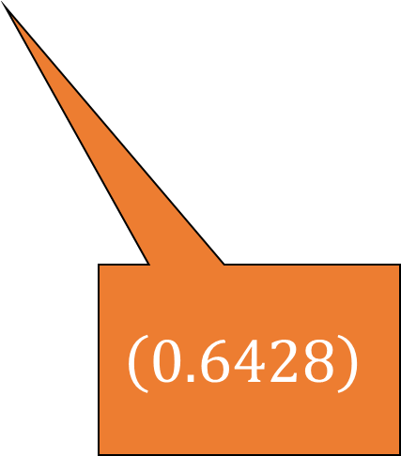
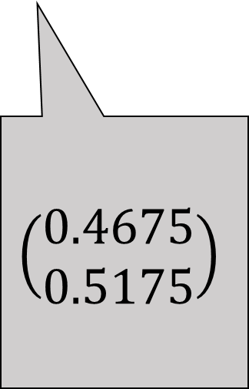
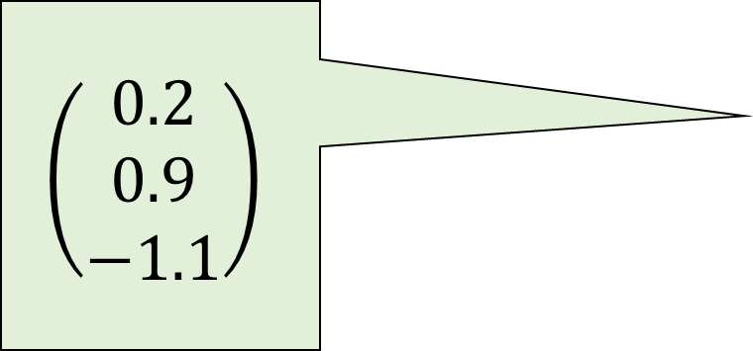
Predictions (forward pass)
$\left(\begin{matrix}w_{0}^{0} & w_{1}^{0} & w_{2}^{0} \\ w_{0}^{1} & w_{1}^{1} & w_{2}^{1}\end{matrix}\right)$ , $\left(\begin{matrix}β^{0} \\ β^{1}\end{matrix}\right)$
$\left(\begin{matrix}w_{0}^{out} & w_{1}^{out}\end{matrix}\right)$, ${(β}^{out})$
$$\left(\begin{matrix}0.2 \\ 0.9 \\ −1.1\end{matrix}\right)$$
$$\left(\begin{matrix}0.4675 \\ 0.5175\end{matrix}\right)$$
$$\left(0.6428\right)$$
Notes:
Let’s go back to the original network, and let’s reorganize it as matrices.

Slide 26
Predictions (forward pass)
$\left(\begin{matrix}w_{0}^{0} & w_{1}^{0} & w_{2}^{0} \\ w_{0}^{1} & w_{1}^{1} & w_{2}^{1}\end{matrix}\right)$ , $\left(\begin{matrix}β^{0} \\ β^{1}\end{matrix}\right)$
Matrix multiplications (and additions)
with several possible notations!
$\left(\begin{matrix}w_{0}^{out} & w_{1}^{out}\end{matrix}\right)$, ${(β}^{out})$
$$\left(\begin{matrix}0.2 \\ 0.9 \\ −1.1\end{matrix}\right)$$
$$\left(\begin{matrix}0.4675 \\ 0.5175\end{matrix}\right)$$
$$\left(0.6428\right)$$
Notes:
Let’s go back to the original network, and let’s reorganize it as matrices.

Slide 27
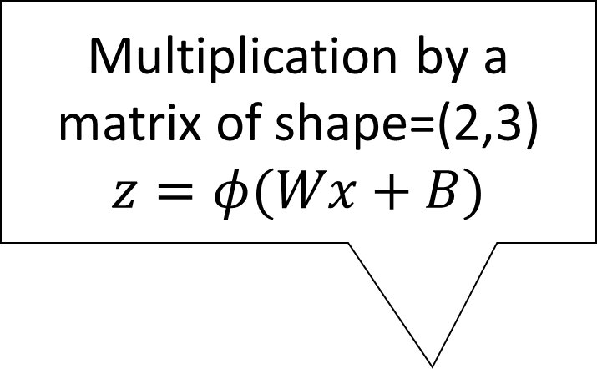
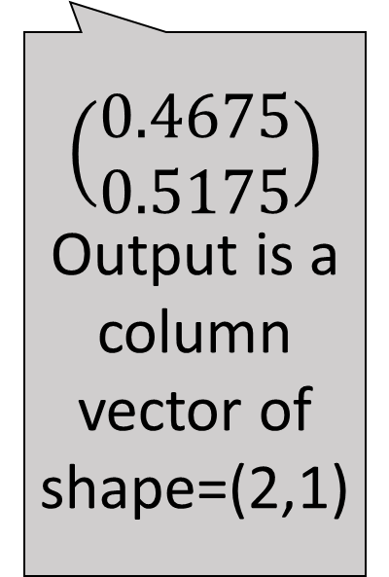
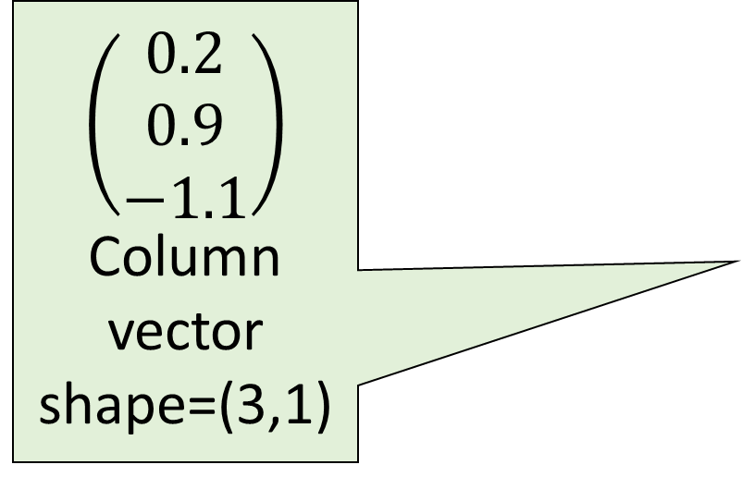
Predictions (forward pass)
Multiplication by a matrix of shape=(2,3)
$$z=φ(Wx+B)$$
$\left(\begin{matrix}w_{0}^{0} & w_{1}^{0} & w_{2}^{0} \\ w_{0}^{1} & w_{1}^{1} & w_{2}^{1}\end{matrix}\right)$ , $\left(\begin{matrix}β^{0} \\ β^{1}\end{matrix}\right)$
$$\left(\begin{matrix}0.2 \\ 0.9 \\ −1.1\end{matrix}\right)$$
Column vector shape=(3,1)
$\left(\begin{matrix}w_{0}^{out} & w_{1}^{out}\end{matrix}\right)$, ${(β}^{out})$
$$\left(\begin{matrix}0.4675 \\ 0.5175\end{matrix}\right)$$
Output is a column vector of shape=(2,1)
$$\left(0.6428\right)$$
Notes:
Let’s go back to the original network, and let’s reorganize it as matrices.

Slide 28
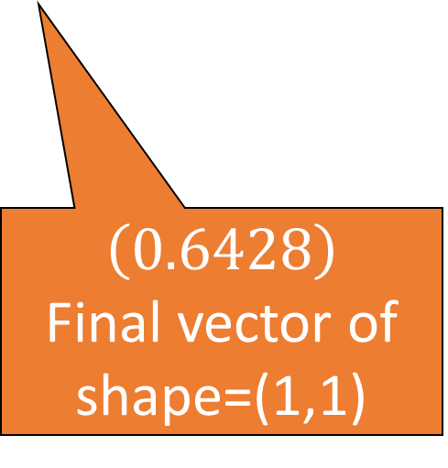

Predictions (forward pass)
Multiplication by a matrix of shape=(2,3)
$$z=φ(Wx+B)$$
$\left(\begin{matrix}w_{0}^{0} & w_{1}^{0} & w_{2}^{0} \\ w_{0}^{1} & w_{1}^{1} & w_{2}^{1}\end{matrix}\right)$ , $\left(\begin{matrix}β^{0} \\ β^{1}\end{matrix}\right)$
Multiplication by a “matrix” of shape=(1,2)
$$\hat{y}=W_{out}⋅z+B_{out}$$
$$\left(\begin{matrix}0.2 \\ 0.9 \\ −1.1\end{matrix}\right)$$
Column vector shape=(3,1)
$\left(\begin{matrix}w_{0}^{out} & w_{1}^{out}\end{matrix}\right)$, ${(β}^{out})$
$$\left(\begin{matrix}0.4675 \\ 0.5175\end{matrix}\right)$$
Output is a column vector of shape=(2,1)
$$\left(0.6428\right)$$
Final vector of shape=(1,1)
Notes:
Let’s go back to the original network, and let’s reorganize it as matrices.

Slide 29
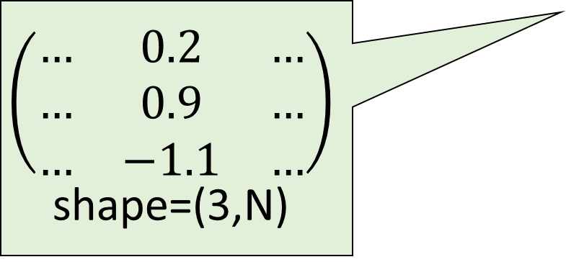
Predictions (forward pass)
What would happen if we had more samples?
$$\left(\begin{matrix}… & 0.2 & … \\ … & 0.9 & … \\ … & −1.1 & …\end{matrix}\right)$$
shape=(3,N)
Notes:
Let’s go back to the original network, and let’s reorganize it as matrices.

Slide 30
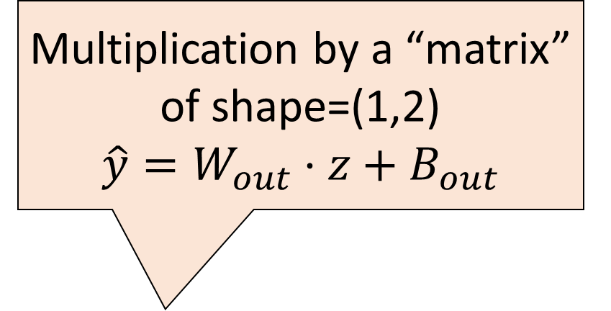

Predictions (forward pass)
Multiplication by a matrix of shape=(2,3)
$$z=φ(Wx+B)$$
Multiplication by a “matrix” of shape=(1,2)
$$\hat{y}=W_{out}⋅z+B_{out}$$
What would happen if we had more samples?
$$\left(\begin{matrix}… & 0.2 & … \\ … & 0.9 & … \\ … & −1.1 & …\end{matrix}\right)$$
shape=(3,N)
Notes:
Let’s go back to the original network, and let’s reorganize it as matrices.

Slide 31
Predictions (forward pass)
Multiplication by a matrix of shape=(2,3)
$$z=φ(Wx+B)$$
Multiplication by a “matrix” of shape=(1,2)
$$\hat{y}=W_{out}⋅z+B_{out}$$
What would happen if we had more samples?
$$\left(\begin{matrix}… & 0.2 & … \\ … & 0.9 & … \\ … & −1.1 & …\end{matrix}\right)$$
shape=(3,N)
Output is a column vector of shape=(2,N)
Output is a row vector, shape=(1,N)
Notes:
Let’s go back to the original network, and let’s reorganize it as matrices.

Slide 32

A flow of tensors through modules
The generic name for n-dimensional arrays is tensors
The high-level view of NNs (shared by multiple libraries)
Each network is a sequence of layers (or better, modules)
Input and output of each layer/module: tensors of a certain shape
The shape of the tensors is modified as data flows through NN
The output tensor is interpreted in a human-readable way

Slide 33
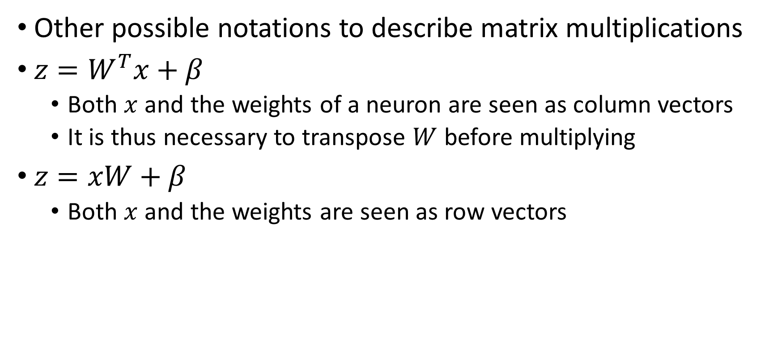
Notations?
Other possible notations to describe matrix multiplications
$z=W^{T}x+β$
Both $x$ and the weights of a neuron are seen as column vectors
It is thus necessary to transpose $W$ before multiplying
$z=xW+β$
Both $x$ and the weights are seen as row vectors

Slide 34
Machine learning (supervised)
Training data
Features
Training...
Predictions
Prediction 1
Prediction 2
Prediction 3
Prediction 4
…
Ground truth
Truth 1
Truth 2
Truth 3
Truth 4
…
ML algorithm (model+optimizer)
Samples
Internal parameters (to be optimized)
If we are learning, how do we get the feedback to optimize the parameters?

Slide 35
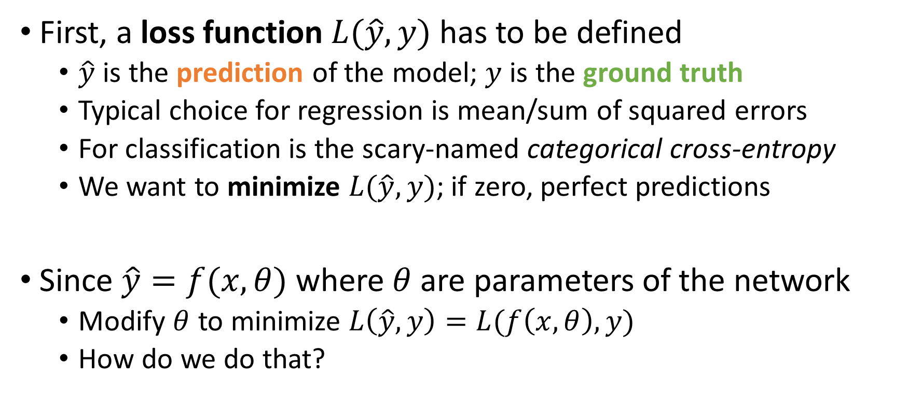
Machine learning with neural networks
First, a loss function $L(\hat{y},y)$ has to be defined
$\hat{y}$ is the prediction of the model; $y$ is the ground truth
Typical choice for regression is mean/sum of squared errors
For classification is the scary-named categorical cross-entropy
We want to minimize $L(\hat{y},y)$; if zero, perfect predictions
Since $\hat{y}=f(x,θ)$ where $θ$ are parameters of the network
Modify $θ$ to minimize $L\left(\hat{y},y\right)=L(f\left(x,θ\right),y)$
How do we do that?

Slide 36
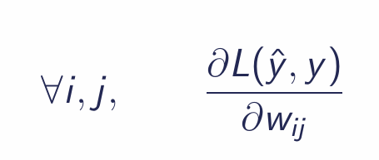
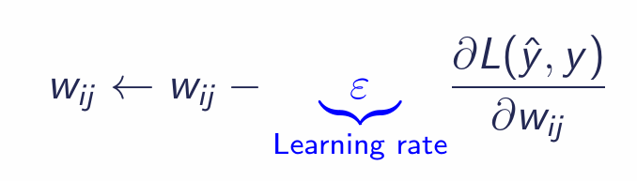
Gradient descent
A classic optimization algorithm is gradient descent
If the derivative of the target function can be computed
Compute partial derivative w.r.t. each weight
Push each weight in the “right direction” by a bit (learning rate)
Evaluate loss function again, compute derivative, iterate

Slide 37
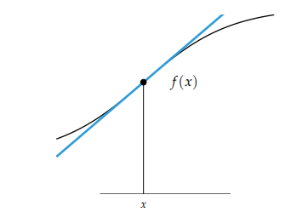
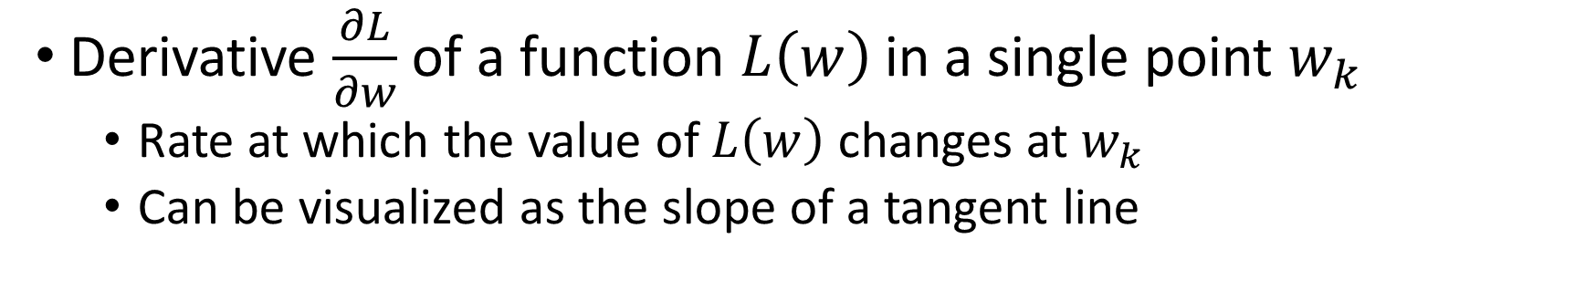


Gradient descent
Derivative $\frac{∂L}{∂w}$ of a function $L\left(w\right)$ in a single point $w_{k}$
Rate at which the value of $L\left(w\right)$ changes at $w_{k}$
Can be visualized as the slope of a tangent line
$$L\left(w\right)$$
$$w_{k}$$

Slide 38
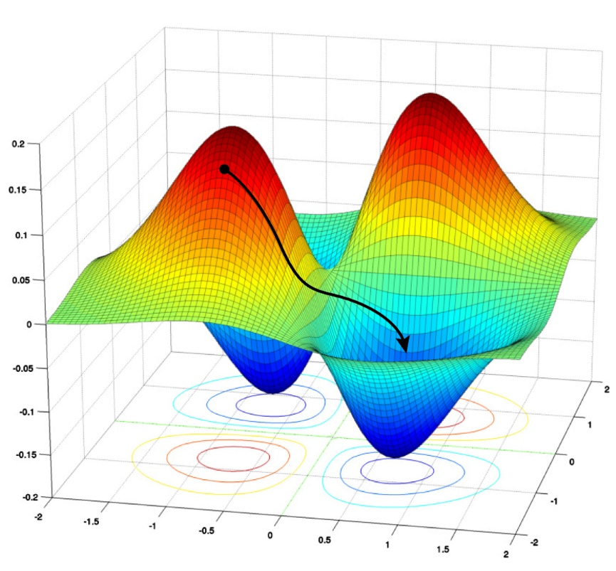
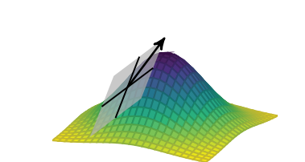

Gradient descent
Derivative in multiple dimensions is the gradient (Jacobian)
$$∇L(θ_{k})=\left(\frac{∂L(θ_{k})}{∂w_{0}},…,\frac{∂L(θ_{k})}{∂w_{N}}\right)$$

Slide 39

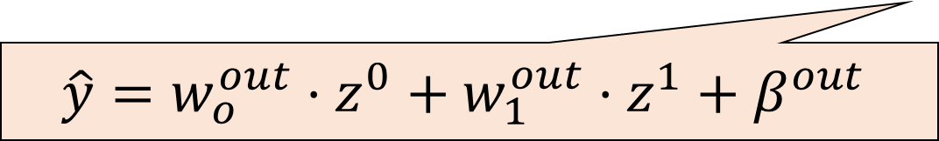
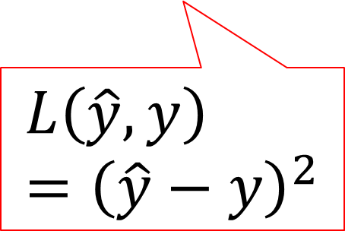

Computing derivatives: backward pass
Derivatives of output w.r.t last weights are straightforward
$$\hat{y}$$
$$y$$
$$\hat{y}=w_{o}^{out}⋅z^{0}+w_{1}^{out}⋅z^{1}+β^{out}$$
$$L\left(\hat{y},y\right)={\left(\hat{y}−y\right)}^{2}$$

Slide 40

Computing derivatives: backward pass
Derivatives of output w.r.t last weights are straightforward
$$\hat{y}$$
$$y$$
$$\hat{y}=w_{o}^{out}⋅z^{0}+w_{1}^{out}⋅z^{1}+β^{out}$$
$$L\left(\hat{y},y\right)={\left(\hat{y}−y\right)}^{2}$$
$$\frac{∂L}{∂w_{0}^{out}}=?$$

Slide 41
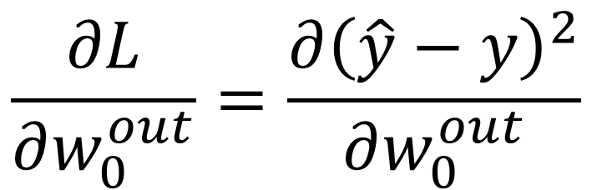
Computing derivatives: backward pass
Derivatives of output w.r.t last weights are straightforward
$$\hat{y}$$
$$y$$
$$\hat{y}=w_{o}^{out}⋅z^{0}+w_{1}^{out}⋅z^{1}+β^{out}$$
$$L\left(\hat{y},y\right)={\left(\hat{y}−y\right)}^{2}$$
$$\frac{∂L}{∂w_{0}^{out}}=\frac{∂{\left(\hat{y}−y\right)}^{2}}{∂w_{0}^{out}}$$

Slide 42
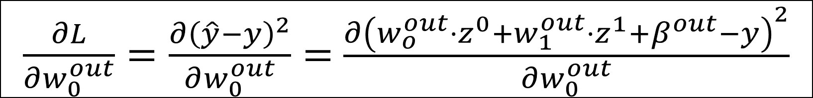
Computing derivatives: backward pass
Derivatives of output w.r.t last weights are straightforward
$$\hat{y}$$
$$y$$
$$\hat{y}=w_{o}^{out}⋅z^{0}+w_{1}^{out}⋅z^{1}+β^{out}$$
$$L\left(\hat{y},y\right)={\left(\hat{y}−y\right)}^{2}$$
$\frac{∂L}{∂w_{0}^{out}}=\frac{∂{\left(\hat{y}−y\right)}^{2}}{∂w_{0}^{out}}=$ $\frac{∂{\left(w_{o}^{out}⋅z^{0}+w_{1}^{out}⋅z^{1}+β^{out}−y\right)}^{2}}{∂w_{0}^{out}}$

Slide 43
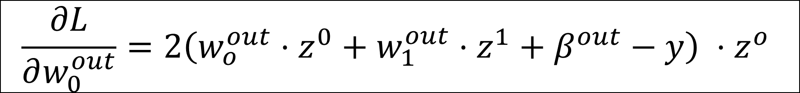
Computing derivatives: backward pass
Derivatives of output w.r.t last weights are straightforward
$$\hat{y}$$
$$y$$
$$\hat{y}=w_{o}^{out}⋅z^{0}+w_{1}^{out}⋅z^{1}+β^{out}$$
$$L\left(\hat{y},y\right)={\left(\hat{y}−y\right)}^{2}$$
$$\frac{∂L}{∂w_{0}^{out}}=2\left(w_{o}^{out}⋅z^{0}+w_{1}^{out}⋅z^{1}+β^{out}−y\right) ⋅z^{o}$$

Slide 44



Computing derivatives: backward pass
Derivatives of output w.r.t last weights are straightforward
$$\frac{∂L}{∂w_{0}^{out}}$$
$$\frac{∂L}{∂β^{out}}$$
$$\hat{y}$$
$$y$$
$$\frac{∂L}{∂w_{1}^{out}}$$
$$L\left(\hat{y},y\right)={\left(\hat{y}−y\right)}^{2}$$

Slide 45

Computing derivatives: backward pass
But what about weights in the first layer?
$$\frac{∂L}{∂w_{0}^{0}}=?$$
$$\frac{∂L}{∂w_{0}^{out}}$$
$$\frac{∂L}{∂β^{out}}$$
$$\hat{y}$$
$$y$$
$$\frac{∂L}{∂w_{1}^{out}}$$
$$L\left(\hat{y},y\right)={\left(\hat{y}−y\right)}^{2}$$

Slide 46
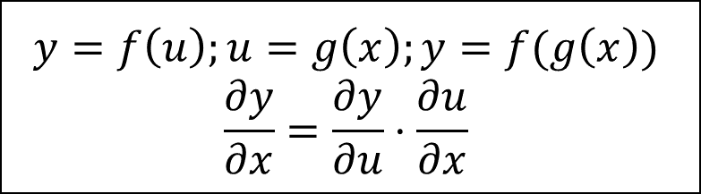
Computing derivatives: backward pass
Chain rule!
$$\frac{∂L}{∂w_{0}^{0}}=?$$
$$\frac{∂L}{∂w_{0}^{out}}$$
$$\frac{∂L}{∂β^{out}}$$
$$\hat{y}$$
$$y$$
$$\frac{∂L}{∂w_{1}^{out}}$$
$$L\left(\hat{y},y\right)={\left(\hat{y}−y\right)}^{2}$$
$$y=f\left(u\right);u=g\left(x\right);y=f(g\left(x\right))$$
$$\frac{∂y}{∂x}=\frac{∂y}{∂u}⋅\frac{∂u}{∂x}$$

Slide 47

Computing derivatives: backward pass
Chain rule!
$$\frac{∂L}{∂w_{0}^{0}}=?$$
$$\frac{∂L}{∂w_{0}^{out}}$$
$$\frac{∂L}{∂β^{out}}$$
$$\hat{y}$$
$$y$$
$$\frac{∂L}{∂w_{1}^{out}}$$
$$L\left(\hat{y},y\right)={\left(\hat{y}−y\right)}^{2}$$
$$L=f\left(\hat{y}\right);\hat{y}=g\left(z^{0}\right);z^{0}=h(w_{0}^{0})$$
$\frac{∂L}{∂w_{0}^{0}}=\frac{∂L}{∂\hat{y}}⋅\frac{∂\hat{y}}{∂z^{0}}⋅$ $\frac{∂z^{0}}{∂w_{0}^{0}}$

Slide 48

Computing derivatives: backward pass
At the end of the backward pass (or backpropagation)
We have the gradient $∇L$, that we can use to update weights
$∇L$ gives us the direction in which we should go to minimize $L$
We take a step (learning rate) in that direction, updating weights
Another forward pass, another $\hat{y}$, another $L$, another $∇L$
Repeat until $L=0$ (unlikely), or run out of time (or other)

Slide 49
A few remarks
Computing the gradient is a fundamental operation
Luckily, we don’t have to do it by hand
Automatic computation of gradients
This is a highly parallelizable operation!
The NN representation with layers is a bit inconsistent
What does a single neuron represent?
Sometimes it’s a weighted sum, sometimes + activation function
Where are weights and biases stored? On the arcs? Even biases?

Slide 50
Philosophy of pytorch
Like other libraries, tensors flow through modules
Tensors (torch.Tensor) are specific data structures
Just like numpy arrays, multi-dimensional matrices
They can easily be assigned to run on GPUs for quick computations
They store information about gradients!
Context torch.no_grad() or Tensor.detach() to deactivate

Slide 51
Philosophy of pytorch
Modules
torch.nn.Module represents a (unitary*) operation on a tensor
Implements both forward() and backward()
Expects a tensor of given shape in input
Gives tensor of another shape in output
*this is true for most Modules found in pytorch

Slide 52
Philosophy of pytorch
Input layer
Hidden layer
Output layer

Slide 53
Philosophy of pytorch

Slide 54
Philosophy of pytorch
Module 2: Sigmoid (activation function, nonlinearity)
Module 1: Linear (weighted sum)
Input: (3, N)
Output: (2, N)
Parameters: 6 (4 weights, 2 biases)
Input: (2, N)
Output: (2, N)
Parameters: None

Slide 55
Philosophy of pytorch
Module 2: Sigmoid (activation function, nonlinearity)
Module 1: Linear (weighted sum)
Module 3: Linear (weighted sum)
Input: (3, N)
Output: (2, N)
Parameters: 6 (4 weights, 2 biases)
Input: (2, N)
Output: (2, N)
Parameters: None
Input: (?, ?)
Output: (?, ?)
Parameters: ? (? weights, ? biases)

Slide 56

Philosophy of pytorch
Module 2: Sigmoid (activation function, nonlinearity)
Module 1: Linear (weighted sum)
Module 3: Linear (weighted sum)
Input: (3, N)
Output: (2, N)
Parameters: 6 (4 weights, 2 biases)
Input: (2, N)
Output: (2, N)
Parameters: None
Input: (2, N)
Output: (1, N)
Parameters: 3 (2 weights, 1 bias)
$$\hat{y}$$

Slide 57
pytorch modules
Considerable number of different Modules
Implementing layers of different type (convolutional, recurrent, …)
Different activation functions (Sigmoid, Tanh, ReLU, …)
Adding new Modules is relatively easy
Need to implement forward() and backward()

Slide 58
Philosophy of pytorch: inheritance
pytorch wants users to create new Classes
Classes that inherit from existing classes
For example, Neural Networks inherit from Module
Load data efficiently, creating a Class that inherits from Dataset

Slide 59
General view, shared by multiple libraries
Sequence of modules
Flow of tensors in the network
Input and outputs are interpreted in human-readable way

Slide 60
Philosophy of pytorch
Every network is an instance of a torch.nn.Module object
Methods inside a Module:
__init__(self) : builder, used to set up layers (and other stuff)
forward(self, X) : forward pass of the Module
backward(self, X) : backward pass of the Module
forward() is called during training, so it’s necessary

Slide 61
Neural networks vs Deep learning
What is the difference?

Slide 62
Neural networks vs Deep learning
(1) Considerable improvements over classic Neural Networks
New (more effective!) algorithms to optimize parameters
New architectures to deal with structured data
Better software engineering
More computing power available, better results
(2) Rebranding
Interest for Neural Networks declined in the 1990s
At the time, considered less effective than other methods
Any network with more than one hidden layer is “deep”

Slide 63




Worst enemies of DL (in this class, at least)
Space
Time

Slide 64
Worst enemies of DL (in this class, at least)
(Disk) Space
Modern DL models contain billions (10⁹) of parameters
GPT-4 has ~220 billion parameters
If a single parameter is a floating point represented on 32 bits…
…that is 220 * 10⁹ * 32 / 8 = 880 Giga Bytes (!!!)
They have to be stored on a hard drive and IN MEMORY!
During training, you’ll need to also store the gradient IN MEMORY!

Slide 65
Worst enemies of DL (in this class, at least)
(Training) Time
Training iterations take a lot of time

Slide 66
Practical issues with neural networks
Size of parameters (downcasting)

Slide 67
Why are neural networks winning?
Lots of competitors! Why is Deep Learning so dominant?

Slide 68
Why are neural networks winning?
On tabular data, they are not winning
Current consensus is that ensembles of boosted trees are better
See Grinsztajn et al. (2022) Why do tree-based models still outperform deep learning on tabular data?
On structured data, they are massively dominant
Remove the need for feature construction (and maybe selection)
Any type of structure: sequences, graphs, images, videos, …

Slide 69
Why are neural networks winning?
Generative models: how can a NNs output an image?

Slide 70

Why are neural networks winning?
Output tensors interpreted as (approximately) anything!
Example: image
Tensor (c * w * h)
Each value $x_{i,j}$ inside each channel indicates the level or red, blue, or green for pixel $p_{i,j}$ respectively
Image channel (w * h)

Slide 71

Why are neural networks winning?
Output tensors interpreted as (approximately) anything!
Example: video
Tensor (t*c*w*h)
Each value $x_{i,j}^{t}$inside each channel indicates the level or red, blue, or green for pixel $p_{i,j}$ for the frame at time $t$
Image channel (w * h)
Image channel (w * h)
…
t=0
t=T

Slide 72
Why are neural networks winning?
And when we have to choose between n discrete values?

Slide 73

Why are neural networks winning?
Tensor is interpreted as a probability distribution
Each cell in output tensor is “probability” of picking element
Tensor (1 * n)

Slide 74

Why are neural networks winning?
Tensor is interpreted as a probability distribution
Each cell in output tensor is “probability” of picking element
Tensor (1 * n)

Slide 75
Why are neural networks winning?
Transfer learning
Somehow, using multiple layers

Slide 76


Multiple architectures!
https://www.asimovinstitute.org/neural-network-zoo/

Slide 77
Pseudo-random number generation in pytorch
Unfortunately, it’s not easy
Computing on GPUs makes consistent PRNG difficult
Libraries optimized for speed, not consistent behavior
Still, a few good practices:
https://pytorch.org/docs/stable/notes/randomness.html

Slide 78
pytorch FAQ
Excellent resource for most common issues
https://pytorch.org/docs/stable/notes/faq.html

