Slide 1
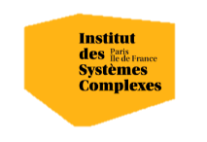

Optimization algorithms for Artificial Intelligence: Introduction
Alberto TONDA, Senior Researcher (DR), <alberto.tonda@inrae.fr>
UMR 518 MIA-PS (Applied Mathematics and Computer Science) INRAE, AgroParisTech, Université Paris-Saclay Institut des Systèmes Complexes, Paris-Ile-de-France

Slide 2
Outline
What is this class about?
Who am I?
What is optimization?
What is Artificial Intelligence?
Is optimization a kind of Artificial Intelligence?
What is the relationship between AI and optimization?
Why are we still here? Just to suffer? Every night, I can feel my leg... And my arm... even my fingers... The body I've lost... the comrades I've lost... won't stop hurting... It's like they're all still there. You feel it, too, don't you? I'm gonna make them give back our past!

Slide 3
What is this class about?
Optimization!
Overview of optimization techniques, when/how to use them
How these techniques power modern Artificial Intelligence
Optimization to improve performance of AI methods
At the end of the class, you should know
What techniques are more appriopriate for different problems
How (several) AI systems work, especially for Machine Learning
Hyperparameter optimization for your AI applications
Keywords for further research (e.g. Neuro-symbolic, AutoML)

Slide 4
What is this class about?
Optimization!
Overview of optimization techniques, when/how to use them
How these techniques power modern Artificial Intelligence
Optimization to improve performance of AI methods
At the end of the class, you should know
What techniques are more appriopriate for different problems
How (several) AI systems work, especially for Machine Learning
Hyperparameter optimization for your AI applications
Keywords for further research (e.g. Neuro-symbolic, AutoML)

Slide 5
(Tentative) Schedule
April 1, Amphi IV
- Optimization: introduction - Continuous optimization
Exercises
- Linear programming
April 3, Amphi VI
- Discrete optimization
Exercises
- Multi-objective optimization
Exercises
- Optimization of structures
Exercises
April 8, Amphi IV
- Optimization in ML
Exercises
- Hyperparameter optimization
April 8, Amphi IV
Discussion
- Recent developments

Slide 6
(Tentative) Schedule
April 1, Amphi IV
- Optimization: introduction - Continuous optimization
Exercises
- Linear programming
April 3, Amphi VI
- Discrete optimization
Exercises
- Multi-objective optimization
Exercises
- Optimization of structures
Exercises
April 8, Amphi IV
- Optimization in ML
Exercises
- Hyperparameter optimization
April 8, Amphi IV
Discussion
- Recent developments
Prepare a few slides to present your problem, then we discuss how to frame it as an optimization problem

Slide 7
What happened in past iterations
April 1, Amphi IV
- Optimization: introduction - Continuous optimization
Exercises
- Linear programming
April 3, Amphi VI
- Discrete optimization
Exercises
- Multi-objective optimization
Exercises
- Optimization of structures
Exercises
April 8, Amphi IV
- Optimization in ML
Exercises
- Hyperparameter optimization
April 8, Amphi IV
Discussion
- Recent developments
Students asked me questions after class on during pauses (shyness)? I asked for feeback
Students asked me questions after class on during pauses (shyness)? I asked for feeback
Students asked me questions after class on during pauses (shyness)? I asked for feeback
Students asked me questions after class on during pauses (shyness)? I asked for feedback
Students asked me questions after class on during pauses (shyness)? I asked for feeback

Slide 8
What happened in the past

Slide 9
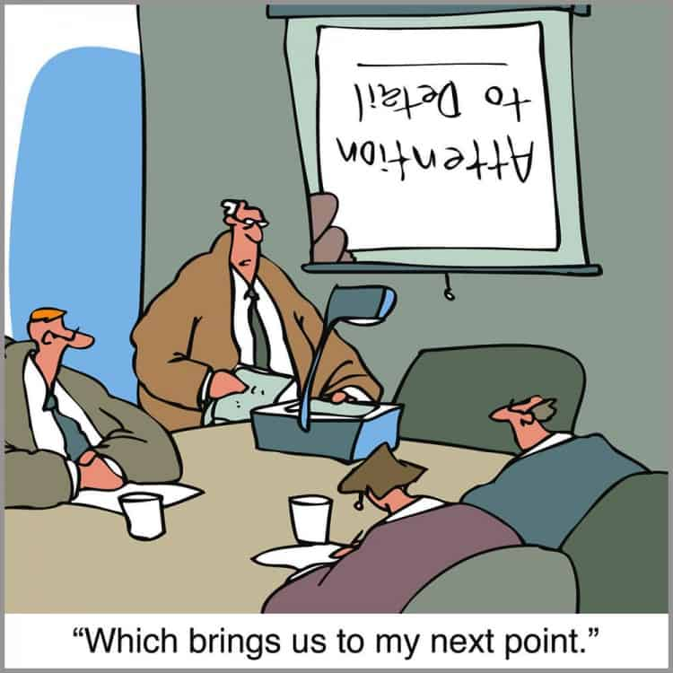
What is this class about?
General ideas are relatively easy to grasp
Details are complicated and require longer study
Get the general idea, try to understand if it fits your problem

Slide 10
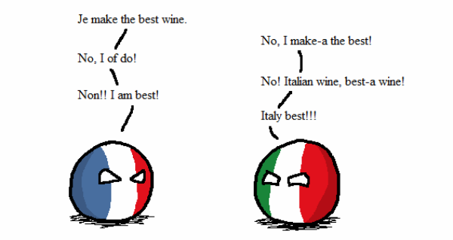
Who am I?
Career
Bachelor and Master in Computer Science Engineering
Ph.D. from Politecnico di Torino, Italy, in 2011
Permanent researcher in France since late 2012 (INRAE)
Senior researcher since 2023
Research interests
Stochastic optimization, ML (xAI)
Applied to biological/agri-food data
Research: applied + algorithms
Notes:
I am NOT an expert of ALL methods that I am going to present.

Slide 11
What is optimization?
Nearly every choice is an optimization problem
Shape of a car to minimize wind resistance
Values of the weights of a neural network to best perform a task
Weight distribution in a plane to minimize shaking
Pick a stock market portfolio to maximize revenue
Trace route inside a city to reach a point as fast as possible
Choose career that makes you satisfied and happy
...

Slide 12
What is optimization?
Nearly every choice is an optimization problem
Shape of a car to minimize wind resistance
Values of the weights of a neural network to best perform a task
Weight distribution in a plane to minimize shaking
Pick a stock market portfolio to maximize revenue
Trace route inside a city to reach a point as fast as possible
Choose career that makes you satisfied and happy
...
OBJECTIVE FUNCTION

Slide 13
What is optimization?
Nearly every choice is an optimization problem
Shape of a car to minimize wind resistance
Values of the weights of a neural network to best perform a task
Weight distribution in a plane to minimize shaking
Pick a stock market portfolio to maximize revenue
Trace route inside a city to reach a point as fast as possible
Choose career that makes you satisfied and happy
...
COST FUNCTION
OBJECTIVE FUNCTION
FITNESS FUNCTION
LOSS FUNCTION

Slide 14
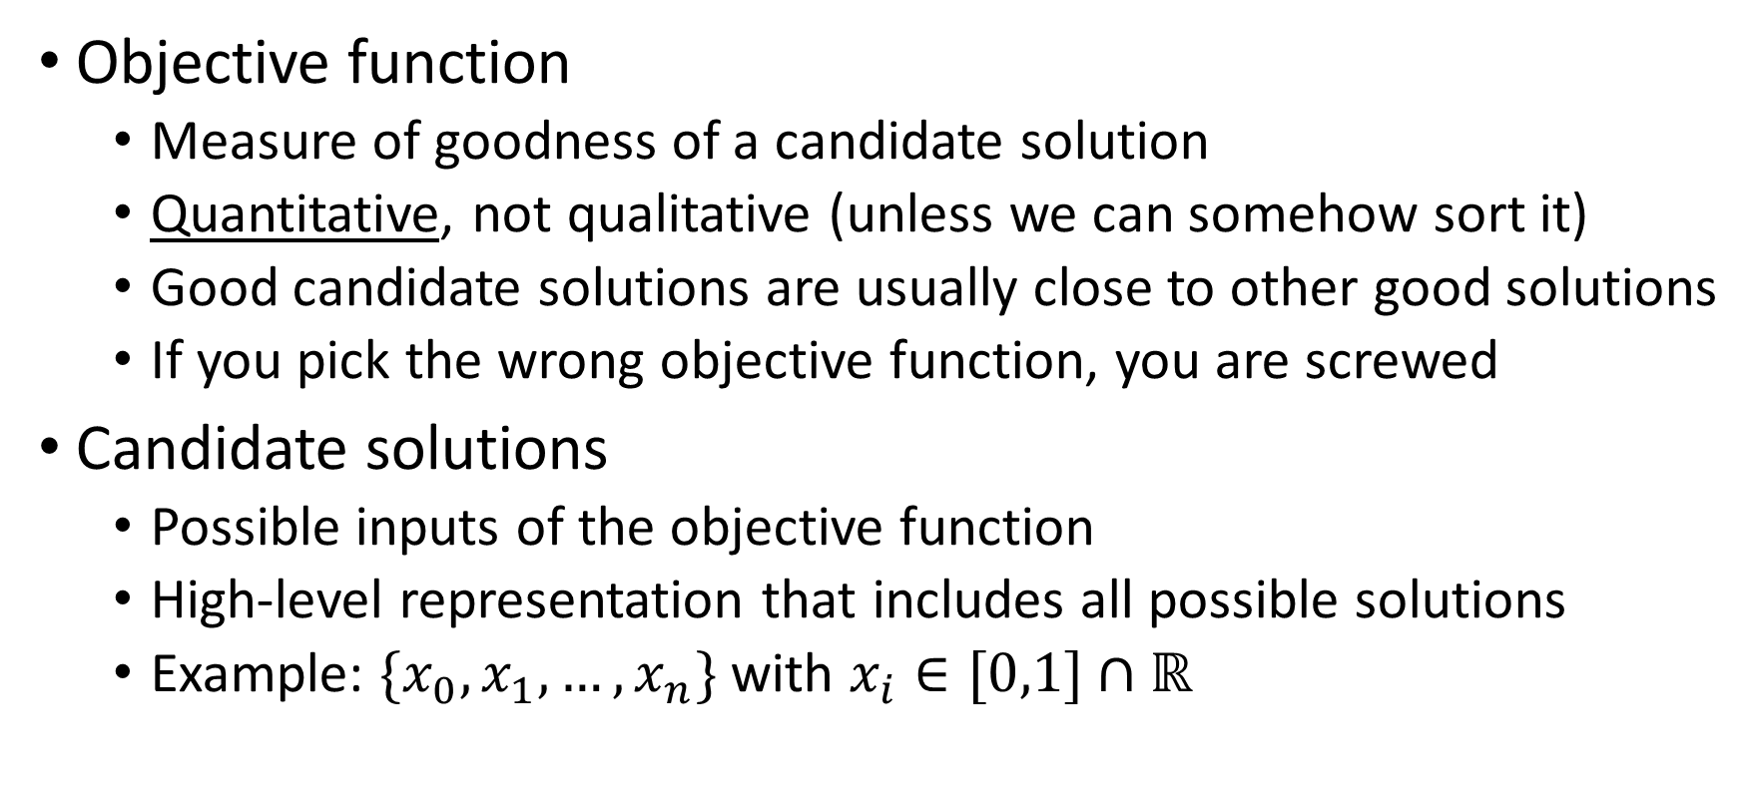
What is optimization?
Objective function
Measure of goodness of a candidate solution
Quantitative, not qualitative (unless we can somehow sort it)
Good candidate solutions are usually close to other good solutions
If you pick the wrong objective function, you are screwed
Candidate solutions
Possible inputs of the objective function
High-level representation that includes all possible solutions
Example: $\{x_{0},x_{1}, …, x_{n}\}$ with $x_{i}∈[0,1]∩ℝ$

Slide 15
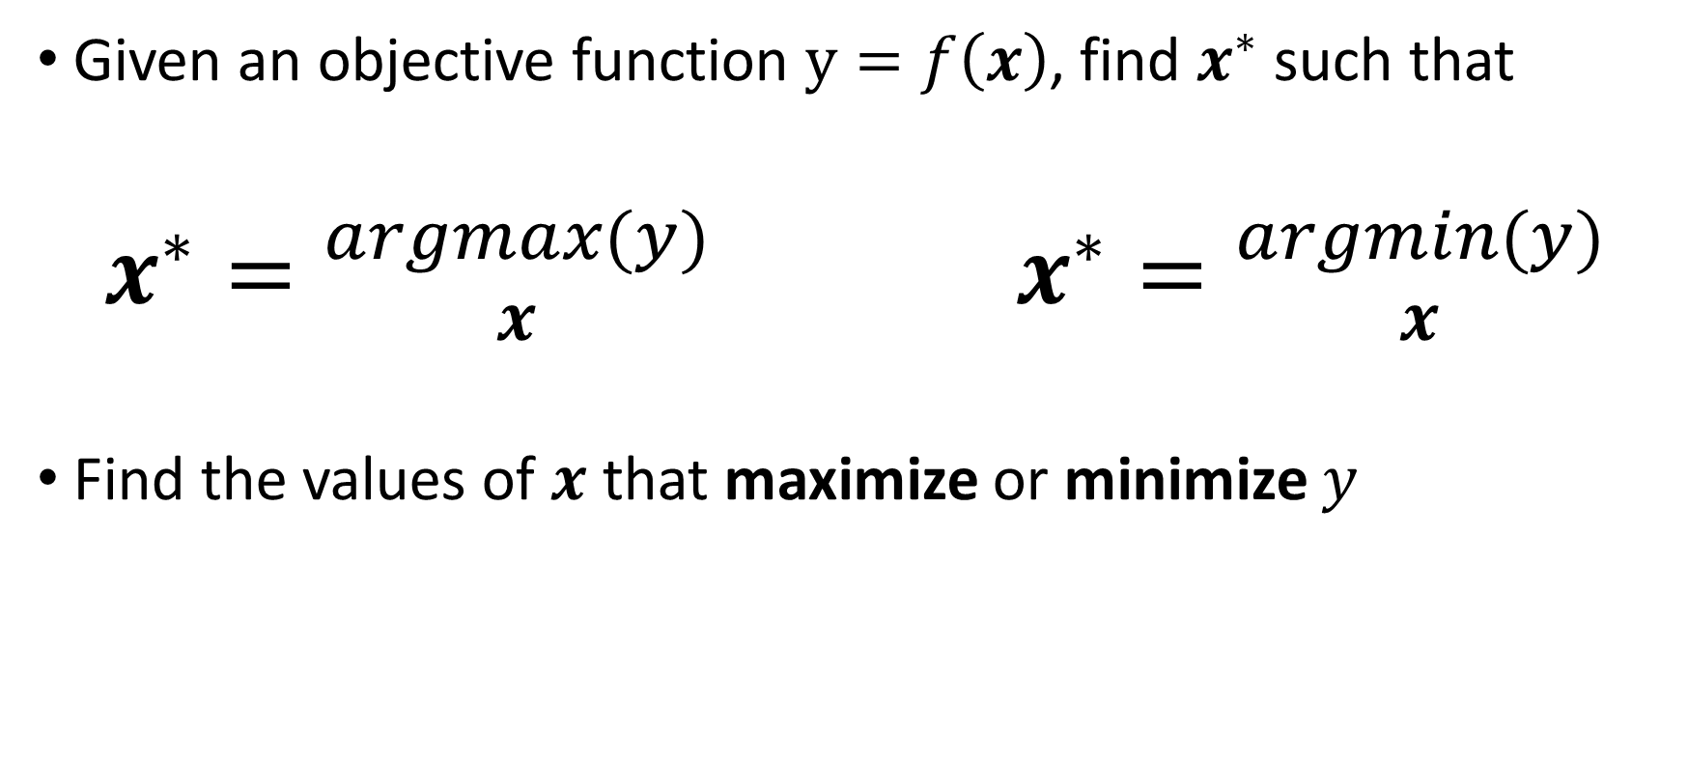
What is optimization?
Given an objective function $y=f\left(x\right)$, find $x^{∗}$ such that
$x^{∗}={argmax(y) \atop x}$ $x^{∗}={argmin(y) \atop x}$
Find the values of $x$ that maximize or minimize $y$

Slide 16
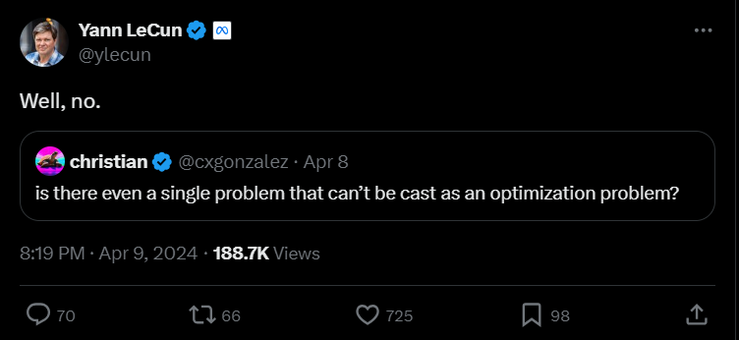
What is optimization?

Slide 17
What is an algorithm?

Slide 18
What is an algorithm?
Series of steps to achieve an objective
Bake a cake
Sort the elements inside an array, by increasing value
Find the best possible input value for a given function
Algorithmic complexity
Time to complete objective often depends on size of input
Baking ten cakes takes more time than baking one
Sorting a large array takes more time than a small one

Slide 19
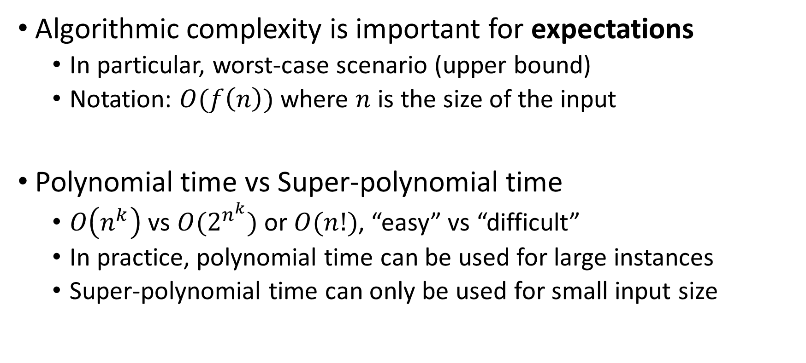
What is an algorithm?
Algorithmic complexity is important for expectations
In particular, worst-case scenario (upper bound)
Notation: $O(f\left(n\right))$ where $n$ is the size of the input
Polynomial time vs Super-polynomial time
$O\left(n^{k}\right)$ vs $O(2^{n^{k}})$ or $O(n!)$, “easy” vs “difficult”
In practice, polynomial time can be used for large instances
Super-polynomial time can only be used for small input size

Slide 20
What is an algorithm?
Computer scientists often look at worst-case scenario
In some cases, average-case scenario might be better
E.g. worst-case scenario exponential time, average polynomial
Most real-world problems are Nondeterministic Polynomial
Checking if a solution is correct in polynomial time
Finding the best solution takes super-polynomial time

Slide 21
What is Artificial Intelligence?

Slide 22
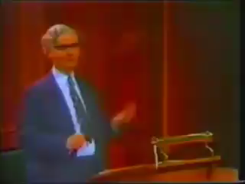
What is Artificial Intelligence?
John McCarthy, one of the founding fathers of Artificial Intelligence
«I invented this term Artificial Intelligence [...] because [...] we were trying to get money for a summer study [...] in 1956 [...]»

Slide 23
What is Artificial Intelligence?
Short answer, there is no clear definition
We do not have a good definition of intelligence, so...
Broadly speaking, AI defines a field more than a method
Machine learning, reinforcement learning, symbolic AI, ...
Tentative definitions (there is no agreement)
«When a non-biological being successfully completes a task commonly believed to require biological intelligence»
«Perceiving, synthesizing, and inferring information»
How do we measure intelligence?

Slide 24
What is Artificial Intelligence?
NARROW / WEAK
Focused on a specific task
Symbolic AI
E.g. rule-based systems
Machine learning
Supervised, unsupervised
Natural language processing
Image recognition/segmentation
Reinforcement learning
Neuro-symbolic AI
GENERAL (AGI)
Can perform any type of (human?) task
Does not exist (...yet?)
Closest thing is NLP: Large Language Models (LLM) like ChatGPT

Slide 25
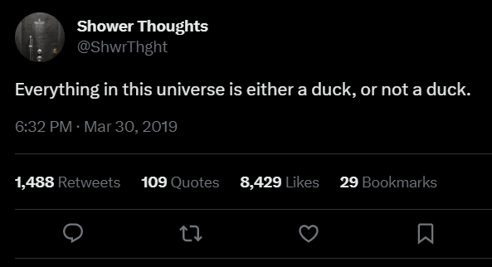
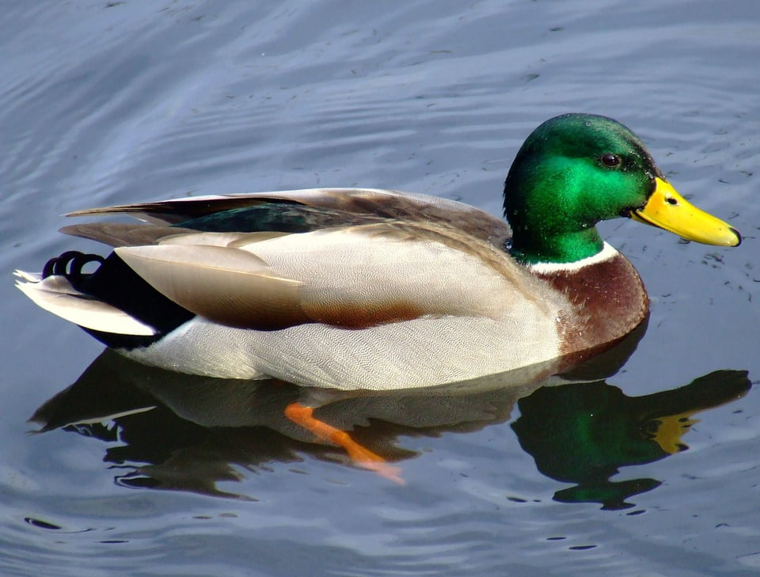
Symbolic AI
Symbolic manipulation
Reality is continuous (with good approximation)
Symbols are discrete, and humans are good at using them

Slide 26
Symbolic AI
Symbols seem normal and natural, map into the real world (in linguistics, it’s called extension)
Natural language is a powerful human symbol manipulator
However, there is chaos hidden under the surface
What is the reality of a river?
What is the reality of a chair?
What is the reality of a number?

Slide 27
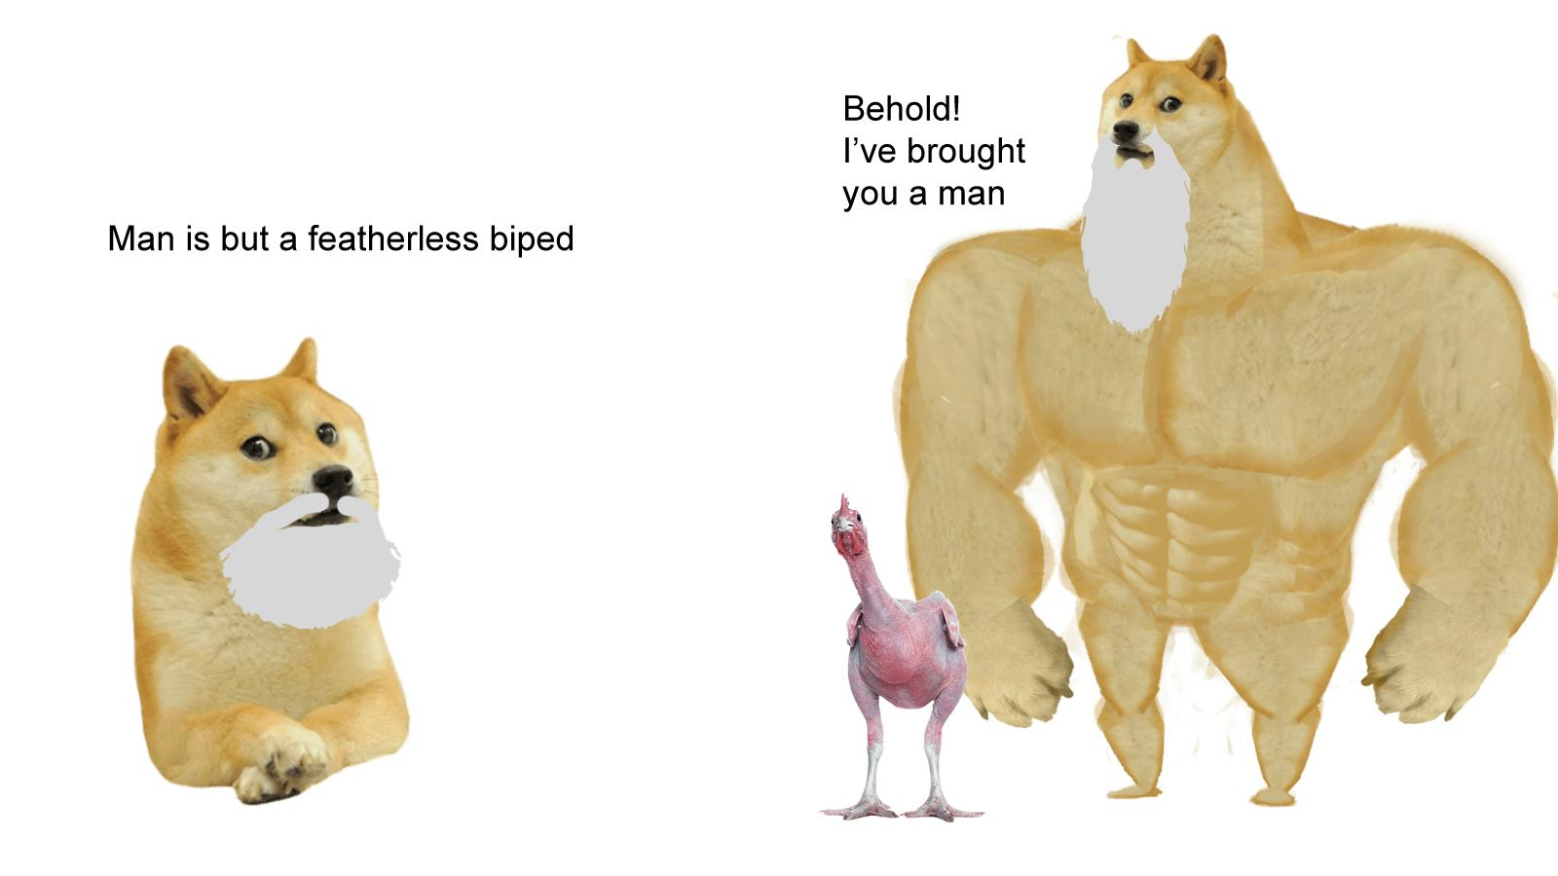
Symbolic AI
Symbol can be hard to define, but we grasp it intuitively
It’s an old, old problem: see Plato and Diogenes
Entire fields of research on this (neuroscience, cognitive sciences, neurolinguistics, …)
“Explaining” symbols to AI is harder yet
Issues with “common sense”
Reached limits in the 1980s

Slide 28
Symbolic AI
In practice, find or exploit human-readable rules
Expert systems (“if-then-else” rules)
Knowledge graphs, linking entities with relationships
First-order logic rules
Decision trees (that are also considered part of ML!)
Before the advent of ML, considerable success stories
Symbolic AI is still in use, paired with ML

Slide 29
Machine learning
Learn a task directly from examples
No need for symbols, just large quantities of data
Samples (rows) and features (columns)
“Dirty secret” of ML: it’s mostly optimization
Restate learning task as optimization task
Solve it relying on available (training) data
Learning Task
Optimization Task

Slide 30
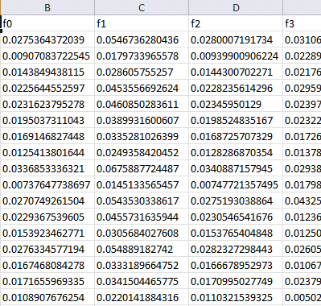

Machine learning (supervised)
Features
Training...
Predictions
Prediction 1
Prediction 2
Prediction 3
Prediction 4
…
Ground truth
Truth 1
Truth 2
Truth 3
Truth 4
…
ML algorithm (model+optimizer)
Samples
Internal parameters (variables to be optimized)

Slide 31
Machine learning
Dominant paradigm since the 90s
First, artificial neural networks (ANNs or NNs)
Then, statistical learning algorithms
Decision trees (and ensembles of) and polynomial models
Feature engineering
Works (still) well for tabular data (e.g. Excel spreadsheet)
Huge issues with relational data (e.g. images, text, sound…)
Hand-crafted features (not very successful)

Slide 32
Machine learning
Trade-off effectiveness/interpretability (black-box effect)
Good predictive models are extremely complicated
A single decision tree can be interpreted, 300 trees cannot
Same goes for polynomial models with 300 features
Deep learning
General idea is that deep ANNs can automatically infer features
Convolutional NNs, Recurrent NNs, Transformers, …
Fantastic success stories for relational data!

Slide 33
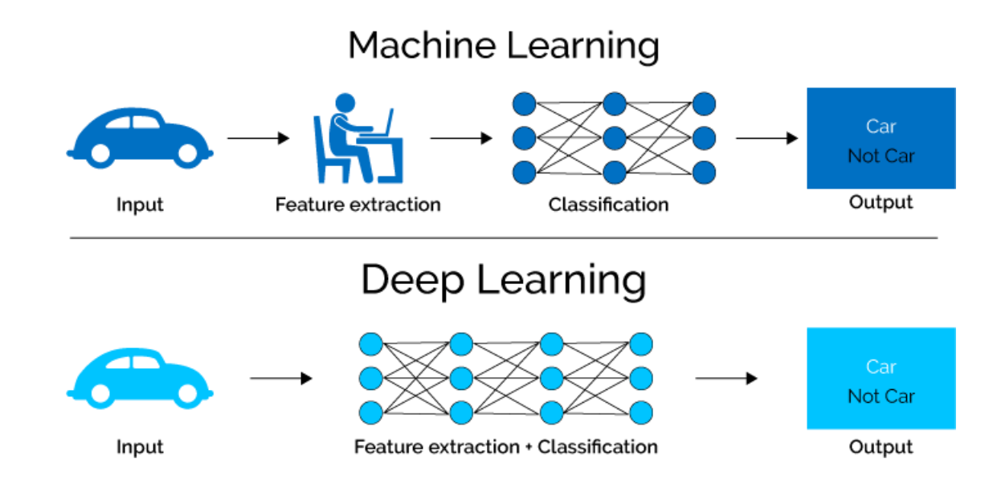
Machine learning

Slide 34
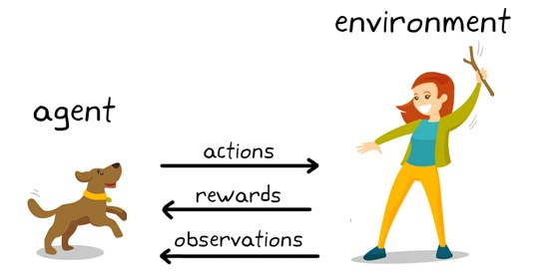
Reinforcement learning
Similar to ML, but not exactly
No value for a single decision; reward after series of decisions
Learn a policy which tells you what to do from the state you are in
Example: chess game; is trading a Queen for a Knight good? Well, it depends on the board state

Slide 35
Neuro-symbolic AI (NeSy)
Might look complex, but the general idea is intuitive
Use neural/ML approach to map from data to symbols
Use symbolic AI to reason on symbols
(possibly) Go back to data using another neural/ML approach
Promise: Effectiveness (ML) + Explainability (Symbolic AI)
However, it’s pretty hard to do, and problem-specific
Interestingly, some of the biggest ML successes are NeSy
AlphaGo uses a mix of symbolic exploration and NN
AlphaFold is a mix of ~30 algorithms (some Symbolic, some ML)

Slide 36
Artificial General Intelligence
Hypothetical artificial intelligent agent
“Can learn (rapidly and cheaply) to perform any task that a human or another animal could perform, with minimal amounts of errors”
It does not exist, there is no clear path towards it
Lots of people scared by apparently quick advances of AI
Even some real experts (!!!)
My opinion
Existential risk is non-existent
Real risks are already here, from misuse/misunderstanding

Slide 37
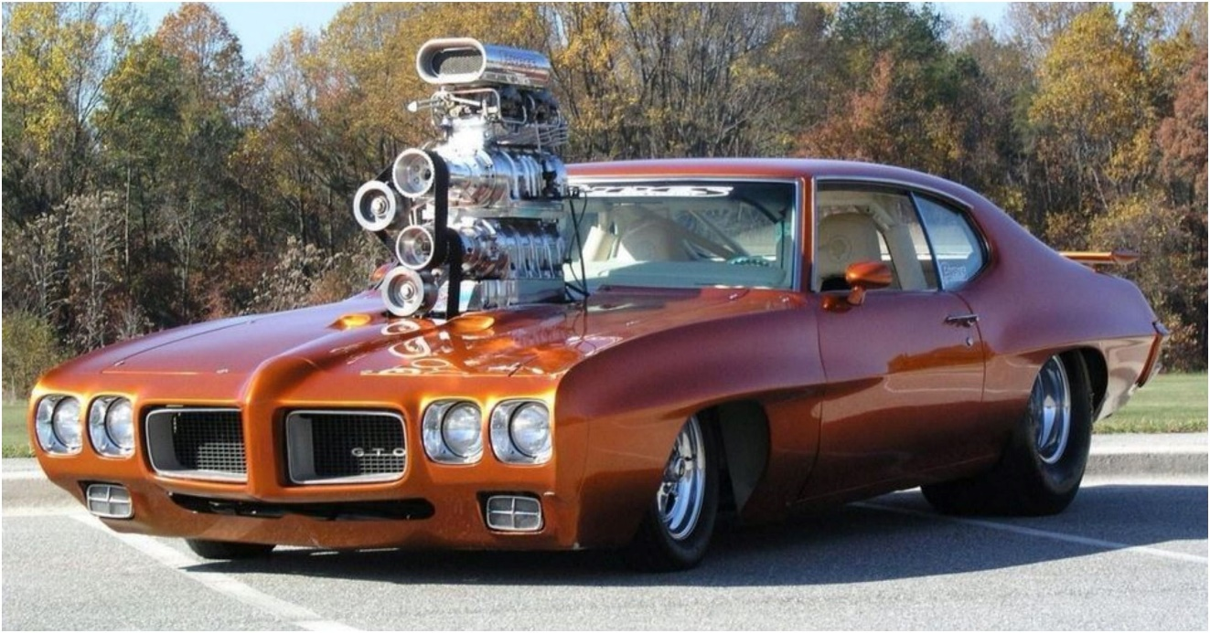
Is optimization a kind of AI?
Debatable, some experts would say “yes”
My opinion: optimization is the engine of AI
…this is almost sure for ML

Slide 38
Relationship between AI and optimization?
Most “Intelligence” requires making good choices
Predict the next value in a time series, as precisely as possible
Correctly identify the human poses in a video
Make the best possible chess move, given the situation
Maximize your score in Super Mario
Generate a sequence of words that best follows the input
Create the painting that best corresponds to a written prompt

Slide 39
Relationship between AI and optimization?
Most “Intelligence” requires making good choices
Predict the next value in a time series, as precisely as possible
Correctly identify the human poses in a video
Make the best possible chess move, given the situation
Maximize your score in Super Mario
Generate a sequence of words that best follows the input
Create the painting that best corresponds to a written prompt

Slide 40
Relationship between AI and optimization?
AI: from many (many!!!) possible choices, pick the best
If you can evaluate your choices, you can optimize
(AFAIK) All AI systems include some type of optimization, with the possible exception of hand-crafted ones
Notes:
There is one possible exception, ontologies

Slide 41
Is it always good to optimize?
Optimizing one objective might lead to undesired outcomes
Supply chain optimized for efficiency is fragile
“Robust optimization” considers perturbations, but how big?
Multi-objective optimization can be helpful
Multiple conflicting objectives, improve one <-> worsen others
Find optimal trade-offs between objectives

Slide 42
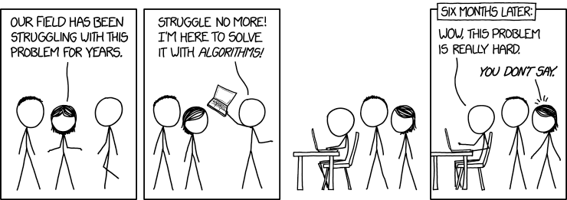
Conclusions
“XKCD” by Randall Munroe www.xkcd.com

Slide 43
Questions?

