Slide 1
Discrete optimization
Alberto TONDA
UMR 518 MIA-PS, INRAE, AgroParisTech, Université Paris-Saclay UAR 3611, Institut des Systèmes Complexes de Paris Île-de-France

Slide 2
Outline
Definition of discrete optimization
Combinatorial optimization
Mixed-integer linear programming
SAT solvers (Boolean satisfiability problem)
Evolutionary algorithms (again)

Slide 3
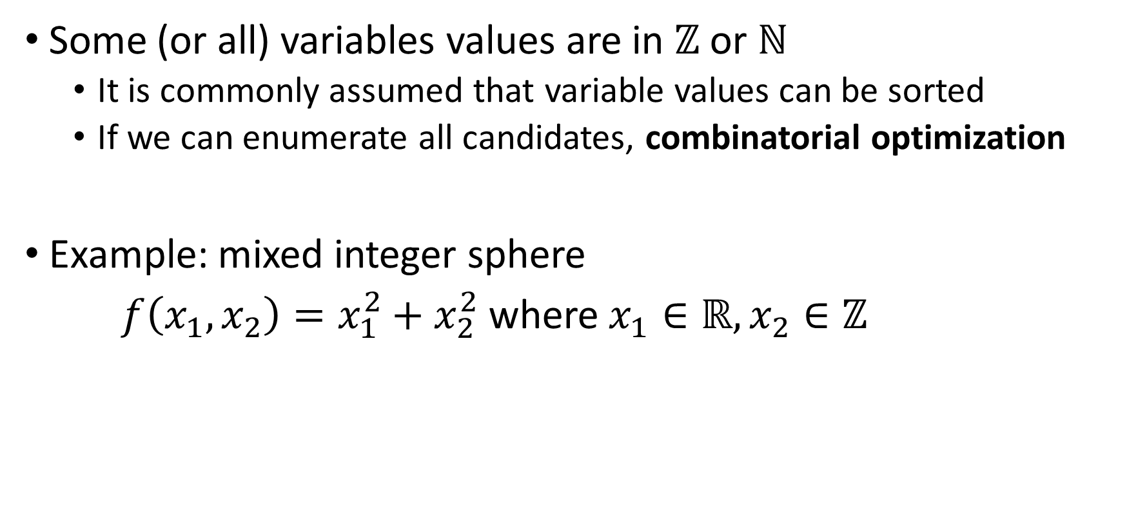
Definition of discrete optimization
Some (or all) variables values are in $ℤ$ or $ℕ$
It is commonly assumed that variable values can be sorted
If we can enumerate all candidates, combinatorial optimization
Example: mixed integer sphere
$f\left(x_{1},x_{2}\right)=x_{1}^{2}+x_{2}^{2}$ where $x_{1}∈ℝ, x_{2}∈ℤ$

Slide 4
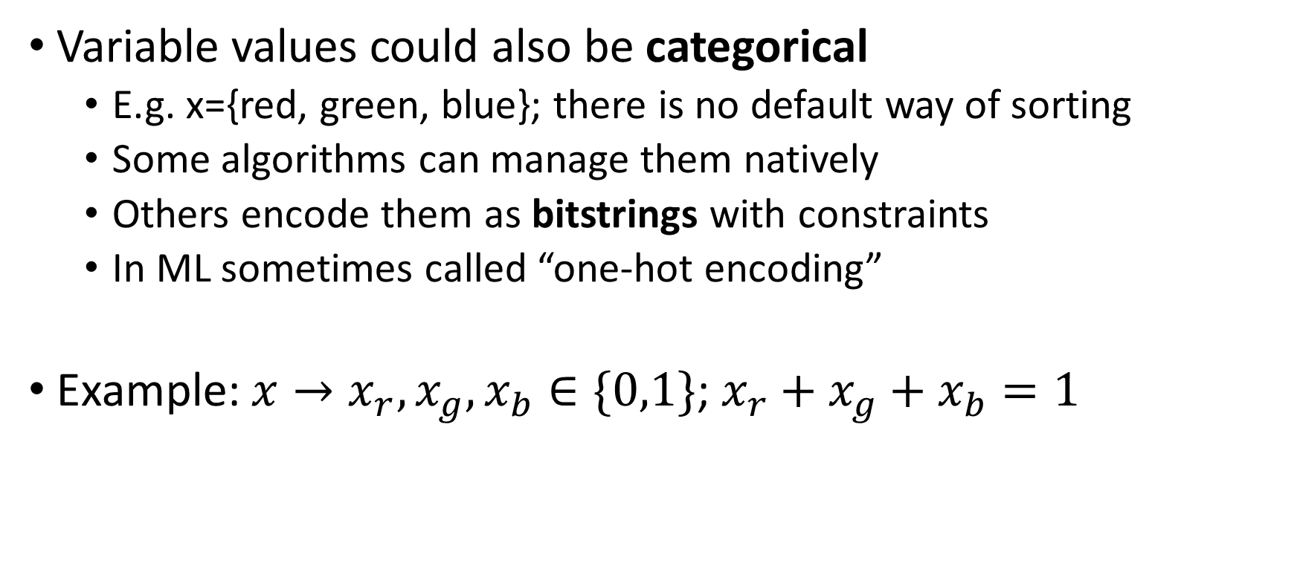
Definition of discrete optimization
Variable values could also be categorical
E.g. x={red, green, blue}; there is no default way of sorting
Some algorithms can manage them natively
Others encode them as bitstrings with constraints
In ML sometimes called “one-hot encoding”
Example: $x→x_{r}, x_{g}, x_{b}∈\{0,1\}$; $x_{r}+x_{g}+x_{b}=1$

Slide 5
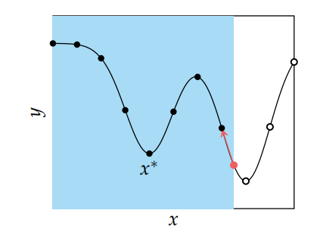
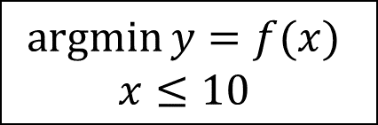
Discrete optimization
Trivial (and ineffective) solution
“Relax” the problem into a continuous one
Round up variable values of best solution to the closest integer
Area of search space within boundaries
Integer values
$$\operatorname{argmin}{y=f(x)}$$
$$x≤10$$
Best value found (but the variable is not an integer!)

Slide 6
Branch and bound
If you can enumerate all possible solutions of a problem
Exhaustive approach: evaluate them all, find global optimum
Branch & Bound guarantees finding the global optimum
Without exploring everything, creates a tree
Branch: divide search space into partitions with extra constraints
Bound: compute lower bound for a partition, linear programming
Pruning: decide what branches are not worthy of being explored

Slide 7

Branch and bound
$$\operatorname{argmax}{f\left(x_{1},x_{2}\right)=5x_{1}+6x_{2}}$$
$$x_{1}+x_{2}≤5$$
$$4x_{1}+7x_{2}≤28$$
$$x_{1},x_{2}≥0$$
$$x_{1},x_{2}∈ℕ$$

Slide 8
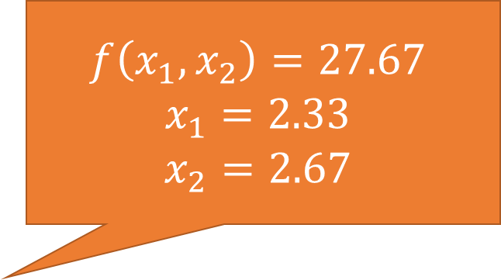
Branch and bound
$$f\left(x_{1},x_{2}\right)=27.67$$
$$x_{1}=2.33$$
$$x_{2}=2.67$$
$$\operatorname{argmax}{f\left(x_{1},x_{2}\right)=5x_{1}+6x_{2}}$$
$$x_{1}+x_{2}≤5$$
$$4x_{1}+7x_{2}≤28$$
$$x_{1},x_{2}≥0$$
$$x_{1},x_{2}∈ℕ$$

Slide 9
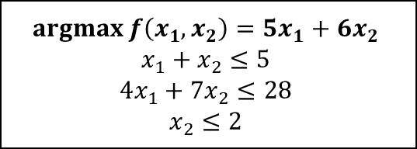



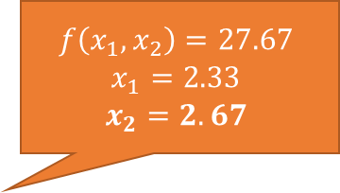
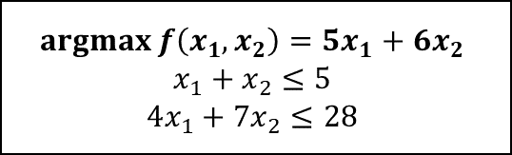
Branch and bound
$$f\left(x_{1},x_{2}\right)=27.67$$
$$x_{1}=2.33$$
$$x_{2}=2.67$$
$$\operatorname{argmax}{f\left(x_{1},x_{2}\right)=5x_{1}+6x_{2}}$$
$$x_{1}+x_{2}≤5$$
$$4x_{1}+7x_{2}≤28$$
$$x_{2}≤2$$
$$x_{2}≥3$$
$$\operatorname{argmax}{f\left(x_{1},x_{2}\right)=5x_{1}+6x_{2}}$$
$$x_{1}+x_{2}≤5$$
$$4x_{1}+7x_{2}≤28$$
$$x_{2}≤2$$
$$\operatorname{argmax}{f\left(x_{1},x_{2}\right)=5x_{1}+6x_{2}}$$
$$x_{1}+x_{2}≤5$$
$$4x_{1}+7x_{2}≤28$$
$$x_{2}≥3$$

Slide 10
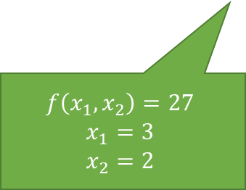
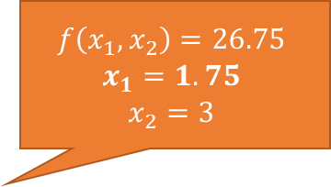
Branch and bound
$$f\left(x_{1},x_{2}\right)=27.67$$
$$x_{1}=2.33$$
$$x_{2}=2.67$$
$$\operatorname{argmax}{f\left(x_{1},x_{2}\right)=5x_{1}+6x_{2}}$$
$$x_{1}+x_{2}≤5$$
$$4x_{1}+7x_{2}≤28$$
$$f\left(x_{1},x_{2}\right)=26.75$$
$$x_{1}=1.75$$
$$x_{2}=3$$
$$x_{2}≤2$$
$$x_{2}≥3$$
$$\operatorname{argmax}{f\left(x_{1},x_{2}\right)=5x_{1}+6x_{2}}$$
$$x_{1}+x_{2}≤5$$
$$4x_{1}+7x_{2}≤28$$
$$x_{2}≤2$$
$$\operatorname{argmax}{f\left(x_{1},x_{2}\right)=5x_{1}+6x_{2}}$$
$$x_{1}+x_{2}≤5$$
$$4x_{1}+7x_{2}≤28$$
$$x_{2}≥3$$
$$f\left(x_{1},x_{2}\right)=27$$
$$x_{1}=3$$
$$x_{2}=2$$

Slide 11


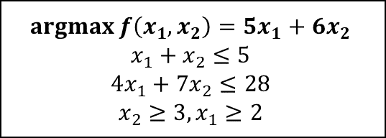
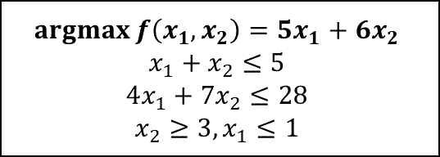
Branch and bound
$$f\left(x_{1},x_{2}\right)=27.67$$
$$x_{1}=2.33$$
$$x_{2}=2.67$$
$$\operatorname{argmax}{f\left(x_{1},x_{2}\right)=5x_{1}+6x_{2}}$$
$$x_{1}+x_{2}≤5$$
$$4x_{1}+7x_{2}≤28$$
$$f\left(x_{1},x_{2}\right)=26.75$$
$$x_{1}=1.75$$
$$x_{2}=3$$
$$x_{2}≤2$$
$$x_{2}≥3$$
$$\operatorname{argmax}{f\left(x_{1},x_{2}\right)=5x_{1}+6x_{2}}$$
$$x_{1}+x_{2}≤5$$
$$4x_{1}+7x_{2}≤28$$
$$x_{2}≤2$$
$$\operatorname{argmax}{f\left(x_{1},x_{2}\right)=5x_{1}+6x_{2}}$$
$$x_{1}+x_{2}≤5$$
$$4x_{1}+7x_{2}≤28$$
$$x_{2}≥3$$
$$x_{1}≤1$$
$$x_{1}≥2$$
$$f\left(x_{1},x_{2}\right)=27$$
$$x_{1}=3$$
$$x_{2}=2$$
$$\operatorname{argmax}{f\left(x_{1},x_{2}\right)=5x_{1}+6x_{2}}$$
$$x_{1}+x_{2}≤5$$
$$4x_{1}+7x_{2}≤28$$
$$x_{2}≥3, x_{1}≤1$$
$$\operatorname{argmax}{f\left(x_{1},x_{2}\right)=5x_{1}+6x_{2}}$$
$$x_{1}+x_{2}≤5$$
$$4x_{1}+7x_{2}≤28$$
$$x_{2}≥3, x_{1}≥2$$

Slide 12
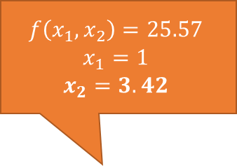
Branch and bound
$$f\left(x_{1},x_{2}\right)=27.67$$
$$x_{1}=2.33$$
$$x_{2}=2.67$$
$$\operatorname{argmax}{f\left(x_{1},x_{2}\right)=5x_{1}+6x_{2}}$$
$$x_{1}+x_{2}≤5$$
$$4x_{1}+7x_{2}≤28$$
$$f\left(x_{1},x_{2}\right)=26.75$$
$$x_{1}=1.75$$
$$x_{2}=3$$
$$x_{2}≤2$$
$$x_{2}≥3$$
$$\operatorname{argmax}{f\left(x_{1},x_{2}\right)=5x_{1}+6x_{2}}$$
$$x_{1}+x_{2}≤5$$
$$4x_{1}+7x_{2}≤28$$
$$x_{2}≤2$$
$$\operatorname{argmax}{f\left(x_{1},x_{2}\right)=5x_{1}+6x_{2}}$$
$$x_{1}+x_{2}≤5$$
$$4x_{1}+7x_{2}≤28$$
$$x_{2}≥3$$
$$f\left(x_{1},x_{2}\right)=25.57$$
$$x_{1}=1$$
$$x_{2}=3.42$$
Unfeasible (no solutions)
$$x_{1}≤1$$
$$x_{1}≥2$$
$$f\left(x_{1},x_{2}\right)=27$$
$$x_{1}=3$$
$$x_{2}=2$$
$$\operatorname{argmax}{f\left(x_{1},x_{2}\right)=5x_{1}+6x_{2}}$$
$$x_{1}+x_{2}≤5$$
$$4x_{1}+7x_{2}≤28$$
$$x_{2}≥3, x_{1}≤1$$
$$\operatorname{argmax}{f\left(x_{1},x_{2}\right)=5x_{1}+6x_{2}}$$
$$x_{1}+x_{2}≤5$$
$$4x_{1}+7x_{2}≤28$$
$$x_{2}≥3, x_{1}≥2$$

Slide 13
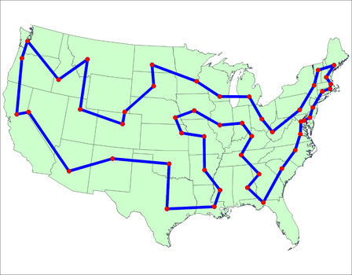
Traveling salesman problem
Salesman has to visit multiple cities once, in any order
What is the optimal order, to minimize total time?

Slide 14
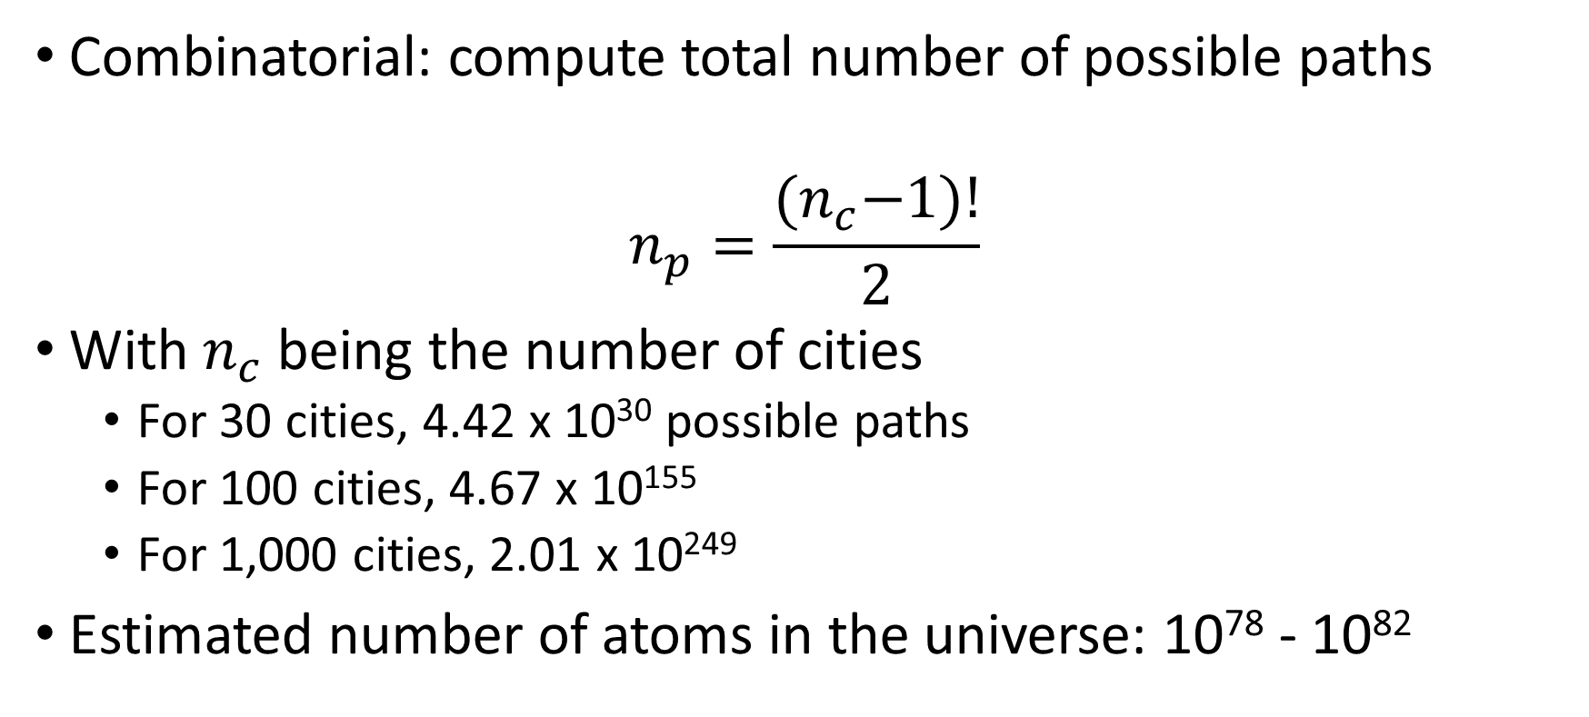
Traveling salesman problem
Combinatorial: compute total number of possible paths
$$n_{p}=\frac{{(n}_{c}−1)!}{2}$$
With $n_{c}$ being the number of cities
For 30 cities, 4.42 x 10³⁰ possible paths
For 100 cities, 4.67 x 10¹⁵⁵
For 1,000 cities, 2.01 x 10²⁴⁹
Estimated number of atoms in the universe: 10⁷⁸ - 10⁸²

Slide 15
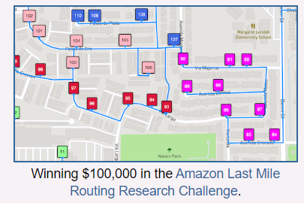
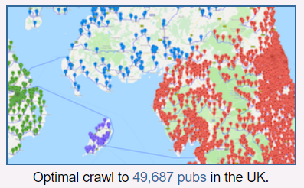
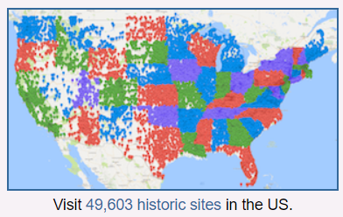
Traveling salesman problem
The best algorithm is (arguably) heuristic
Mix of linear programming, evolutionary algorithms, …
CONCORDE: https://www.math.uwaterloo.ca/tsp/index.html

Slide 16
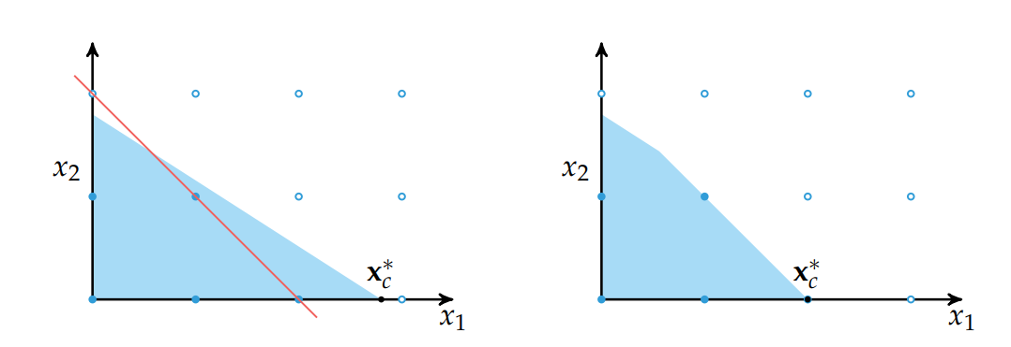
Mixed-integer linear programming
MILP: Class of problems with different solvers
Example: Branch-and-cut
Similar to Branch and Bound + cutting planes (multiple variables)
Different strategies to find best possible cutting planes

Slide 17

Boolean satisfiability (SAT solvers)
Boolean expression (binary variables)
Existence of a candidate solution that outputs true?
Complex problem
Specialized techniques called SAT solvers

Slide 18
Evolutionary algorithms (again)
Internal representation of a candidate solution mixed integer
Requires problem-specific variators (int for int parameters, …)
But in general, it’s relatively straightforward
No guarantee to find the global optimum
Modify candidate solutions, must create valid solutions (e.g. integer values)
Appropriate random sampling
Return best solution(s)
Yes
Stop condition reached?
Generate and evaluate
initial population
Select parents and create offspring
Evaluate new solutions
Remove worst solutions
No

Slide 19


Questions?
Bibliography - Kochenderfer & Wheeler, Algorithms for Optimization, MIT Press, 2019 - Vanderbei, Linear Programming: Foundations and Extensions, 2014 - Hamano et al., CMA-ES with Margin: Lower-Bounding Marginal Probability for Mixed-Integer Black-Box Optimization, 2022 - Applegate et al., Solution of a Min-Max Vehicle Routing Problem, 2002
Images: unless otherwise stated, I stole them from the Internet. I hope they are not copyrighted, or that their use falls under the Fair Use clause, and if not, I am sorry. Please don’t sue me.

