Slide 1
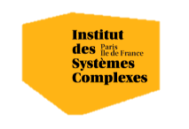

Optimization: an introduction
Alberto TONDA, Senior Researcher (DR)
UMR 518 MIA-PS (Applied Mathematics and Computer Science) INRAE, AgroParisTech, Université Paris-Saclay Institut des Systèmes Complexes, Paris-Ile-de-France

Slide 2
Outline
Vocabulary
General principles
Brainstorming
Taxonomy (-ies)
Intended outcome

Slide 3
Vocabulary
Objective/cost/loss/fitness function
Function that we aim to minimize/maximize
“Function” in the broadest possible sense (input, output)
Variables
Inputs of the objective function; d variables, d dimensions
We can control them, use them to sample the objective function
Search space/objective function landscape
All possible values of the input variables that we could test
Sampled to find best possible values of objective function

Slide 4
Vocabulary
Boundaries
Limits of variable values
Described for each variable, independently
Boundaries define the limits of the search space
Candidate solution
Point in search space that could be the solution to our problem
Constraints
Relationships between multiple problem variables
Must be satisfied to have an acceptable solution

Slide 5
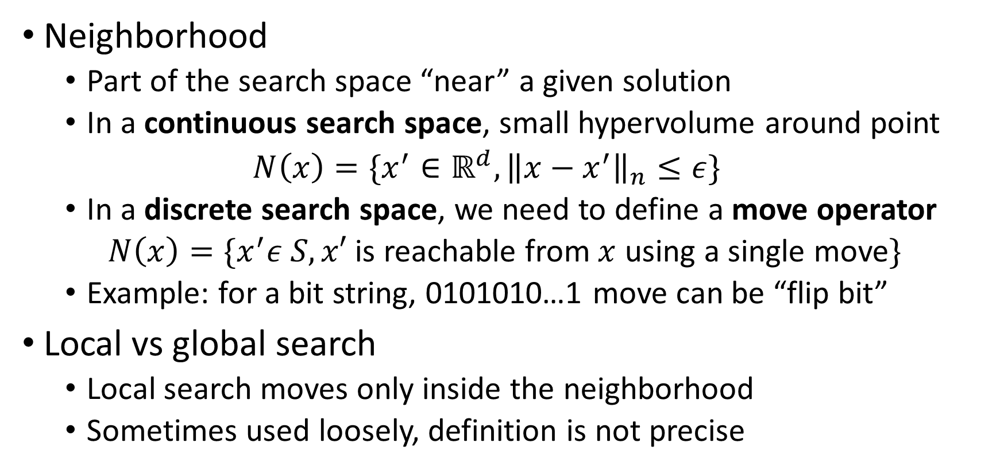
Vocabulary
Neighborhood
Part of the search space “near” a given solution
In a continuous search space, small hypervolume around point
$$N\left(x\right)=\{x^{′}∈ℝ^{d}, {\left\|x−x^{′}\right\|}_{n}≤ε\}$$
In a discrete search space, we need to define a move operator
$N\left(x\right)=\{x^{′}ε S, x′$ is reachable from $x$ using a single move$\}$
Example: for a bit string, 0101010…1 move can be “flip bit”
Local vs global search
Local search moves only inside the neighborhood
Sometimes used loosely, definition is not precise

Slide 6
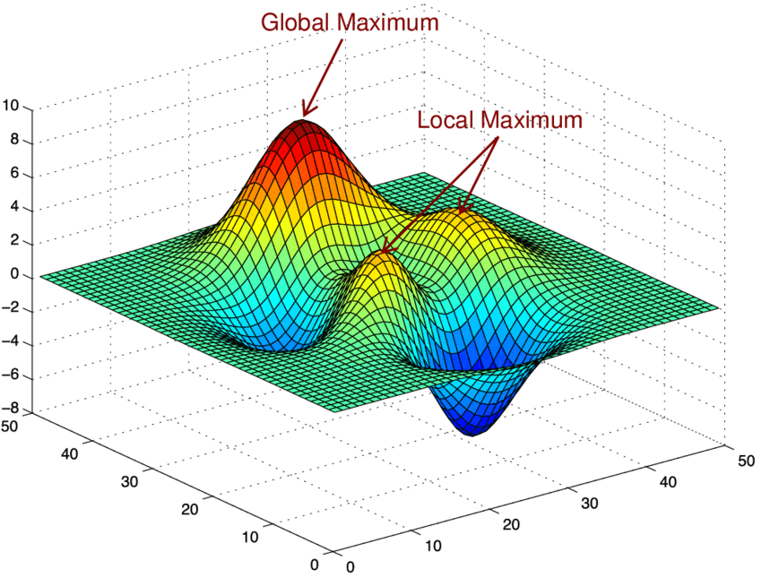
Vocabulary
Global optimum/optima
Input variables values with the best objective function value
Point in the search space with the best objective function value
There might be more than one (multi-modal function)
We might be satisfied with finding one, or wanting all of them

Slide 7
Vocabulary
Local optimum/optima
Point with a (relatively) high value of the objective function
“Surrounded” by points with worse values
Moving away from the point could be difficult for an algorithm
Generally, we don’t know if it a point is a local or global optimum

Slide 8
General principles and assumptions
We do not know much about the search space
Shape of the objective function (search space) is unknown
Mathematical formulation might not be possible
To optimize is to explore the search space, looking for optima
We want to explore in an efficient way!
We cannot spend infinite time wandering about
Even a simple continuous function in one dimension has potentially infinite points in the search space to explore!
Trade-off between quality of solution and time spent

Slide 9
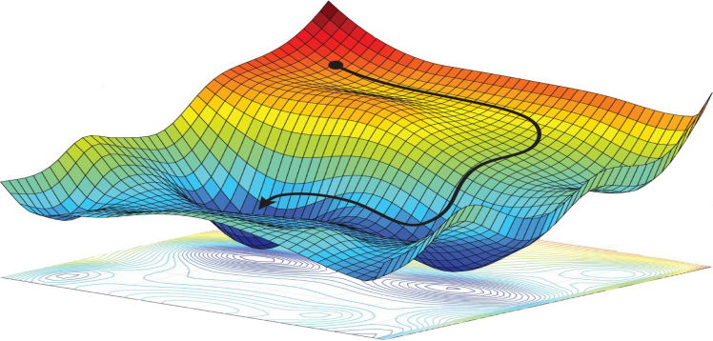
General principles and assumptions
Minimal requirements to be able to optimize
Define boundaries (min and max values of points)
Encode a solution in a computer (e.g. list of floating point values)
Describe how to move in search space (e.g. move by a small Δx in a dimension)

Slide 10
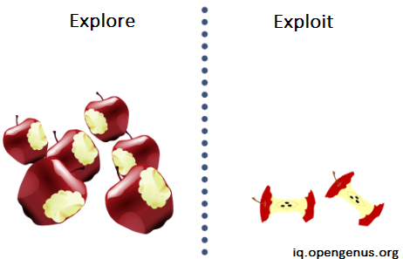
General principles and assumptions
Exploration and exploitation in iterative search algorithms
Initially, explore the search space as much as possible
Then, focus on/exploit the most promising parts found
Switch between exploration and exploitation is hard to time
Vocabulary: horizontal/vertical, breadth/depth, …

Slide 11

Brainstorming
Can we think about a few (simple) strategies to go through the search space and find the best possible point?

Slide 12
Simple strategies
Exhaustive search
Evaluate all possible variable values in search space
In practice, impossible; but a systematic (grid) search could be
Random search
Randomly sample objective function in points within boundaries
Does not take into account the feedback from objective function
Greedy search
Start from a point, explore neighborhood and take best point
Keep going until no improvement is found

Slide 13
Taxonomy of optimization methods
Continuous vs Discrete
For discrete optimization, it becomes “choose one among many”
Domain is “combinatorial optimization”
Mixed discrete/continuous problems exist; also complex structures
Exact vs Stochastic/Approximate
Exact methods guarantee convergence on a global optimum
Too much time or incorrect assumptions on objective function
Stochastic methods deliver reasonable solution in short(er) time…
…but they have no guarantees on whether it’s the global optimum
Terminology: “Stochastic’’ might also refer to stochastic variables

Slide 14
Taxonomy of optimization methods
Archive/Population vs No-Memory
Keep in memory a set of candidate solutions
Representing current “knowledge” of the search space
Use this knowledge to take decisions on next exploration
Lots of function evaluations! Also, memory occupation
Single-objective vs Multi-objective
Conflicting objectives: improve one, deteriorate other(s)
Not searching for a single solution, but several compromises
“Many”-objective: 10 or more objectives (…)

Slide 15
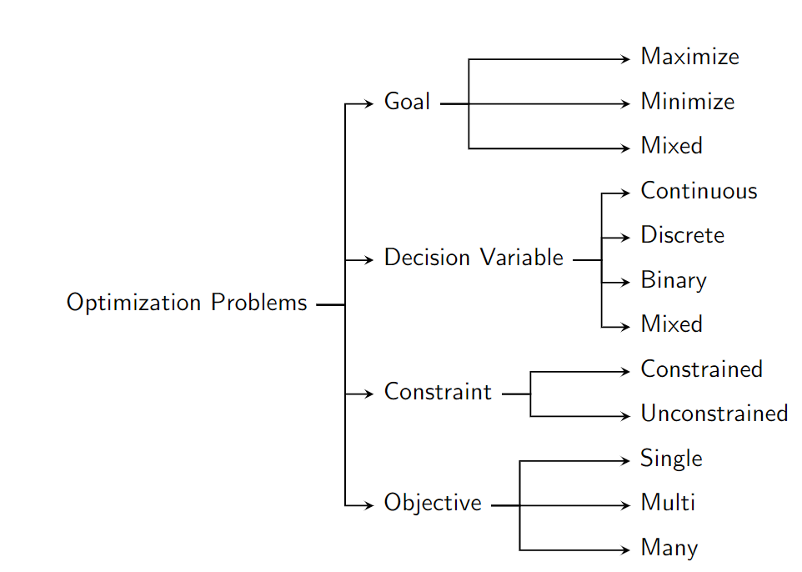
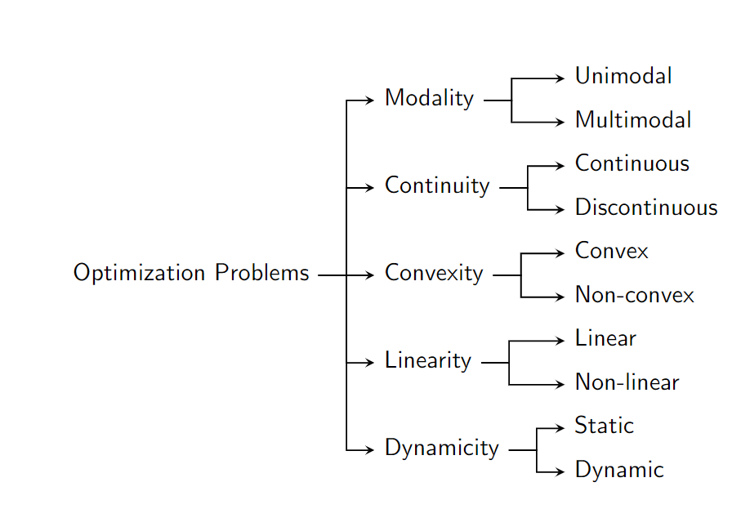
Taxonomy of optimization problems

Slide 16
Taxonomy of optimization problems

Slide 17
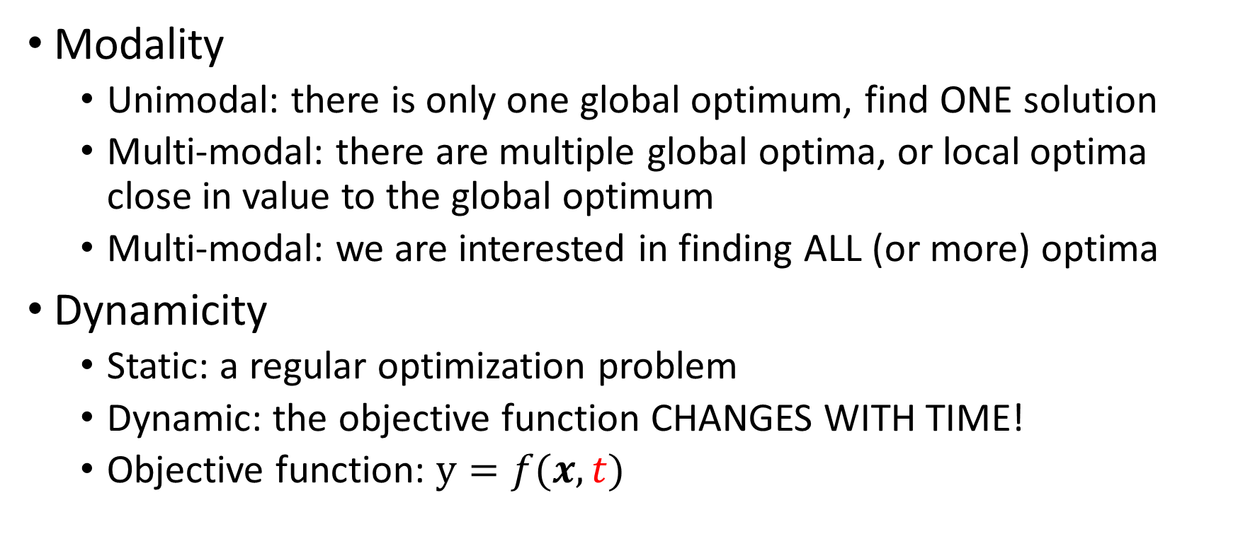
Taxonomy of optimization problems
Modality
Unimodal: there is only one global optimum, find ONE solution
Multi-modal: there are multiple global optima, or local optima close in value to the global optimum
Multi-modal: we are interested in finding ALL (or more) optima
Dynamicity
Static: a regular optimization problem
Dynamic: the objective function CHANGES WITH TIME!
Objective function: $y=f(x,t)$

Slide 18
Taxonomy of optimization problems
Computational expensiveness of objective function
Not expensive: extensive sampling possible
Expensive: surrogate models, Bayesian optimization, store list of all solutions previously evaluated…
Objective function’s search space is deceptive/flat
Assumption: “good solutions are close to other good solutions”
If this is not true, most algorithms don’t work
Better off with a completely random sampling
Flat search space has no clues on where to move

Slide 19
Real-world applications can be weird
Mix of continuous and discrete variables
Optimize graphs, trees, ensembles of trees…
Search space can be hard to characterize
E.g. “optimize the shape of a car to minimize wind resistance”
E.g. “optimize order of visit of towns, to minimize traveling time”
E.g. “optimize an Assembly language program that is able to set all bits in the ax computer registry to zero (maximize number of bits set to zero)”

Slide 20
Intended outcome
You will have optimization problems to solve
Identify the typology (linear, non-linear, dynamic, static…)
Match with the best algorithm for the problem
Or get some ideas on how to design an optimization algorithm
Very often, the best optimization algorithm is HEURISTIC
Heuristic is developed ad-hoc for the target problem
Employs domain knowledge of the problem inside algorithm

Slide 21
Questions?
Bibliography - Kochenderfer & Wheeler, Algorithms for Optimization, MIT Press, 2019
Images: unless otherwise stated, I stole them from the Internet. I hope they are not copyrighted, or that their use falls under the Fair Use clause, and if not, I am sorry. Please don’t sue me.

