Slide 1
Constrained Optimization and Linear Programming
Alberto TONDA
UMR 518 MIA-PS, INRAE, AgroParisTech, Université Paris-Saclay UAR 3611, Institut des Systèmes Complexes de Paris Île-de-France

Slide 2
Outline
Constrained optimization
Linear programming
Other approaches

Slide 3
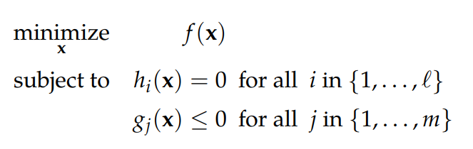

Constrained optimization
Optimizing objective function is not enough
We also have to respect additional constraints on variables
In general, different from boundaries (although, terminology…)
Boundaries can turn into constraints ($x∈\left[0,2\right]→x≥0,x≤2$)
Constraints are usually equalities and inequalities

Slide 4
Constrained optimization
Example: optimize the diet of soldiers
Minimize cost of meals
Attain at least a certain amount of each nutrient group
Original problem had 9 nutrient groups and 77 food items

Slide 5
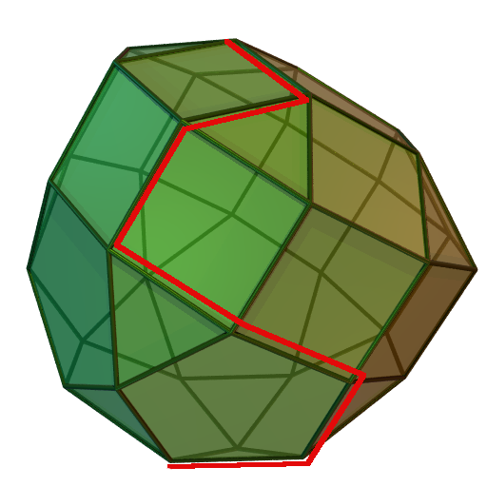
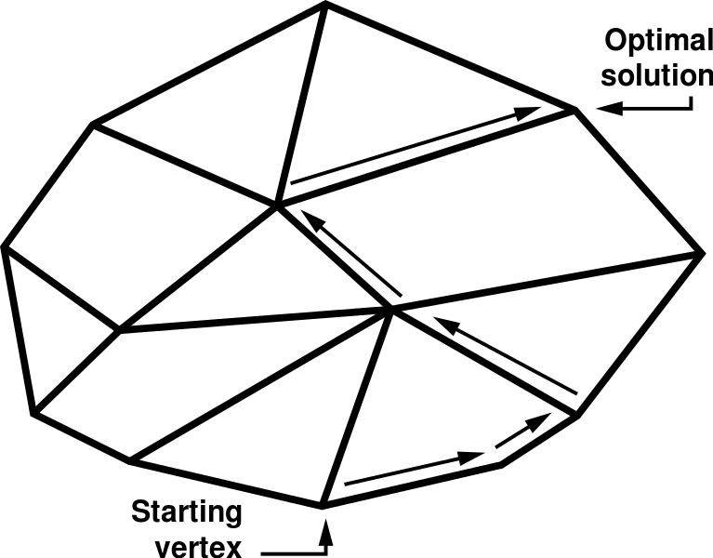
Linear programming
Linear objective function, linear constraints
Stating the problem properly ensures finding global optimum
Simplex: explore vertices of a polytope (hyper-polygon)
Also evaluate feasibility of the problem (e.g. no possible solutions)
Notes:
Worst-case scenario: super-exponential; average-case scenario: polynomial

Slide 6
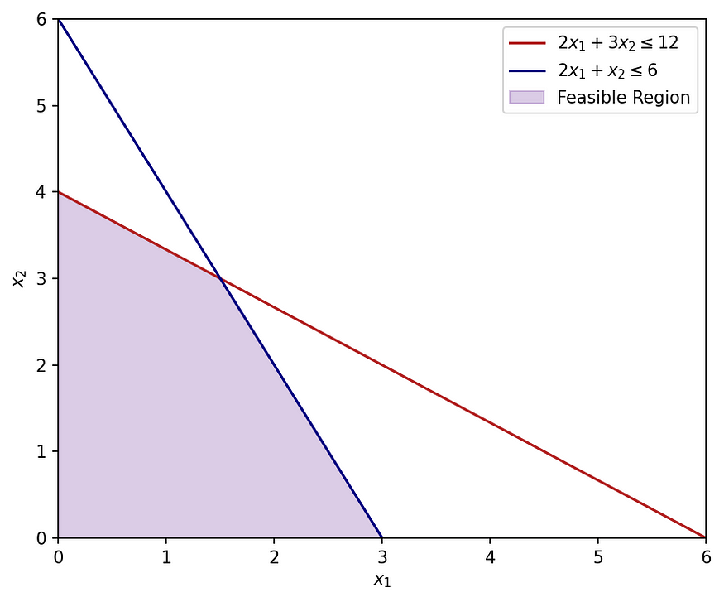
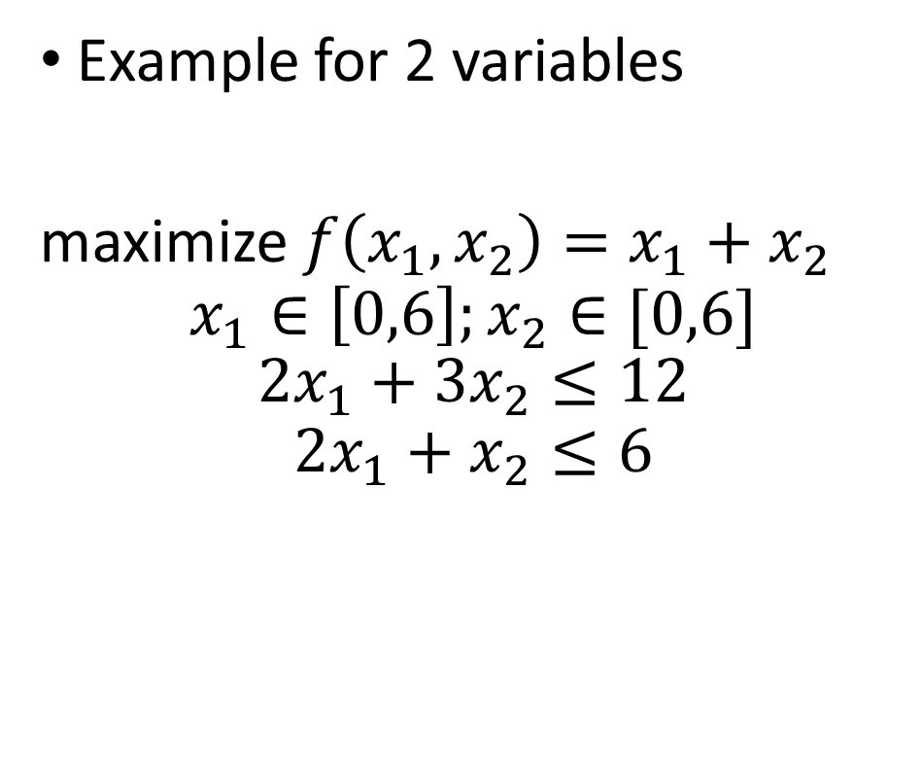
Linear programming
Example for 2 variables
maximize ${f\left(x_{1},x_{2}\right)=x}_{1}+x_{2}$
$$x_{1}∈\left[0,6\right];x_{2}∈[0,6]$$
$$2x_{1}+3x_{2}≤12$$
$$2x_{1}+x_{2}≤6$$

Slide 7
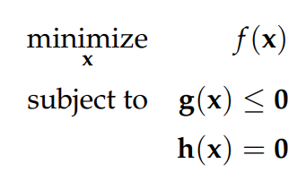

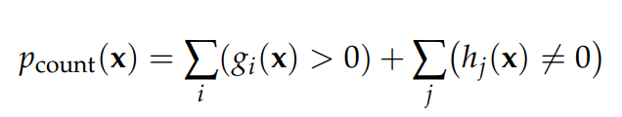
Other approaches
If constraints and/or objective function are not linear
Variations of Linear Programming
Quadratic Programming
Non-linear Programming
Or convert problem into unconstrained using penalties

Slide 8


Questions?
Bibliography - Kochenderfer & Wheeler, Algorithms for Optimization, MIT Press, 2019 - Vanderbei, Linear Programming: Foundations and Extensions, 2014
Images: unless otherwise stated, I stole them from the Internet. I hope they are not copyrighted, or that their use falls under the Fair Use clause, and if not, I am sorry. Please don’t sue me.

