Slide 1
Introduction to Deep Learning in Practice with pytorch
Alberto TONDA, Ph.D. (Senior permanent researcher, DR)
UMR 518 MIA-PS, INRAE, AgroParisTech, Université Paris-Saclay UAR 3611, Institut des Systèmes Complexes de Paris Île-de-France

Slide 2
Objective of this class
Give an overview of deep learning architectures and applications, using pytorch as the support library

Slide 3
Outline
Existential questions: who am I, why are we here?
Current state of the field: why deep learning, why pytorch?
(Tentative) Planning for the class

Slide 4
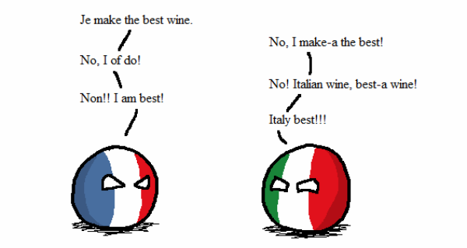
Who am I?
Career
Bachelor and Master in Computer Science Engineering
Ph.D. from Politecnico di Torino, Italy, in 2011
Permanent researcher in France since late 2012 (INRAE)
Senior researcher (DR) since 2023
Research interests
Stochastic multi-objective optimization
Machine learning (explainable AI)
Biological/agri-food problems
Notes:
I am NOT an expert of ALL methods that I am going to present.

Slide 5
What is deep learning?

Slide 6
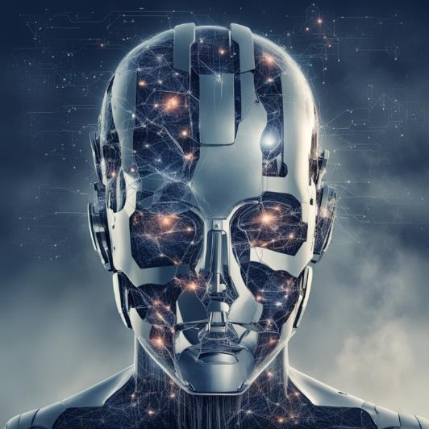
Why is this subject relevant now?
Artificial Intelligence achieved important goals in last decade
Human-competitive* play in difficult games
Improvement in state of the art for image/video classification
Generation of images, text, and sound
Availability of data and computing (phones)
Attempts at commercial use of AI
Self-driving vehicles
Assistants for text and code generation
…

Slide 7
Current state of the field
March 2023
Open letter to slow down AI research
April 2023
Meta releases Segment Anything
November 2022
OpenAI releases ChatGPT
October 2022
I apply to teach this class
December 2022
pytorch 2.0 is announced
April 2023
Experiments with autonomous agents (babyAGI, AutoGPT)

Slide 8
Current state of the field
Large availability of open-ish source tools
The open source movement in computer science is strong
It’s useful for companies to have other people use their code
For deep learning, it started with Tensorflow, 2017 (Google)
General Purpose Graphic Processing Units (GPGPUs)

Slide 9
Current state of the field
An unreasonable amount of enthusiasm!
Why is that?
Competition between large companies (Microsoft, Meta, Google)
Tools that are relatively accessible to non-experts
Considerable amount of passionate practitioners
Communities obsessed with AI (existential risk, accelerationists, …)
Charismatic influencers (Sam Altman, Eliezer Yudkowsky, Yan Le Cunn, Gary Marcus, …)

Slide 10








Why pytorch?
Several competing libraries
keras, pytorch, theano, …
pytorch came out on top, thanks to…
Eager execution, for rapid prototyping
Analysis step by step
Availability of models?

Slide 11
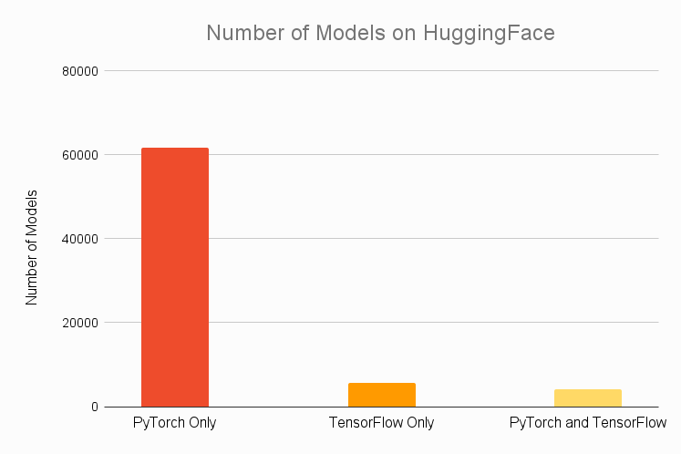
Why pytorch?

Slide 12

HuggingFace?
French-American company
Weird name (IMHO), but 4.5 * 10^9$ evaluation
Library for deep neural networks (transformers)
Hub, to share and discuss trained models
Extremely successful, several useful models
Users can download, fine-tune, change and share
Easy to use

Slide 13
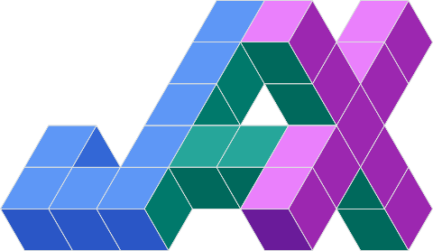
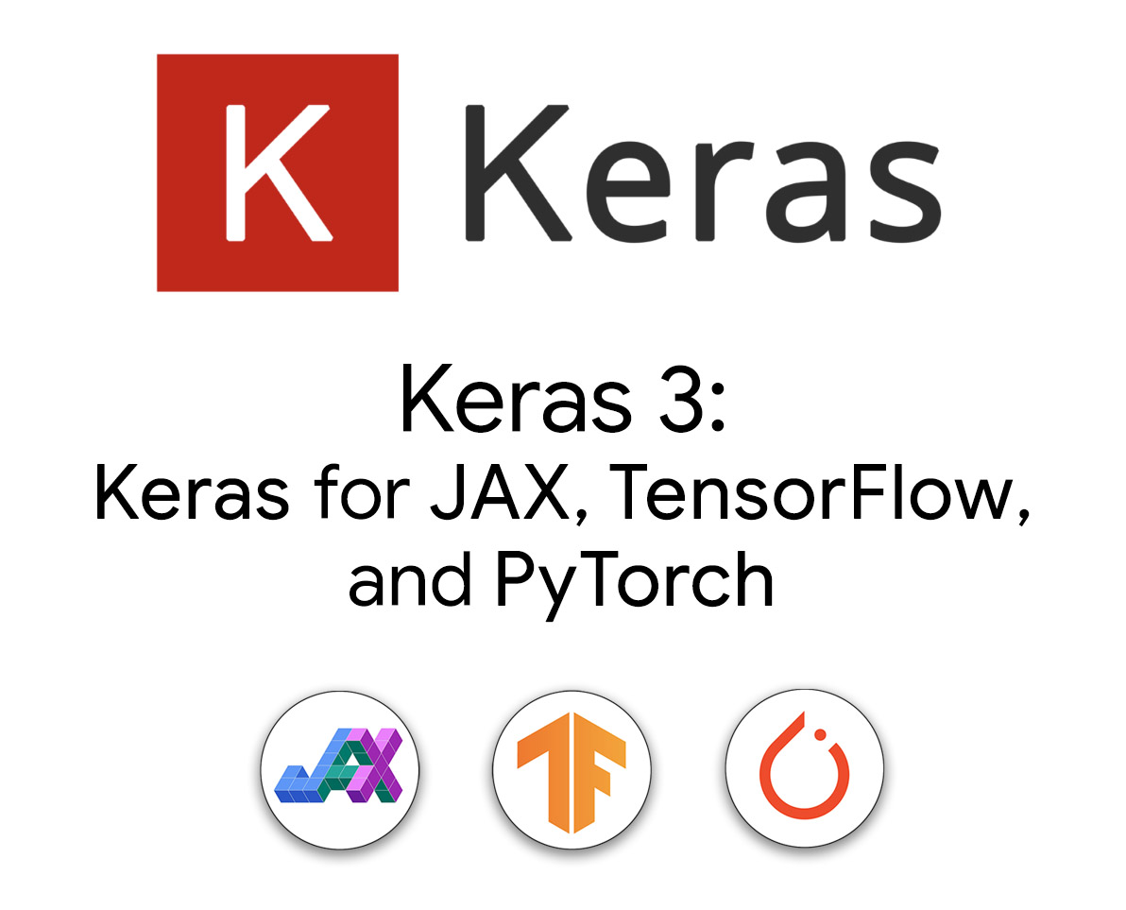

Competition
FLAX neural network library in JAX

Slide 14
Planning: what we will attempt to do

Slide 15
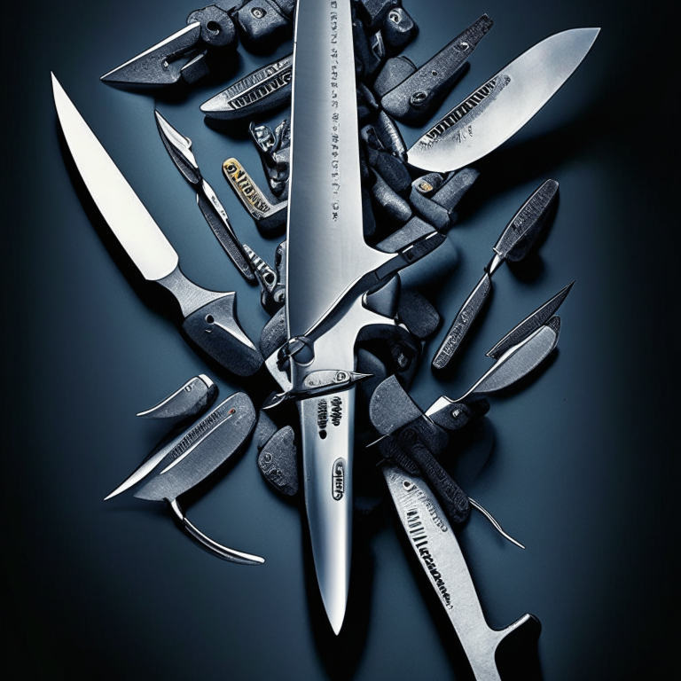
Objective of this class
The stress is on practice
We are going to use pytorch, but also other libraries (often built on top of pytorch)
DL is cool, but comparison with other techniques
Obtain a “Swiss knife” of tools

Slide 16
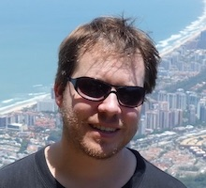
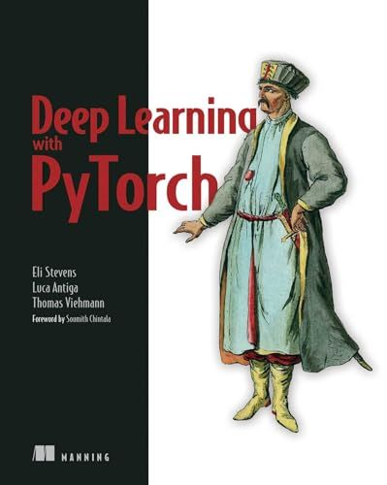
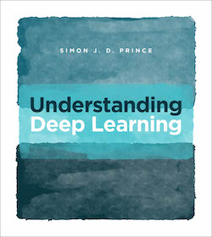
References
“When you are copying from one source, it’s plagiarism; when you are copying from multiple sources, it’s research.”
-- Prof. Notestein, Yale, 1929
Prof. Vincent Guige, AgroParisTech & Sorbonne University,
here depicted with cool sunglasses, https://vguigue.github.io/
“Understanding deep learning”, https://udlbook.github.io/udlbook/
“Deep learning with pytorch”, https://github.com/deep-learning-with-pytorch/

Slide 17
Take home message(s)
Deep Learning is exceptionally good for structured data
Data where adjacency has a meaning
Images, videos, text, graphs, …
For tabular data, there are simpler and better techniques
Boosted forests/ensembles of weak predictors
R. Forest, XGBoost and LightGBM + hyperparameter optimization
For time series, it’s really difficult (!)
Average application: fine-tune existing models (transfer learning)

