Slide 1


Continuous optimization: overview
Alberto TONDA, Senior Researcher (DR)
UMR 518 MIA-PS (Applied Mathematics and Computer Science) INRAE, AgroParisTech, Université Paris-Saclay Institut des Systèmes Complexes, Paris-Ile-de-France

Slide 2
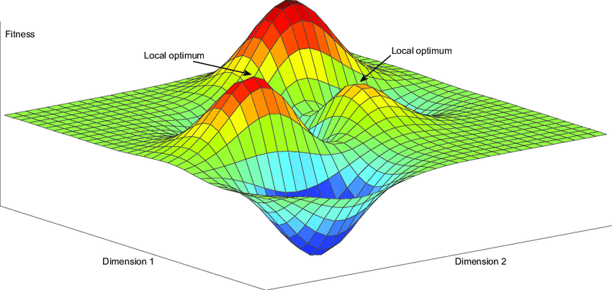
Outline
Gradient-based techniques
Gradient descent
Stochastic gradient descent
Stochastic techniques
Basin hopping
Evolutionary algorithms

Slide 3
Introduction

Slide 4
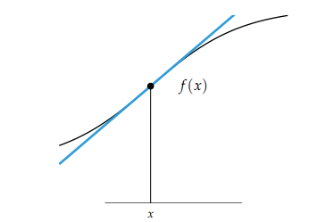

Gradient-based techniques
Derivative $f′(x)$ of a function $f\left(x\right)$ in a single point
Rate at which the value of f changes at x
Can be visualized as a tangent line, derivative is the slope

Slide 5
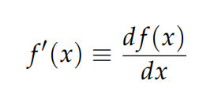

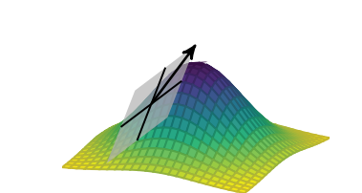
Gradient-based techniques
Different interchangeable notations
Derivative in multiple dimensions is the gradient (Jacobian)

Slide 6
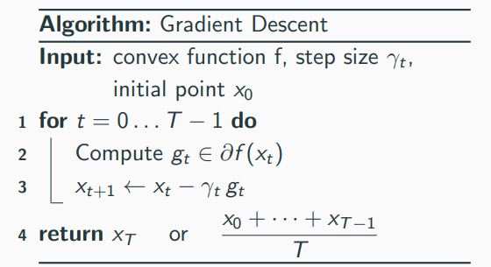
Gradient-based techniques
Simple intuition: always follow steepest descent/ascent
Assumptions
Gradient can be computed
Function is convex (guarantees global optimum)
Can also work on non-convex functions, as long as derivative can be computed

Slide 7
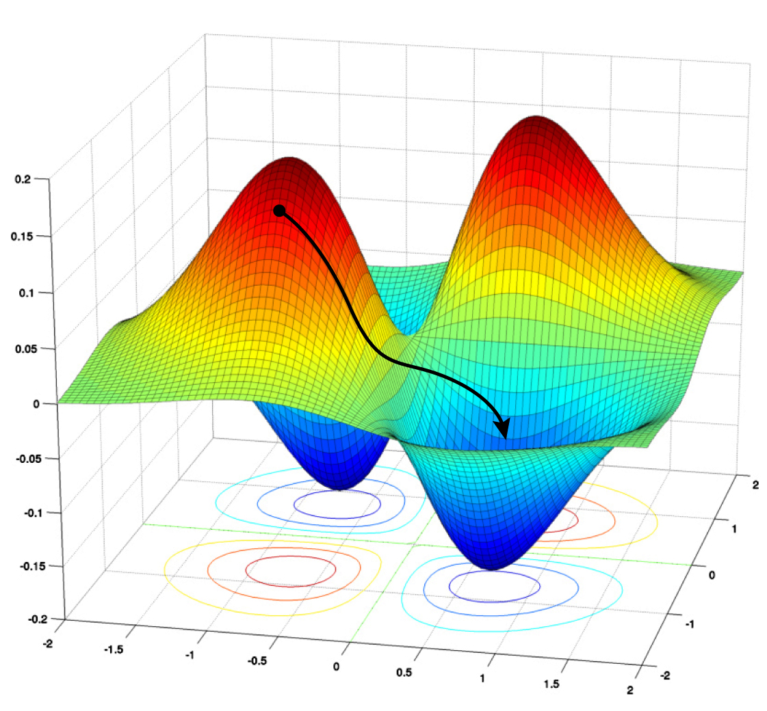
Gradient-based techniques
Simple intuition: always follow steepest descent/ascent
Assumptions
Gradient can be computed
Function is convex (guarantees global optimum)
Can also work on non-convex functions, as long as derivative can be computed

Slide 8
Issues with gradient-based techniques
Brainstorming!

Slide 9

Issues with gradient-based techniques
Starting point of exploration matters
Hard to get out of local optima
Step size? Too small / too large lead to convergence issues

Slide 10
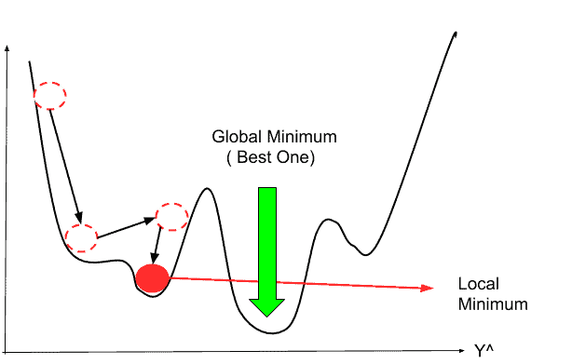
Issues with gradient-based techniques
Starting point of exploration matters

Slide 11
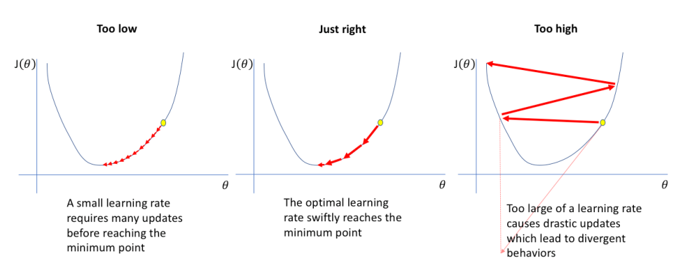
Issues with gradient-based techniques
Step size? Too small / too large lead to convergence issues

Slide 12
Gradient-based techniques for neural networks
Why are gradient-based techniques so successful?
Actually, stochastic gradient descent (SGD) & descendants
Techniques made popular by (deep) neural networks
Can escape local optima!
Self-adapting step size
State-of-the-art for NNs, not very used elsewhere

Slide 13
Modern gradient-based techniques

Slide 14

Stochastic techniques
Limitations of gradient-based techniques were evident
Practical problems had objective functions with local optima
You can randomly sample the search space…
…but exploiting feedback/function characteristics is better!

Slide 15
PSEUDO-random number generation
Important caveat!
“Random” numbers in a computer are NOT random
Specialized algorithms can produce long sequences of numbers
…but in the end they tend to repeat (!!), they have a period
Details are complex and out of scope: see Mersenne Twister
Concrete consequences
PRNG algorithms need to be initialized with random seed
All sequences that start from same random seed are identical
Storing and setting random seed ensures repeatability of experiments

Slide 16
PSEUDO-random number generation
STORE THE RANDOM SEED

Slide 17
Brainstorming!
How to use stochasticity to go beyond limitations of gradient-based techniques?

Slide 18
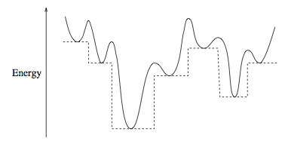
Basin-hopping
Developed starting from a practical application
Protein folding, objective function is derivable
However, it does contain several local optima

Slide 19
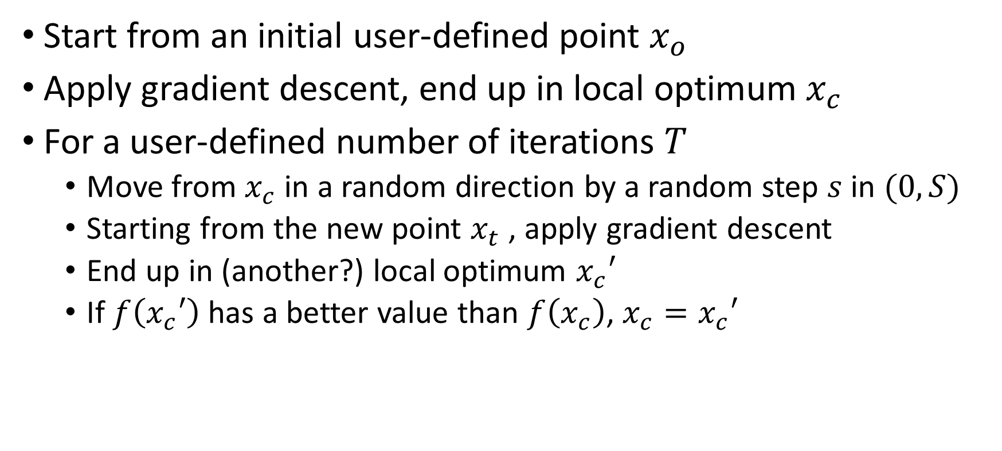
Basin-hopping
Start from an initial user-defined point $x_{o}$
Apply gradient descent, end up in local optimum $x_{c}$
For a user-defined number of iterations $T$
Move from $x_{c}$ in a random direction by a random step $s$ in $(0, S)$
Starting from the new point $x_{t}$ , apply gradient descent
End up in (another?) local optimum $x_{c}′$
If $f\left(x_{c}′\right)$ has a better value than $f\left(x_{c}\right)$, $x_{c}=x_{c}′$

Slide 20
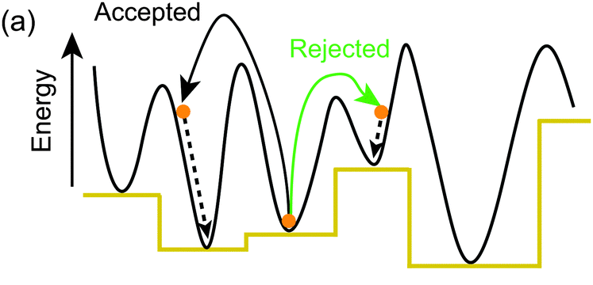
Basin-hopping

Slide 21
Evolutionary algorithms
Stochastic optimization techniques
Sample search space, proceed with “natural selection” of candidate solutions
“Memory” of search space with current set of candidate solutions
Best solutions “reproduce” more often
New solutions are a slightly altered version of parents
Evaluate solution performance
Individuals
Population
Offspring
Fitness
Notes:
They can be used for other purposes, but in this presentation I will focus on optimization. Who here has used evolutionary algorithms, also known as “Genetic Algorithms”?
They are inspired by the neo-Darwinian understanding of natural selection. But keep in mind that this is just a metaphor, they are as close to natural selection as artificial neural networks are close to the brain, which means, very little.
There is some domain-specific terminology that I will try not to use too much. But basically, a candidate solution is sometimes called “individual”; the set of candidate solutions at the current iteration is called “population”; and the new solutions produced at each iteration are called “offspring”

Slide 22
Evolutionary algorithms
Return best solution(s)
Yes
Stop condition reached?
Generate and evaluate
initial population
Select parents and create offspring
Evaluate new solutions
Remove worst solutions
No

Slide 23

Issues with stochastic techniques
Large number of evaluations required
Exploration vs exploitation / step size

Slide 24
Modern evolutionary algorithms

Slide 25
Questions?
Bibliography - Kochenderfer & Wheeler, Algorithms for Optimization, MIT Press, 2019 - De Jong, Evolutionary Computation: A Unified Approach, 2016
Images: unless otherwise stated, I stole them from the Internet. I hope they are not copyrighted, or that their use falls under the Fair Use clause, and if not, I am sorry. Please don’t sue me.

Slide 26
Linear programming
If you manage to describe your problem as
A linear objective function (weighted sum of variables)
Plus a set of linear constraints (same as above)
Linear programming is powerful and effective
Guarantees to find the global optimum

