Slide 1
Discrete optimization
Alberto TONDA
UMR 518 MIA-PS, INRAE, AgroParisTech, Université Paris-Saclay UAR 3611, Institut des Systèmes Complexes de Paris Île-de-France

Slide 2
Outline
Definition of discrete optimization
Combinatorial optimization
Linear programming and mixed-integer linear programming
SAT solvers (Boolean satisfiability problem)
Evolutionary algorithms (again)

Slide 3
Definition of discrete optimization

Slide 4
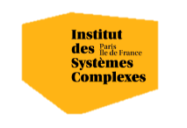

Questions?
Bibliography - Kochenderfer & Wheeler, Algorithms for Optimization, MIT Press, 2019
Images: unless otherwise stated, I stole them from the Internet. I hope they are not copyrighted, or that their use falls under the Fair Use clause, and if not, I am sorry. Please don’t sue me.

