Slide 1
Hyperparameter optimization and AutoML
Alberto TONDA
UMR 518 MIA-PS, INRAE, AgroParisTech, Université Paris-Saclay UAR 3611, Institut des Systèmes Complexes de Paris Île-de-France

Slide 2
Outline
Hyperparameter optimization
Common strategies
Advanced strategies
AutoML

Slide 3
Hyperparameter optimization
ML algorithms have hyperparameters
Number of trees in an ensemble
Number of layers in a neural network
Type of kernel in a support vector machine
…
Values of hyperparameters have influence on performance
How do we select the best values?

Slide 4
Hyperparameter optimization
Let’s frame it as an optimization problem
Mixed integer/floating point/categorical
Candidate solution: set of hyperparameter values
Objective function: performance (in a cross-validation)
Objective function is expensive to evaluate
What types of optimization algorithms could work here?

Slide 5
Common strategies
Grid (exhaustive) search
Select a few meaningful values of parameters
Try all possible combinations
sklearn.model_selection.GridSearchCV
Random search
Lists for discrete parameters and distributions for continuous
Makes a user-specified number of attempts and returns best
sklearn.model_selection.RandomizedSearchCV

Slide 6
Common strategies
Surrogate models
Evaluate candidate solutions on a few samples
Remove the ones that are clearly among the worst
sklearn.model_selection.HalvingGridSearchCV
sklearn.model_selection.HalvingRandomSearchCV
Luckily, some other people know optimization!

Slide 7
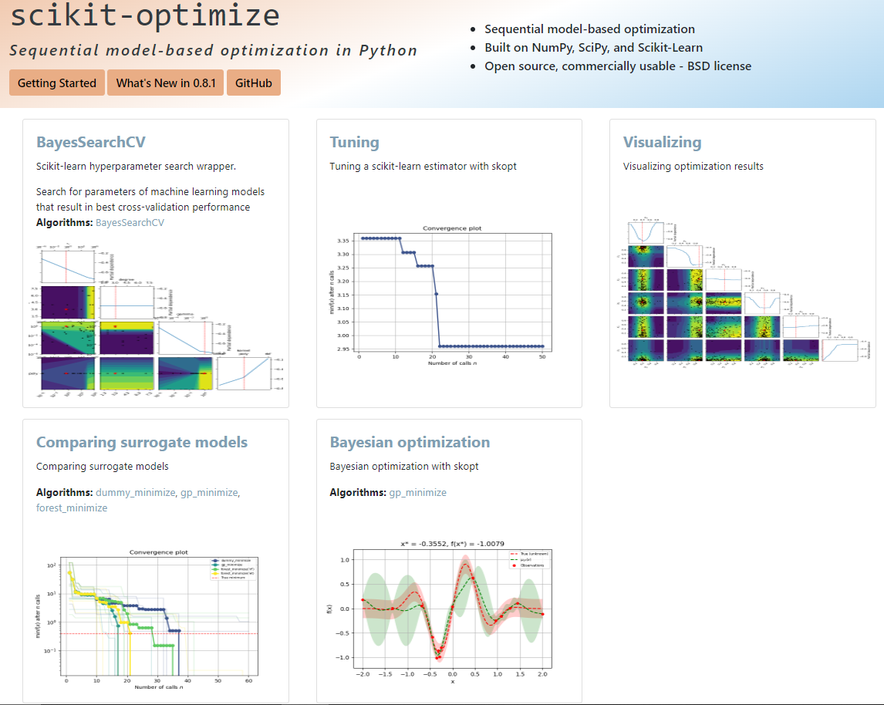
Advanced strategies
Bayesian Optimization!
Surrogate models!

Slide 8
Advanced strategies
Can we do better?
Here we are selecting best hyperparameters for a model…
…but we already chose a specific model/algorithm
Not to mention, preprocessing!
Dimensionality reduction
Feature construction (e.g. polynomial features)
Normalization (several different possibilities)
Can we optimize all this? If so, what kind of representation?

Slide 9
AutoML
The idea of optimizing all choices
Candidate solution: preprocessing, algorithm, hyperparameters…
Objective function: performance in a cross-validation
Several different approaches, budding field
Example: TPOT (and TPOT-2)
Tree-based Pipeline Optimization Tool
https://epistasislab.github.io/tpot/

Slide 10
AutoML
Structure of a candidate solution
Preprocessing 1 (and hyperparameters)
Training data
…
Feature selection (and hyperparameters)
ML algorithm (and hyperparameters)
Preprocessing N (and hyperparameters)

Slide 11
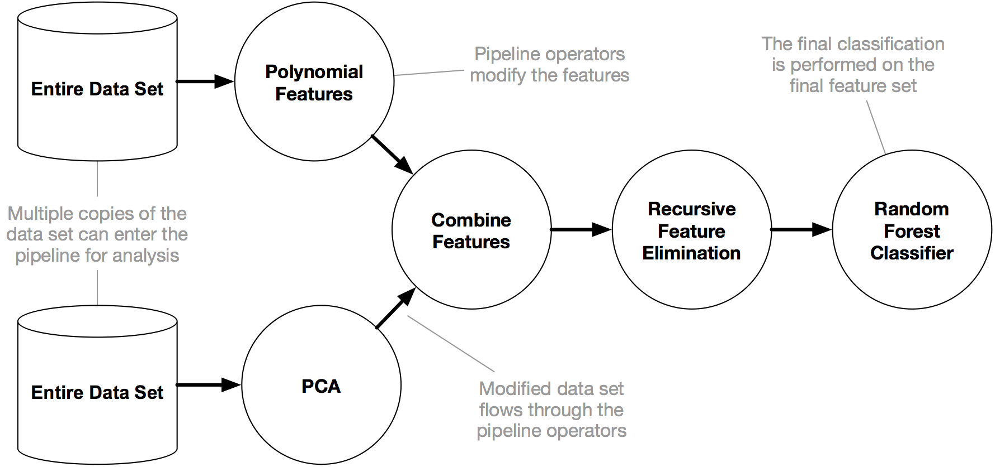
AutoML
It’s Genetic Programming!

Slide 12
AutoML
TPOT/TPOT-2 is just one example of AutoML
Auto-WEKA (Java)
Auto-sklearn (variants of Bayesian optimization)
DataRobot (company, offers an online service)
AutoGluon
H2O AutoML
…
Auto-Pytorch: Neural Architecture Search
Take a look at the bibliography to know more

Slide 13
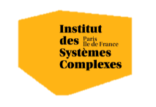

Questions?
Bibliography - James et al., An Introduction to Statistical Learning with Applications in Python, 2023 - Feurer et al., Efficient and Robust Automated Machine Learning, 2015 - Hutter et al., Automated Machine Learning, 2019
Images and videos: unless otherwise stated, I stole them from the Internet. I hope they are not copyrighted, or that their use falls under the Fair Use clause, and if not, I am sorry. Please don’t sue me.

