Slide 1
Making sense of CNNs: Visualization techniques
Alberto TONDA, Ph.D. (Senior permanent researcher, DR)
UMR 518 MIA-PS, INRAE, AgroParisTech, Université Paris-Saclay UAR 3611, Institut des Systèmes Complexes de Paris Île-de-France

Slide 2
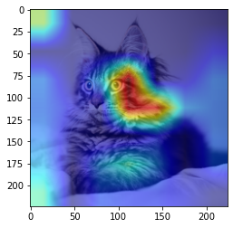
Outline
xAI: eXplainable AI
Visualization of feature patterns
Saliency maps
Grad-CAM

Slide 3
Black-box effect
Black-box effect is common to all ML algorithms
We know that the prediction is, but not why the model did it
Too many parameters to analyze, even for RF or big Decision Trees
For CNNs, it’s even worse
Feature construction/extraction step
What are the features used? What do they look like?
What parts of the images is the CNN analyzing to give a decision?

Slide 4
xAI: eXplainable AI
Relatively new research field
“Open the black box”, answer “Why is it behaving like that?”
Local explanation: why behavior for this sample?
Global explanation: why behavior in general, or for a class?
Ongoing discussion
What is the definition of explanation?
Difference between explanation and interpretation
Is it possible to build white-box ML algorithms? Yes, but…*
*…this is a long discussion. The short version is that there seems to be a trade-off between interpretability and performance

Slide 5
xAI: eXplainable AI
Model-agnostic methods
Local Interpretable Model-agnostic Explanations (LIME)
SHapley Additive exPlanations (SHAP/SHAPLY)
Relative feature importance (e.g. permutation importance)
For CNNs, we have some model-specific methods
Since the models are performing feature construction/extraction
We are not even sure of what the features are!

Slide 6
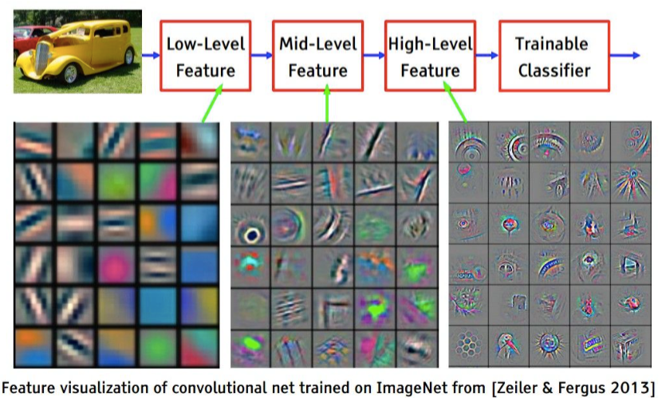
Visualization of feature patterns

Slide 7
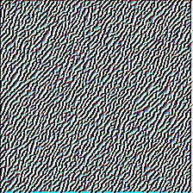
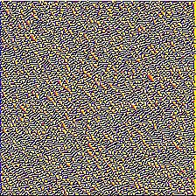
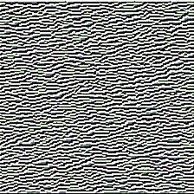
Visualization of feature patterns
Optimize an image
Treat pixel values as variables in the optimization problem
Generate image that maximizes output of a target filter
Backpropagating gradients to the pixels
Zoomed in
Or maybe guided backpropagation…?

Slide 8

Hooks?
The implementation uses pytorch hooks
Not very well documented
Essentially, connect a function to a module or tensor
Every time outputs (forward)…
Every time computes gradient (backward)…
…the function is invoked!
Useful for debugging or visualization
Without having to tweak with model
E.g. without writing extra methods

Slide 9
Saliency maps
What are the most important pixels for the decision?
Forward pass of an image through the network
Take relevant output (classification: tensor value for target class)
Compute derivative of that output w.r.t. to pixels (backward pass)
Pixels with high values of gradient are more important
Changing their value might greatly impact decision
Visualize which pixels impact decision the most

Slide 10
Grad-CAM
Looking at one single pixel at the time not very informative
Later CNN filters (high-level features) map to image areas
Can’t we do the same as saliency maps, but image areas?
Gradient-weighted Class Activation Maps
Focus is on a target class for a classification problem
Outputs of target modules(s) more important for final decision?
Obstacle: last part of CNN is a very complex set of non-linearities, hard to interpret
Solution: replace it with a linear classifier, retrain it

Slide 11


Questions?
Bibliography - Lundberg, S. M., & Lee, S. I. (2017). A unified approach to interpreting model predictions. Advances in neural information processing systems, 30. [SHAP] - Ribeiro, M. T., Singh, S., & Guestrin, C. (2016). "Why should I trust you?" Explaining the predictions of any classifier. In Proceedings of the 22nd ACM SIGKDD international conference on knowledge discovery and data mining (pp. 1135-1144). [LIME] - Selvaraju, R. R., Cogswell, M., Das, A., Vedantam, R., Parikh, D., & Batra, D. (2017). Grad-cam: Visual explanations from deep networks via gradient-based localization. In Proceedings of the IEEE international conference on computer vision (pp. 618-626). - Simonyan, K., Vedaldi, A., & Zisserman, A. (2013). Deep inside convolutional networks: Visualising image classification models and saliency maps. arXiv preprint arXiv:1312.6034. - Springenberg, J. T., Dosovitskiy, A., Brox, T., & Riedmiller, M. (2014). Striving for simplicity: The all convolutional net. arXiv preprint arXiv:1412.6806. [Visualizing Feature Patterns]
Images and videos: unless otherwise stated, I stole them from the Internet. I hope they are not copyrighted, or that their use falls under the Fair Use clause, and if not, I am sorry. Please don’t sue me.

