Slide 1
Convolutional Neural Networks
Alberto TONDA, Ph.D. (Senior permanent researcher, DR)
UMR 518 MIA-PS, INRAE, AgroParisTech, Université Paris-Saclay UAR 3611, Institut des Systèmes Complexes de Paris Île-de-France

Slide 2
Outline
Convolution
Max pooling
Architecture
Applications
Success stories

Slide 3
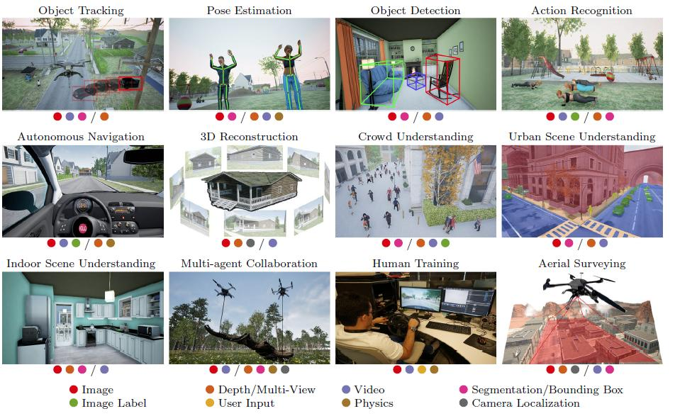
Convolution
Originally from the domain of computer vision

Slide 4
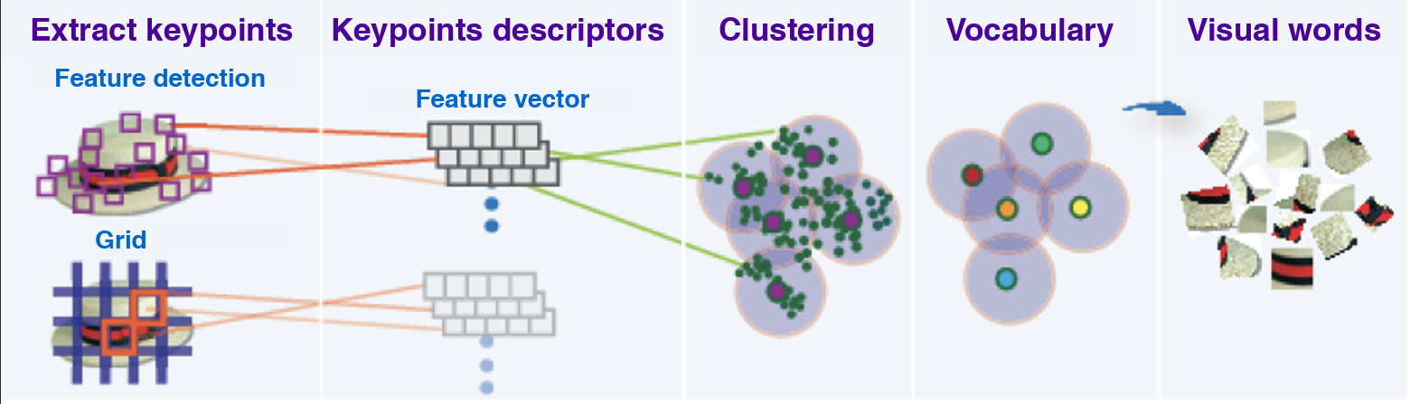
Convolution
Before Deep Learning, considerations from computer vision
Considering an image as a grid of pixels is missing semantics
If a pixel is considered a feature, it’s not informative
Too tied to its absolute position, relative position matters more

Slide 5
Convolution
Convolutional filters
Small set of weights that are applied to the whole input image
“Sliding window”, same operation on different groups of pixels
Output: a tensor more or less of the same size
1 | 0 | 1
0 | 1 | 0
1 | 0 | 1
Convolutional filter

Slide 6
Convolution
Convolutional filters
Learn patterns freely by adjusting weights
The patterns can appear everywhere in the image
Convolutional operation can be applied in parallel
Still, it is not completely free: hyperparameters!
Size of the convolutional window (sometimes called kernel)
Stride, how often to apply the window)
Padding, apply window even in the corners

Slide 7
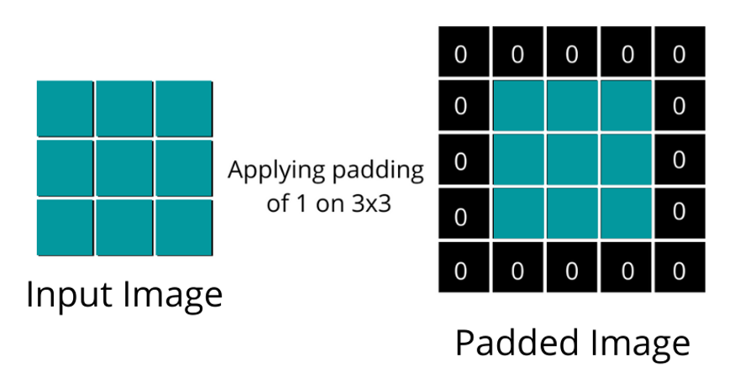
Padding

Slide 8
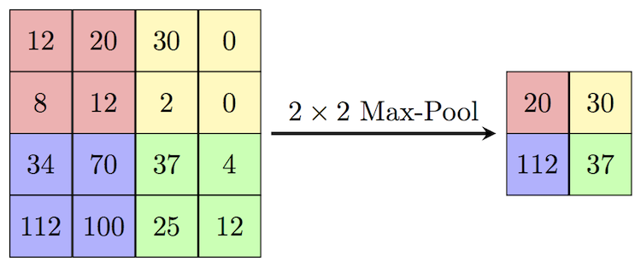
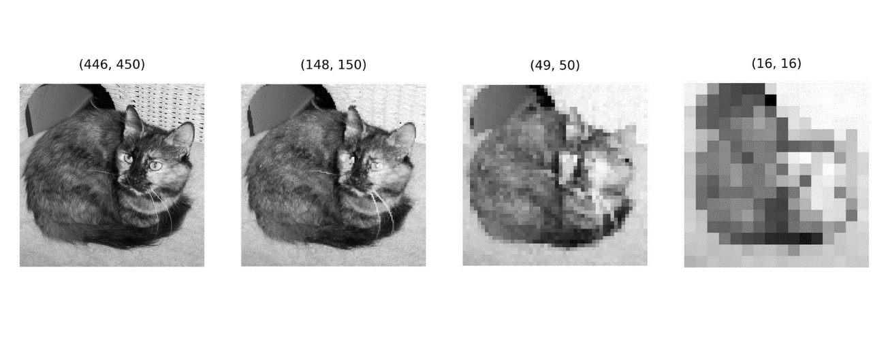
Pooling (Downsampling)
After sending result of the convolution through activation
Pick the highest resulting value in a small grid applied to image
Idea: only pick the most important features created by filters

Slide 9
Pooling (Downsampling)
Different possible choices of pooling
Get the highest value in window (MaxPool)
Average over values in window (AvgPool)
…

Slide 10
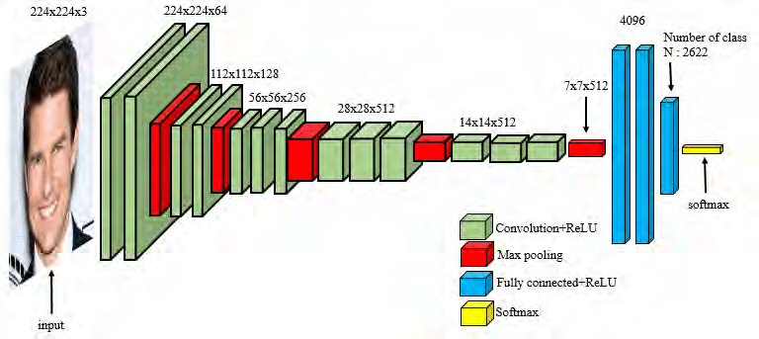
Architecture
The idea is to create a funnel from high dimension to low
With sequences of convolution/activation/pooling
And final linear modules for classification or other
Real architectures can be quite complex

Slide 11
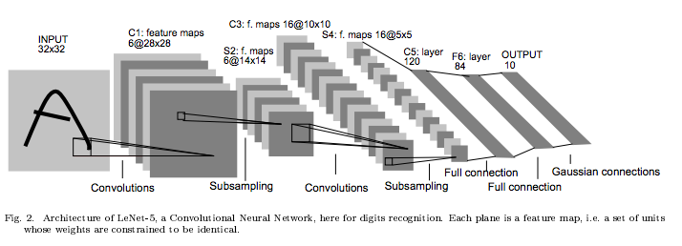
CNNs for image classification
The last part of the network is linear modules + activations
The output is a tensor with one shape (n_classes)

Slide 12
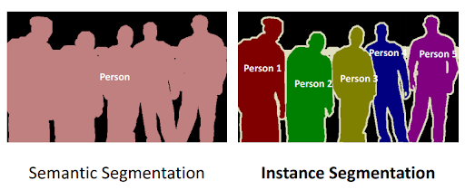
CNNs for image segmentation
Different types of segmentation
Semantic segmentation, associate pixels to classes
Instance segmentation, associate pixel to object instances

Slide 13
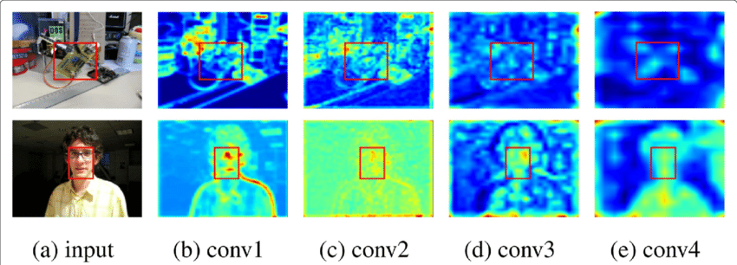
Looking inside a CNN
Tensors in output to every module
Input has original meaning as an image
Visualize the intermediate tensors (convolutional and pooling)
Notes:
But what are these weird things?

Slide 14
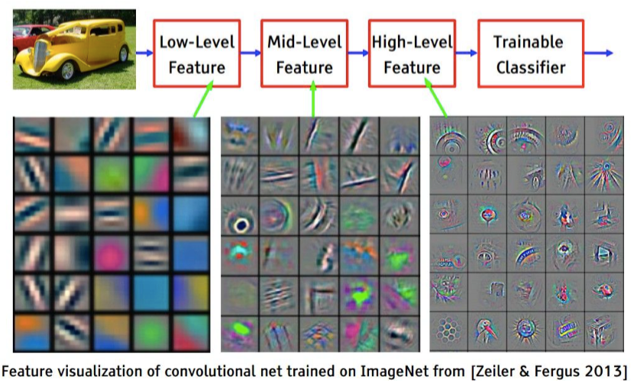
Features constructed by the CNN
Visualize features, creating images that max module output

Slide 15
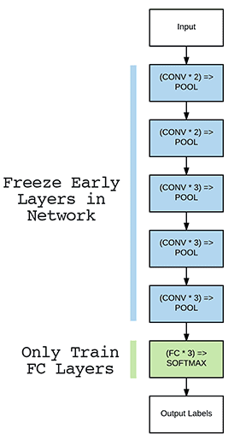
Features constructed by the CNN
If this is true (very likely true for large models)
Knowledge encoded in first layers can be re-used
No need to re-learn from scratch features for lines or edges
What should be re-learned are mid-to-high-level features
Or maybe only the final part! (linear + activations)
First seeds of transfer learning
Transfer learning? Fine-tuning? LoRA?
Very similar concepts

Slide 16
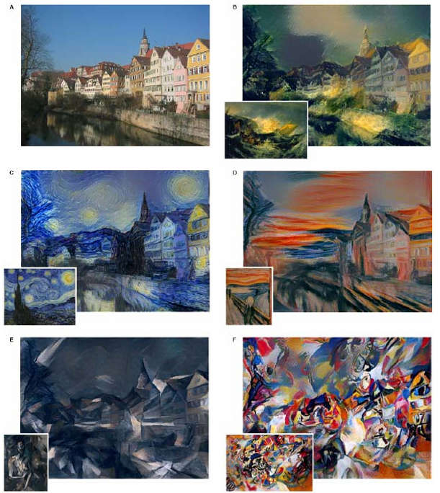
Style transfer
Using the fact that weights in modules capture features
“Style” is a feature
Apply style to content

Slide 17
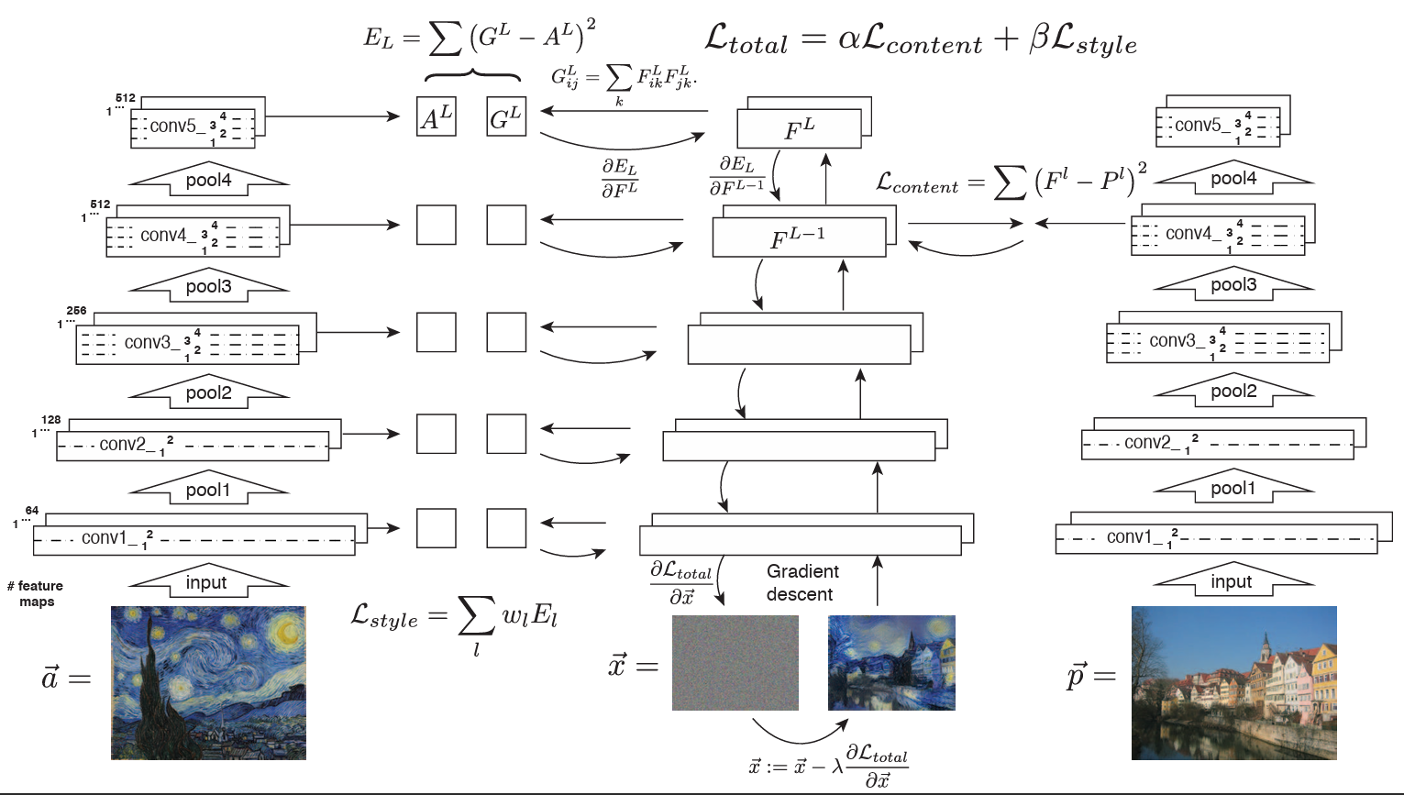
Style transfer

Slide 18
CNNs for non-images?
Can you imagine to use the feature construction ability of CNNs to applications that are not related to vision?

Slide 19
CNNs for time series analysis
CNNs perform automatic feature construction
There are alternatives, using expert-designed features
For example, python library tsfresh
Transform the dynamic problem into a series of static features
This is tabular data! Apply classic ML algorithms
(IMHO) Decent for classification, not so much for forecasting

Slide 20
Structured data
In general, every data where adjacency has meaning
DNA/RNA, for example
Signals coming from spectrometry
Voxels from 3D scans
Adjacent nodes in a graph (Convolutional Graph Neural Networks)
The only big difference is the shape of convolutional filters

Slide 21


Questions?
Bibliography
Images and videos: unless otherwise stated, I stole them from the Internet. I hope they are not copyrighted, or that their use falls under the Fair Use clause, and if not, I am sorry. Please don’t sue me.

