Slide 1
Transformers
Alberto TONDA, Ph.D. (Senior permanent researcher, DR)
UMR 518 MIA-PS, INRAE, AgroParisTech, Université Paris-Saclay UAR 3611, Institut des Systèmes Complexes de Paris Île-de-France

Slide 2
This is a new thing
Ciao
Ciaooooooooooooooo

Slide 3
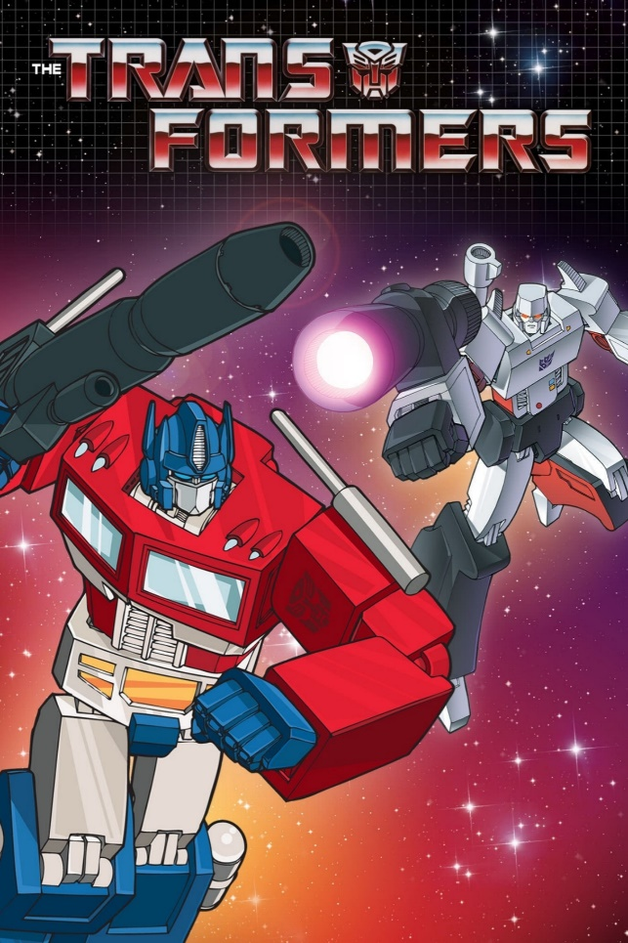
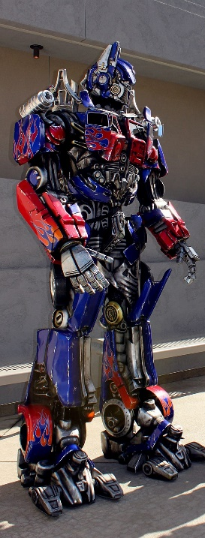
Transformers?
Transformer architecture took AI by storm
Never-before-seen performances
It just works, for a lot of different applications
Killer application: text generation
If the 2010s have been decade of CNNs…
...early 2020s are the years of Transformers

Slide 4
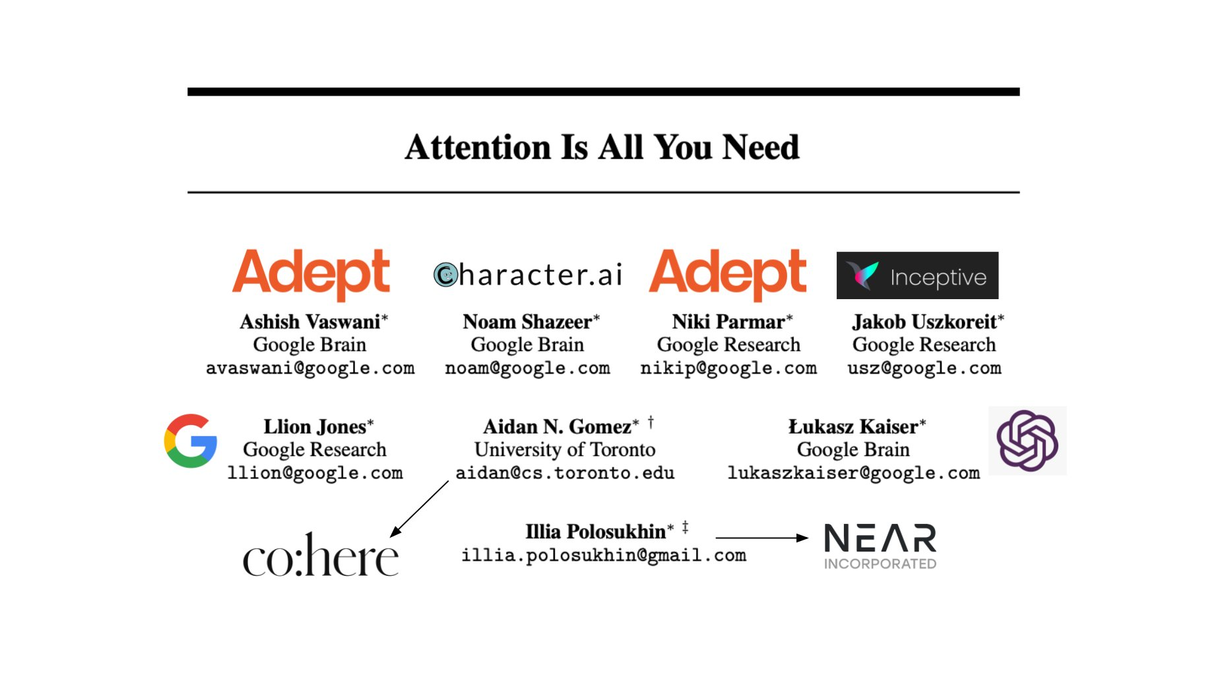
Attention Is All You Need

Slide 5
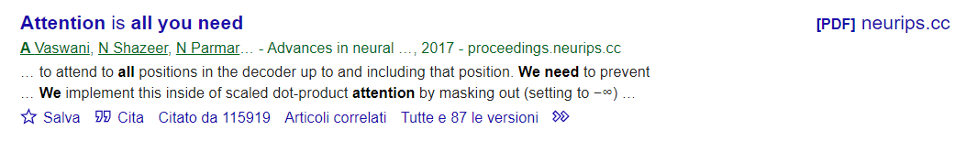
Attention Is All You Need

Slide 6
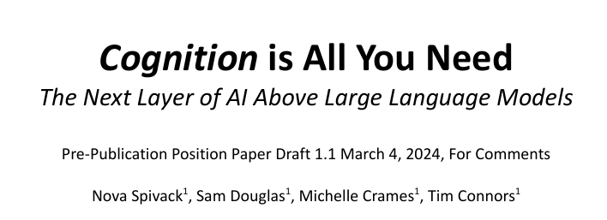
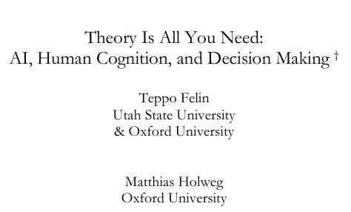
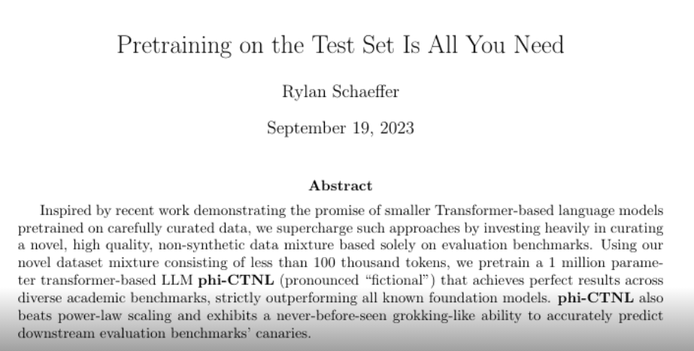
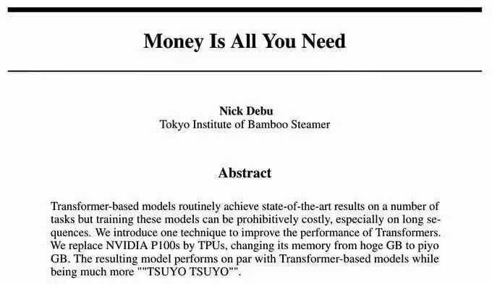
Attention Is All You Need

Slide 7
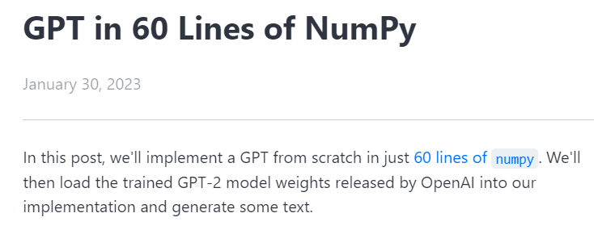
Reference(s)
https://jaykmody.com/blog/gpt-from-scratch

Slide 8
GPT
Generative: A GPT generates text.
Pre-trained: A GPT is trained on lots of text from books, the internet, etc ...
Transformer: A GPT is a decoder-only transformer neural network.

Slide 9
Vocabulary
Vocabulary: limited set of discrete items
For example: all words* in the English language
Vocabulary is used for both inputs and outputs
Elements in the vocabulary are commonly called tokens
Basic Transformer idea
Input: set of tokens
Output: one (or more) token(s)

Slide 10
Visual Transformers?

