Slide 1
Neural networks and Deep learning
Alberto TONDA
UMR 518 MIA-PS, INRAE, AgroParisTech, Université Paris-Saclay UAR 3611, Institut des Systèmes Complexes de Paris Île-de-France

Slide 2
Outline
Artificial neural networks
Optimizing a neural network
Overparametrization (“double descent”)
Convolutional neural networks
Recurrent neural networks
Transformers
Autoencoders
From the point of view of optimization…

Slide 3
Artificial neural networks
…
…
…
…

Slide 4
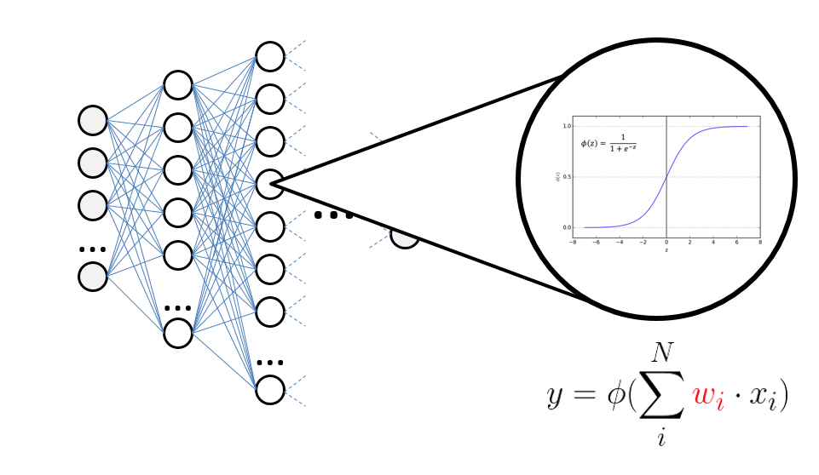
Artificial neural networks
Based on an old (and wrong) model of a real neuron

Slide 5
Artificial neural networks
…
…
…
Input layer
…
Output layer

Slide 6
Artificial neural networks
…
…
…
…
Hidden layer
Hidden layer

Slide 7
Artificial neural network
So, an ANN is just a very complex function
In ML terms, its parameters are the weights
Modern ANNs have thousands/millions/billions of weights!
How to optimize a function in such high dimension?

Slide 8
SGD and backpropagation
Objective function is called loss function
To be minimized; exact content depends on the task
MSE for regression, categorical cross-entropy for classification
It is possible to compute the derivative of the loss
Thanks to chain rule and backpropagation
Partial derivative of loss with respect to each weight/parameter
Stochastic Gradient Descent (and successors)
“Stochastic” = use only a subset of samples at each iteration

Slide 9
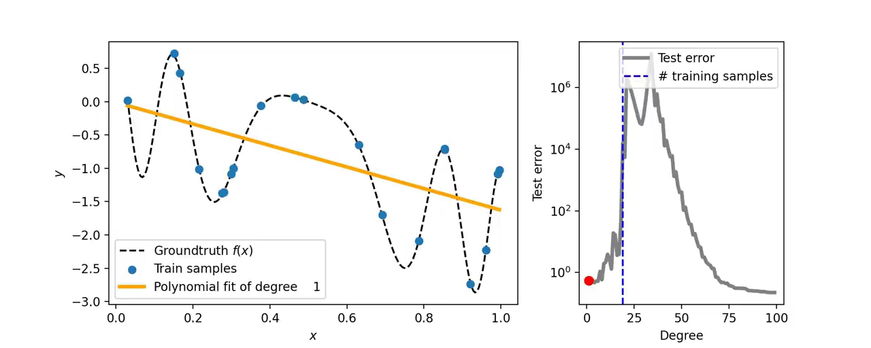
Overparametrization
Wait a second!
From ML, we learned that having too many parameters is bad!
Models with too many parameters tend to overfit terribly…right?

Slide 10
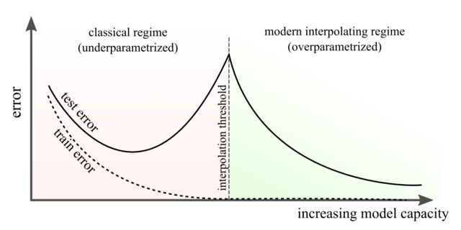
Overparametrization
What is happening here? Well, we don’t really know
Empirical results, overparametrizing improves generalization
“Double descent” or “W figure”

Slide 11
Why are neural networks so successful?
Extremely performant for structured data
Thanks to recent architectures (CNNs, RNNs, Transformers, …)
Images, text, sound, …
Other ML approaches are just not as good
Graphics Processing Units (GPUs)
Are really good at performing parallel computations
And in fact, they are excellent to speed up gradient computation
Multiple outputs can be interpreted as pixels/audio/text…
More and more data is available!

Slide 12
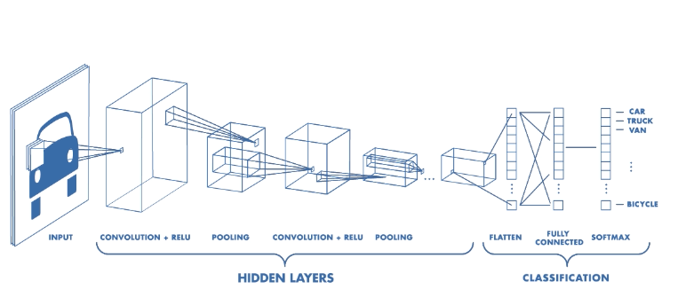
Convolutional neural networks
Specialized layers that scan the whole structured input
They can find patterns in every part of it
Example: images (square window, slide over pixels)

Slide 13
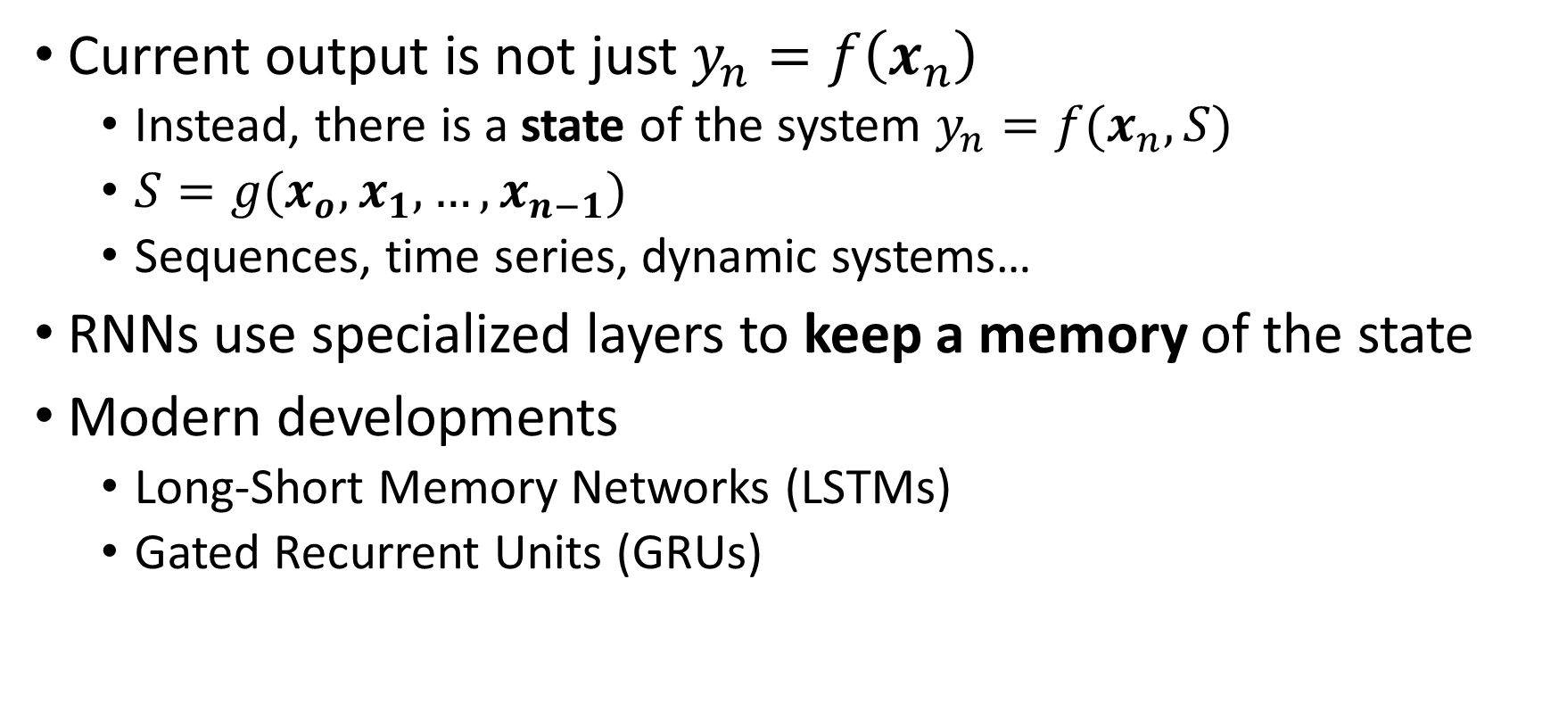
Recurrent neural networks
Current output is not just $y_{n}=f\left(x_{n}\right)$
Instead, there is a state of the system $y_{n}=f(x_{n}, S)$
$S=g(x_{o}, x_{1}, …, x_{n−1})$
Sequences, time series, dynamic systems…
RNNs use specialized layers to keep a memory of the state
Modern developments
Long-Short Memory Networks (LSTMs)
Gated Recurrent Units (GRUs)

Slide 14
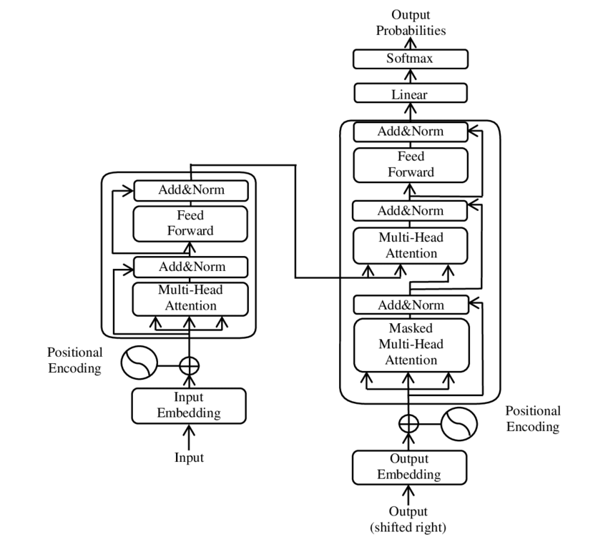
Transformers
De-facto replaced RNNs
Gets all the data at once
Specialized layers that try to capture relationships between parts of the input

Slide 15


Autoencoders
Train unsupervised to exactly reproduce the input
Optimization task: $argmin(\sum_{i=0}^{N}{| \hat{x}(i) −x(i) |)}$
Autoencoder
$$x$$
$$\hat{x}$$

Slide 16
Autoencoders
Force the computation to go through bottleneck
Dimension of the bottleneck much smaller than input
…
…
…
…
Bottleneck/Latent space

Slide 17
Autoencoders
Remove the second part of the model
…
…

Slide 18
Autoencoders
Remove the second part of the model
Going from input to (lower dimensionality) bottleneck
Dimensionality reduction
…
Generation of an embedding
…

Slide 19
Autoencoders
However, we can also remove the first part
From the bottleneck/latent space to the output
…
…

Slide 20
Autoencoders
However, we can also remove the first part
From the bottleneck/latent space to the output
Generation of content
…
…

Slide 21
Autoencoders and generative NNs
I
M
A
G
E
I
M
A
G
E
…
…
…
…

Slide 22
Autoencoders and generative NNs
I
M
A
G
E
…
…

Slide 23
Autoencoders and generative NNs
T
E
X
T
I
M
A
G
E
Attempt to align
…
…
…
…

Slide 24
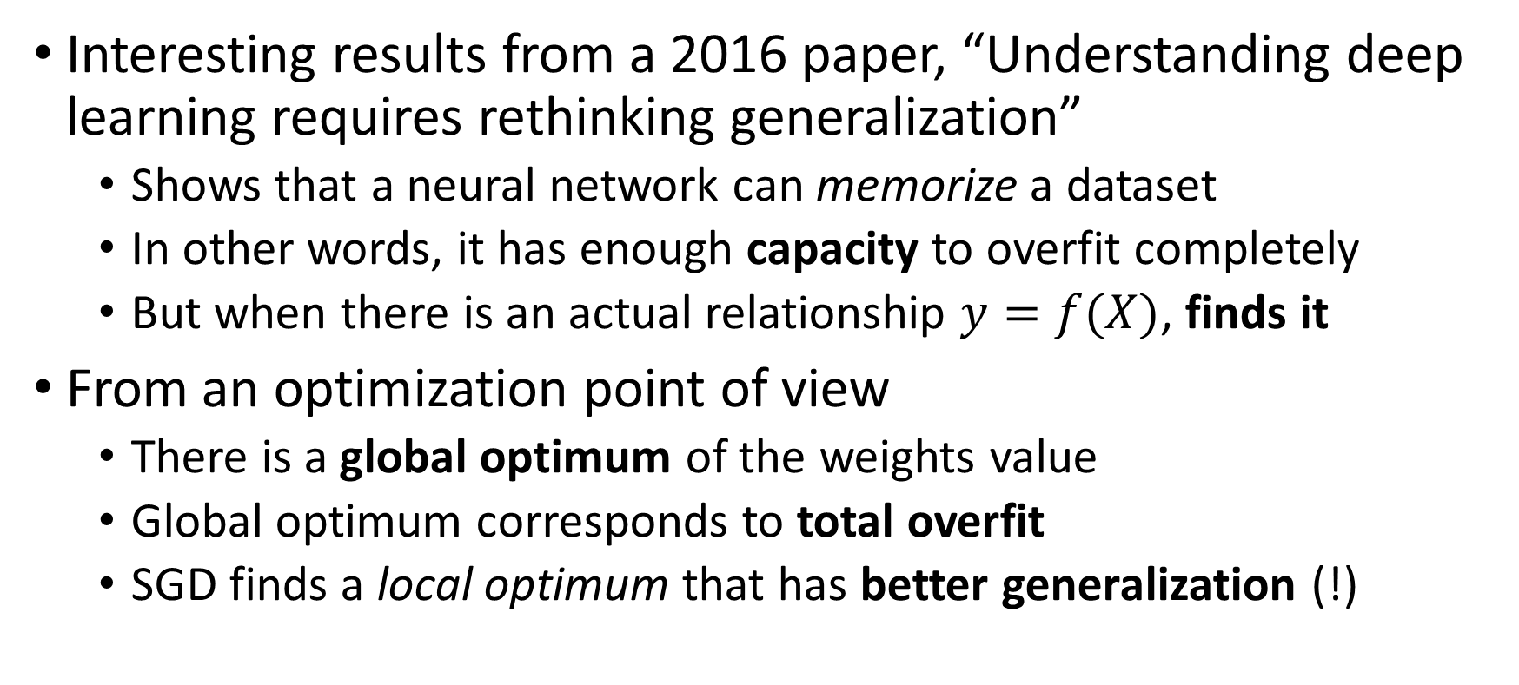
From the point of view of optimization…
Interesting results from a 2016 paper, “Understanding deep learning requires rethinking generalization”
Shows that a neural network can memorize a dataset
In other words, it has enough capacity to overfit completely
But when there is an actual relationship $y=f(X)$, finds it
From an optimization point of view
There is a global optimum of the weights value
Global optimum corresponds to total overfit
SGD finds a local optimum that has better generalization (!)

Slide 25
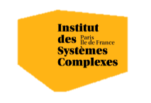

Questions?
Bibliography - Goodfellow et al., The Deep Learning Book, 2016 - Zhang et al., Understanding Deep Learning Requires Rethinking Generalization, 2016
Images and videos: unless otherwise stated, I stole them from the Internet. I hope they are not copyrighted, or that their use falls under the Fair Use clause, and if not, I am sorry. Please don’t sue me.

