Slide 1
Optimization: Advanced Topics
Alberto TONDA
UMR 518 MIA-PS, INRAE, AgroParisTech, Université Paris-Saclay UAR 3611, Institut des Systèmes Complexes de Paris Île-de-France

Slide 2
Outline
Finding more optima
Flat objective function
Expensive objective function
Dynamic objective function

Slide 3
Finding more optima
Niching
Salto technique

Slide 4
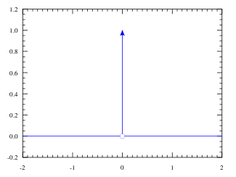
Flat objective function
Your objective function has the same value everywhere…
…EXCEPT in one (or few) specific points you are interested in
Example: bug in software/hardware

Slide 5
Flat objective function
There is NO SOLUTION
However, we can smoothen the objective function
Using domain knowledge, create another function
New function is at least correlated to the “true” one

Slide 6
Flat objective function
Example: finding bugs in software / hardware
Candidate solution: input to the device under test
Fitness function: we found a bug (crash) / we did not find a bug
Smoothening: number of different functionalities activated
“The more functions activated, the more likely to trigger a bug”
As there are no gradients, stochastic optimization (EAs)
Meta (Facebook) uses Sapienz to test/debug user interfaces
Motorola used it to test phones (2008)

Slide 7
Example

