Slide 1
Refresher on Machine Learning
Alberto TONDA, Ph.D. (Senior permanent researcher, DR)
UMR 518 MIA-PS, INRAE, AgroParisTech, Université Paris-Saclay UAR 3611, Institut des Systèmes Complexes de Paris Île-de-France

Slide 2
Outline
Artificial Intelligence
Machine Learning
Typical Machine Learning pipeline
Evaluating performance
Overfitting
Good practices

Slide 3
What is Artificial Intelligence?

Slide 4
What is Artificial Intelligence?
Short answer, there is no clear definition
We do not have a good definition of intelligence, so...
Broadly speaking, AI defines a field more than a method
Machine learning, reinforcement learning, symbolic AI, ...
Tentative definitions (there is no agreement)
«When a non-biological being successfully completes a task commonly believed to require biological intelligence»
«Perceiving, synthesizing, and inferring information»
«Efficiency and speed, in learning a new task» (Chollet, 2019)
How do we measure intelligence?

Slide 5
What is Artificial Intelligence?
NARROW / WEAK
Focused on a specific task
Symbolic AI
E.g. rule-based systems
Machine learning
Supervised, unsupervised
Natural language processing
Image recognition/segmentation
Reinforcement learning
Neuro-symbolic AI
GENERAL (AGI)
Can perform any type of (human?) task
Does not exist (...yet?)
Closest thing is NLP: Large Language Models (LLM) like ChatGPT

Slide 6
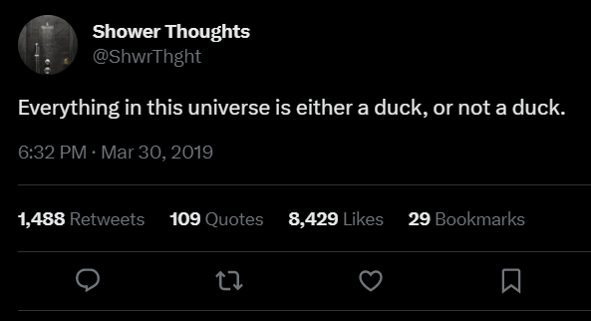
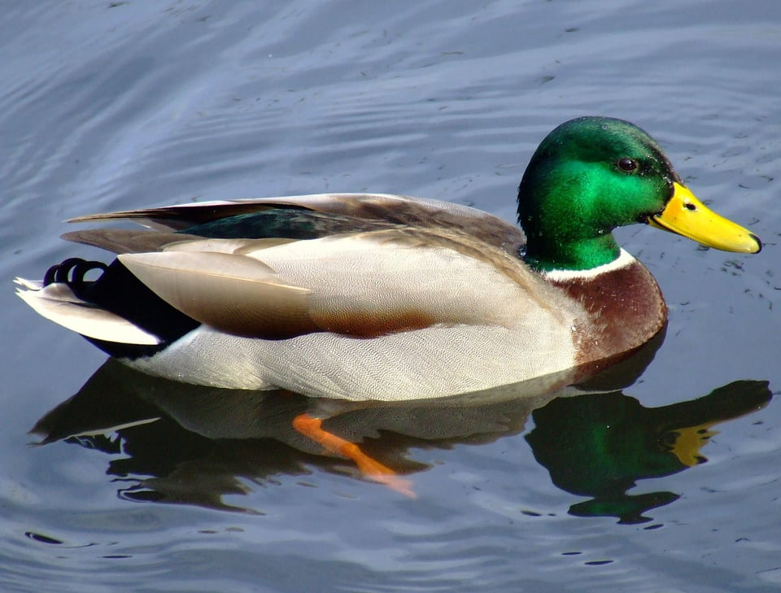
Symbolic AI
Symbolic manipulation
Reality is continuous (with good approximation)
Symbols are discrete, and humans are good at using them
Notes:
This is something that will come back when we will discuss the use of deep neural networks in natural language processing. As words and symbols are discrete, our machines are not great at using them.

Slide 7
Symbolic AI
Symbols seem normal and natural, map into the real world (in linguistics, it’s called extension)
Natural language is a powerful human symbol manipulator
However, there is chaos hidden under the surface
What is the reality of a river?
What is the reality of a chair?
What is the reality of a number?

Slide 8

Symbolic AI
Symbol can be hard to define, but we grasp it intuitively
It’s an old, old problem: see Plato and Diogenes
Entire fields of research on this (neuroscience, cognitive sciences, neurolinguistics, …)
“Explaining” symbols to AI is harder yet
Issues with “common sense”
Reached limits in the 1980s

Slide 9
Symbolic AI
In practice, find or exploit human-readable rules
Expert systems (“if-then-else” rules)
Knowledge graphs, linking entities with relationships
First-order logic rules
Ontologies
Decision trees (that are also considered part of ML!)
Before the advent of ML, considerable success stories
Symbolic AI is still in use, paired with ML

Slide 10
Machine learning
Learn a task directly from examples
No need for theory, just large quantities of data
Samples (rows) and features (columns)
“Dirty secret” of ML: it’s mostly optimization
Restate learning task as optimization task
Solve it relying on available (training) data
Learning Task
Optimization Task

Slide 11
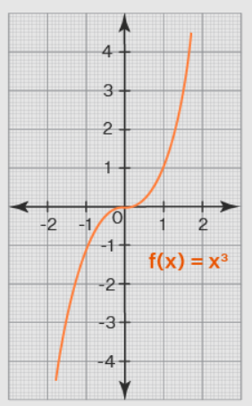
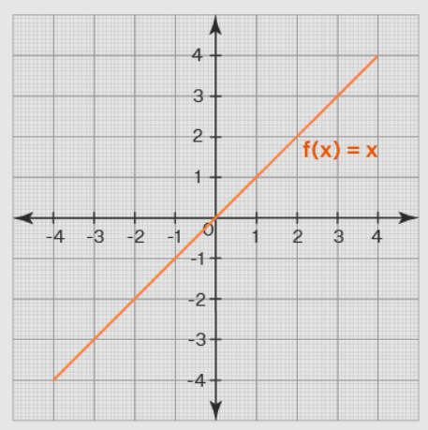

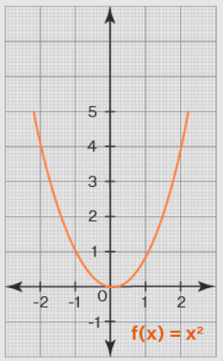
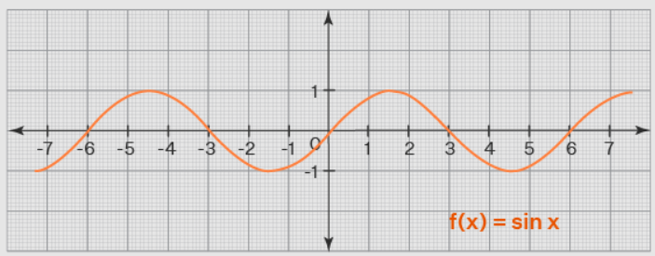
Machine learning algorithms
e
e
ML algorithm (model+optimizer)
e
e
Internal parameters (to be optimized)

Slide 12
Supervised machine learning
Learn from examples where correct answer is known
Data contains measured values of the target (ground truth)
Minimize difference between model predictions and ground truth
Regression
Target is a continuous value (0.9, 22.5, 0.0017, …)
From the values of the features of a sample, predict target value
Classification
Target is a category (good/bad, high/medium/low, toxic/ok, …)
From the values of the features of a sample, assign to category

Slide 13
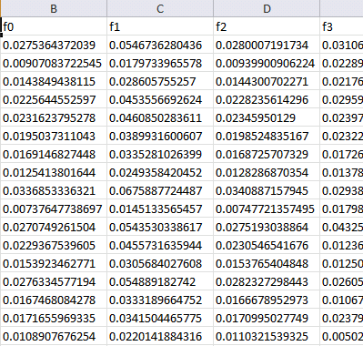
Machine learning (supervised)
Training data
Features
Training...
Predictions
Prediction 1
Prediction 2
Prediction 3
Prediction 4
…
Ground truth
Truth 1
Truth 2
Truth 3
Truth 4
…
ML algorithm (model+optimizer)
Samples
Internal parameters (to be optimized)

Slide 14
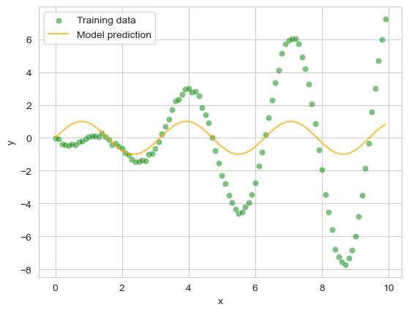
Machine learning (supervised)
Training data
Features
Training...
ML algorithm (model+optimizer)
Samples
Internal parameters (to be optimized)

Slide 15
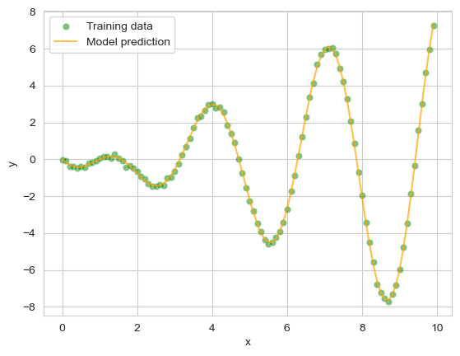
Machine learning (supervised)
Training data
Features
Training...
ML algorithm (model+optimizer)
Samples
Internal parameters
(to be optimized)
Notes:
Here, I can speak about a linear regression

Slide 16
Machine learning (supervised)
Test (unseen) data
Features
Prediction...
ML algorithm (model+optimizer)
Samples
Internal parameters
(fixed)
Notes:
Here, I can speak about a linear regression

Slide 17
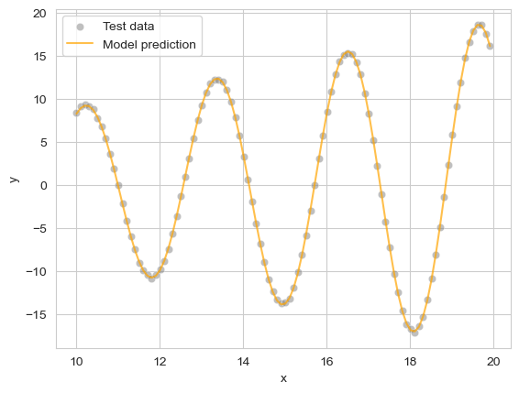
Machine learning (supervised)
Test (unseen) data
Features
Prediction...
ML algorithm (model+optimizer)
Samples
Internal parameters
(fixed)
Notes:
Here, I can speak about a linear regression

Slide 18
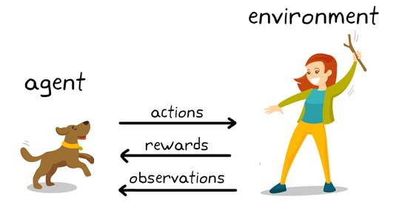
Reinforcement learning
Similar to supervised ML, but not exactly
No value associated to a single decision
Reward is consequence of a series of decisions
Example: a chess game; should we trade a Queen for a Knight? Well, it depends on the board state

Slide 19
Reinforcement learning
Issues with the state space
Real-world applications have Vast search spaces
Even a game like chess has ~10²⁰ possible board states
Impossible to explore exhaustively! (highest is checkers, 10¹⁰)
Tricks to reduce states: exploit symmetries, remove useless…
Game of Go (~10¹⁰⁰ states) believed to be unapproachable
Estimated number of atoms in universe ~10⁸⁰
In 2016, world champion defeated! Deep reinforcement learning

Slide 20
Unsupervised Machine Learning
Supervised ML, min. difference predictions - ground truth
What happens when we do not have the ground truth?

Slide 21
Unsupervised Machine Learning

Slide 22
Machine Learning pipeline
Machine Learning
Model selection
Raw data
Preprocessing
Feature engineering
Hyperparameter tuning
Training and validation
Notes:
Qui chiedi cosa può includere il pre-processing

Slide 23
Machine Learning pipeline
Machine Learning
Model selection
Raw data
Preprocessing
Feature engineering
Hyperparameter tuning
Training and validation
Missing values
Non-numerical features
Outlier detection
Normalization?

Slide 24
Missing values
ML algorithms cannot natively deal with missing data
Trivial solutions
Remove samples with missing feature values
If a feature is often empty/NaN, remove whole feature
Issue: this reduces the available data
Can you think of any other solution?

Slide 25
Missing values
Imputation
Replace the missing value with another value; but which one?
Zero, -1, (…)
Mean/median value of the feature over all samples/same class
Expert judgment (if not too many missing values)
Machine learning for imputation
Train a ML model to predict the value of the feature
Example: KNN imputation
(IMHO) If possible, try avoiding imputation

Slide 26
Non-numerical features
Categorical features to numbers?
If ordered (“high”/“medium”/“low”), to integers (2/1/0)
If not ordered (“red”/“blue”/“green”), one-hot encoding
Create additional binary (0/1) features, equal to number of values of categorical feature
Set binary feature to ‘1’ and others to ‘0’ to represent values
E.g. red=100, blue=010, green=001
Utils in Pandas that already take care of (most of) this

Slide 27
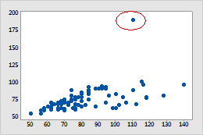
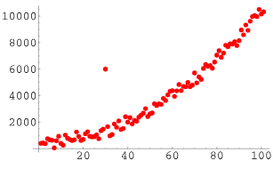
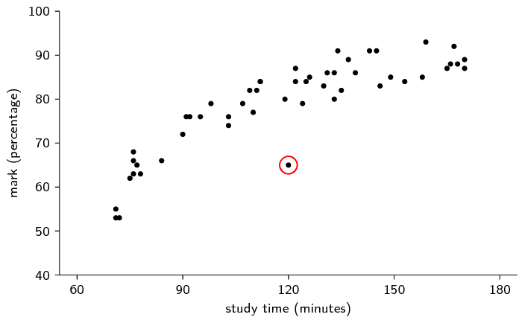
Outlier detection
What is an outlier?

Slide 28
Outlier detection
While the idea is intuitive, its application is difficult
Sometimes outliers are errors in data collection…
…but sometimes they are representative of the phenomenon
“Out of Distribution”, but can we identify the distribution?
Machine learning methods
Isolation Forest
Local Outlier Factor
Problem sometimes called “Novelty Detection”
(IMHO) Expert knowledge or avoid removing outliers

Slide 29
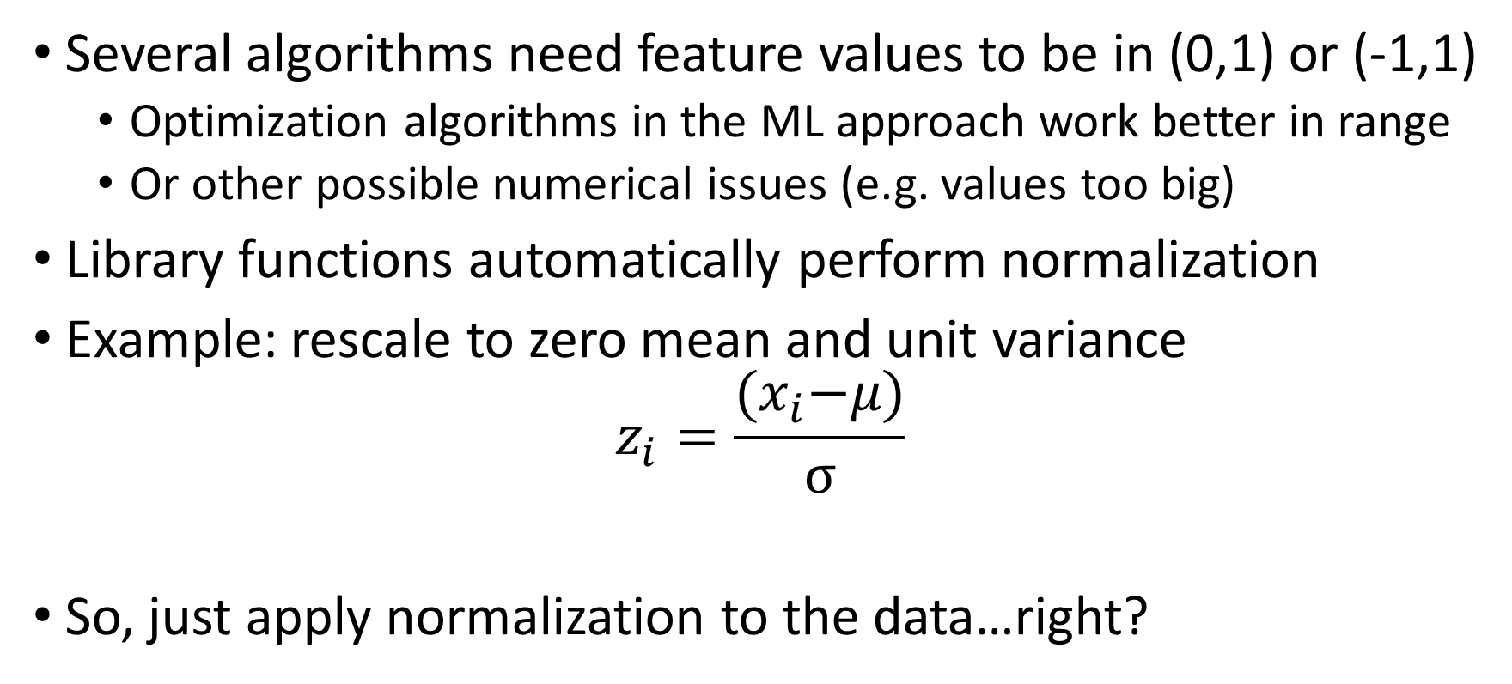
Normalization?
Several algorithms need feature values to be in (0,1) or (-1,1)
Optimization algorithms in the ML approach work better in range
Or other possible numerical issues (e.g. values too big)
Library functions automatically perform normalization
Example: rescale to zero mean and unit variance
$$z_{i}=\frac{{(x}_{i}−μ)}{σ}$$
So, just apply normalization to the data…right?

Slide 30
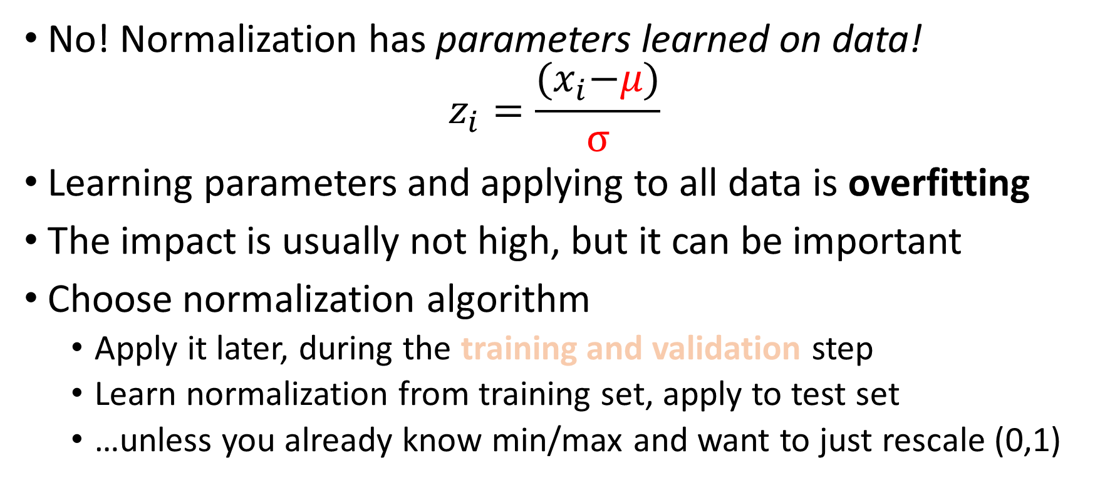
Normalization
No! Normalization has parameters learned on data!
$$z_{i}=\frac{{(x}_{i}−μ)}{σ}$$
Learning parameters and applying to all data is overfitting
The impact is usually not high, but it can be important
Choose normalization algorithm
Apply it later, during the training and validation step
Learn normalization from training set, apply to test set
…unless you already know min/max and want to just rescale (0,1)

Slide 31
Machine Learning pipeline
Machine Learning
Model selection
Raw data
Preprocessing
Feature engineering
Hyperparameter tuning
Training and validation
Feature selection
Feature construction

Slide 32
Feature selection

Slide 33
Feature construction

Slide 34
Deep Learning pipeline…?
Instead, pick a model able to automatically select or construct features
Machine Learning
Model selection
Raw data
Preprocessing
Feature engineering
Hyperparameter tuning
Training and validation

Slide 35
Machine Learning pipeline
Machine Learning
Model selection
Raw data
Preprocessing
Feature engineering
Hyperparameter tuning
Training and validation
Adjust all ML algorithm parameters set before training starts
Notes:
Qui chiedi cosa può includere il pre-processing

Slide 36
Hyperparameter tuning

Slide 37
Machine Learning pipeline
Machine Learning
Model selection
Raw data
Preprocessing
Feature engineering
Hyperparameter tuning
Training and validation
Try to evaluate whether the choices we made make sense

Slide 38
Machine Learning pipeline
Machine Learning
Model selection
Raw data
Preprocessing
Feature engineering
Hyperparameter tuning
Training and validation
Try to evaluate whether the choices we made make sense
Vocabulary clash! “Validation”? “Test”?

Slide 39
Why do we need test/validation?

Slide 40
Why do we need test/validation?
The Final Boss: OVERFITTING

Slide 41
Algorithms work inside a computer
How are numbers represented inside a computer?

Slide 42
Algorithms work inside a computer
Limit to minimum and maximum representable
Limit to the smallest detectable difference (machine epsilon)
Precision can be increased, at the cost of memory

Slide 43
(Pseudo-)Random number generation

Slide 44
Vocabulary
Model/predictor: one candidate solution (regressor/classifier)
Model parameters
Values (numerical, categorical, …) inside the model
Optimized (e.g. change values) during training process
Samples: rows of the dataset
Features: columns of the dataset
Training data: data from which we want to learn
Test data: unseen data, kept aside to assess generalization
Validation data: used during training, not for training (!)
Training/Fit: optimize parameter values to fit training data

Slide 45
Vocabulary
Model hyperparameters
Choices/parameters outside the model
Usually user-defined before training process starts
Capacity (loose definition)
Maximum order of function that can be approximated by model
The more parameters, the more capacity
Bias: source of errors, not enough capacity (underfitting)
Variance: sensitivity to small variations in training data, too much capacity (overfitting)

Slide 46
Take-home message(s)
Always preprocess your data, carefully
Missing values? Remove rows, imputation

