Slide 1
Refresher on Neural Networks and Philosophy of pytorch
Alberto TONDA, Ph.D. (Senior permanent researcher, DR)
UMR 518 MIA-PS, INRAE, AgroParisTech, Université Paris-Saclay UAR 3611, Institut des Systèmes Complexes de Paris Île-de-France

Slide 2
This is a new thing
Ciao
Ciaooooooooooooooo

Slide 3
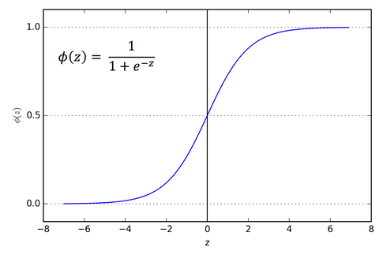

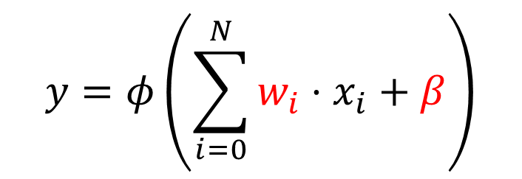



What is a neural network?
Everything starts from the (wrong) model of a neuron
$$x_{0}$$
$$x_{1}$$
$$y∈[0,1]$$
…
$$x_{N}$$
$$y=φ\left(\sum_{i=0}^{N}{w_{i}⋅x_{i}}+β\right)$$

Slide 4
What is a neural network?
Everything starts from the (wrong) model of a neuron
$$x_{0}$$
$$x_{1}$$
$$y∈[0,1]$$
…
$$x_{N}$$
$$y=φ\left(\sum_{i=0}^{N}{w_{i}⋅x_{i}}+β\right)$$
This part inside is a linear model (a weighted sum)

Slide 5
What is a neural network?
Everything starts from the (wrong) model of a neuron
$$x_{0}$$
$$x_{1}$$
$$y∈[0,1]$$
…
$$x_{N}$$
$$y=φ\left(\sum_{i=0}^{N}{w_{i}⋅x_{i}}+β\right)$$
This part inside is a linear model (a weighted sum)
Weights and bias can be learned, depending on application
The weights can be learned, depending on application

Slide 6
What is a neural network?
Everything starts from the (wrong) model of a neuron
$$x_{0}$$
$$x_{1}$$
$$y∈[0,1]$$
…
$$x_{N}$$
$$y=φ\left(\sum_{i=0}^{N}{w_{i}⋅x_{i}}+β\right)$$
This part inside is a linear model (a weighted sum)
Weights and bias can be optimized, depending on application
The weights can be learned, depending on application

Slide 7
What is a neural network?
Everything starts from the (wrong) model of a neuron
$$x_{0}$$
$$x_{1}$$
$$y∈[0,1]$$
…
$$x_{N}$$
This is a non-linearity, increases capacity
$$y=φ\left(\sum_{i=0}^{N}{w_{i}⋅x_{i}}+β\right)$$
This part inside is a linear model (a weighted sum)
Weights and bias can be optimized, depending on application
The weights can be learned, depending on application

Slide 8
What is a neural network?
Neurons are used in subsequent sets, called layers
…
…
Input layer
Output layer
Hidden layer

Slide 9
What is a neural network?
Neurons are used in subsequent sets, called layers
…
Input layer does not really have neurons, just feature values (inputs)
…
Input layer
Output layer
Hidden layer

Slide 10
What is a neural network?
Neurons are used in subsequent sets, called layers
…
Input layer does not really have neurons, just feature values (inputs)
Values in output of the output layer are interpreted as predictions for the target(s)
…
Input layer
Output layer
Hidden layer

Slide 11
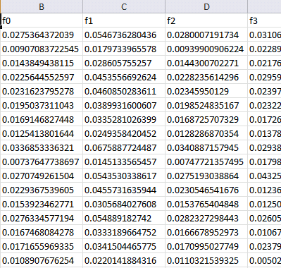

Machine learning (supervised)
Training data
Features
Training...
Predictions
Prediction 1
Prediction 2
Prediction 3
Prediction 4
…
Ground truth
Truth 1
Truth 2
Truth 3
Truth 4
…
ML algorithm (model+optimizer)
Samples
Internal parameters (to be optimized)
In the case of a neural network, what are the parameters to be optimized?

Slide 12
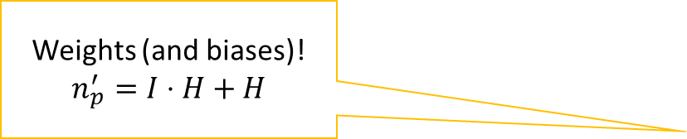
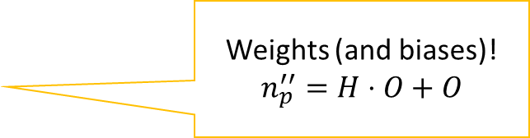
What is a neural network?
Neurons are used in subsequent sets, called layers
Weights (and biases)!
$$n_{p}^{′}=I⋅H+H$$
Weights (and biases)!
$$n_{p}^{′′}=H⋅O+O$$
…
Input layer does not really have neurons, just feature values (inputs)
Values in output of the output layer are interpreted as predictions for the target(s)
…
Input layer
Output layer
Hidden layer

Slide 13
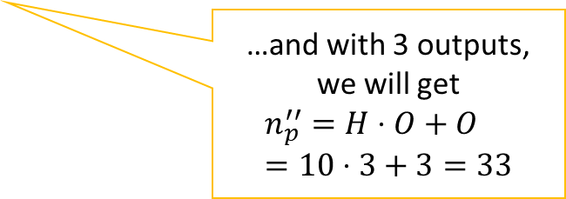
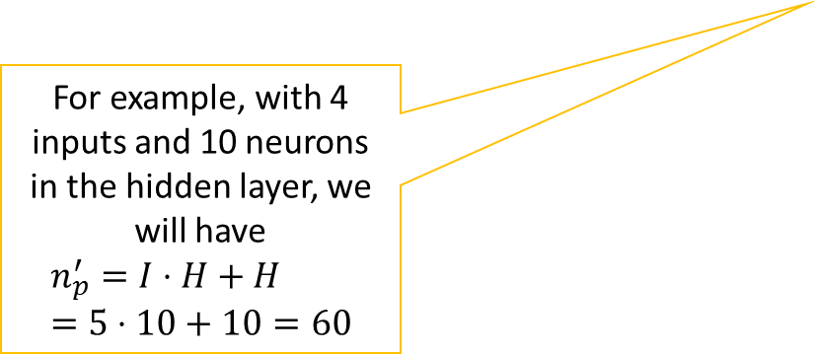

What is a neural network?
Neurons are used in subsequent sets, called layers
Weights (and biases)!
$$n_{p}^{′}=I⋅H+H$$
Weights (and biases)!
$$n_{p}^{′′}=H⋅O+O$$
…
For example, with 4 inputs and 10 neurons in the hidden layer, we will have
$$n_{p}^{′}=I⋅H+H=5⋅10+10=60$$
…and with 3 outputs, we will get
$$n_{p}^{′′}=H⋅O+O=10⋅3+3=33$$
…
Input layer
Output layer
Hidden layer
For a remarkable total of $n_{p}^{′}+n_{p}^{′′}=93$

Slide 14
What is a neural network?
Several ways of seeing a neural network
Classic view
Matrix multiplications
pytorch: sequence of functions

Slide 15
General view, shared by multiple libraries
Sequence of modules
Flow of tensors in the network
Input and outputs are interpreted in human-readable way

Slide 16
Philosophy of pytorch
Every network is an instance of a torch.nn.Module object
Methods inside a Module:
__init__(self) : builder, used to set up layers (and other stuff)
forward(self, X) : forward pass of the network
forward() is called during training, so it’s necessary

Slide 17
Neural networks vs Deep learning
What is the difference?

Slide 18
Neural networks vs Deep learning
(1) Considerable improvements over classic Neural Networks
New (more effective!) algorithms to optimize parameters
New architectures to deal with structured data
Better software engineering
More computing power available, better results
(2) Rebranding
Interest for Neural Networks declined in the 1990s
At the time, considered less effective than other methods
Any network with more than one hidden layer is “deep”

Slide 19
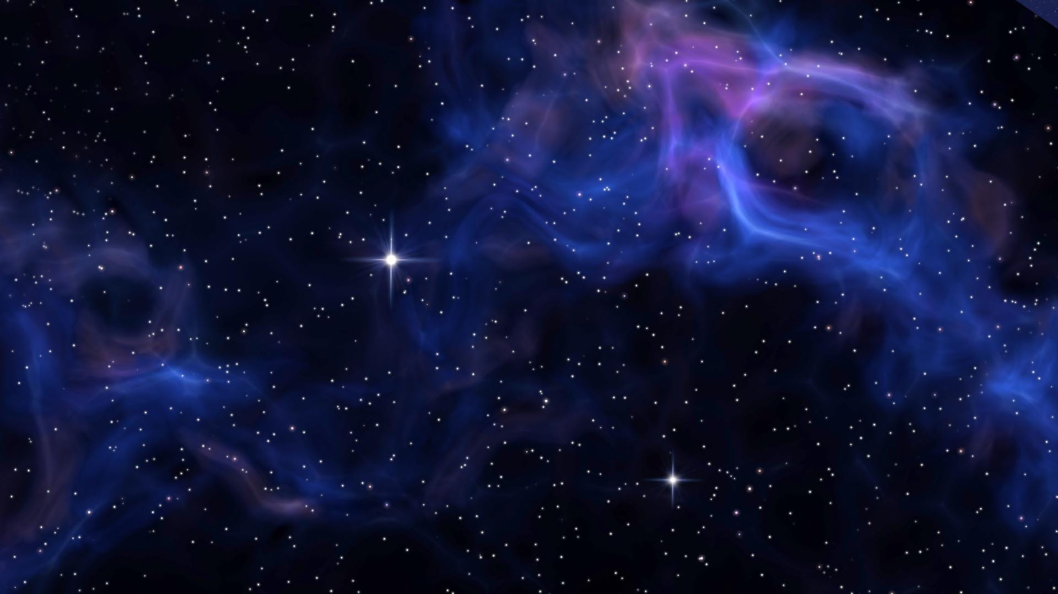
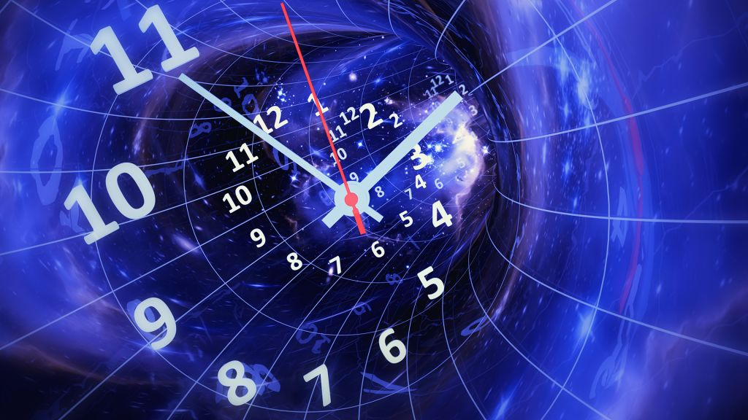


Worst enemies of DL (in this class, at least)
Space
Time

Slide 20
Worst enemies of DL (in this class, at least)
(Disk) Space
Modern DL models contain billions (10⁹) of parameters
GPT-4 has ~220 billion parameters
If a single parameter is a floating point represented on 32 bits…
…that is 220 * 10⁹ * 32 / 8 = 880 Giga Bytes (!!!)
They have to be stored on a hard drive and IN MEMORY!
During training, you’ll need to also store the gradient IN MEMORY!

Slide 21
Worst enemies of DL (in this class, at least)
(Training) Time
Training iterations take a lot of time

Slide 22
Practical issues with neural networks
Size of parameters (downcasting)

Slide 23
Why are neural networks winning?
Lots of competitors! Why is Deep Learning so dominant?

Slide 24
Why are neural networks winning?
On tabular data, they are not winning
Current consensus is that ensembles of boosted trees are better
See Grinsztajn et al. (2022) Why do tree-based models still outperform deep learning on tabular data?
On structured data, they are massively dominant
Remove the need for feature construction (and maybe selection)
Any type of structure: sequences, graphs, images, videos, …

Slide 25
Why are neural networks winning?
Generative models: how can a NNs output an image?

Slide 26
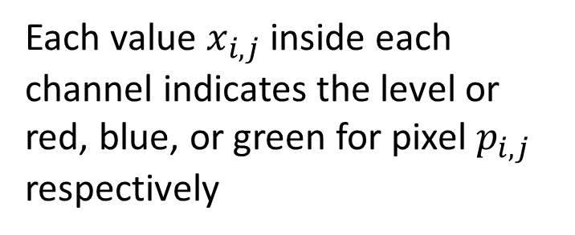
Why are neural networks winning?
Output tensors interpreted as (approximately) anything!
Example: image
Tensor (c * w * h)
Each value $x_{i,j}$ inside each channel indicates the level or red, blue, or green for pixel $p_{i,j}$ respectively
Image channel (w * h)

Slide 27
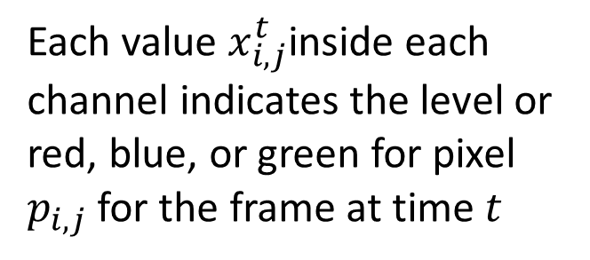
Why are neural networks winning?
Output tensors interpreted as (approximately) anything!
Example: video
Tensor (t*c*w*h)
Each value $x_{i,j}^{t}$inside each channel indicates the level or red, blue, or green for pixel $p_{i,j}$ for the frame at time $t$
Image channel (w * h)
Image channel (w * h)
…
t=0
t=T

Slide 28
Why are neural networks winning?
And when we have to choose between n discrete values?

Slide 29
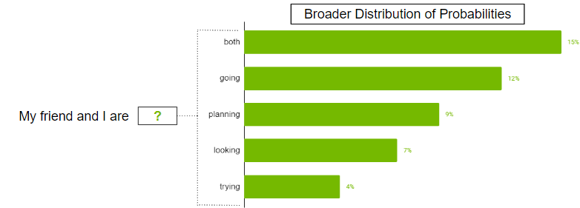
Why are neural networks winning?
Tensor is interpreted as a probability distribution
Each cell in output tensor is “probability” of picking element
Tensor (1 * n)

Slide 30
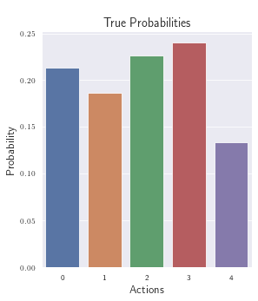
Why are neural networks winning?
Tensor is interpreted as a probability distribution
Each cell in output tensor is “probability” of picking element
Tensor (1 * n)

Slide 31
Why are neural networks winning?
Transfer learning
Somehow, using multiple layers

Slide 32
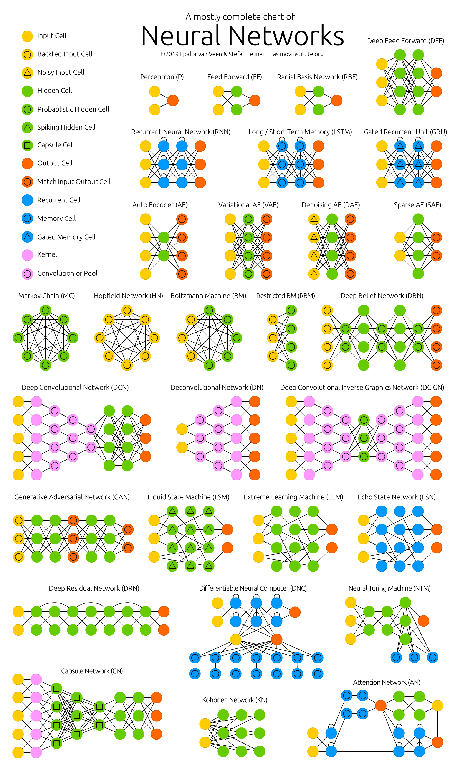
Multiple architectures!
https://www.asimovinstitute.org/neural-network-zoo/

Slide 33
Pseudo-random number generation in pytorch
Unfortunately, it’s not easy
Computing on GPUs makes consistent PRNG difficult
Libraries optimized for speed, not consistent behavior
Still, a few good practices:
https://pytorch.org/docs/stable/notes/randomness.html

Slide 34
pytorch FAQ
Excellent resource for most common issues
https://pytorch.org/docs/stable/notes/faq.html

