Slide 1
Continuous optimization: overview
Alberto TONDA, Senior Researcher (DR)
UMR 518 MIA-PS (Applied Mathematics and Computer Science) INRAE, AgroParisTech, Université Paris-Saclay Institut des Systèmes Complexes, Paris-Ile-de-France

Slide 2
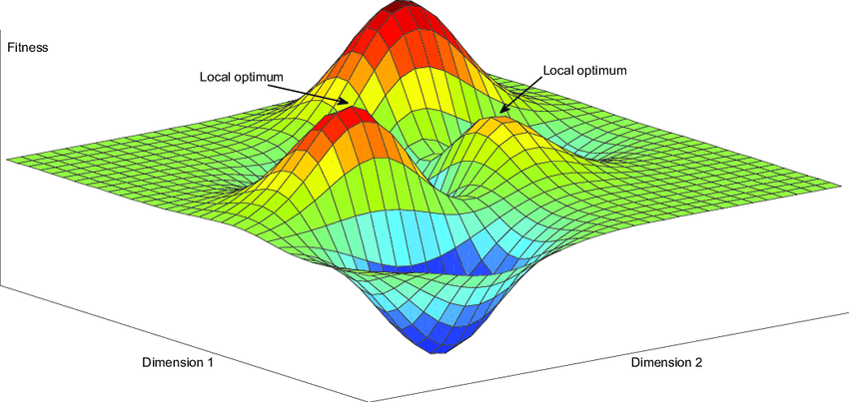
Outline
Gradient-based techniques
Gradient descent
Stochastic gradient descent
Stochastic techniques
Simulated annealing
Evolutionary algorithms

Slide 3
Introduction

Slide 4
Gradient-based techniques

Slide 5
Issues with gradient-based techniques
Brainstorming!

Slide 6
Issues with gradient-based techniques
Starting point of exploration matters
Hard to get out of local optima

Slide 7


Questions?
Bibliography - Kochenderfer & Wheeler, Algorithms for Optimization, MIT Press, 2019 - De Jong, Evolutionary Computation: A Unified Approach, 2016
Images: unless otherwise stated, I stole them from the Internet. I hope they are not copyrighted, or that their use falls under the Fair Use clause, and if not, I am sorry. Please don’t sue me.

