Slide 1
Errata and omissis
Alberto TONDA, Ph.D. (Senior permanent researcher, DR)
UMR 518 MIA-PS, INRAE, AgroParisTech, Université Paris-Saclay UAR 3611, Institut des Systèmes Complexes de Paris Île-de-France

Slide 2
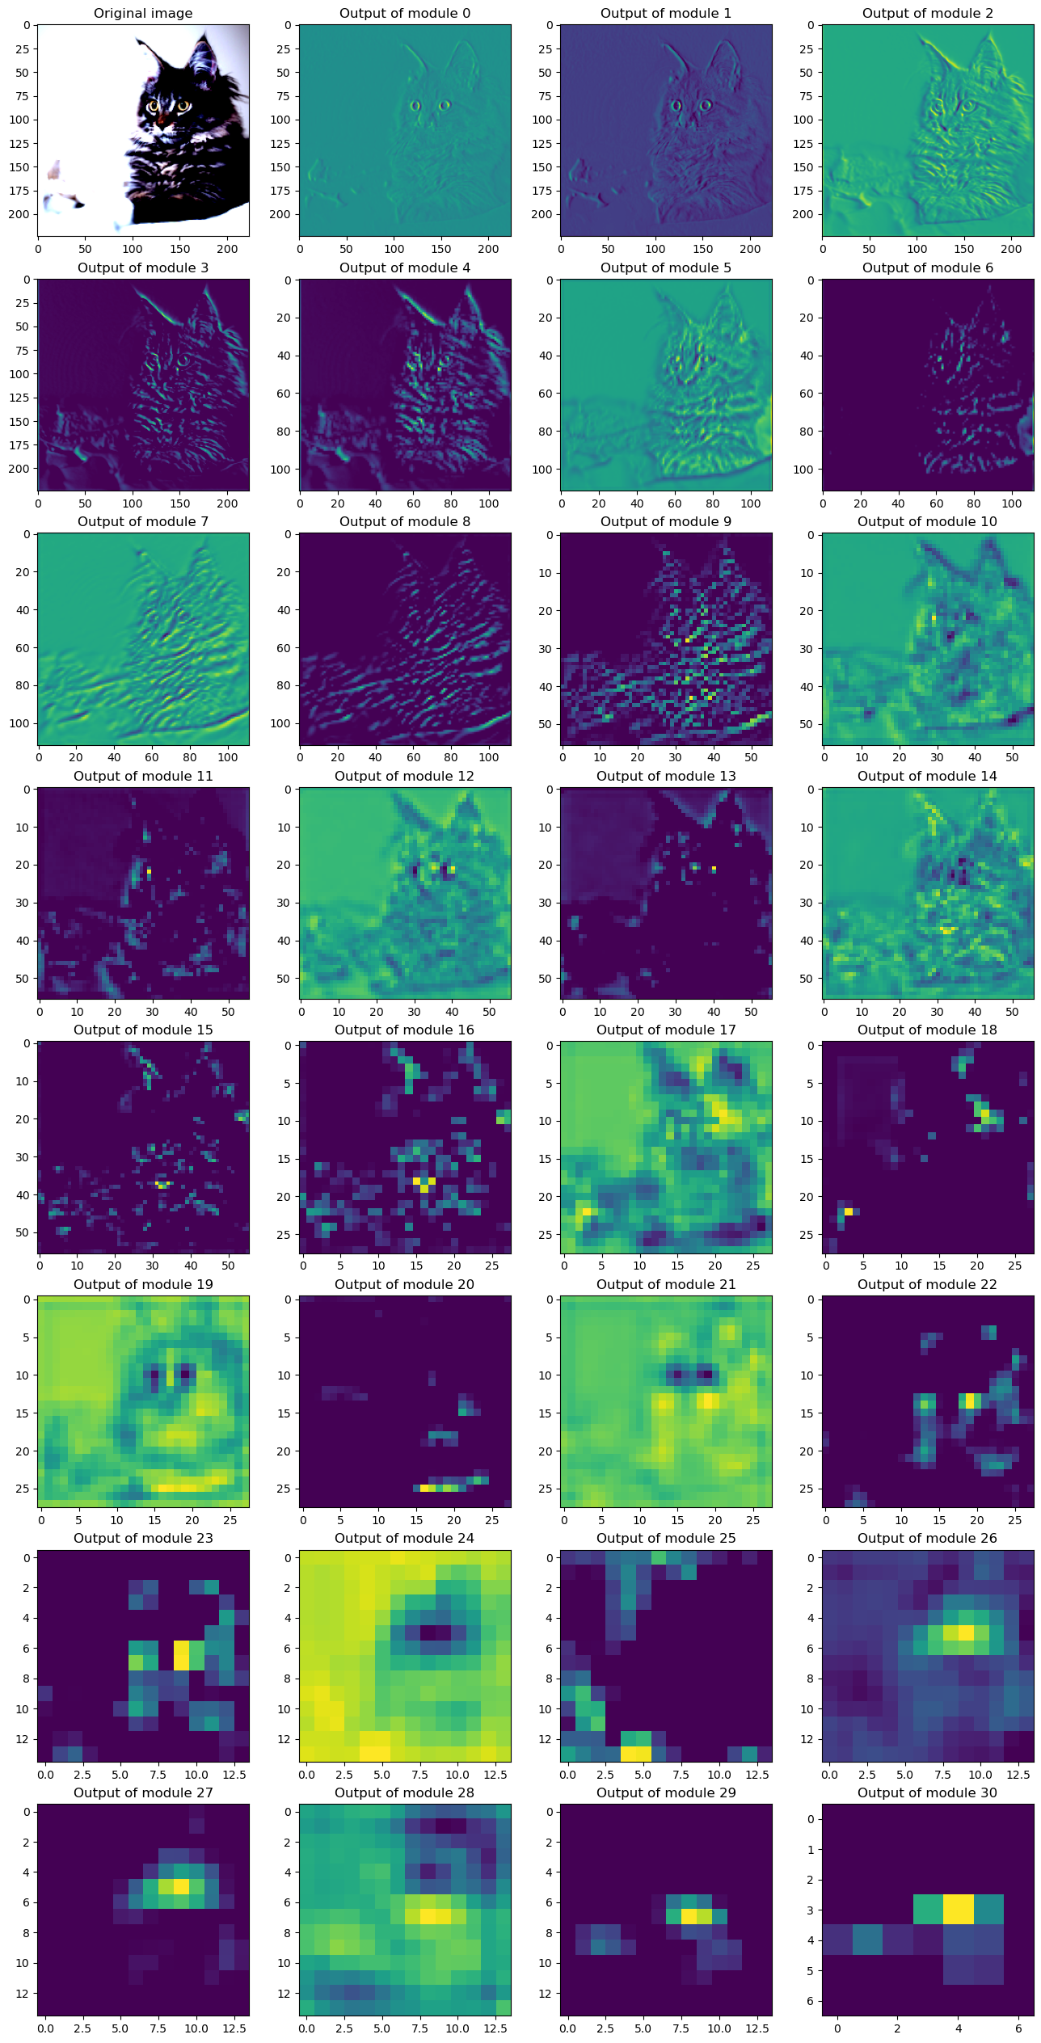
Errata: CNN features
Notes:
This is what happens when you pass the image through the network

Slide 3
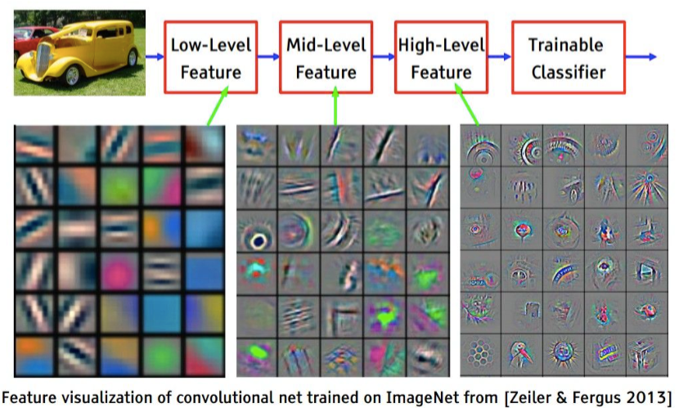
Errata: CNN features
These patterns are produced by a visualization technique
Optimize image to maximize filter activation
More details later

Slide 4
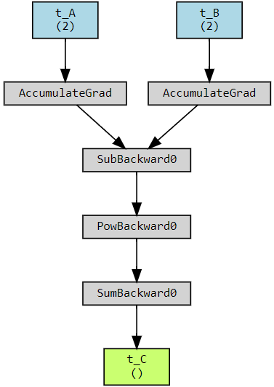
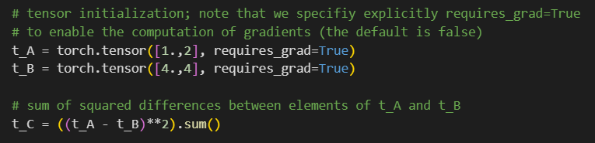
Omissis: computational graph
pytorchviz

Slide 5
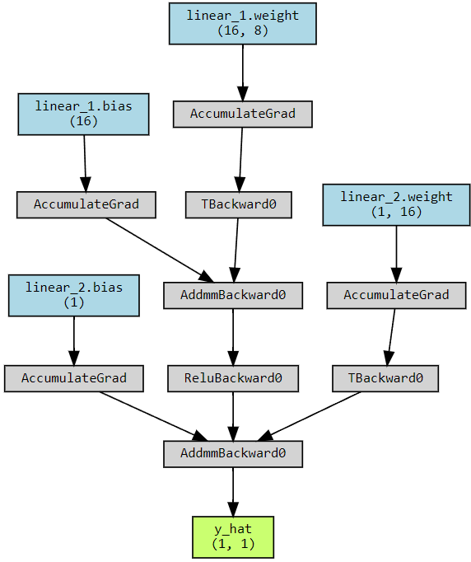
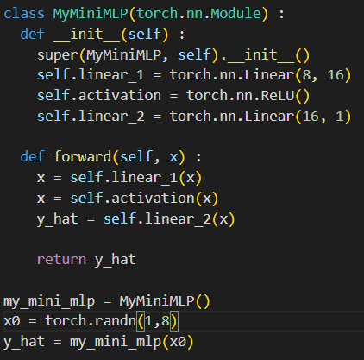
Omissis: computational graph

Slide 6
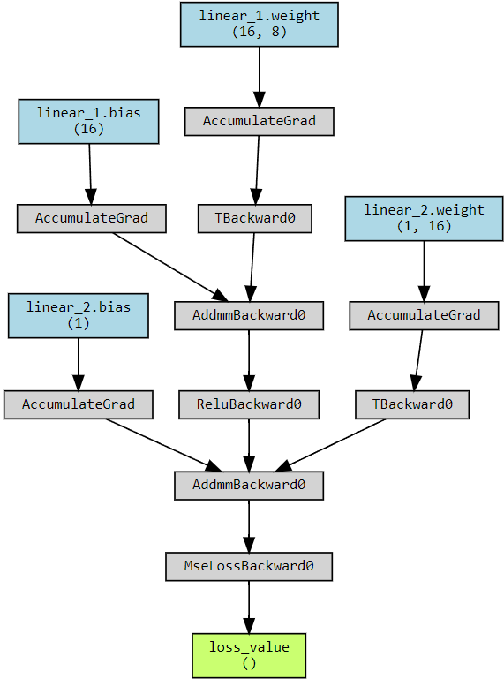
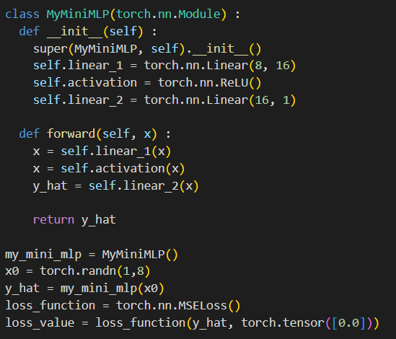
Omissis: computational graph

Slide 7
Omissis: computational graph
I modified the notebook on basic pytorch concepts to add a visualization of the computational graph
Relying on an external library, pytorchviz
Link is the same, so you can find it on the e-campus webpage

Slide 8
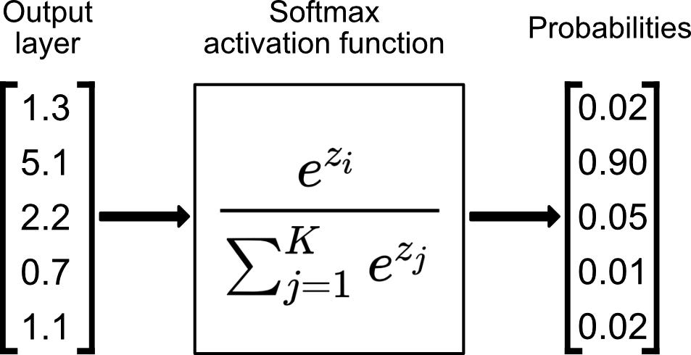
Omissis: where is the SoftMax?
We grazed over classification
But in literature, output tensor is sent through SoftMax
SoftMax is used to get values in [0.0,1.0]
Sometimes called “class probabilities”, but they are not
Where was the SoftMax? Was there an error in the code?

Slide 9
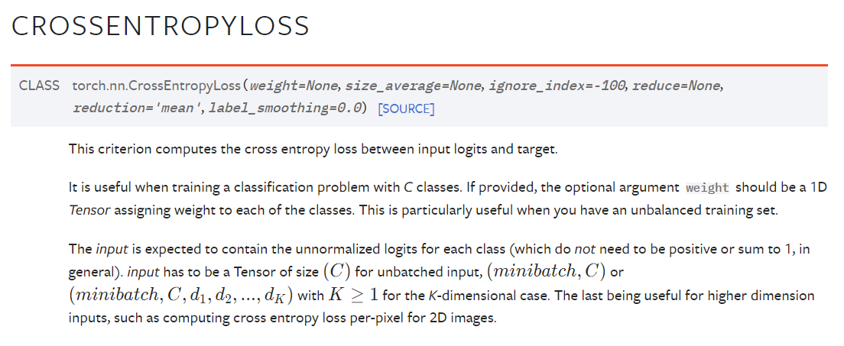
Omissis: where is the SoftMax?
The SoftMax is inside the loss function

Slide 10
Omissis: where is the SoftMax?
What is a logit?!?

Slide 11
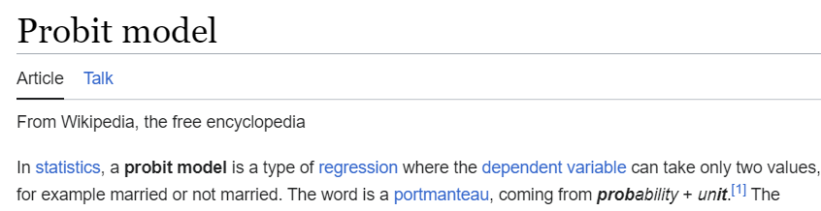
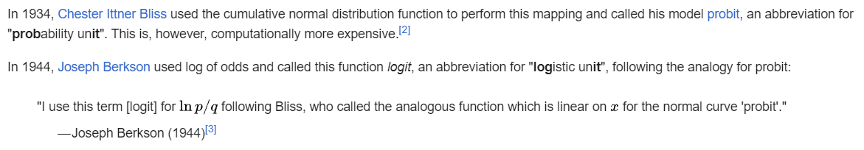
Omissis: where is the SoftMax?
What is a logit?!?

Slide 12

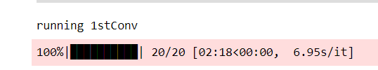


Omissis: GPU vs CPU test?
CPU
GPU
~3.78x speed up

Slide 13
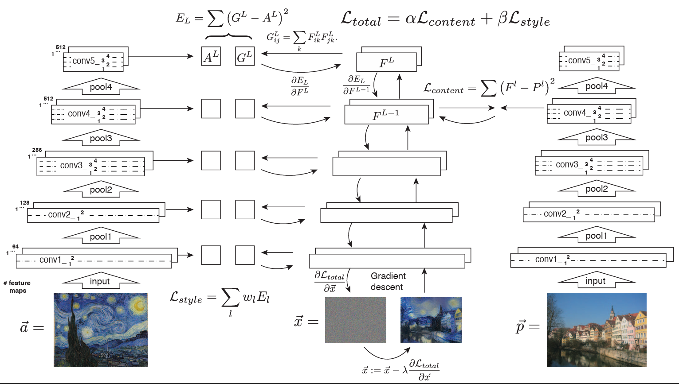

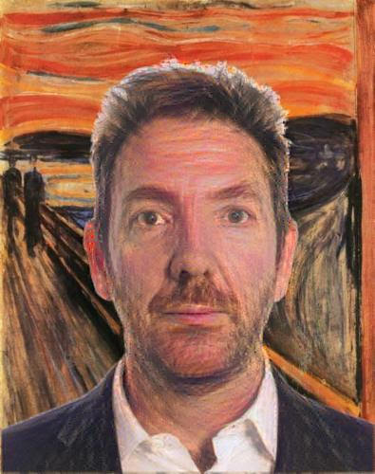
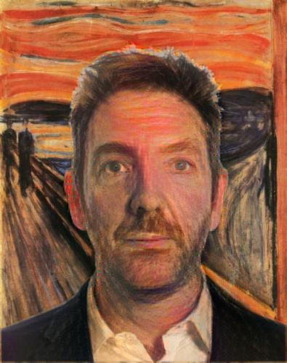

Questions?

