Slide 1
Decision trees (and ensembles of)
Alberto TONDA, Senior Researcher (DR)
UMR 518 MIA-PS (Applied Mathematics and Computer Science) INRAE, AgroParisTech, Université Paris-Saclay Institut des Systèmes Complexes, Paris-Ile-de-France

Slide 2
Outline
Decision trees
Classification and regression trees
Optimization algorithm
Ensembles
Random forest
Boosting

Slide 3
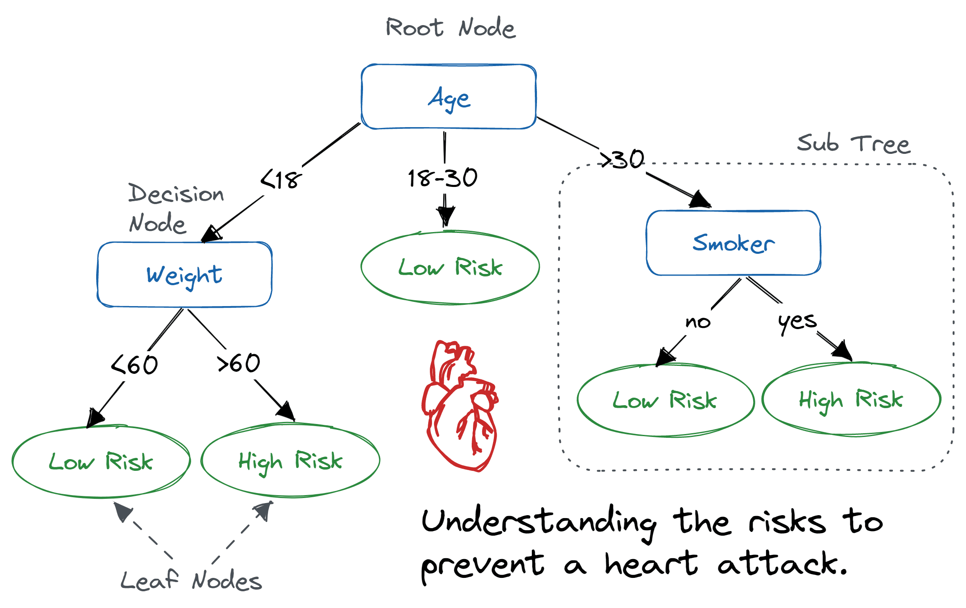
Decision trees
Decision trees are one of the simplest kinds of AI algorithms
Easy to read* for humans, we can follow the decision process
Can be hand-crafted! Encode expertise
Or created from data (ML)
*for small trees

Slide 4
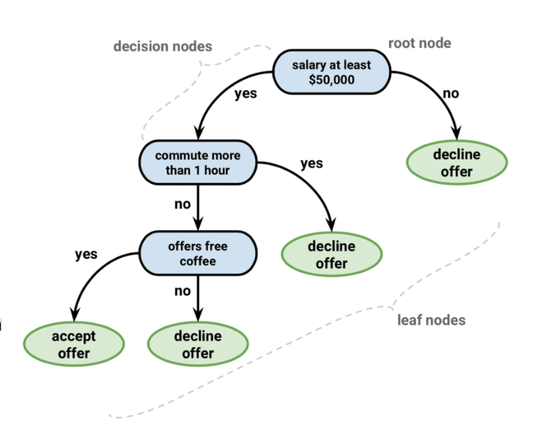
Decision trees
Classification trees: leaves are CLASSES
Assign a sample to a “category”
For each job offer, should I accept or decline it?

Slide 5
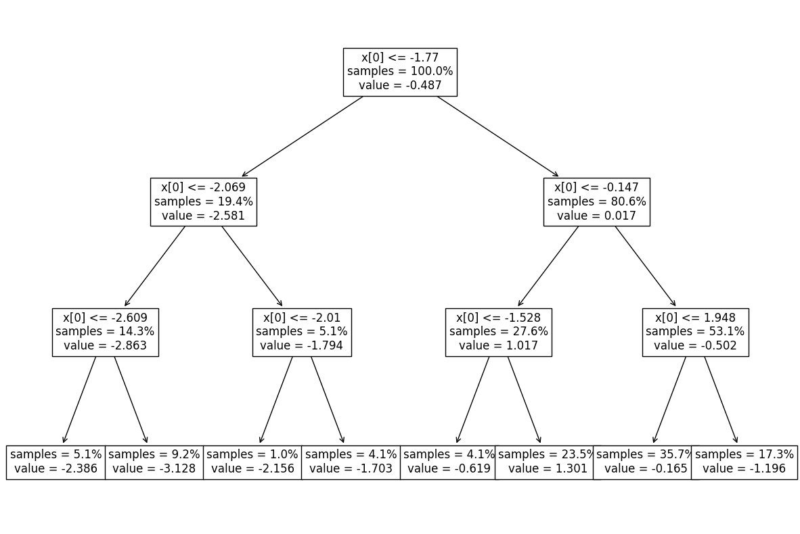
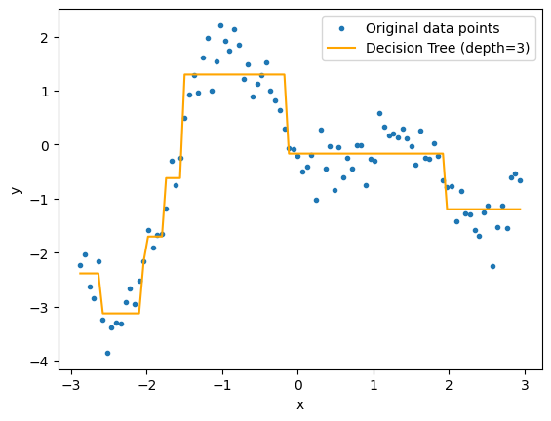

Decision trees
Regression trees: leaves are VALUES
Hypothesis: function can be approximated by linear segments
Each leaf is in the form $f\left(x\right)=k$ with $k$ a floating-point value

Slide 6
Decision trees: optimization algorithm
Can you guess the optimization algorithm used for CARTs?

Slide 7
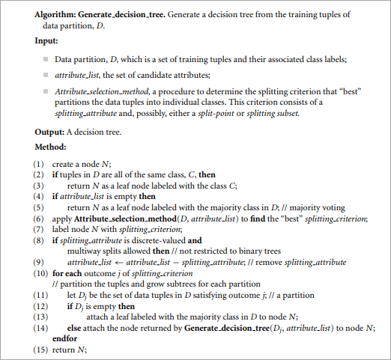
Decision trees: optimization algorithm
It’s greedy!
Every time it needs to create a split, it finds the feature (or attribute) that best divides the remaining data into groups
Quality is measured by purity (samples belonging to the same class) or mean squared error
Leaves are majority class or mean value

Slide 8
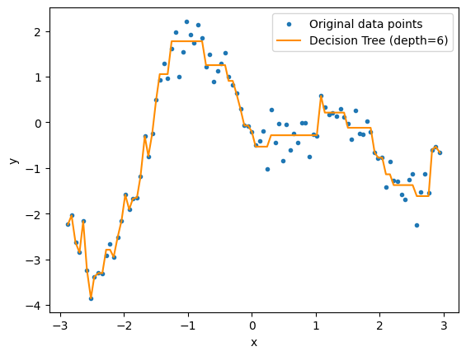
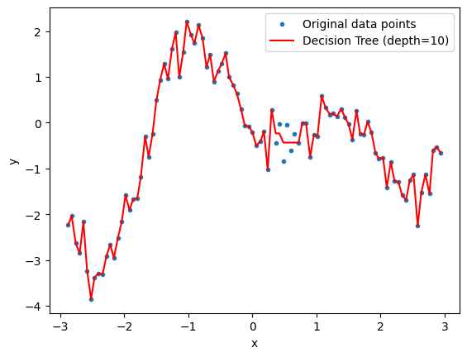
Decision trees
Several hyperparameters
Maximum depth of the tree
Type of criterion used to evaluate purity of the splits

Slide 9
Decision trees
For the moment, they seem fantastic! Any drawbacks?

Slide 10
Decision trees
For the moment, they seem fantastic! Any drawbacks?
Yep, they are pretty terrible at predictions

Slide 11
Ensembles
A single decision tree is a weak predictor
“Performs slightly better than random guessing” (Freund & Schapire, 1995)
Weak also implies low capacity (underfitting)
…but then we don’t have to worry too much about overfitting!
What if use an ensemble of trees?
They can collectively vote for a class (majority vote)
Or just average their prediction in the case of regression
But algorithm is deterministic, how do we create different trees?

Slide 12
Random forest
Randomly “hide” some features and samples
Each tree only sees a part of the training data
All trees are generated in parallel
Number of trees is hyperparameter (plus all of CART)
The more trees, the more capacity

Slide 13
Boosting
Iterative algorithm for the creation of trees
Set a same weight for all samples in training set
Creates first tree using all the training data
Then, evaluates performance
Increases weight of samples where first tree performed badly
Lowers weight of samples where first tree performed well
Creates a new tree, using new weights
Evaluates first+second tree
Alters the weights depending on performance
Creates a third tree…

Slide 14

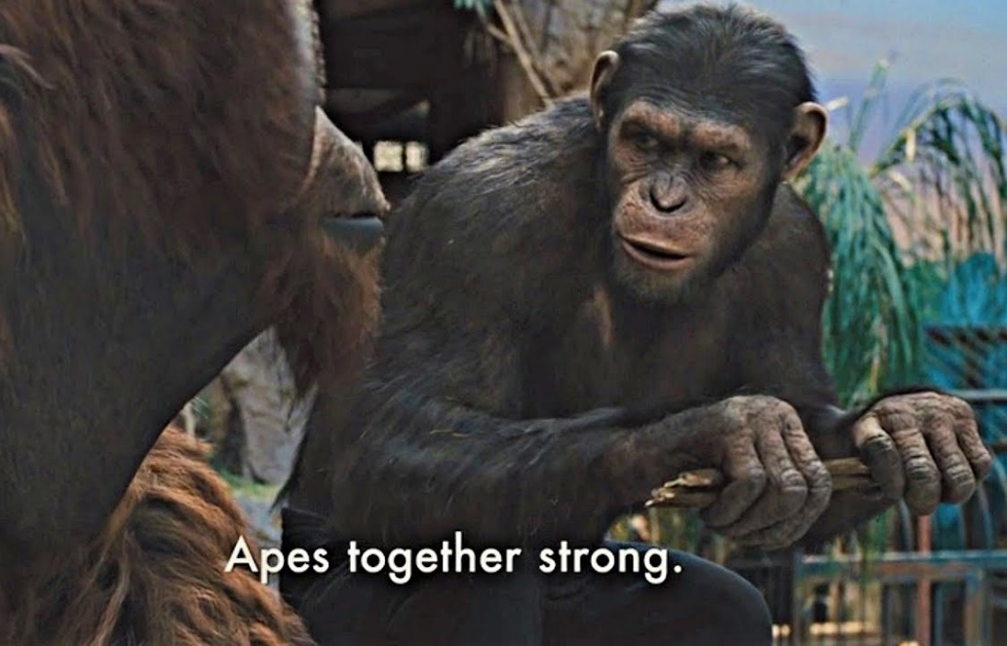
Ensembles
In practice, ensembles perform well on tabular data
Win most Kaggle challenges
Between a few and a lot of hyperparameters
Weak predictors

Slide 15


Questions?
Bibliography - Kochenderfer & Wheeler, Algorithms for Optimization, MIT Press, 2019 - McElfresh et al., When Do Neural Nets Outperform Boosted Trees on Tabular Data?, 2023
Images and videos: unless otherwise stated, I stole them from the Internet. I hope they are not copyrighted, or that their use falls under the Fair Use clause, and if not, I am sorry. Please don’t sue me.

