Slide 1
Optimizing complex structures - addenda
Alberto TONDA
UMR 518 MIA-PS, INRAE, AgroParisTech, Université Paris-Saclay UAR 3611, Institut des Systèmes Complexes de Paris Île-de-France

Slide 2
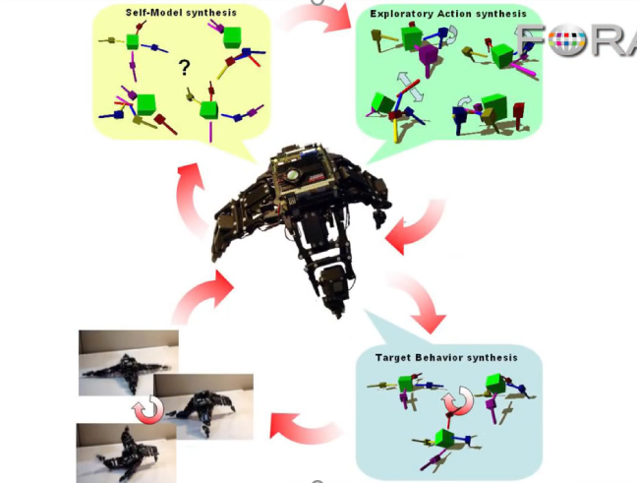
Hod Lipson mentioned something…
While speaking about the candidate models for the robot
He said “next, we are going to compare the models on the most discriminating movement”
Candidate models fit the data they have already seen
It make sense to test them on new data where they have different predictions
But how do we know what is the movement for which the models have the most different predictions?

Slide 3
He did not say! But I know…
It’s optimization!
You have a vast search space of possible movements
And an archive of candidate models
Search for the candidate movement that maximizes the difference in prediction between candidate models
Competitive Co-evolutionary Algorithms
Lipson and Schmidt, “Coevolving Fitness Models for Accelerating Evolution and Reducing Evaluations”, 2007
Lipson and Schmidt, “Coevolution of Fitness Predictors”, 2008

