Slide 1
Discrete optimization
Alberto TONDA
UMR 518 MIA-PS, INRAE, AgroParisTech, Université Paris-Saclay UAR 3611, Institut des Systèmes Complexes de Paris Île-de-France

Slide 2
Outline
Definition of discrete optimization
Combinatorial optimization
Mixed-integer linear programming
SAT solvers (Boolean satisfiability problem)
Evolutionary algorithms (again)

Slide 3
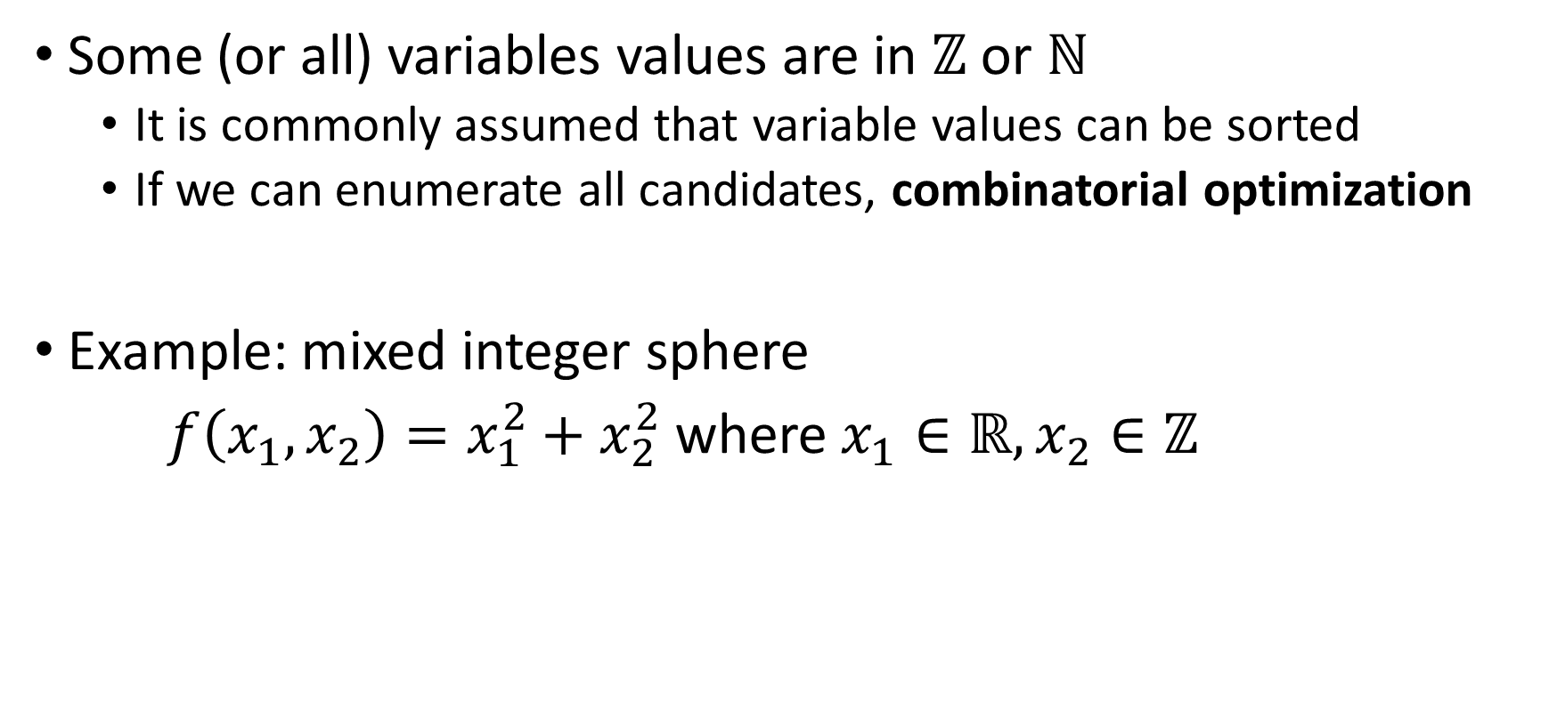
Definition of discrete optimization
Some (or all) variables values are in $ℤ$ or $ℕ$
It is commonly assumed that variable values can be sorted
If we can enumerate all candidates, combinatorial optimization
Example: mixed integer sphere
$f\left(x_{1},x_{2}\right)=x_{1}^{2}+x_{2}^{2}$ where $x_{1}∈ℝ, x_{2}∈ℤ$

Slide 4
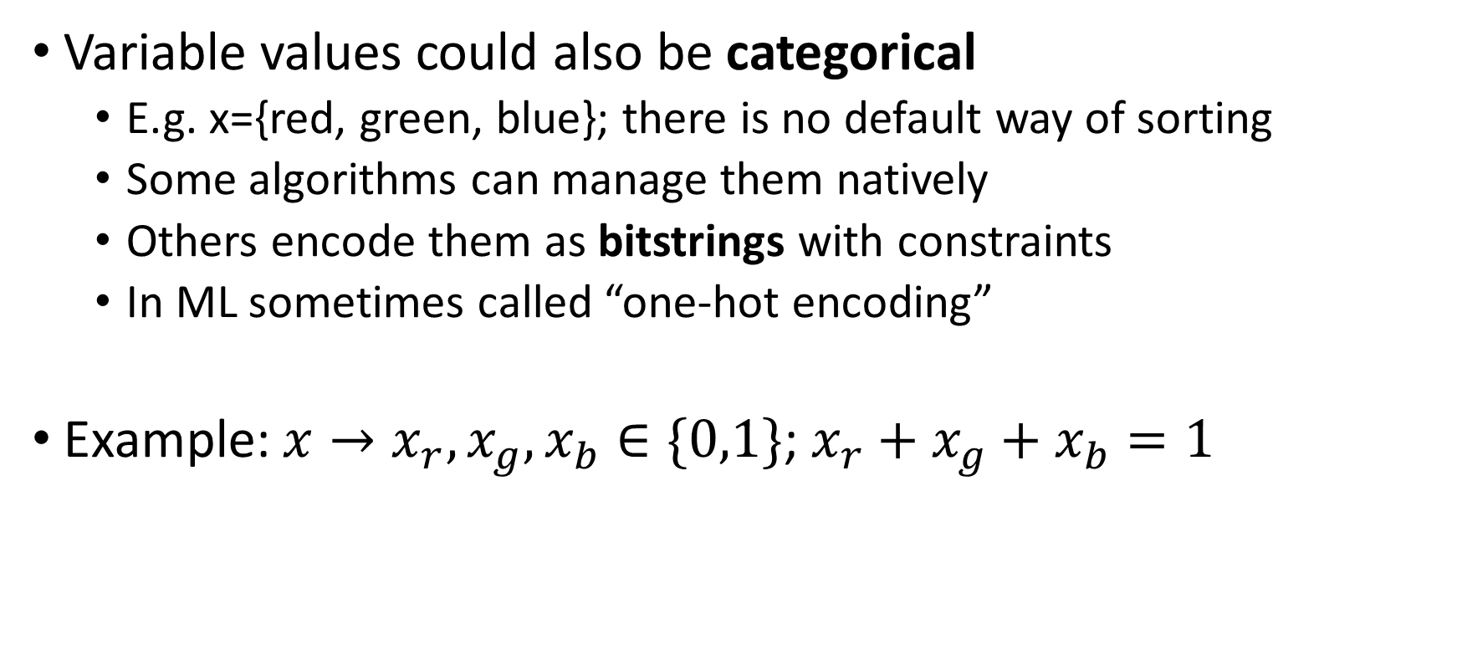
Definition of discrete optimization
Variable values could also be categorical
E.g. x={red, green, blue}; there is no default way of sorting
Some algorithms can manage them natively
Others encode them as bitstrings with constraints
In ML sometimes called “one-hot encoding”
Example: $x→x_{r}, x_{g}, x_{b}∈\{0,1\}$; $x_{r}+x_{g}+x_{b}=1$

Slide 5
Branch and bound

Slide 6
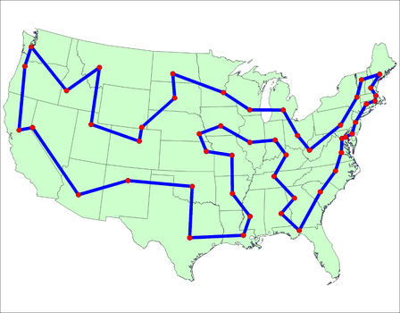
Traveling salesman problem
Salesman has to visit multiple cities once, in any order
What is the optimal order, to minimize total time?

Slide 7
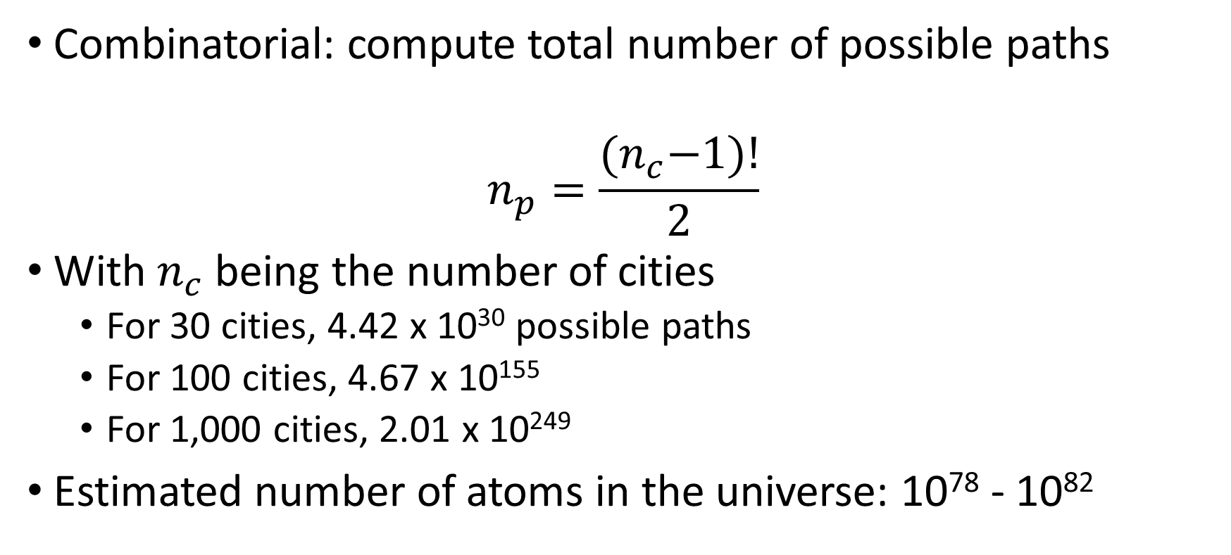
Traveling salesman problem
Combinatorial: compute total number of possible paths
$$n_{p}=\frac{{(n}_{c}−1)!}{2}$$
With $n_{c}$ being the number of cities
For 30 cities, 4.42 x 10³⁰ possible paths
For 100 cities, 4.67 x 10¹⁵⁵
For 1,000 cities, 2.01 x 10²⁴⁹
Estimated number of atoms in the universe: 10⁷⁸ - 10⁸²

Slide 8
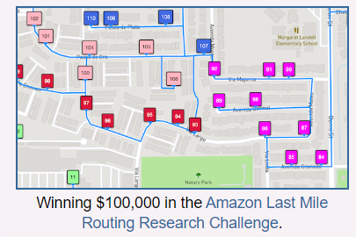
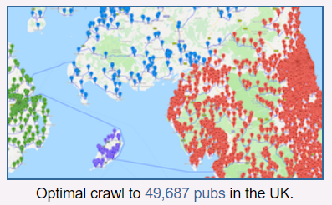
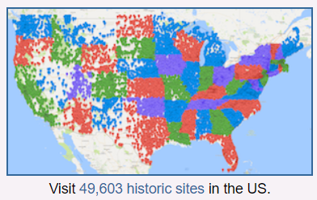
Traveling salesman problem
The best algorithm is (arguably) heuristic
Mix of linear programming, evolutionary algorithms, …
CONCORDE: https://www.math.uwaterloo.ca/tsp/index.html

Slide 9
Mixed-integer linear programming
MILP: Starts from classical linear programming
Add constraints that force variables to assume integer values
Most solvers allow integer variables by default

Slide 10
Boolean satisfiability (SAT solvers)

Slide 11
Evolutionary algorithms (again)
Internal representation of a candidate solution mixed integer
Requires problem-specific mutations (int for int parameters, …)
Might require problem-specific cross-overs
But in general, it’s relatively straightforward

Slide 12
Covariance Matrix Adaptation (again)
Classic CMA-ES with continuous variables
Round up the discrete variables to the closest integer

Slide 13


Questions?
Bibliography - Kochenderfer & Wheeler, Algorithms for Optimization, MIT Press, 2019 - Vanderbei, Linear Programming: Foundations and Extensions, 2014 - Hamano et al., CMA-ES with Margin: Lower-Bounding Marginal Probability for Mixed-Integer Black-Box Optimization, 2022 - Applegate et al., Solution of a Min-Max Vehicle Routing Problem, 2002
Images: unless otherwise stated, I stole them from the Internet. I hope they are not copyrighted, or that their use falls under the Fair Use clause, and if not, I am sorry. Please don’t sue me.

