Slide 1
Neural networks and Deep learning
Alberto TONDA
UMR 518 MIA-PS, INRAE, AgroParisTech, Université Paris-Saclay UAR 3611, Institut des Systèmes Complexes de Paris Île-de-France

Slide 2
Outline
Artificial neural networks
Optimizing a neural network
Convolutional neural networks
Recurrent neural networks
Transformers
Autoencoders
Overparametrization (“double descent”)
From the point of view of optimization…

Slide 3
Artificial neural networks
…
…
…
…

Slide 4
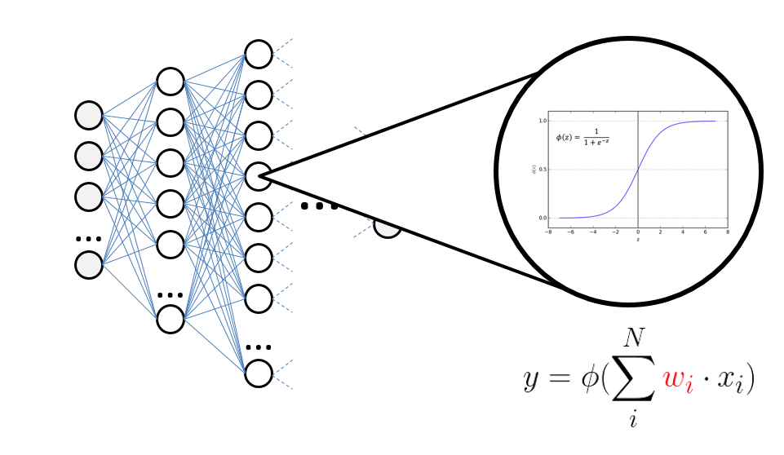
Artificial neural networks
Based on an old (and wrong) model of a real neuron

Slide 5


Autoencoders
Train unsupervised to exactly reproduce the input
Optimization task: $argmin(\sum_{i=0}^{N}{| \hat{x}(i) −x(i) |)}$
Autoencoder
$$x$$
$$\hat{x}$$

Slide 6
Autoencoders
Force the computation to go through bottleneck
Dimension of the bottleneck much smaller than input
…
…
…
…
Bottleneck/Latent space

Slide 7
Autoencoders
Remove the second part of the model
…
…

Slide 8
Autoencoders
Remove the second part of the model
Going from input to (lower dimensionality) bottleneck
Dimensionality reduction
…
…

Slide 9
Autoencoders
However, we can also remove the first part
From the bottleneck to the output
…
…

Slide 10
Autoencoders
However, we can also remove the first part
From the bottleneck to the output
Generation of content
…
…

Slide 11
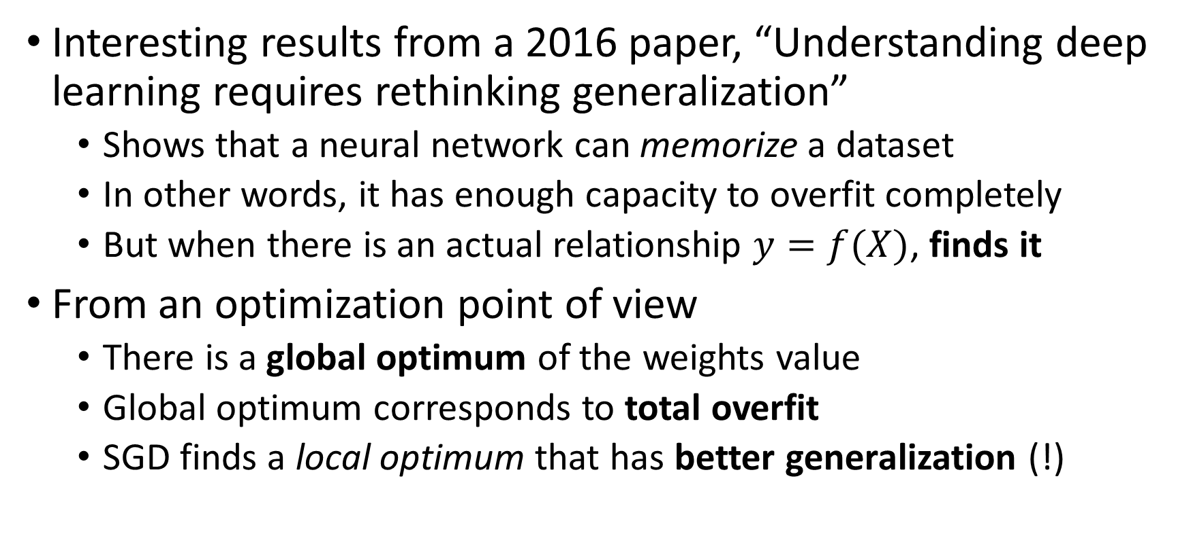
From the point of view of optimization…
Interesting results from a 2016 paper, “Understanding deep learning requires rethinking generalization”
Shows that a neural network can memorize a dataset
In other words, it has enough capacity to overfit completely
But when there is an actual relationship $y=f(X)$, finds it
From an optimization point of view
There is a global optimum of the weights value
Global optimum corresponds to total overfit
SGD finds a local optimum that has better generalization (!)

Slide 12


Questions?
Bibliography - Goodfellow et al., The Deep Learning Book, 2016 - Zhang et al., Understanding Deep Learning Requires Rethinking Generalization, 2016
Images and videos: unless otherwise stated, I stole them from the Internet. I hope they are not copyrighted, or that their use falls under the Fair Use clause, and if not, I am sorry. Please don’t sue me.

