Slide 1
Intermediate pytorch concepts
Alberto TONDA, Ph.D. (Senior permanent researcher, DR)
UMR 518 MIA-PS, INRAE, AgroParisTech, Université Paris-Saclay UAR 3611, Institut des Systèmes Complexes de Paris Île-de-France

Slide 2
Outline
Neural Networks vs Deep Learning?
Monitor performance on validation
(Really) Stochastic Gradient Descent
Save training checkpoints
Tensorboard
pytorch lightning

Slide 3
Outline

Slide 4
Neural Networks vs Deep Learning
What is the difference?

Slide 5
Neural Networks vs Deep Learning
(1) Considerable improvements over classic Neural Networks
New (more effective!) algorithms to optimize parameters
New architectures to deal with structured data
Better software engineering
More computing power available, better results
(2) Rebranding
Interest for Neural Networks declined in the 1990s
At the time, considered less effective than other methods
Any network with more than one hidden layer is “deep”

Slide 6
Why are neural networks winning?
Lots of competitors! Why is Deep Learning so dominant?

Slide 7
Why are neural networks winning?
On tabular data, they are not winning
Current consensus is that ensembles of boosted trees are better
See Grinsztajn et al. (2022) Why do tree-based models still outperform deep learning on tabular data?
On structured data, they are massively dominant
Remove the need for feature construction (and maybe selection)
Any type of structure: sequences, graphs, images, videos, …

Slide 8
Why are neural networks winning?
Generative models: how can a NNs output an image?

Slide 9
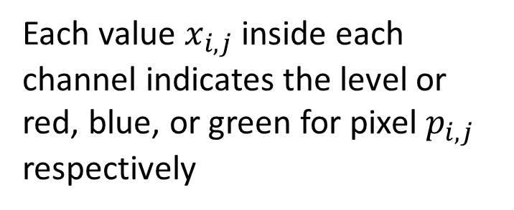
Why are neural networks winning?
Output tensors interpreted as (approximately) anything!
Example: image
Tensor (c * w * h)
Each value $x_{i,j}$ inside each channel indicates the level or red, blue, or green for pixel $p_{i,j}$ respectively
Image channel (w * h)

Slide 10
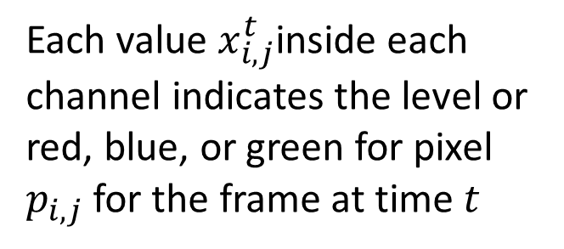
Why are neural networks winning?
Output tensors interpreted as (approximately) anything!
Example: video
Tensor (t*c*w*h)
Each value $x_{i,j}^{t}$inside each channel indicates the level or red, blue, or green for pixel $p_{i,j}$ for the frame at time $t$
Image channel (w * h)
Image channel (w * h)
…
t=0
t=T

Slide 11
Why are neural networks winning?
And when we have to choose between n discrete values?

Slide 12
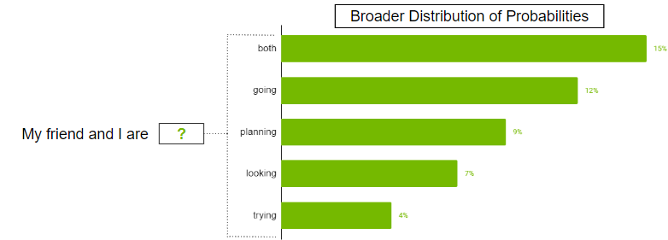
Why are neural networks winning?
Tensor is interpreted as a probability distribution
Each cell in output tensor is “probability” of picking element
Tensor (1 * n)

Slide 13
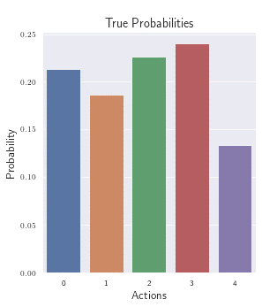
Why are neural networks winning?
Tensor is interpreted as a probability distribution
Each cell in output tensor is “probability” of picking element
Tensor (1 * n)

Slide 14
Why are neural networks winning?
Transfer learning
Somehow, using multiple layers

Slide 16
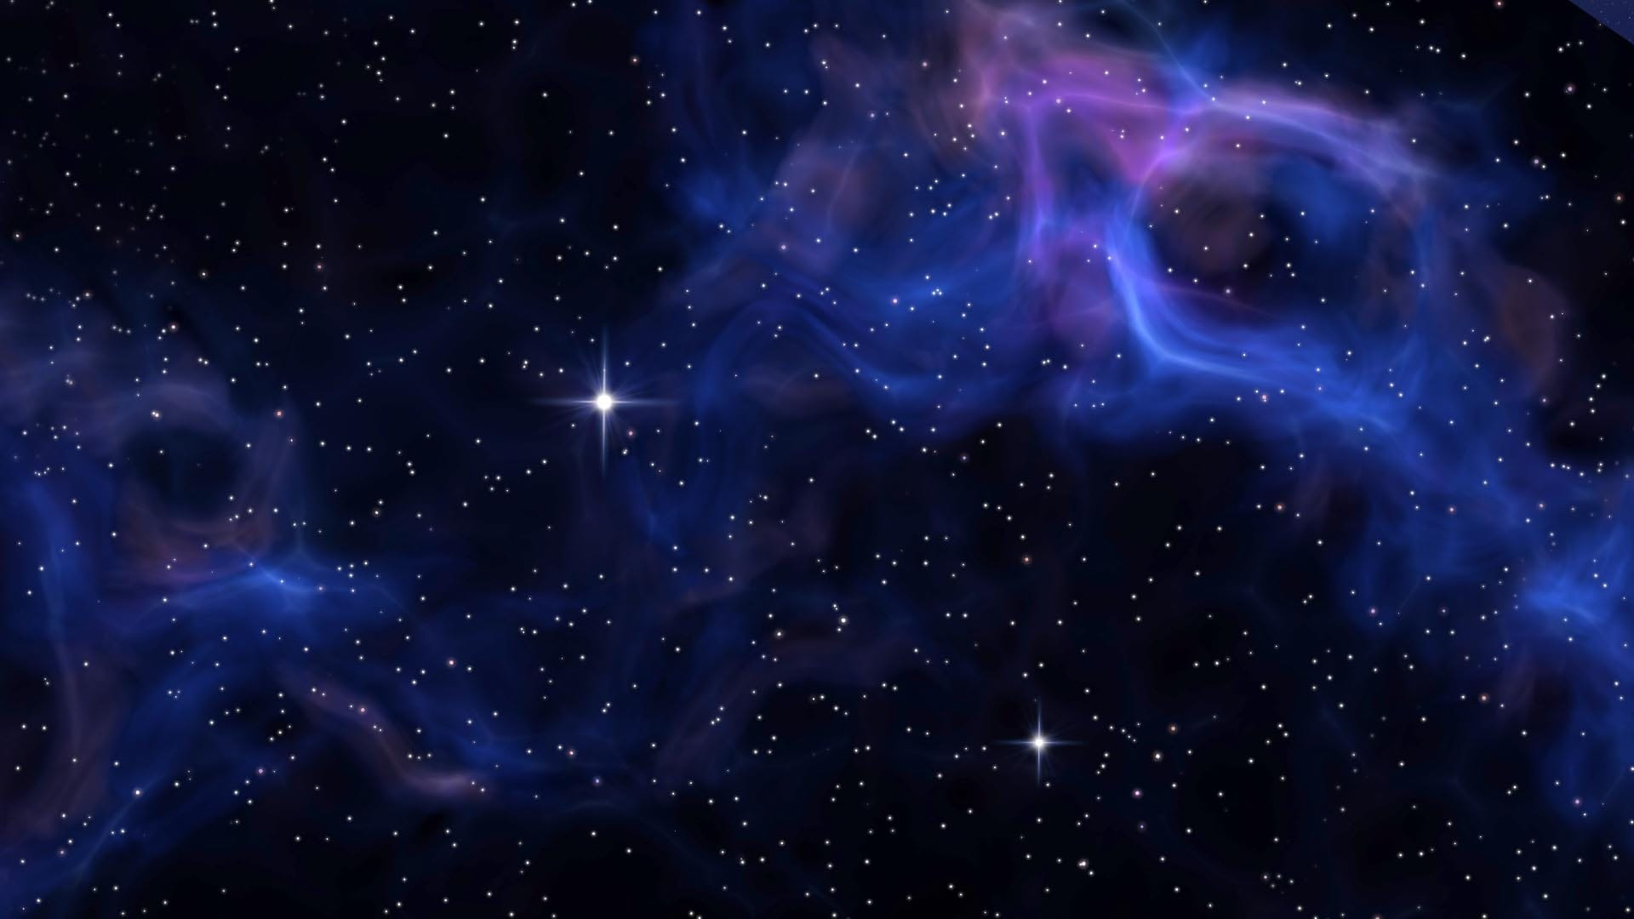
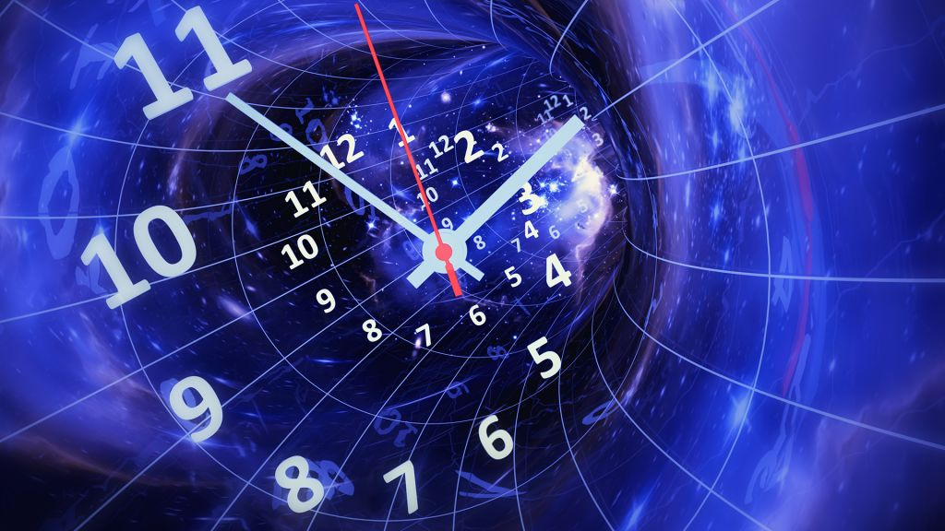


Worst enemies of DL (in this class, at least)
Space
Time

Slide 17
Worst enemies of DL (in this class, at least)
(Disk) Space
Modern DL models contain billions (10⁹) of parameters
GPT-4 has ~220 billion parameters
If a single parameter is a floating point represented on 32 bits…
…that is 220 * 10⁹ * 32 / 8 = 880 Giga Bytes (!!!)
They have to be stored on a hard drive and IN MEMORY!
During training, you’ll need to also store the gradient IN MEMORY!

Slide 18
Worst enemies of DL (in this class, at least)
(Training) Time
Training iterations take a lot of time

Slide 19
Practical issues with neural networks
Size of parameters (downcasting)

Slide 20
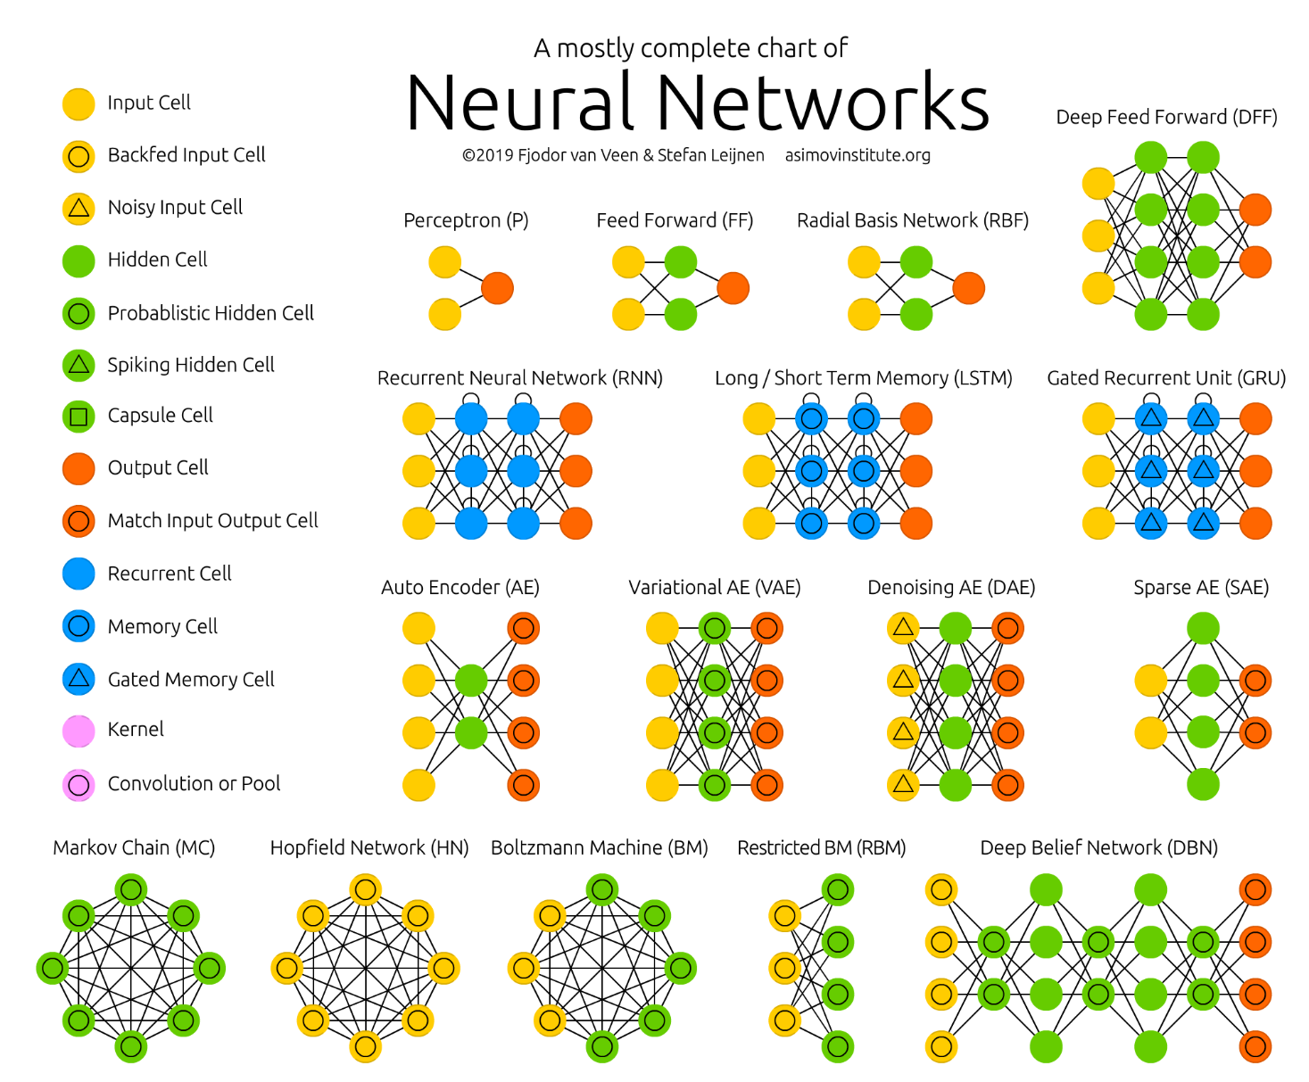
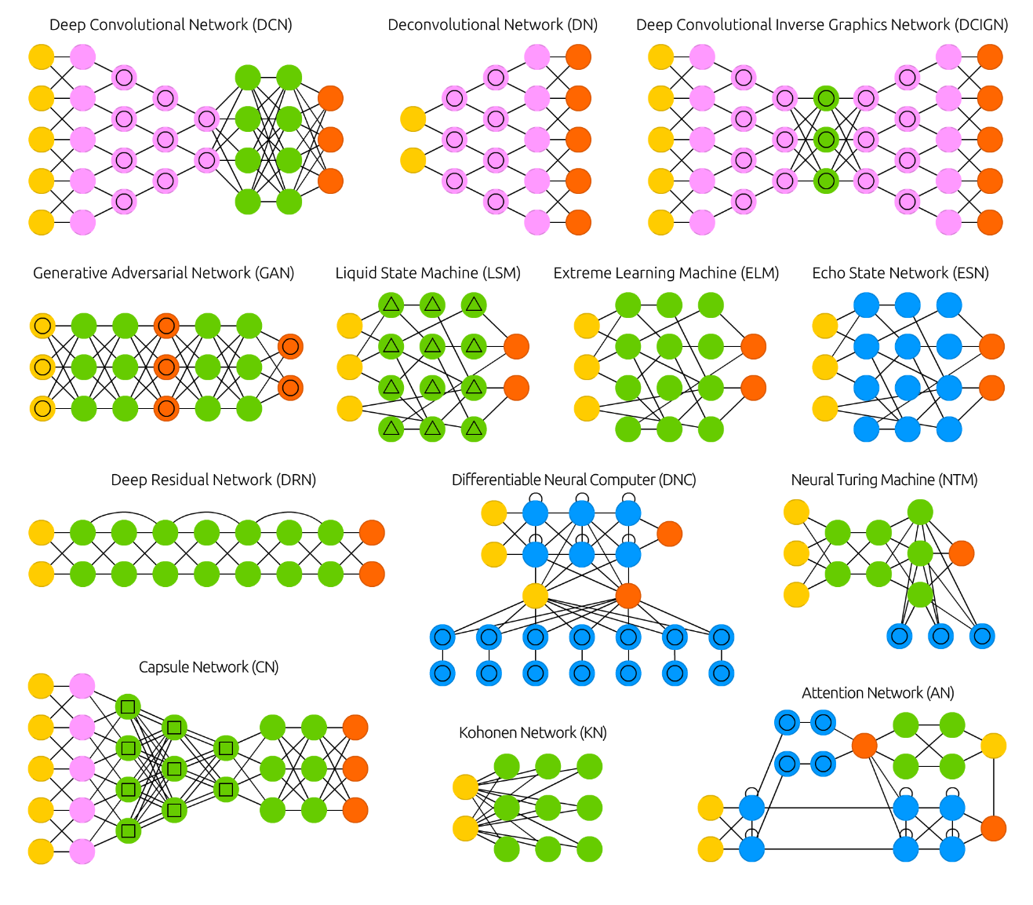
Multiple architectures!
https://www.asimovinstitute.org/neural-network-zoo/

Slide 21
Pseudo-random number generation in pytorch
Unfortunately, it’s not easy
Computing on GPUs makes consistent PRNG difficult
Libraries optimized for speed, not consistent behavior
Still, a few good practices:
https://pytorch.org/docs/stable/notes/randomness.html

Slide 22
pytorch FAQ
Excellent resource for most common issues
https://pytorch.org/docs/stable/notes/faq.html

