Slide 1
Introduction to Deep Learning in Practice with pytorch
Alberto TONDA, Ph.D. (Senior permanent researcher, DR)
UMR 518 MIA-PS, INRAE, AgroParisTech, Université Paris-Saclay UAR 3611, Institut des Systèmes Complexes de Paris Île-de-France

Slide 2
Objective of this class
Overview of deep learning architectures and applications, using pytorch as the support library

Slide 3
Objective of this class
At the end of the class, you should know
Deep Learning architectures suited to different problems
Problems for which DL is suited, and problems for which it is not
Basic usage of pytorch and a few other DL libraries
Where to find and how to use large pre-trained models
Keywords to perform further research/reading

Slide 4
Outline
Existential questions: who am I, why are we here?
Current state of the field: why deep learning, why pytorch?
(Tentative) Planning for the class

Slide 5
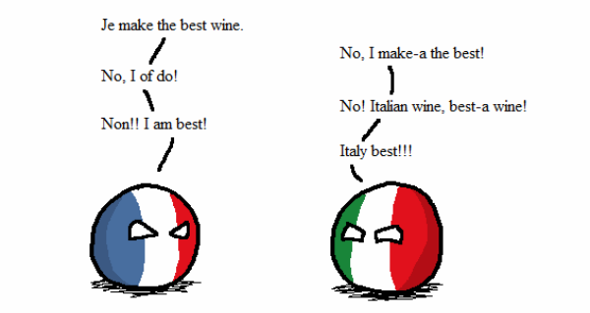
Who am I?
Career
Bachelor and Master in Computer Science Engineering
Ph.D. from Politecnico di Torino, Italy, in 2011
Permanent researcher in France since late 2012 (INRAE)
Senior researcher (DR) since 2023
Research interests
Stochastic multi-objective optimization
Machine learning (explainable AI)
Biological/agri-food problems
Notes:
I am NOT an expert of ALL methods that I am going to present.

Slide 6
What is deep learning?
One technique among many in Machine Learning
Rebranding of Artificial Neural Networks
Currently extremely successful
Artificial Intelligence (AI)
Symbolic AI
Machine Learning (ML)
Other techniques
Deep Learning (DL, DNN)

Slide 7
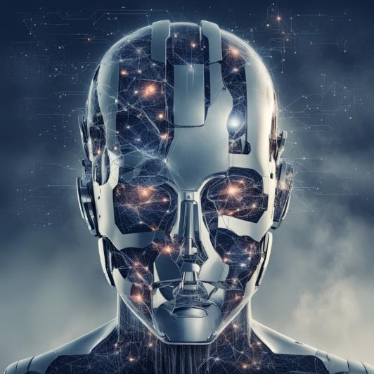
Why is this subject relevant now?
Artificial Intelligence achieved important goals in last decade
Human-competitive* play in difficult games
Improvement in state of the art for image/video classification
Generation of images, text, and sound
Availability of data and computing (phones)
Attempts at commercial use of AI
Self-driving vehicles
Assistants for text and code generation
Prediction of protein structures
…

Slide 8
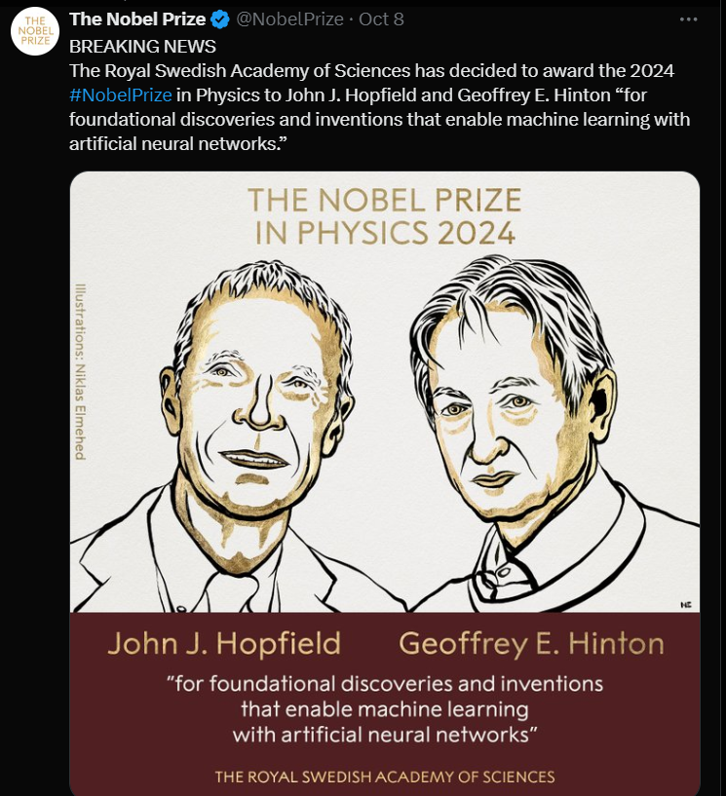
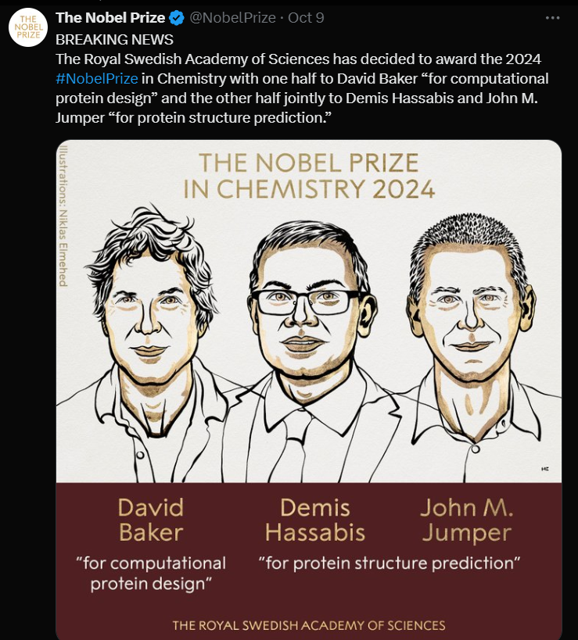
Why is this subject relevant now?

Slide 9
Current state of the field
March 2023
Open letter to slow down AI research
April 2023
Meta releases Segment Anything
November 2022
OpenAI releases ChatGPT
October 2022
I apply to teach this class
December 2022
pytorch 2.0 is announced
April 2023
Experiments with autonomous agents (babyAGI, AutoGPT)

Slide 10
Current state of the field
November 2023
Musk’s xAI releases Grok
November 2024
Time-test tuning
July 2023
Meta releases Llama 2, open LLM
December 2023
Google releases Gemini

Slide 11
Current state of the field
Large availability of open-ish source tools
The open source movement in computer science is strong
It’s useful for companies to have other people use their code
For deep learning, it started with Tensorflow, 2017 (Google)
General Purpose Graphic Processing Units (GPGPUs)
GPUs originally created for gaming, lots of processors (low-spec)
Great for massive parallelization of simple computations

Slide 12
Current state of the field
A vast (unreasonable?) amount of enthusiasm!
Why is that?
Competition between large companies (Microsoft, Meta, Google)
Tools that are relatively accessible to non-experts
Considerable amount of passionate practitioners
Communities obsessed with AI (existential risk, accelerationists, …)
Charismatic influencers (Sam Altman, Eliezer Yudkowsky, Yann Le Cunn, Gary Marcus, …)

Slide 13








Why pytorch?
Several competing libraries
keras, pytorch, theano, …
pytorch (currently) most popular
Eager execution, for rapid prototyping
Analysis step by step
Availability of models

Slide 14
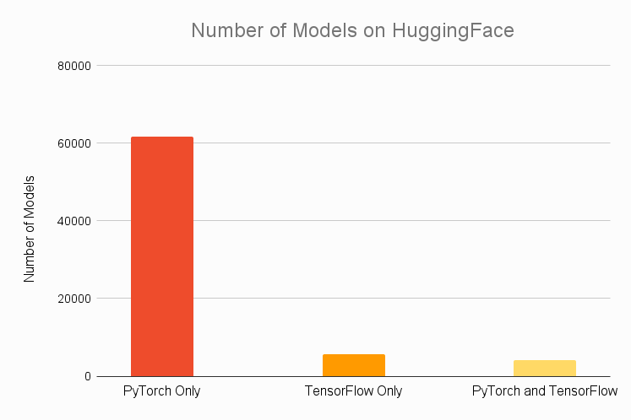
Why pytorch?

Slide 15

HuggingFace?
French-American company
Weird name (IMHO), but 4.5 * 10^9$ evaluation
Library for deep neural networks (transformers and others)
Hub, to share and discuss trained models
Extremely successful, several useful models
Users can download, fine-tune, change and share
Relatively easy to use, loved by practitioners

Slide 16
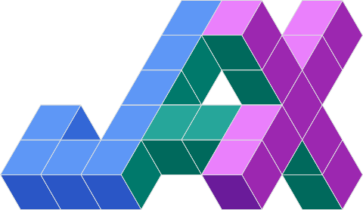
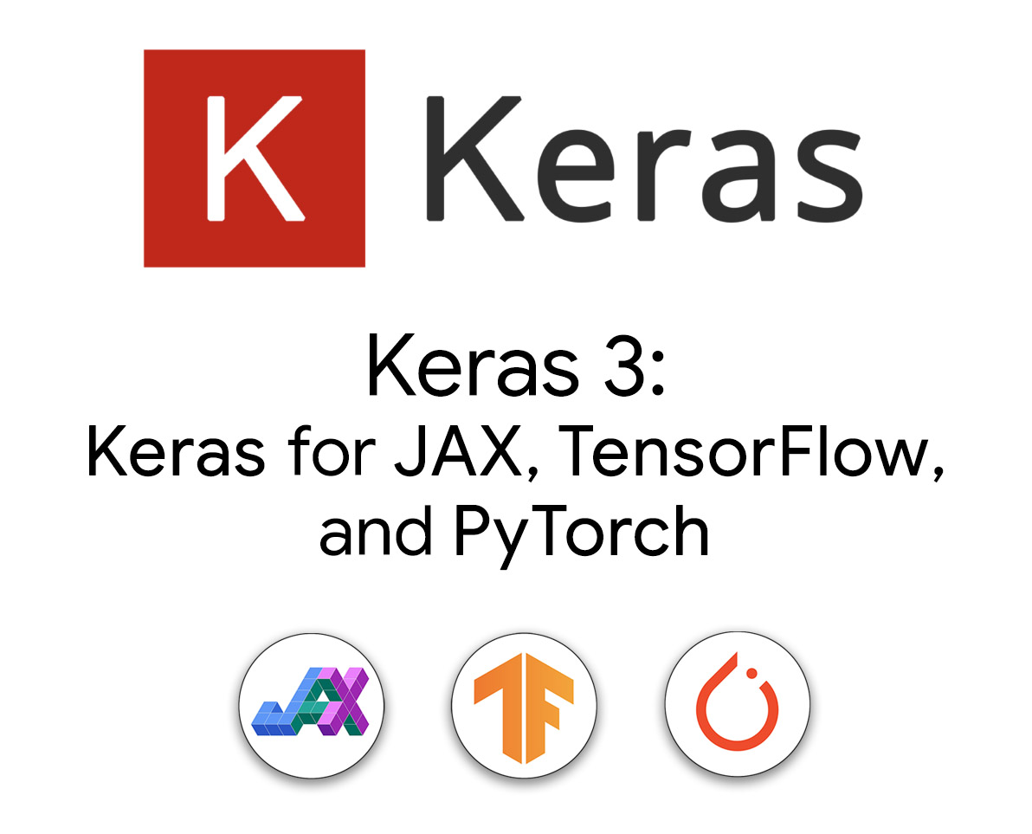

Competition
FLAX neural network library in JAX

Slide 17
(Tentative) Planning
December 02 Introduction, ML summary, Basics of deep neural networks
December 04 Convolutional Neural Networks
December 06 Recurrent Neural Networks, Embeddings,
Autoencoders
December 09
Generative models, Deep reinforcement learning, Concept bottlenecks
December 11
Project and/or advanced topics (Physics-informed Neural Networks, Hybrid models, Neural-symbolic AI, Causality)

Slide 18

(Tentative) Planning
December 02 Introduction, ML summary, Basics of deep neural networks
December 04 Convolutional Neural Networks
December 06 Recurrent Neural Networks, Embeddings,
Autoencoders
December 09
Generative models, Deep reinforcement learning, Concept bottlenecks
December 11
Project and/or advanced topics (Physics-informed Neural Networks, Hybrid models, Neural-symbolic AI, Causality)
Pacing likely all over the place
Learning from last year’s class

Slide 19
(Tentative) Planning
We will always be in Amphithéâtre e.068…
December 02 Introduction, ML summary, Basics of deep neural networks
December 04 Convolutional Neural Networks
December 06 Recurrent Neural Networks, Embeddings,
Autoencoders
December 09
Generative models, Deep reinforcement learning, Concept bottlenecks
December 11
Project and/or advanced topics (Physics-informed Neural Networks, Hybrid models, Neural-symbolic AI, Causality)
…except on Monday 09/12 (Amphithéâtre III)

Slide 20
(Tentative) Planning
09h30-12h00
13h00-15h30
Amphi e.068
09h30-12h00
13h00-15h30
09h30-12h00
13h00-15h30
December 02 Introduction, ML summary, Basics of deep neural networks
December 04 Convolutional Neural Networks
December 06 Recurrent Neural Networks, Embeddings,
Autoencoders
December 09
Generative models, Deep reinforcement learning, Concept bottlenecks
December 11
Project and/or advanced topics (Physics-informed Neural Networks, Hybrid models, Neural-symbolic AI, Causality)
Amphi e.068
09h00-12h00
13h00-15h00
Amphi III
09h45-12h00
13h00-15h45

Slide 21
(Tentative) Planning
???
Relational Concept Bottleneck Models
Pietro Barbiero (Cambridge, UK and Univ. della Svizzera Italiana, Switzerland)
???
Relational Concept Bottleneck Models
Pietro Barbiero (Cambridge, UK and Univ. della Svizzera Italiana, Switzerland)
December 02 Introduction, ML summary, Basics of deep neural networks
December 04 Convolutional Neural Networks
December 06 Recurrent Neural Networks, Embeddings,
Autoencoders
December 09
Generative models, Deep reinforcement learning, Concept bottlenecks
December 11
Project and/or advanced topics (Physics-informed Neural Networks, Hybrid models, Neural-symbolic AI, Causality)

Slide 22
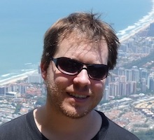
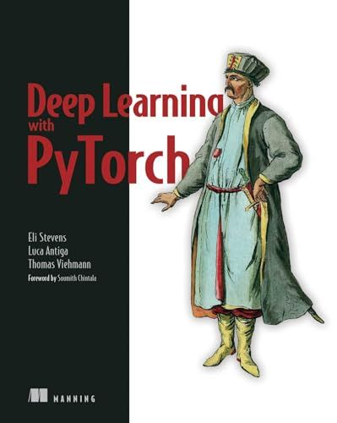
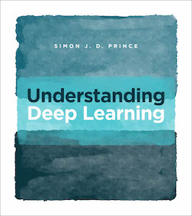
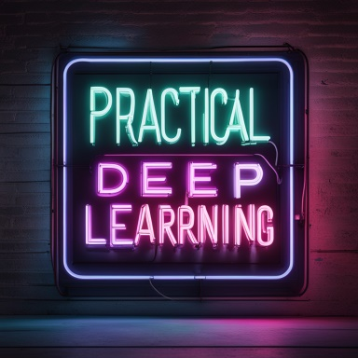
References
“When you are copying from one source, it’s plagiarism; when you are copying from multiple sources, it’s research.”
-- Prof. Notestein, Yale, 1929
Prof. Vincent Guige, AgroParisTech & Sorbonne University,
here depicted with cool sunglasses, https://vguigue.github.io/
“Practical deep learning”, https://jxmo.io/deep-learning-workshop/
“Understanding deep learning”, https://udlbook.github.io/udlbook/
“Deep learning with pytorch”, https://github.com/deep-learning-with-pytorch/
Notes:
Technical check: can everybody access the e-campus page? Otherwise, send slides and links by email

