Slide 1
Refresher on Machine Learning
Alberto TONDA, Ph.D. (Senior permanent researcher, DR)
UMR 518 MIA-PS, INRAE, AgroParisTech, Université Paris-Saclay UAR 3611, Institut des Systèmes Complexes de Paris Île-de-France

Slide 2
Outline
Artificial Intelligence
Machine Learning
Typical Machine Learning pipeline
Evaluating performance
Overfitting

Slide 3
What is Artificial Intelligence?

Slide 4
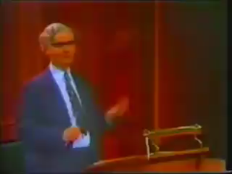
What is Artificial Intelligence?
John McCarthy, one of the founding fathers of Artificial Intelligence
«I invented this term Artificial Intelligence [...] because [...] we were trying to get money for a summer study [...]»

Slide 5
What is Artificial Intelligence?
Short answer, there is no clear definition
We do not have a good definition of intelligence, so...
Broadly speaking, AI defines a field more than a method
Tentative definitions (there is no agreement)
«When a non-biological being successfully completes a task commonly believed to require biological intelligence»
«Perceiving, synthesizing, and inferring information»
«Efficiency and speed, in learning a new task» (Chollet, 2019)
How do we measure intelligence?

Slide 6
What is Artificial Intelligence?
Artificial Intelligence (AI)
Symbolic AI
Machine Learning (ML)
Reinforcement Learning
Deep Learning (DL, DNN)
Neuro-Symbolic AI
Many other techniques and open questions, like “is optimization AI”?
Most successful approaches employ MULTIPLE TECHNIQUES AT THE SAME TIME

Slide 7
What is Artificial Intelligence?
NARROW / WEAK
Focused on a specific task
Symbolic AI
E.g. rule-based systems
Machine learning
Supervised, unsupervised
Natural language processing
Image recognition/segmentation
Reinforcement learning
Neuro-symbolic AI
GENERAL (AGI)
Can perform any type of (human?) task
Does not exist (...yet?)
Closest thing is NLP: Large Language Models (LLM) like ChatGPT

Slide 8
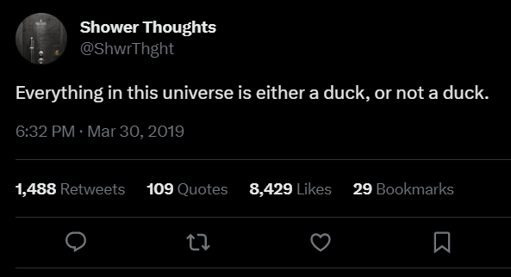
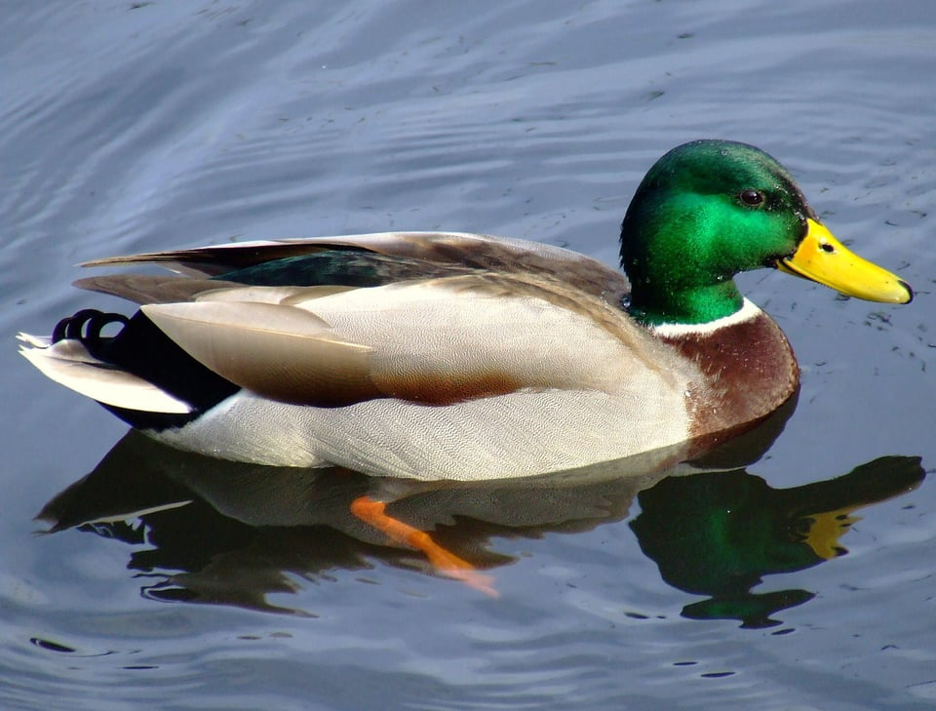
Symbolic AI
Symbolic manipulation
Reality is continuous (with good approximation)
Symbols are discrete, and humans are good at using them
Notes:
This is something that will come back when we will discuss the use of deep neural networks in natural language processing. As words and symbols are discrete, our machines are not great at using them.

Slide 9
Symbolic AI
Symbols seem normal and natural, map into the real world (in linguistics, it’s called extension)
Natural language is a powerful human symbol manipulator
However, there is chaos hidden under the surface
What is the reality of a river?
What is the reality of a chair?
What is the reality of a number?

Slide 10

Symbolic AI
Symbol can be hard to define, but we grasp it intuitively
It’s an old, old problem: see Plato and Diogenes
Entire fields of research on this (neuroscience, cognitive sciences, neurolinguistics, …)
“Explaining” symbols to AI is harder yet
Issues with “common sense”
Reached limits in the 1980s

Slide 11
Symbolic AI
In practice, find or exploit human-readable rules
Expert systems (“if-then-else” rules)
Knowledge graphs, linking entities with relationships
First-order logic rules
Ontologies
Decision trees (that are also considered part of ML!)
Before the advent of ML, considerable success stories
Symbolic AI is still in use, paired with ML

Slide 12
Machine Learning
Given a class of tasks T, a performance measure P, and experience E, a machine learning algorithm improves its performance measured with P, for tasks in T, using the experience E

Slide 13
Machine Learning
Learn a task directly from examples
No need for theory, just large quantities of data
Samples (rows) and features (columns)
“Dirty secret” of ML: it’s mostly optimization
Restate learning task as optimization task
Solve it relying on available (training) data
Learning Task
Optimization Task

Slide 14
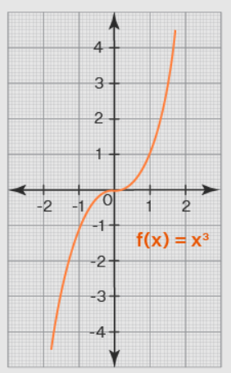
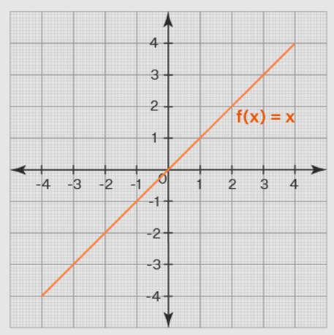

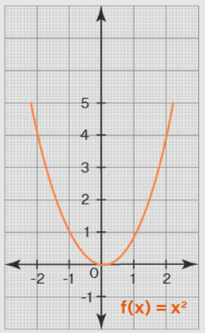
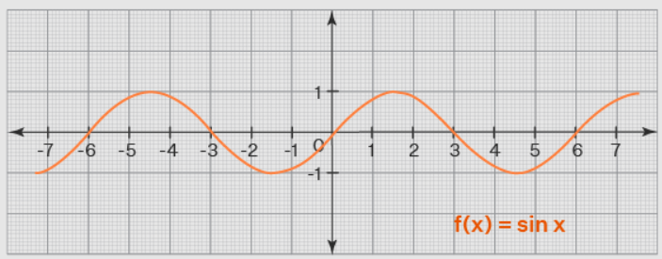
Machine Learning algorithms
e
e
ML algorithm (model+optimizer)
e
e
Internal parameters (to be optimized)

Slide 15
Supervised Machine Learning
Learn from examples for which correct answer is known
Data contains measured values of the target (ground truth)
Minimize difference between model predictions and ground truth
Regression
Target is a continuous value (0.9, 22.5, 0.0017, …)
From the values of the features of a sample, predict target value
Classification
Target is a category (good/bad, high/medium/low, toxic/ok, …)
From the values of the features of a sample, assign to category

Slide 16
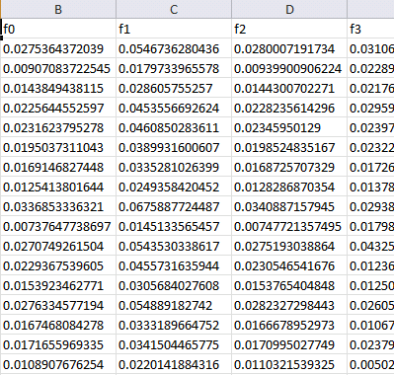
Machine Learning (supervised)
Training data
Features
Training...
Predictions
Prediction 1
Prediction 2
Prediction 3
Prediction 4
…
Ground truth
Truth 1
Truth 2
Truth 3
Truth 4
…
ML algorithm (model+optimizer)
Samples
Internal parameters (to be optimized)

Slide 17
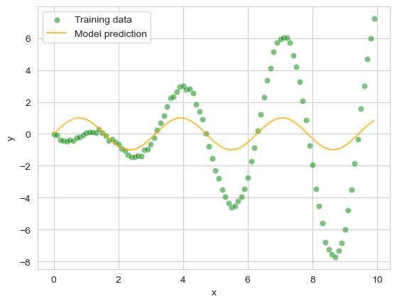
Machine Learning (supervised)
Training data
Features
Training...
ML algorithm (model+optimizer)
Samples
Internal parameters (to be optimized)

Slide 18
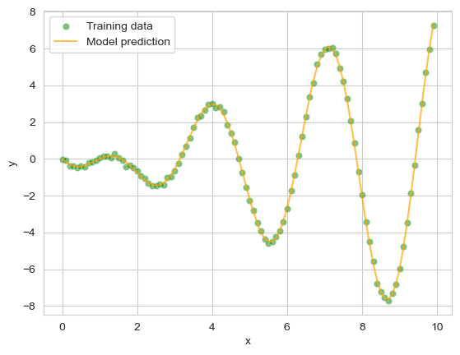
Machine Learning (supervised)
Training data
Features
Training...
ML algorithm (model+optimizer)
Samples
Internal parameters
(to be optimized)
Notes:
Here, I can speak about a linear regression

Slide 19
Machine Learning (supervised)
Test (unseen) data
Features
Prediction...
ML algorithm (model+optimizer)
Samples
Internal parameters
(fixed)
Notes:
Here, I can speak about a linear regression

Slide 20
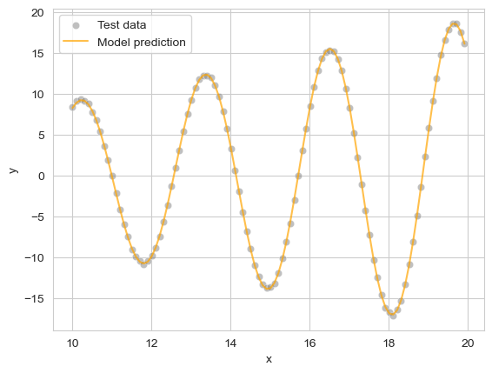
Machine Learning (supervised)
Test (unseen) data
Features
Prediction...
ML algorithm (model+optimizer)
Samples
Internal parameters
(fixed)
Notes:
Here, I can speak about a linear regression

Slide 21
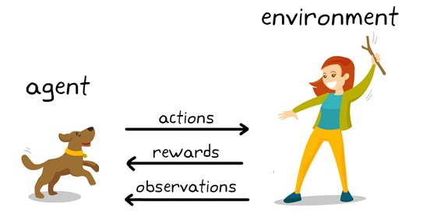
Reinforcement Learning
Similar to supervised ML, but not exactly
No value associated to a single decision
Reward is consequence of a series of decisions
Example: a chess game; should we trade a Queen for a Knight? Well, it depends on the board state
Learn policy π
From state to best action
π can be approximated by a neural network

Slide 22
Reinforcement Learning
Issues with the state space
Real-world applications have Vast search spaces
Even a game like chess has ~10²⁰ possible board states
Impossible to explore exhaustively! (highest is checkers, 10¹⁰)
Tricks to reduce states: exploit symmetries, remove useless…
Game of Go (~10¹⁰⁰ states) believed to be unapproachable
Estimated number of atoms in visible universe ~10⁸⁰
In 2016, world champion defeated! Deep reinforcement learning

Slide 23
Unsupervised Machine Learning
What happens when we do not have the ground truth?

Slide 24
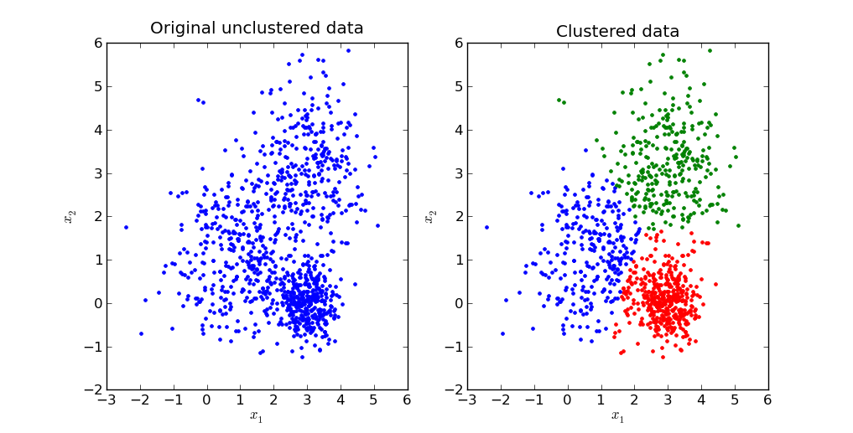
Unsupervised Machine Learning
We suspect existence of regularities in the data
Find/create metric correlated with what we are looking for
Optimize the new metric, just as for classic ML
Clustering
Find groups of data points that are similar to each other
What kind of metric could we image using here?

Slide 25
Unsupervised Machine Learning
We suspect existence of regularities in the data
Find/create metric correlated with what we are looking for
Optimize the new metric, just as for classic ML
Clustering
Find groups of data points that are similar to each other
Minimize intra-group distance, maximize inter-group distance

Slide 26
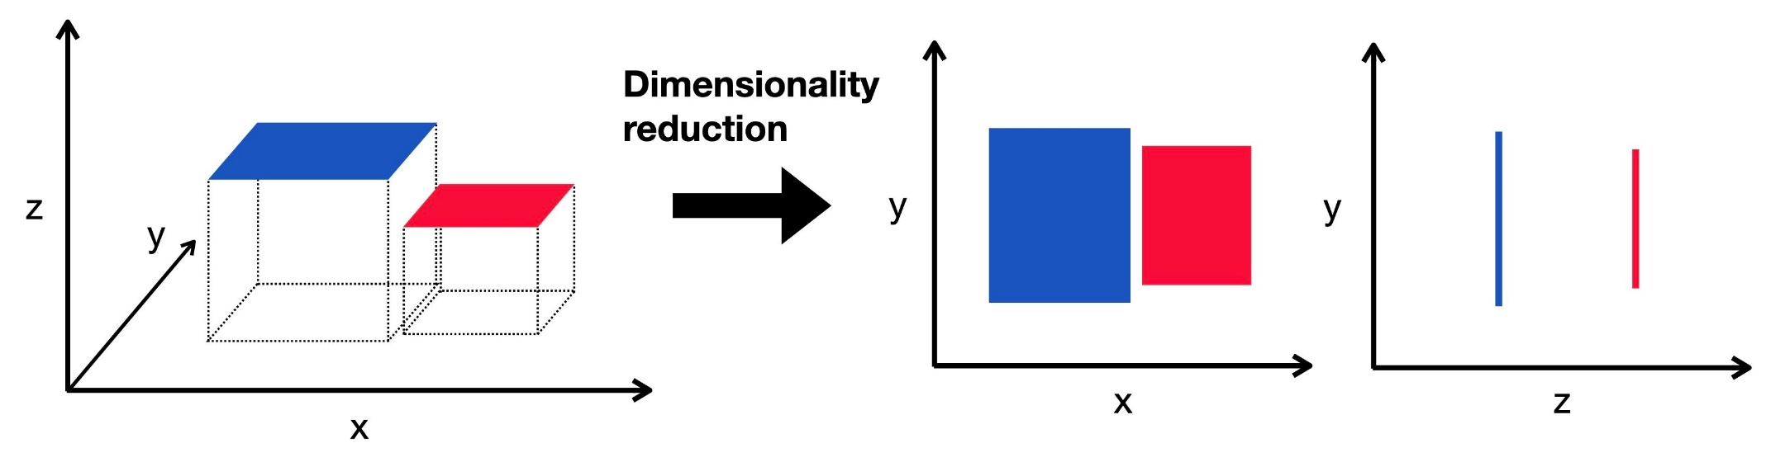
Unsupervised Machine Learning
Dimensionality reduction
Original feature space is high-dimensional
Cannot be easily visualized or understood by humans
Features could be useless or redundant

Slide 27
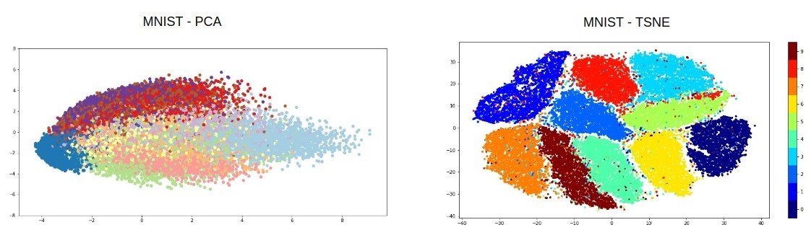
Unsupervised Machine Learning
Create new dimensions as a combination of features
Principal Component Analysis, linear combination
Approaches creating non-linear combinations
t-distributed stochastic neighbour embedding (t-SNE)
Kernel PCA

Slide 28
Machine Learning pipeline
Machine Learning
Model selection
Raw data
Preprocessing
Feature engineering
Hyperparameter tuning
Training and validation
Notes:
Qui chiedi cosa può includere il pre-processing

Slide 29
Machine Learning pipeline
Machine Learning
Model selection
Raw data
Preprocessing
Feature engineering
Hyperparameter tuning
Training and validation
Missing values
Non-numerical features
Outlier detection
Normalization?

Slide 30
Missing values
ML algorithms cannot natively deal with missing data
Trivial solutions
Remove samples with missing feature values
If a feature is often empty/NaN, remove whole feature
Issue: this reduces the available data
Can you think of any other solution?

Slide 31
Missing values
Imputation
Replace the missing value with another value; but which one?
Zero, -1, (…)
Mean/median value of the feature over all samples/same class
Expert judgment (if not too many missing values)
Machine learning for imputation
Train a ML model to predict the value of the feature
Example: KNN imputation
(IMHO) If possible, try avoiding imputation

Slide 32
Non-numerical features
Categorical features to numbers?
If ordered (“high”/“medium”/“low”), to integers (2/1/0)
If not ordered (“red”/“blue”/“green”), one-hot encoding
Create additional binary (0/1) features, equal to number of values of categorical feature
Set binary feature to ‘1’ and others to ‘0’ to represent values
E.g. red=100, blue=010, green=001
Utils in Pandas that already take care of (most of) this

Slide 33
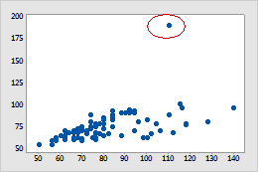
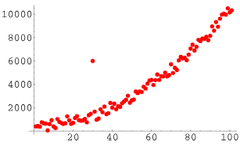
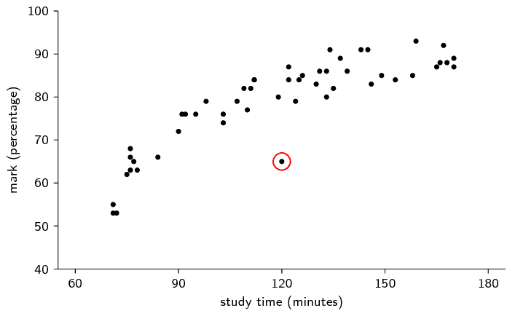
Outlier detection
What is an outlier?

Slide 34
Outlier detection
While the idea is intuitive, its application is difficult
Sometimes outliers are errors in data collection…
…but sometimes they are representative of the phenomenon
“Out of Distribution”, but can we identify the distribution?
Machine learning methods
Isolation Forest
Local Outlier Factor
Problem sometimes called “Novelty Detection”
(IMHO) Expert knowledge or avoid removing outliers

Slide 35
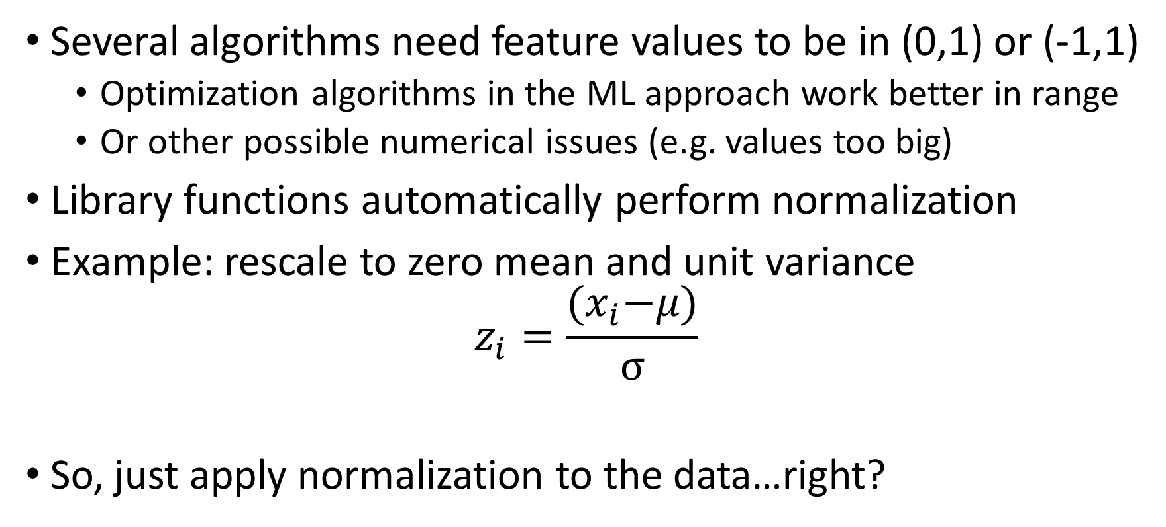
Normalization?
Several algorithms need feature values to be in (0,1) or (-1,1)
Optimization algorithms in the ML approach work better in range
Or other possible numerical issues (e.g. values too big)
Library functions automatically perform normalization
Example: rescale to zero mean and unit variance
$$z_{i}=\frac{{(x}_{i}−μ)}{σ}$$
So, just apply normalization to the data…right?

Slide 36
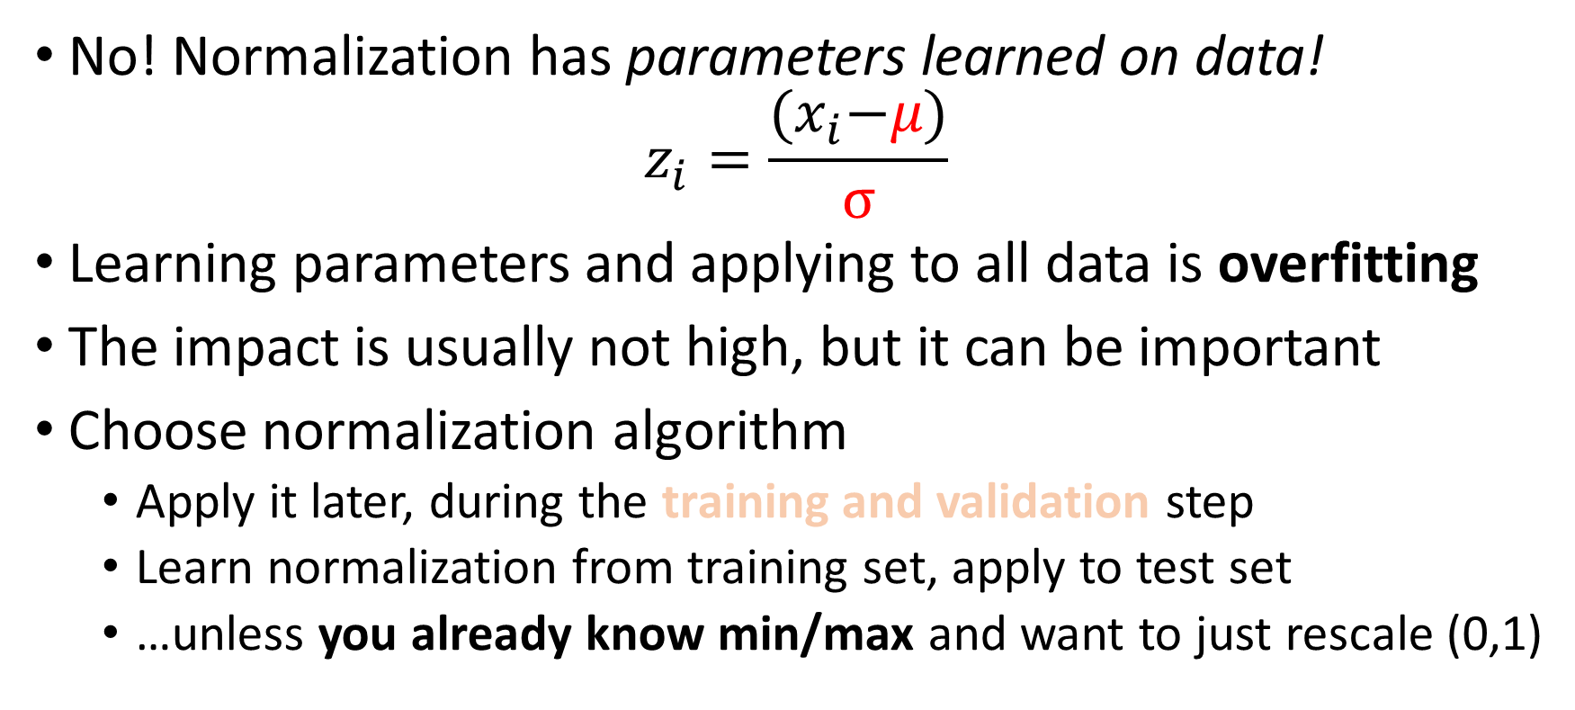
Normalization
No! Normalization has parameters learned on data!
$$z_{i}=\frac{{(x}_{i}−μ)}{σ}$$
Learning parameters and applying to all data is overfitting
The impact is usually not high, but it can be important
Choose normalization algorithm
Apply it later, during the training and validation step
Learn normalization from training set, apply to test set
…unless you already know min/max and want to just rescale (0,1)

Slide 37
Machine Learning pipeline
Machine Learning
Model selection
Raw data
Preprocessing
Feature engineering
Hyperparameter tuning
Training and validation
Feature selection
Dimensionality reduction
Feature construction

Slide 38
Feature selection
Why reduce the number of features in the problem?

Slide 39
Feature selection
Human-readability: make sense of 10 features, not 100
Improve performance
Difficulty of the task is usually correlated with number of features
Sometimes, ill-posed problems (more features than samples)
Reducing features might improve behavior of ML algorithm

Slide 40
Feature selection
Remove all useless or redundant features
Useful: features (strongly) correlated with the target
Redundant: features (strongly) correlated with other features
Filter methods
Analyze simple univariate correlations
For example, mutual information or covariance
Strong hypothesis: contribution of features is separable
Example: SelectKBest function in scikit-learn
Embedded methods (as part of a ML algorithm, LASSO)

Slide 41
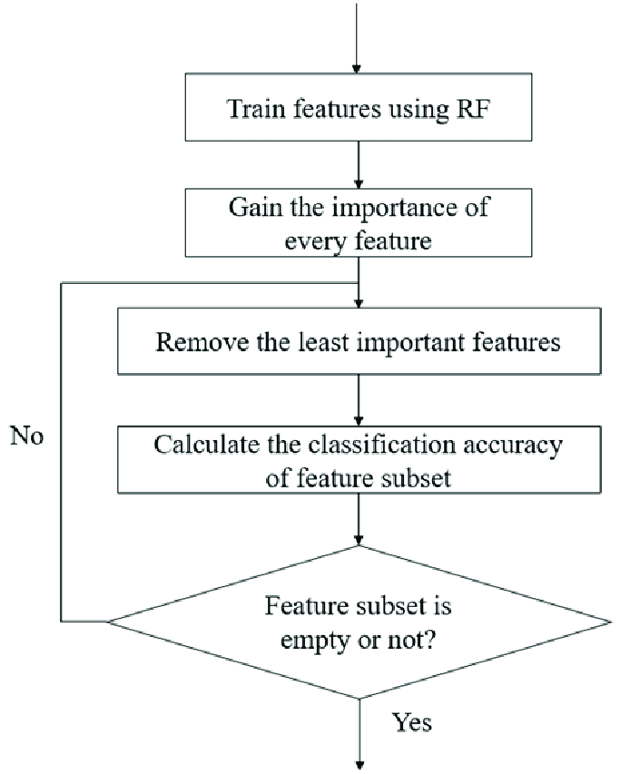
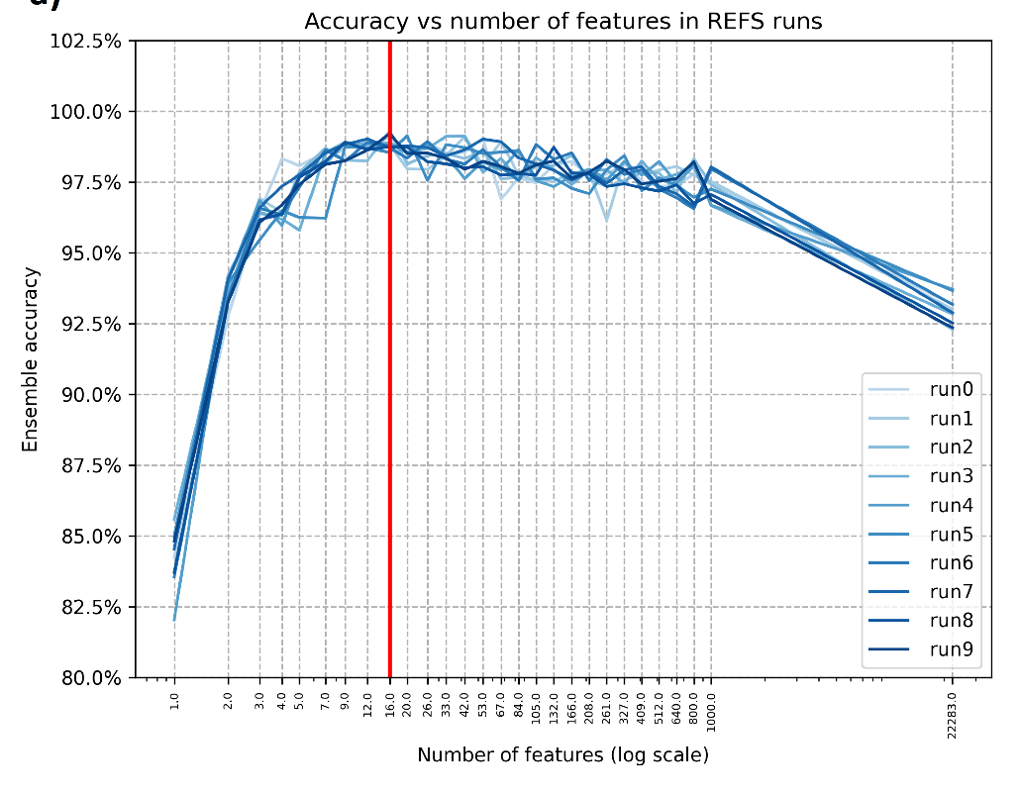
Feature selection
Wrapper methods
Use a ML algorithm in a loop, evaluate its performance
Search space of all possible feature subsets
Recursive Feature Elimination (RFE), Permutation Importance

Slide 42
Feature construction
Typical issue with relational data
Raw features of the problem are not really relevant
What is important is a combination of the raw features
Example: single pixels in an image are not very important
What matters are recurring patterns of pixels
A fundamental problem for lots of practical applications
Features hand-crafted by human experts of the problem
Limited success, especially with images
Notes:
Also mention time series!

Slide 43
Deep Learning pipeline…?
Instead, pick a model able to automatically select or construct features
Machine Learning
Model selection
Raw data
Preprocessing
Feature engineering
Hyperparameter tuning
Training and validation

Slide 44
Machine Learning pipeline
Among many possible ML algorithms, pick the best
Machine Learning
Model selection
Raw data
Preprocessing
Feature engineering
Hyperparameter tuning
Training and validation

Slide 45
Model selection
Model/ML algorithm with best performance on training data
What if multiple algorithms have similar performance?

Slide 46
Model selection
Model/ML algorithm with best performance on training data
Among models with similar performance, lowest capacity

Slide 47
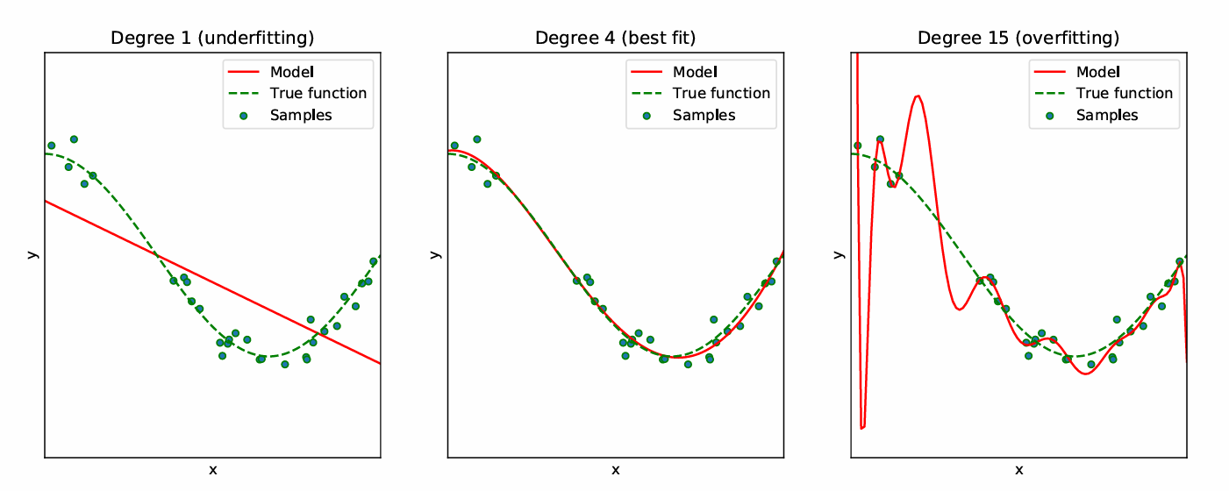
Capacity?
The most complex function a ML model can approximate
A linear model cannot fit a quadratic function well
A quadratic model cannot fit a cubic function well (…and so on)
However, larger capacities are also linked to overfitting

Slide 48
Capacity and overfitting
Overfitting
The performance on training does not generalize to unseen data
Model captured correlations that only exist in training (e.g. noise)
High capacity fits well, may lead to overfitting
Low capacity might underfit, performance more predictable
Know optimal capacity needed for a target data set?
No.
Estimate and compare capacity of different algorithms?
Also no. (maybe upper bound, Vapnik-Chervonenkis dimension)

Slide 49
Model selection in practice
Try as many different algorithms as you can
Evaluate algorithms in a cross-validation on training data
Check mean and standard deviation of performance
Best mean, lowest stdev (more reliable)
Alternative: AutoML
Search a Vast space of possible algorithms (and configurations)
Still extremely slow and computationally expensive
Growing research interest

Slide 50
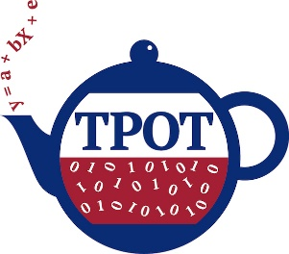
AutoML?
AutoML
AutoML aims to automatize all this part of the pipeline
Machine Learning
Model selection
Raw data
Preprocessing
Feature engineering
Hyperparameter tuning
Training and validation
Example: TPOT and TPOT2 (α)
https://github.com/EpistasisLab/tpot
https://github.com/EpistasisLab/tpot2
Notes:
Qui chiedi cosa può includere il pre-processing

Slide 51
Machine Learning pipeline
Machine Learning
Model selection
Raw data
Preprocessing
Feature engineering
Hyperparameter tuning
Training and validation
Adjust all ML algorithm parameters set before training starts
Notes:
Qui chiedi cosa può includere il pre-processing

Slide 52
Hyperparameter tuning
Hyperparameters?
Parameters are all numbers “inside” a ML model
Parameters are adjusted during the learning/training process
Hyper-parameters are set before training starts
Examples of hyperparameters
In a Random Forest, number of trees, depth of trees, criterion for creating splits in trees
In a Neural Network, number of layers, number of neurons per layer, activation function of neurons, optimization algorithm, …
Hyperparameters impact capacity

Slide 53
Machine Learning pipeline
Difficult to separate these two parts, often performed together
Machine Learning
Model selection
Raw data
Preprocessing
Feature engineering
Hyperparameter tuning
Training and validation
Sometimes a validation set is used to assess impact of hyperparameters
Notes:
Qui chiedi cosa può includere il pre-processing

Slide 54
Hyperparameter tuning
Hyperparameters have little impact* on performance
*not always true, but true for lots of practical applications
So, in principle you can pick model first, and then hyperparameters
However, this is absolutely not true for Deep Learning
DL has way more hyperparameters than other methods
Hyperparameters literally make or break a DL network
Changing the learning rate, for example, has HUGE IMPACT
Subset of AutoML exclusively dedicated to DL
Neuro-evolution, Neural Architecture Search

Slide 55
Machine Learning pipeline
Machine Learning
Model selection
Raw data
Preprocessing
Feature engineering
Hyperparameter tuning
Training and validation
Try to evaluate whether the choices we made make sense

Slide 56
Machine Learning pipeline
Machine Learning
Model selection
Raw data
Preprocessing
Feature engineering
Hyperparameter tuning
Training and validation
Try to evaluate whether the choices we made make sense
Vocabulary clash! “Validation”? “Test”?

Slide 57

Why do we need test/validation?
Overfitting is the final boss
We want to be sure that model generalizes
Test data: unseen (during training)
Risk that the model captures unique properties of the training data…
…that only exist for that training set!
How to evaluate overfitting?
AI-generated image, prompt “The concept of overfitting in machine learning as the final boss monster in a videogame”

Slide 58
Why do we need test/validation?
In theory, we would need unseen data (that we don’t have)
Train/test split: hide part of the available data, use it for test
Even better: k-fold cross-validation (k=5 or 10)
Divide data into k parts (folds), then iterate k times
Each time, use k-1 folds for training; one fold for testing
Obtain an average and a standard deviation of performance
Large stdev usually indicates issues: outliers?

Slide 59
Algorithms work inside a computer
How are numerical values represented inside a computer?

Slide 60
Algorithms work inside a computer
How are numerical values represented inside a computer?
1
1
0
1
0
0
0
1
…
Sequence of bits (binary values) of fixed length (8, 16, 32…)

Slide 61
Algorithms work inside a computer
Limit to minimum and maximum representable
Limit to the smallest detectable difference (machine epsilon)
Precision can be increased, at the expense of memory

Slide 62
(Pseudo-)Random number generation
There is no true random number generation in a computer
Algorithms generate sequences of pseudo-random numbers
But after a (long) time, they start repeating
Entire field of research on PRNG
PRNG algorithm initialized with a certain value (seed)
If no value is specified, system time converted to integer
If the seed is the same, the sequence will be the same
Set and store the random seed to reproduce experiments

Slide 63
Vocabulary
ML algorithm: model type + optimization algorithm
Model/predictor: one trained ML algorithm
Model parameters
Values (numerical, categorical, …) inside the model
Optimized (e.g. change values) during training process
Samples: rows of the dataset
Features: columns of the dataset
Target(s): feature(s) we are interested in predicting

Slide 64
Vocabulary
Training data: data from which we want to learn
Test data: unseen data, kept aside to assess generalization
Validation data: used during training, not for training (!)
Training/Fit: optimize parameter values to fit training data
Cross-validation: iterative performance where data is split into different training/test sets, and model re-trained

Slide 65
Vocabulary
Model hyperparameters
Choices/parameters outside the model
Usually user-defined before training process starts
Capacity (loose definition)
Maximum order of function that can be approximated by model
The more parameters, the more capacity
Bias: source of errors, not enough capacity (underfitting)
Variance: sensitivity to small variations in training data, too much capacity (overfitting)

Slide 66
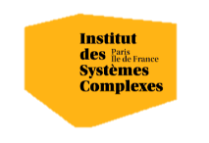

Questions?
Bibliography - James et al. 2023. An Introduction to Statistical Learning with Applications in Python
Images and videos: unless otherwise stated, I stole them from the Internet. I hope they are not copyrighted, or that their use falls under the Fair Use clause, and if not, I am sorry. Please don’t sue me.

