Slide 1
Intermediate pytorch concepts
Alberto TONDA, Ph.D. (Senior permanent researcher, DR)
UMR 518 MIA-PS, INRAE, AgroParisTech, Université Paris-Saclay UAR 3611, Institut des Systèmes Complexes de Paris Île-de-France

Slide 2
Outline
Where is the SoftMax?
Monitor performance
Tensorboard
Stochastic Gradient Descent
Activation functions
Checkpointing

Slide 3
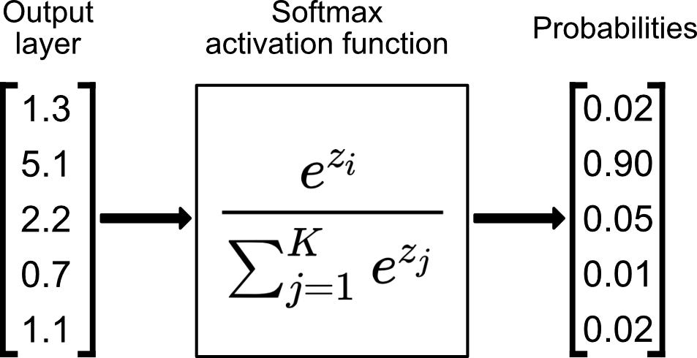
Where is the SoftMax?
We grazed over classification
But in literature, output tensor is sent through SoftMax
SoftMax is used to get values in [0.0,1.0]
Sometimes called “class probabilities”, but they are not
Where was the SoftMax? Was there an error in the code?

Slide 4
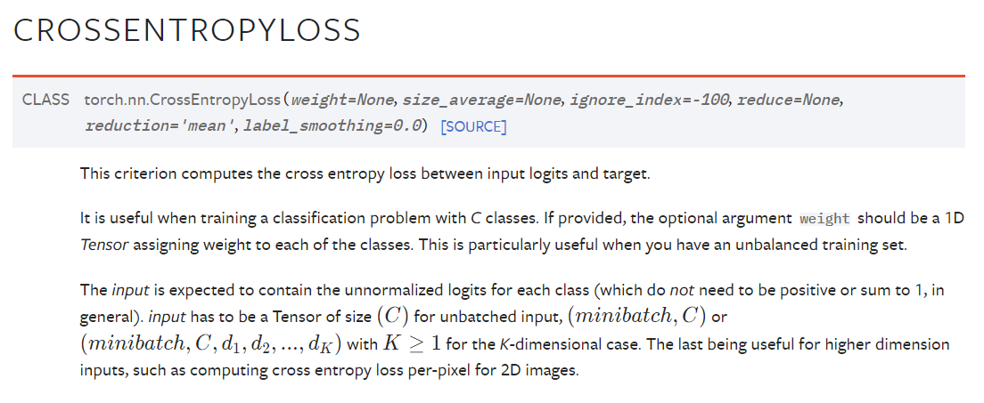
Where is the SoftMax?
The SoftMax is inside the loss function

Slide 5
Where is the SoftMax?
What is a logit?!?

Slide 6
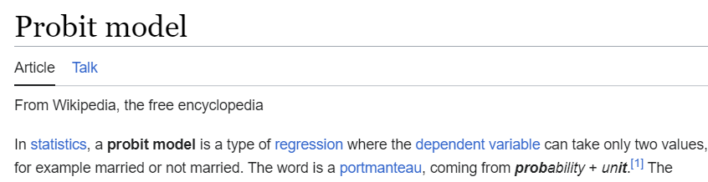
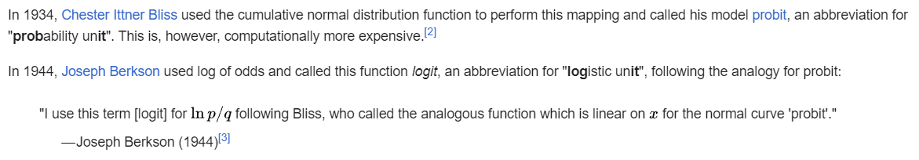
Where is the SoftMax?
What is a logit?!?

Slide 7
Monitor performance
Assess performance during training
But performance is better evaluated on test!
Evaluating performance on training is not very informative
Overfitting gives the illusion of increasing performance on training
We want to know performance on unseen data!
But at the same time, we don’t want to use the test set!
How can we solve this conundrum?

Slide 8
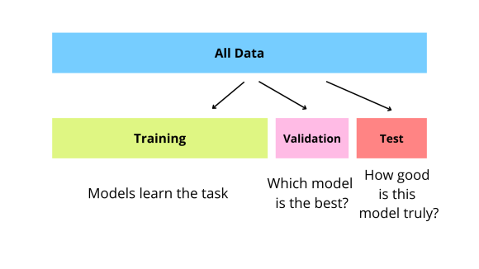
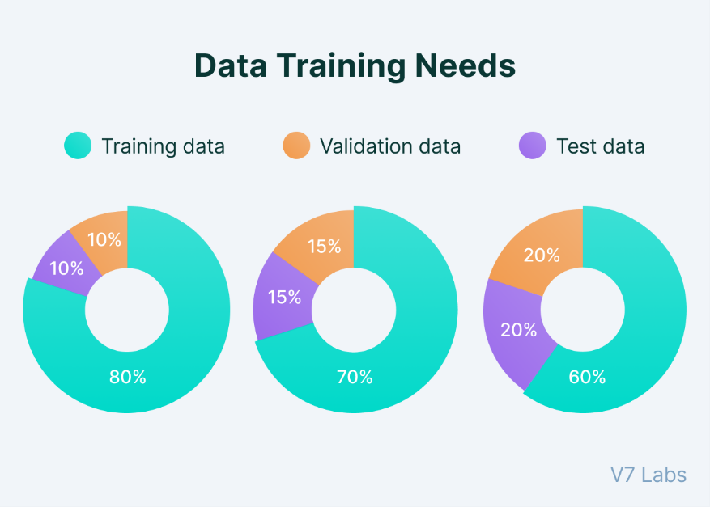
Monitor performance
Further split in the data
Three parts: training, validation, test
Validation is used to assess performance at a given epoch
Commonly called “validation loss” (vs “training loss”)

Slide 9
Monitor performance
Using training loss and validation loss, detect overfitting!
How?

Slide 10
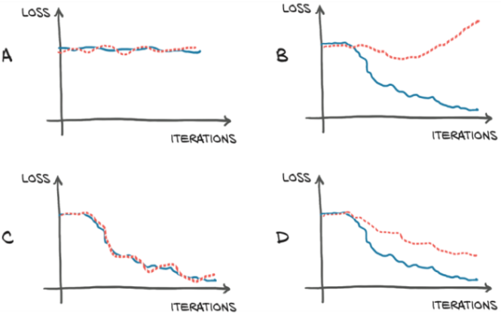
Monitor performance
Using training loss and validation loss, detect overfitting!
When training loss keeps decreasing, but validation loss increases
…or remains stationary for a long time
Training loss
Validation loss

Slide 11
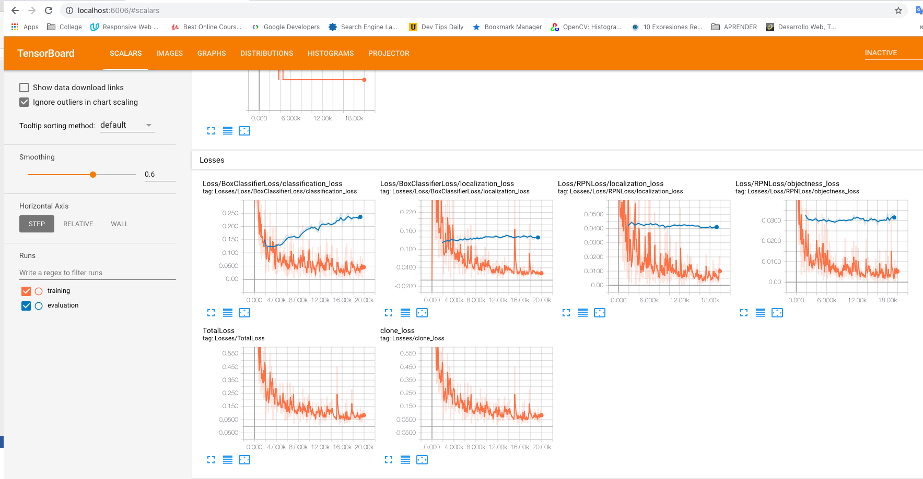
Tensorboard
Software developed by Google (part of Tensorflow)
During training, write logs to text files
Read text files and present a visualization

Slide 12
Stochastic Gradient Descent?
You already used SGD in the exercises
What is stochastic about SGD?

Slide 13
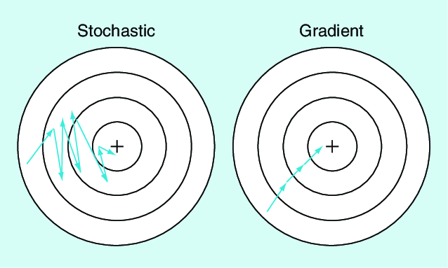
(Really) Stochastic Gradient Descent
It was NOT STOCHASTIC AT ALL!
Difference between SGD and GD
SGD updates gradients after seeing a random subset of the data
Random subset is called batch
Smaller, more frequent updates are more robust and faster
Typically SGD uses a smaller learning rate

Slide 14
Beyond Stochastic Gradient Descent
Nobody uses SGD anymore
However, its descendants thrive!
A cumulative research effort over generations to overcome issues
Issues of gradient-based techniques
Hard/impossible to get out of local optima
Starting point of exploration matters
Step size? Too small / too large leads to convergence issues

Slide 15
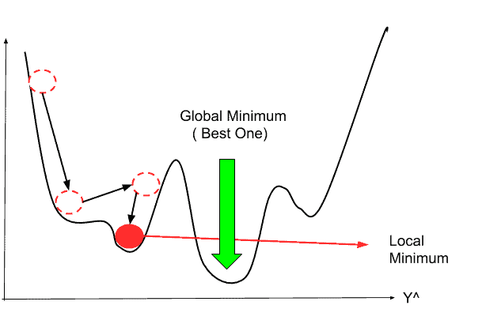
Issues with gradient-based techniques
Starting point of exploration matters

Slide 16
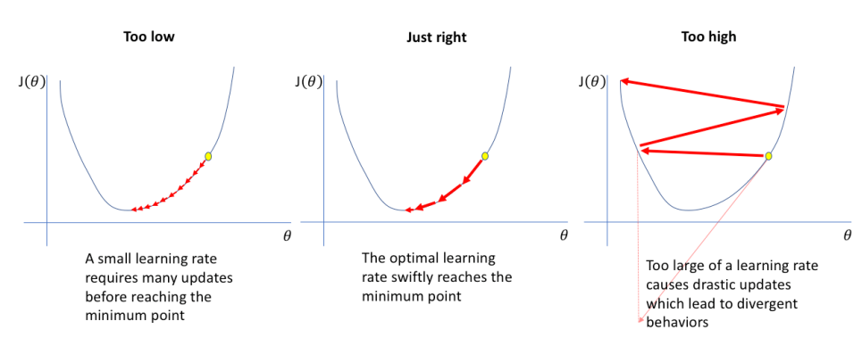
Issues with gradient-based techniques
Step size? Too small / too large lead to convergence issues

Slide 17
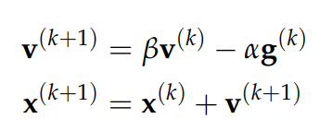
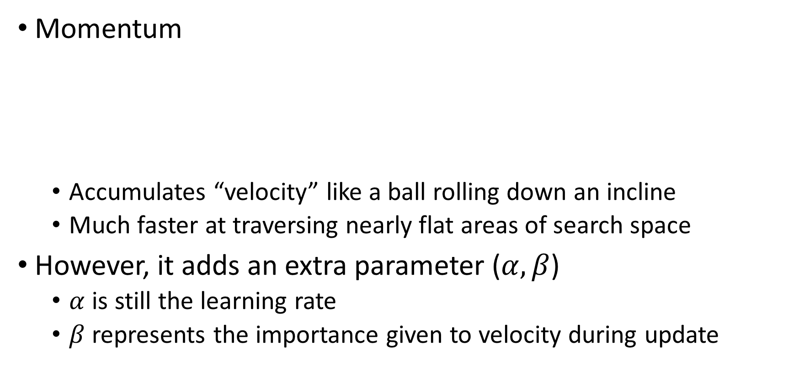
Modern gradient-based techniques
Momentum
Accumulates “velocity” like a ball rolling down an incline
Much faster at traversing nearly flat areas of search space
However, it adds an extra parameter ($α,β$)
$α$ is still the learning rate
$β$ represents the importance given to velocity during update

Slide 18
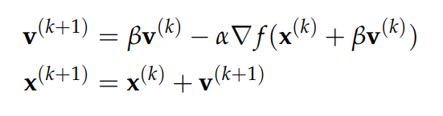
Modern gradient-based techniques
However, now it cumulates too much momentum!
Nesterov momentum
Evaluate the gradient at the point planned to end in
Velocity is rescaled accordingly

Slide 19
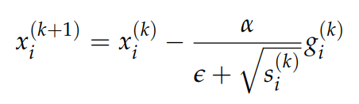
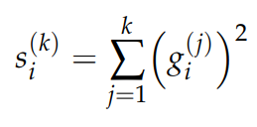
Modern gradient-based techniques
Further issues motivated further advances (Adagrad)
The step size could be different in each dimension
Maintain a “memory” of the gradient values in each direction
However, this leads to the step size always decreasing

Slide 20
Modern gradient-based techniques
https://deepdatascience.wordpress.com/2017/02/03/optimiser-choice/

Slide 21
Modern gradient-based techniques
Solutions to issues of previous algorithms create new issues
Commonly used Adam and RMSProp have 3-4 hyperparameters
Also take more memory (history of gradient values)
Default values work reasonably well (but not always)
Practical advice
Use Adam (Adaptive Moment Estimation) in most cases
Check out new algorithms! torch.optim.*

Slide 22
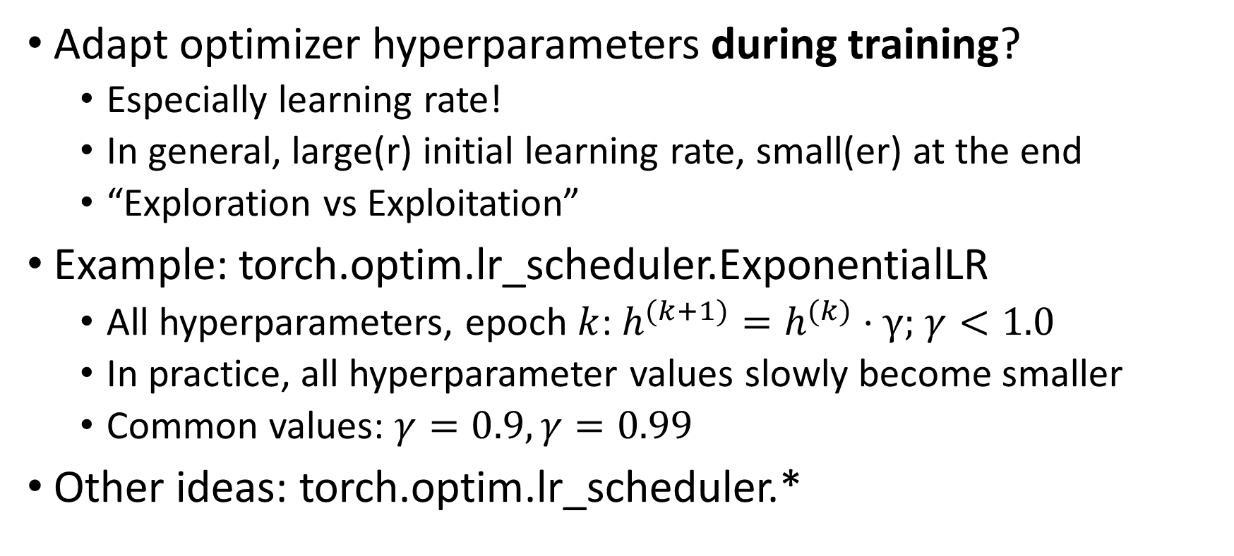
Schedulers
Adapt optimizer hyperparameters during training?
Especially learning rate!
In general, large(r) initial learning rate, small(er) at the end
“Exploration vs Exploitation”
Example: torch.optim.lr_scheduler.ExponentialLR
All hyperparameters, epoch $k$: $h^{(k+1)}=h^{(k)}⋅γ;$ $γ<1.0$
In practice, all hyperparameter values slowly become smaller
Common values: $γ=0.9, γ=0.99$
Other ideas: torch.optim.lr_scheduler.*

Slide 23
Pseudo-random number generation in pytorch
Unfortunately, it’s not easy
Computing on GPUs makes consistent PRNG difficult
Libraries optimized for speed, not consistent behavior
Still, good practices:
https://pytorch.org/docs/stable/notes/randomness.html

Slide 24
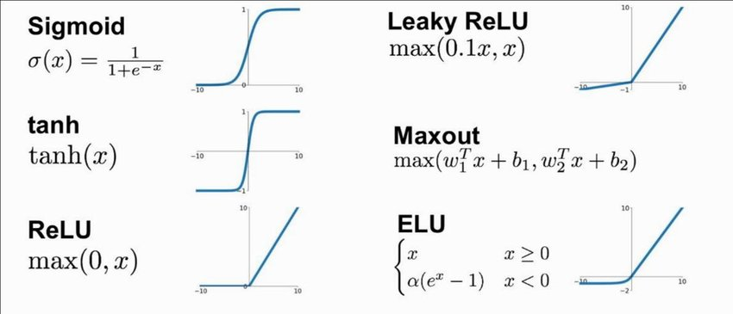
Activation functions
So far, we used one of the most basic activation functions
But there are several others, more modern
Better theoretical properties and empirical results

Slide 25
Activation functions
Practical advice
Check function typically used in literature for target application
For recurrent neural networks, TanH or Sigmoid
When in doubt, go for ReLUs
Lots of available activation functions
https://pytorch.org/docs/stable/nn.html#non-linear-activations-weighted-sum-nonlinearity
https://pytorch.org/docs/stable/nn.html#non-linear-activations-other

Slide 26
Checkpointing
Training neural networks can take a long time
We can save the state of the network during training!
State depends only on weight values (+ optimizer, + scheduler)
Stop and resume training
Share weights with other people!
Checkpoints are one of the foundations of transfer learning

Slide 27


Questions?
Bibliography - pytorch FAQs, https://pytorch.org/docs/stable/notes/faq.html
Images and videos: unless otherwise stated, I stole them from the Internet. I hope they are not copyrighted, or that their use falls under the Fair Use clause, and if not, I am sorry. Please don’t sue me.

