Slide 1
Convolutional Neural Network for the Classification of SARS-CoV-2 and Primer Creation
Alberto TONDA, Ph.D. (Senior permanent researcher, DR)
UMR 518 MIA-PS, INRAE, AgroParisTech, Université Paris-Saclay UAR 3611, Institut des Systèmes Complexes de Paris Île-de-France

Slide 2
Outline
Application
Formalization
Classification results
Extracting information from filters
A new primer

Slide 3
Application
Separate genomic samples of SARS-CoV-2 from others
SARS-CoV-2 belongs to the Coronavirus family
Lots of “relatives” that are genomically similar
For example, the regular flu!
During the pandemic, collective effort to share data
Open repositories with genomic sequences from all the world
Fast and reliable genomic sequences from high-throughput

Slide 4
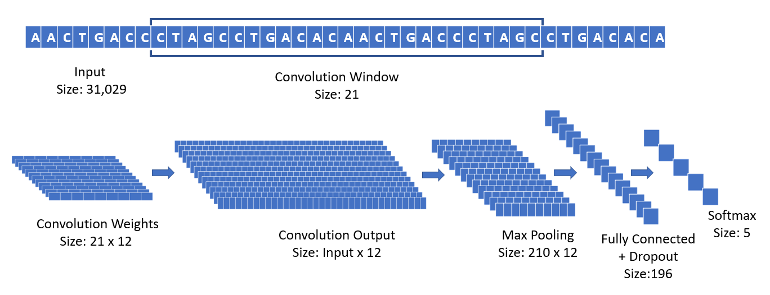
Formalization
Basically a classification problem
Input: sequence of variable size (RNA, cDNA)
Output: class

Slide 5
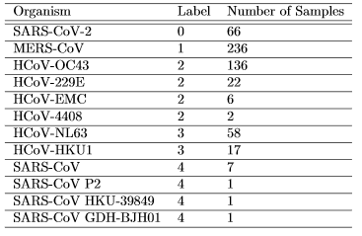
Formalization
Data: a few hundred samples

Slide 6
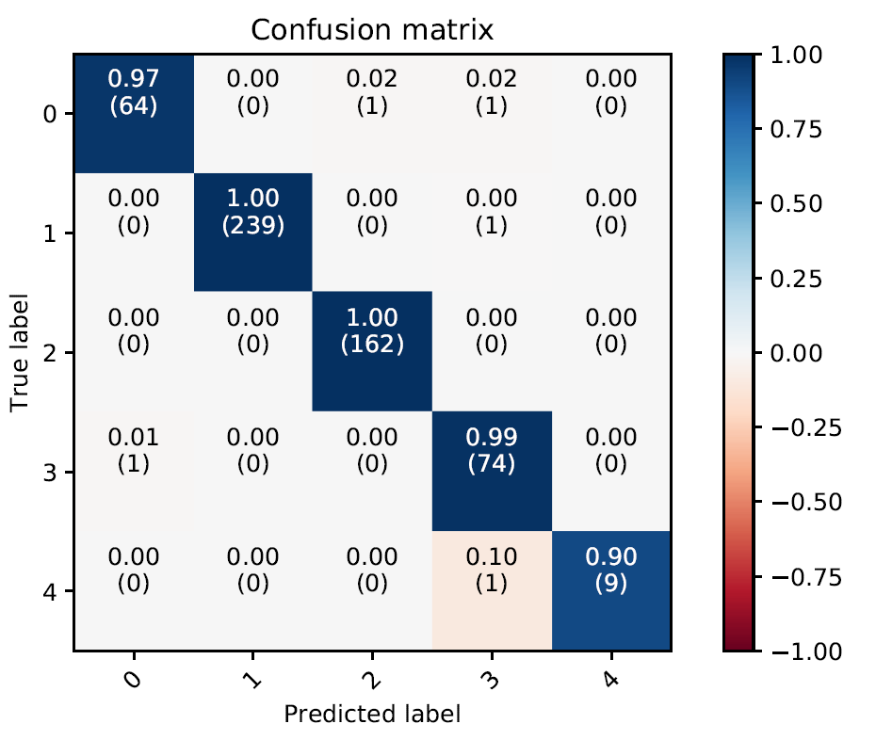
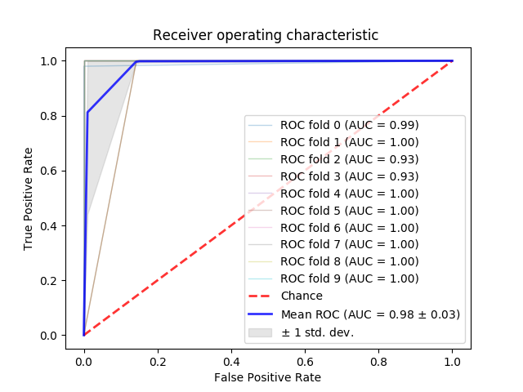
Classification results

Slide 7
Classification results
Good! But can we do something more?
Visualization tell us where filters are maximally activated in sample
By looking at recurring patterns for classification of SARS-CoV-2
Why 21?

Slide 8
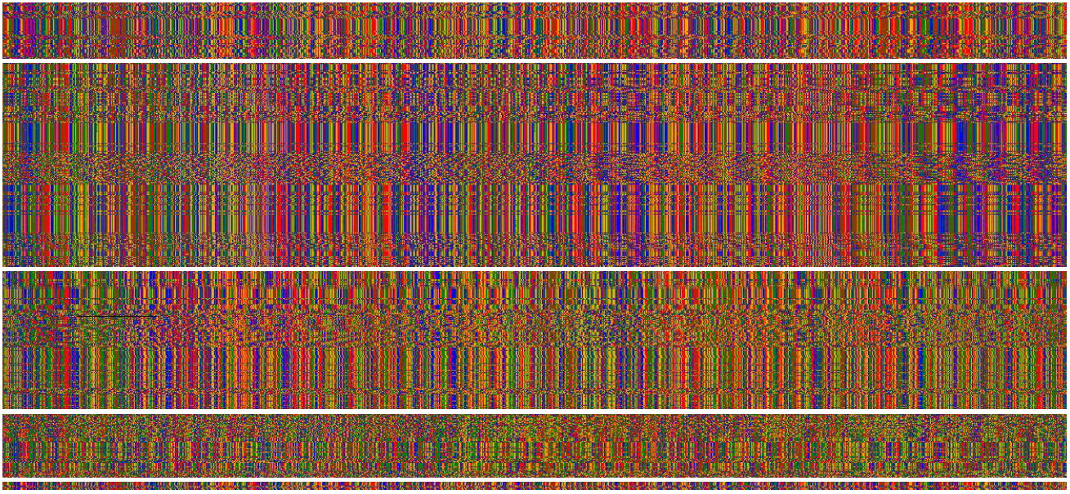
Filter activations
SARS-CoV-2
MERS-CoV
HCoV-OC43
HCoV-229E
HCoV-NL63
HCoV-HKU1
SARS-CoV-1
bps

Slide 9
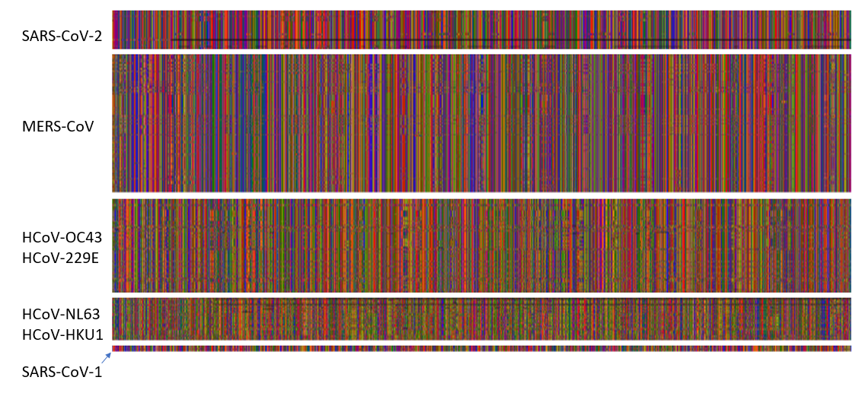
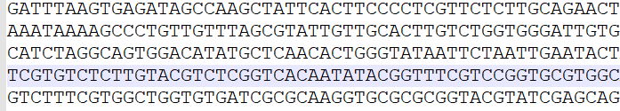

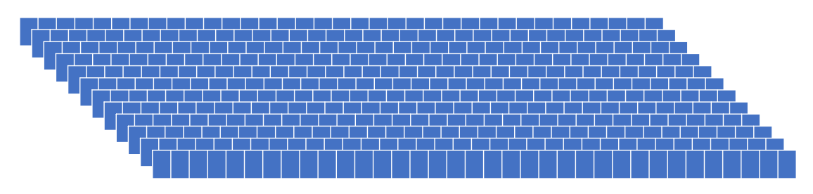


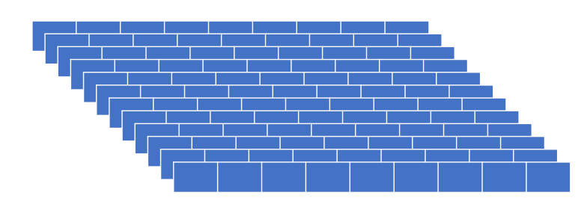
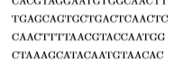
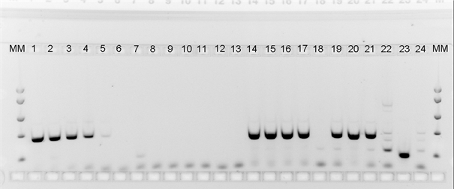
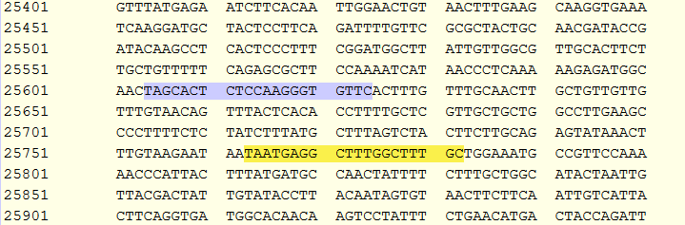
Extracting information from filters
Sequencing
Apply Deep Learning (CNN)
Feature
Creation
Get SARS-CoV-2 specific
bps sequences
Laboratory Testing
Primer Design
Feature Selection

Slide 10
Great success!
It works!

Slide 11
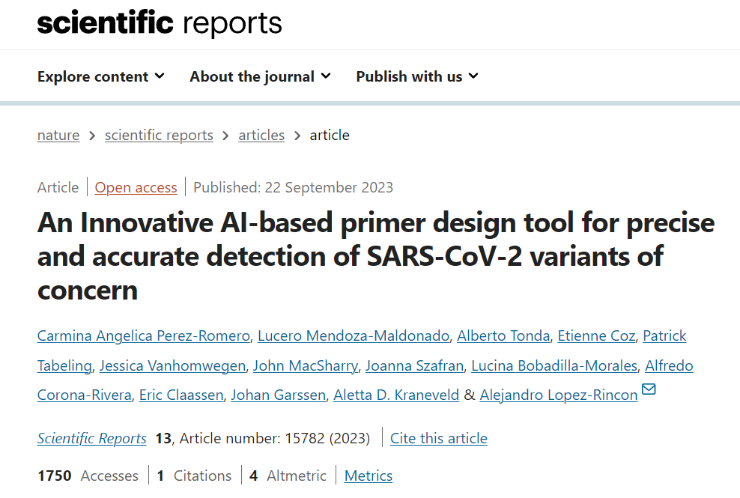
Great success…?
Later, same results obtained with simpler methods
But they required more thinking and expert knowledge
ML/DL can be good for first approach
It also works for SARS-CoV-2 variants!

Slide 12


Questions?
Bibliography - Lopez-Rincon, A., Tonda, A., Mendoza-Maldonado, L. et al. Classification and specific primer design for accurate detection of SARS-CoV-2 using deep learning. Sci Rep 11, 947 (2021). https://doi.org/10.1038/s41598-020-80363-5 - Lopez Rincon A., …, and Alberto Tonda. 2021. Design of specific primer sets for SARS-CoV-2 variants using evolutionary algorithms. In Proceedings of the Genetic and Evolutionary Computation Conference (GECCO '21). Association for Computing Machinery, New York, NY, USA, 982–990. https://doi.org/10.1145/3449639.3459359 - Perez-Romero, C.A., Mendoza-Maldonado, L., Tonda, A. et al. An Innovative AI-based primer design tool for precise and accurate detection of SARS-CoV-2 variants of concern. Sci Rep 13, 15782 (2023). https://doi.org/10.1038/s41598-023-42348-y
Images and videos: unless otherwise stated, I stole them from the Internet. I hope they are not copyrighted, or that their use falls under the Fair Use clause, and if not, I am sorry. Please don’t sue me.

