Slide 1
Recurrent Neural Networks
Alberto TONDA, Ph.D. (Senior permanent researcher, DR)
UMR 518 MIA-PS, INRAE, AgroParisTech, Université Paris-Saclay UAR 3611, Institut des Systèmes Complexes de Paris Île-de-France
Notes:
TODO: change the background image for LSTM cells in the description of how they work

Slide 2
Outline
Dynamical systems
What is a Recurrent Neural Network (RNN)?
First architectures and issues
Long-Short-Term Memory Networks (LSTM)

Slide 3
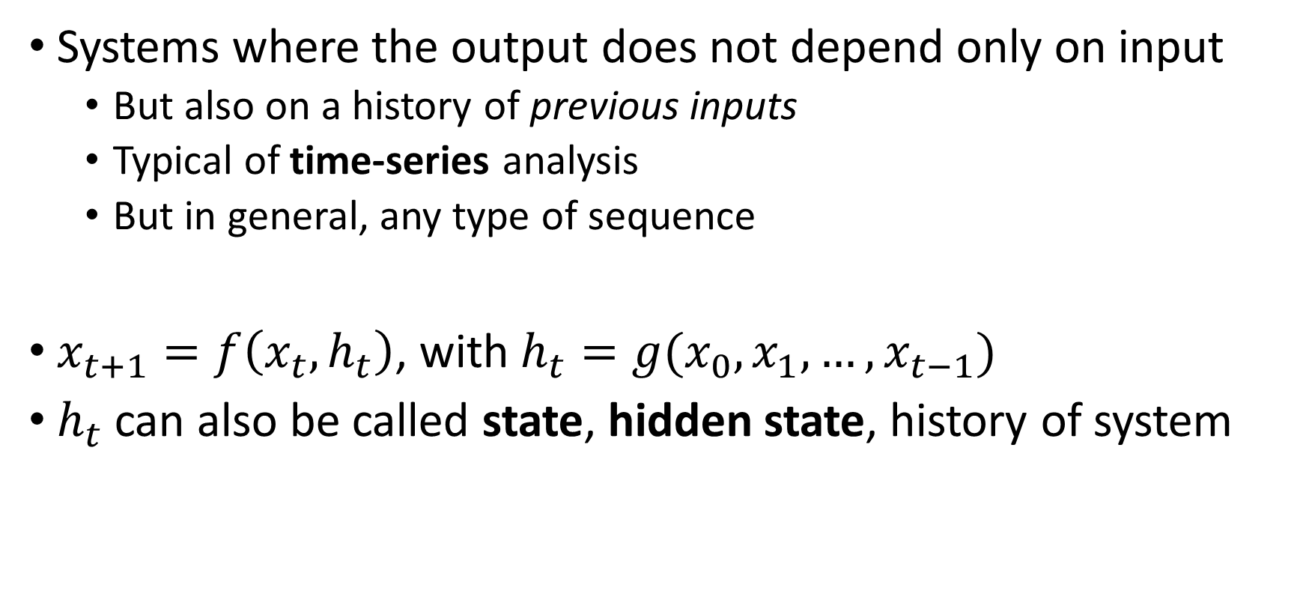
Dynamical systems
Systems where the output does not depend only on input
But also on a history of previous inputs
Typical of time-series analysis
But in general, any type of sequence
$x_{t+1}=f\left(x_{t}, h_{t}\right)$, with $h_{t}=g(x_{0}, x_{1}, …, x_{t−1})$
$h_{t}$ can also be called state, hidden state, history of system

Slide 4
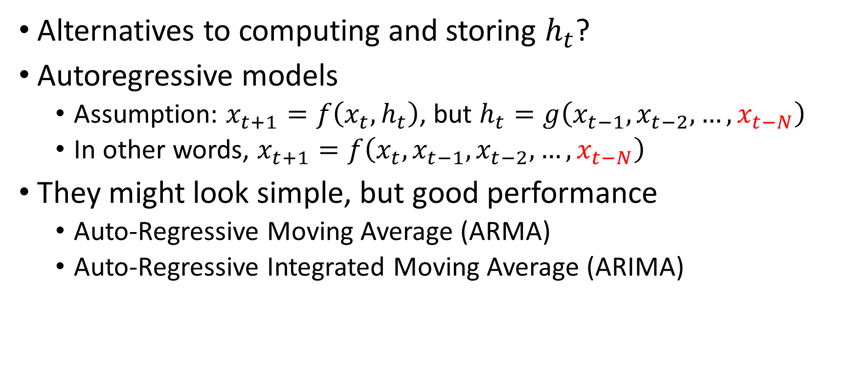
Dynamical systems
Alternatives to computing and storing $h_{t}$?
Autoregressive models
Assumption: $x_{t+1}=f\left(x_{t}, h_{t}\right)$, but $h_{t}=g\left({x_{t−1},x}_{t−2},…,x_{t−N}\right)$
In other words, $x_{t+1}=f\left(x_{t},{x_{t−1},x}_{t−2},…,x_{t−N}\right)$
They might look simple, but good performance
Auto-Regressive Moving Average (ARMA)
Auto-Regressive Integrated Moving Average (ARIMA)

Slide 5
Dynamical systems
For neural networks, this could be an issue
So far, input tensors for an application had the exact same shape
Variable number of steps in sequences for same application
For example, how could a CNN deal with a variable-sized input?
Notes:
Padding

Slide 6



Recurrent Neural Networks
Interestingly, first ideas are from 1925 (!)
“Ising model” (Lenz and Ising), model of magnetism (no learning)
Shin’ici Amari, 1972, version with adaptable weights
Popularized by John Hopfield in 1982, “Hopfield Networks”
RNN
…
$$x_{t}$$
$$h_{t}$$
$${\hat{x}}_{t+1}$$

Slide 7

Recurrent Neural Networks
The architecture is conceived to predict $x_{t+1}=f\left(x_{t}, h_{t}\right)$
RNN unit is designed to compute $h_{t}=f(x_{t}, h_{t−1})$
Other modules can later obtain $x_{t+1}=f(x_{t}, h_{t})$
RNN
…
$$x_{t}$$
$$h_{t}$$
$${\hat{x}}_{t+1}$$

Slide 8






Recurrent Neural Networks
How is a RNN trained? Unrolling!
$${\hat{x}}_{t1}$$
$${\hat{x}}_{t2}$$
$${\hat{x}}_{T+1}$$
…
…
…
RNN
RNN
RNN
0.0
…
$$x_{t0}$$
$$x_{t1}$$
$$x_{T}$$

Slide 9
Recurrent Neural Networks
How is a RNN trained? Unrolling!
$${\hat{x}}_{t1}$$
$${\hat{x}}_{t2}$$
$${\hat{x}}_{T+1}$$
…
…
…
RNN
RNN
RNN
0.0
…
$$x_{t0}$$
$$x_{t1}$$
$$x_{T}$$

Slide 10
Recurrent Neural Networks
How is a RNN trained? Unrolling!
$${\hat{x}}_{t1}$$
$${\hat{x}}_{t2}$$
$${\hat{x}}_{T+1}$$
…
…
…
RNN
RNN
RNN
0.0
…
All the weights are the same, but they have different gradient values at a different “copy”!
$$x_{t0}$$
$$x_{t1}$$
$$x_{T}$$

Slide 11
Recurrent Neural Networks
How is a RNN trained? Unrolling!
$${\hat{x}}_{t1}$$
$${\hat{x}}_{t2}$$
$${\hat{x}}_{T+1}$$
Solution: accumulate gradients before updating
…
…
…
RNN
RNN
RNN
0.0
…
All the weights are the same, but they have different gradient values at a different “copy”!
$$x_{t0}$$
$$x_{t1}$$
$$x_{T}$$

Slide 12

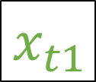
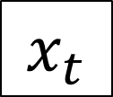

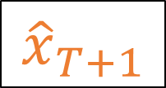


Recurrent Neural Networks
Linear module + activation function
RNN
MLP
$$x_{t}$$
$${\hat{x}}_{t+1}$$
Input sequence
$$x_{t0}$$
$$x_{t1}$$
$$…$$
$$x_{T}$$
Target
$${\hat{x}}_{T+1}$$

Slide 13



Recurrent Neural Networks
$$?$$
MLP
$$h_{0}$$
RNN
0.0
$$?$$
Input sequence
$$x_{t0}$$
$$x_{t1}$$
$$…$$
$$x_{T}$$
Target
$${\hat{x}}_{T+1}$$

Slide 14



Recurrent Neural Networks
$${\hat{x}}_{t1}$$
MLP
$$h_{0}$$
RNN
0.0
$$x_{t0}$$
Input sequence
$$x_{t0}$$
$$x_{t1}$$
$$…$$
$$x_{T}$$
Target
$${\hat{x}}_{T+1}$$

Slide 15
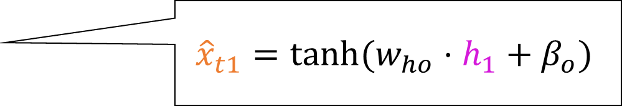
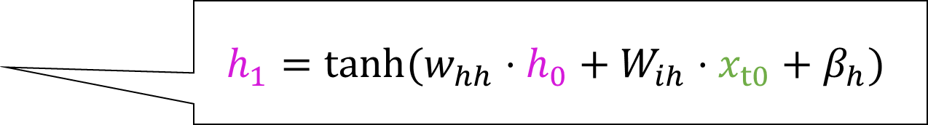
Recurrent Neural Networks
$${\hat{x}}_{t1}$$
$${\hat{x}}_{t1}=tanh⁡(w_{ho}⋅h_{1}+β_{o})$$
MLP
$$h_{0}$$
RNN
0.0
$$h_{1}=tanh⁡(w_{hh}⋅h_{0}+W_{ih}⋅x_{t0}+β_{h})$$
$$x_{t0}$$
Input sequence
$$x_{t0}$$
$$x_{t1}$$
$$…$$
$$x_{T}$$
Target
$${\hat{x}}_{T+1}$$

Slide 16
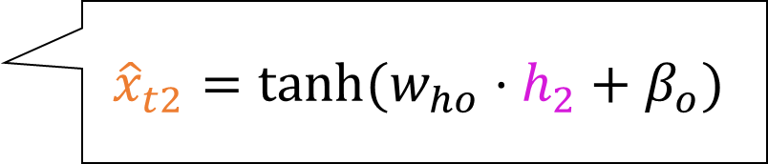
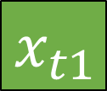
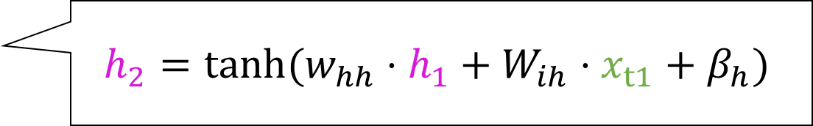
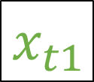

Recurrent Neural Networks
$${\hat{x}}_{t1}$$
$${\hat{x}}_{t2}$$
MLP
MLP
$${\hat{x}}_{t2}=tanh⁡(w_{ho}⋅h_{2}+β_{o})$$
$$h_{0}$$
RNN
RNN
0.0
$$h_{2}=tanh⁡(w_{hh}⋅h_{1}+W_{ih}⋅x_{t1}+β_{h})$$
$$x_{t0}$$
$$x_{t1}$$
Input sequence
$$x_{t0}$$
$$x_{t1}$$
$$…$$
$$x_{T}$$
Target
$${\hat{x}}_{T+1}$$

Slide 17




Recurrent Neural Networks
$${\hat{x}}_{t1}$$
$${\hat{x}}_{t2}$$
$${\hat{x}}_{T+1}$$
MLP
MLP
MLP
$$h_{0}$$
RNN
RNN
RNN
0.0
…
$$x_{t0}$$
$$x_{t1}$$
$$x_{T}$$
Input sequence
$$x_{t0}$$
$$x_{t1}$$
$$…$$
$$x_{T}$$
Target
$${\hat{x}}_{T+1}$$

Slide 18
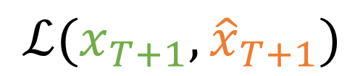
Recurrent Neural Networks
$${\hat{x}}_{t1}$$
$${\hat{x}}_{t2}$$
$${\hat{x}}_{T+1}$$
MLP
MLP
MLP
$$h_{0}$$
RNN
RNN
RNN
0.0
…
$$ℒ(x_{T+1},{\hat{x}}_{T+1})$$
$$x_{t0}$$
$$x_{t1}$$
$$x_{T}$$
Input sequence
$$x_{t0}$$
$$x_{t1}$$
$$…$$
$$x_{T}$$
Target
$${\hat{x}}_{T+1}$$

Slide 19

Recurrent Neural Networks
$${\hat{x}}_{t1}$$
$${\hat{x}}_{t2}$$
$${\hat{x}}_{T+1}$$
MLP
MLP
MLP
$$h_{0}$$
RNN
RNN
RNN
0.0
…
$$x_{t0}$$
$$x_{t1}$$
$$x_{T}$$
?
Input sequence
$$x_{t0}$$
$$x_{t1}$$
$$…$$
$$x_{T}$$
Target
$${\hat{x}}_{T+1}$$
$${\hat{x}}_{T+2}$$

Slide 20
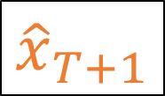


Recurrent Neural Networks
$${\hat{x}}_{t1}$$
$${\hat{x}}_{t2}$$
$${\hat{x}}_{T+1}$$
$${\hat{x}}_{T+2}$$
MLP
MLP
MLP
MLP
$$h_{0}$$
RNN
RNN
RNN
RNN
0.0
…
$$x_{t0}$$
$$x_{t1}$$
$$x_{T}$$
$${\hat{x}}_{T+1}$$
Input sequence
$$x_{t0}$$
$$x_{t1}$$
$$…$$
$$x_{T}$$
Target
$${\hat{x}}_{T+1}$$
$${\hat{x}}_{T+2}$$

Slide 21
Recurrent Neural Networks
$${\hat{x}}_{t1}$$
$${\hat{x}}_{t1}=tanh⁡(w_{ho}⋅h_{1}+β_{o})$$
MLP
$$h_{0}$$
RNN
0.0
$$h_{1}=tanh⁡(w_{hh}⋅h_{0}+W_{ih}⋅x_{t0}+β_{h})$$
$$x_{t0}$$
Input sequence
$$x_{t0}$$
$$x_{t1}$$
$$…$$
$$x_{T}$$
Target
$${\hat{x}}_{T+1}$$

Slide 22
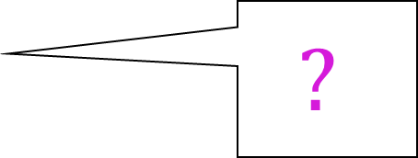

Recurrent Neural Networks
$${\hat{x}}_{t1}$$
MLP
$$h_{0}$$
0.00.0
RNN
$$?$$
$$x_{t0}$$
Input sequence
$$x_{t0}$$
$$x_{t1}$$
$$…$$
$$x_{T}$$
Target
$${\hat{x}}_{T+1}$$

Slide 23
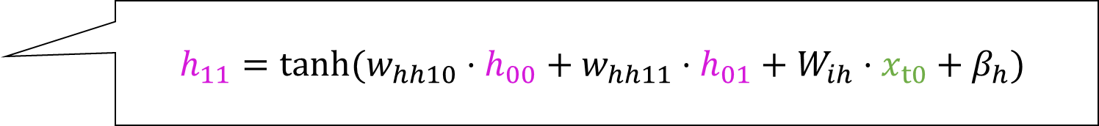
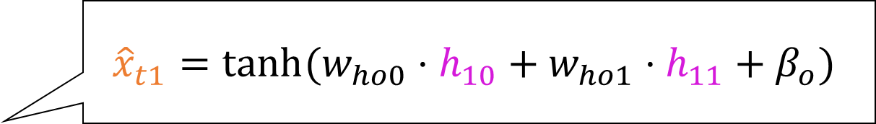
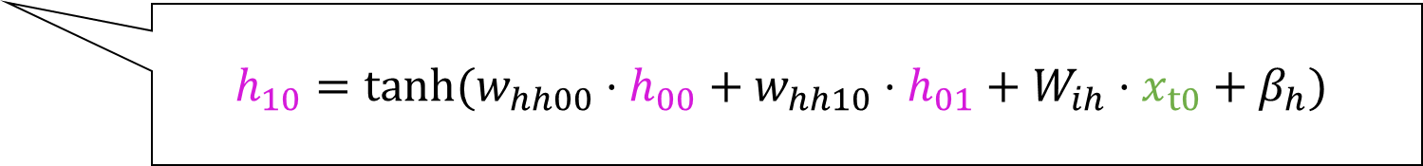
Recurrent Neural Networks
$${\hat{x}}_{t1}$$
$${\hat{x}}_{t1}=tanh⁡(w_{ho0}⋅h_{10}+w_{ho1}⋅h_{11}+β_{o})$$
MLP
$$h_{0}$$
$$h_{11}=tanh⁡(w_{hh10}⋅h_{00}+w_{hh11}⋅h_{01}+W_{ih}⋅x_{t0}+β_{h})$$
0.00.0
RNN
RNN
$$h_{10}=tanh⁡(w_{hh00}⋅h_{00}+w_{hh10}⋅h_{01}+W_{ih}⋅x_{t0}+β_{h})$$
$$x_{t0}$$
Input sequence
$$x_{t0}$$
$$x_{t1}$$
$$…$$
$$x_{T}$$
Target
$${\hat{x}}_{T+1}$$

Slide 24
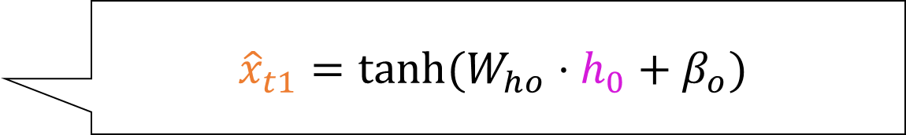
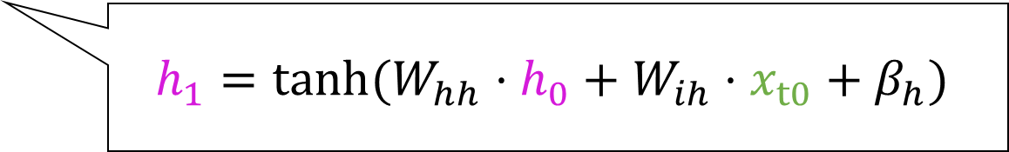

Recurrent Neural Networks
$${\hat{x}}_{t1}$$
$${\hat{x}}_{t1}=tanh⁡(W_{ho}⋅h_{0}+β_{o})$$
MLP
$$h_{0}$$
RNN
$$h_{1}=tanh⁡(W_{hh}⋅h_{0}+W_{ih}⋅x_{t0}+β_{h})$$
$$x_{t0}$$
Input sequence
$$x_{t0}$$
$$x_{t1}$$
$$…$$
$$x_{T}$$
Target
$${\hat{x}}_{T+1}$$

Slide 25

Recurrent Neural Networks
$${\hat{x}}_{t1}$$
$${\hat{x}}_{t1}=tanh⁡(W_{ho}⋅h_{0}+β_{o})$$
MLP
$$h_{0}$$
RNN
(2,2)
(2,3)
(2,1)
$$h_{1}=tanh⁡(W_{hh}⋅h_{0}+W_{ih}⋅x_{t0}+β_{h})$$
(2,1)
$$x_{t0}$$
(2,1)
(3,1)
Input sequence
$$x_{t0}$$
$$x_{t1}$$
$$…$$
$$x_{T}$$
Target
$${\hat{x}}_{T+1}$$

Slide 26
Recurrent Neural Networks
(3,2)
(2,1)
(3,1)
$${\hat{x}}_{t1}$$
$${\hat{x}}_{t1}=tanh⁡(W_{ho}⋅h_{0}+β_{o})$$
MLP
$$h_{0}$$
RNN
(2,2)
(2,3)
(2,1)
$$h_{1}=tanh⁡(W_{hh}⋅h_{0}+W_{ih}⋅x_{t0}+β_{h})$$
(2,1)
$$x_{t0}$$
(2,1)
(3,1)
Input sequence
$$x_{t0}$$
$$x_{t1}$$
$$…$$
$$x_{T}$$
Target
$${\hat{x}}_{T+1}$$

Slide 27
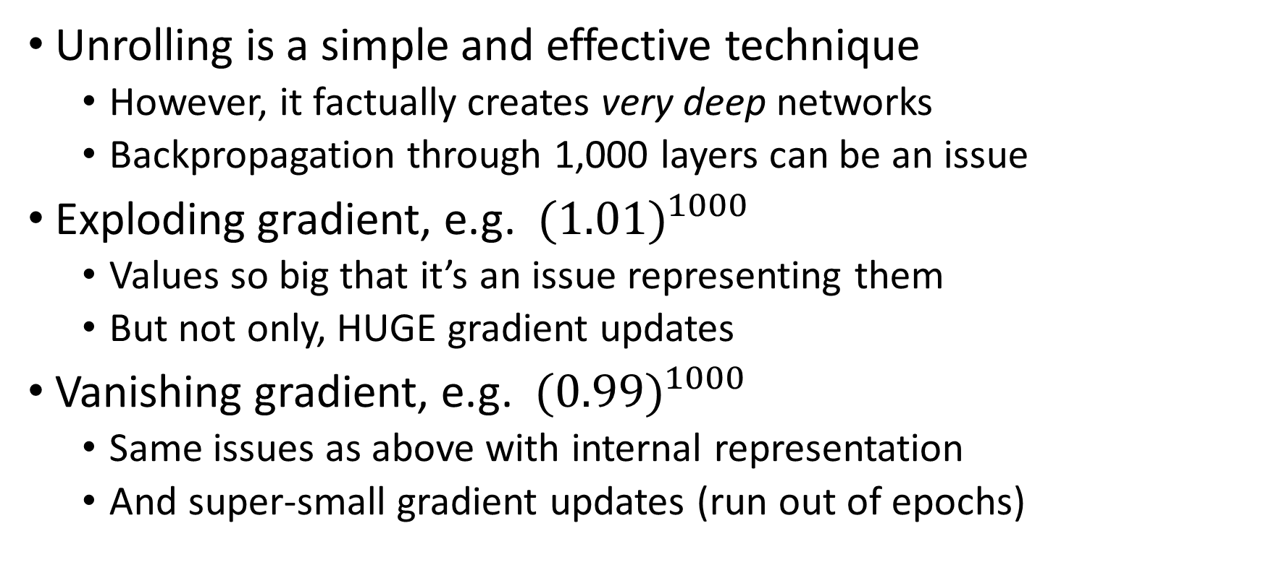
Issues with RNNs
Unrolling is a simple and effective technique
However, it factually creates very deep networks
Backpropagation through 1,000 layers can be an issue
Exploding gradient, e.g. ${(1.01)}^{1000}$
Values so big that it’s an issue representing them
But not only, HUGE gradient updates
Vanishing gradient, e.g. ${(0.99)}^{1000}$
Same issues as above with internal representation
And super-small gradient updates (run out of epochs)

Slide 28
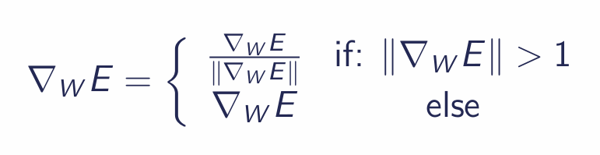
Issues with RNNs
Solutions have been proposed
Gradient clipping to solve exploding gradient, normalize
Long-Short Term Memory Networks (LSTMs)
New type of module, “reset” hidden state when needed
No weights on the path of updating the long-term history
Successful in practical applications
E here is the error function (loss)

Slide 29
output
recurrent
LSTM unit
recurrent
Legend
σ
Sum
tanh
input
Multiplication
Branching point
recurrent
tanh
Hyperbolic tangent
σ
recurrent
input
σ
Logistic sigmoid
σ
input
Unweighted connection
tanh
Weighted connection
Time-lagged connection
input
recurrent
Notes:
This is horrible! I have so many questions! Why using two different activation functions? Where are the weights?

Slide 30


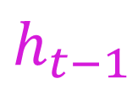


Long-Short Term Memory Networks
Two “memory lanes” per unit
Long-term memory, no weights (!), avoids exploding/vanishing
Short-term memory, carried out from the recent past
$$c_{t−1}$$
$$c_{t}$$
Long-term memory
(“cell state”)
LSTM unit
$$h_{t}$$
Short-term memory
(“hidden state”)
$$h_{t−1}$$
$$x_{t}$$

Slide 31
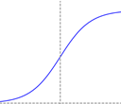
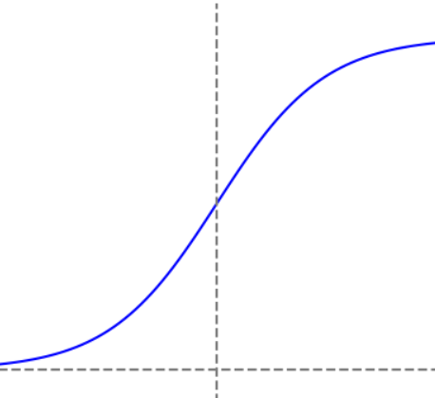
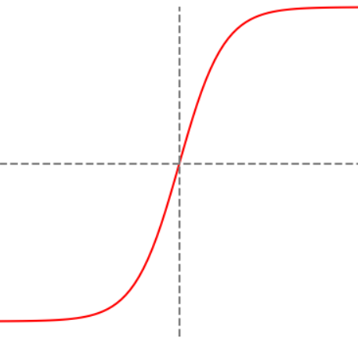
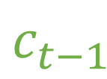
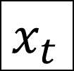

Long-Short Term Memory Unit
$$c_{t−1}$$
Long-term memory
(“cell state”)
%
value
Short-term memory
(“hidden state”)
$$h_{t−1}$$
$$x_{t}$$
Input

Slide 32

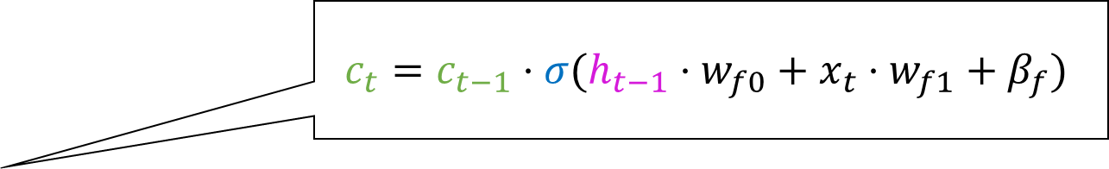
Long-Short Term Memory Unit
$$c_{t}=c_{t−1}⋅σ(h_{t−1}⋅w_{f0}+x_{t}⋅w_{f1}+β_{f})$$
“What percentage of Long-Term Memory should we push forward?”
Compute value between 0 and 1, that will multiply the current value of the Long-Term Memory
This is why it is using a Sigmoid activation function, whose output is in [0.0,1.0]!
$$x_{t}$$
Since the value can also be zero, it can erase Long-Term Memory!
“FORGET GATE”

Slide 33
Long-Short Term Memory Unit
“How much of the current Short-Term Memory, modified by the input, should we use to update the Long-Term Memory?”
%
value
This computes a percentage (or ratio), which activation function do you think it will use?
This computes a value, which activation function do you think it will use?
$$x_{t}$$

Slide 34
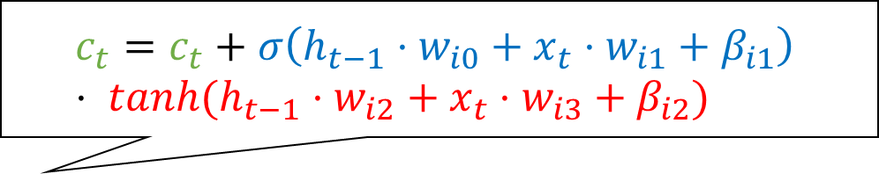
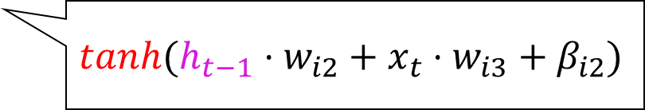
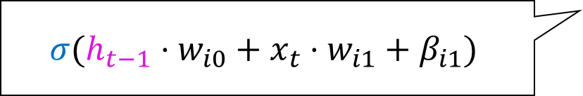
Long-Short Term Memory Unit
$$c_{t}=c_{t}+σ\left(h_{t−1}⋅w_{i0}+x_{t}⋅w_{i1}+β_{i1}\right) \\ ⋅ tanh(h_{t−1}⋅w_{i2}+x_{t}⋅w_{i3}+β_{i2})$$
“How much of the current Short-Term Memory, modified by the input, should we use to update the Long-Term Memory?”
%
value
$$σ(h_{t−1}⋅w_{i0}+x_{t}⋅w_{i1}+β_{i1})$$
$$tanh(h_{t−1}⋅w_{i2}+x_{t}⋅w_{i3}+β_{i2})$$
$$x_{t}$$
“INPUT GATE”

Slide 35
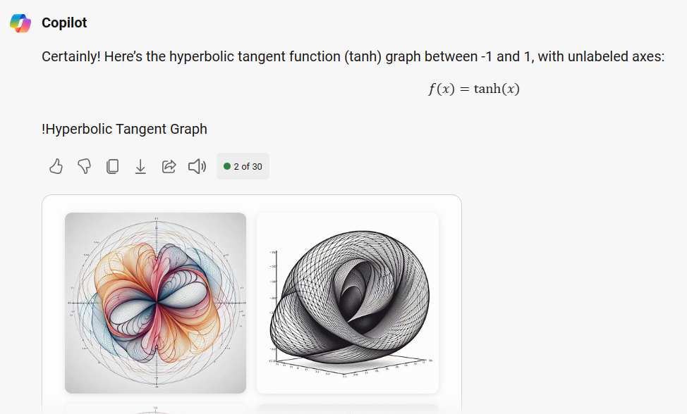
Parenthesis

Slide 36

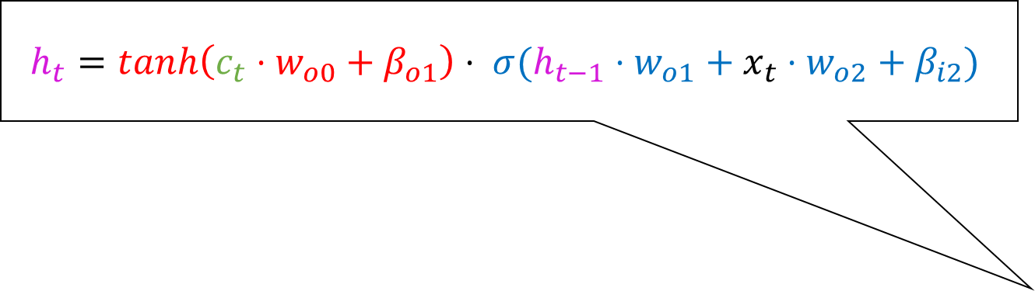
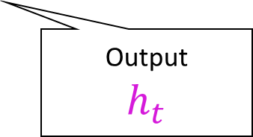
Long-Short Term Memory Unit
$$h_{t}=tanh\left(c_{t}⋅w_{o0}+β_{o1}\right)⋅ σ(h_{t−1}⋅w_{o1}+x_{t}⋅w_{o2}+β_{i2})$$
Potential Short-Term Memory
LSTM unit
“How should we update the Short-Term Memory, taking into account the current input and the updated Long-Term Memory?”
Output
$$h_{t}$$
$$x_{t}$$
“OUTPUT GATE”
How much of it will actually be passed on to the next LSTM unit

Slide 37


LSTM architecture
LSTM₁
Other
Modules
LSTM₂
$${\hat{y}}_{t+1}$$
LSTM_{N}
$$x_{t}$$

Slide 38
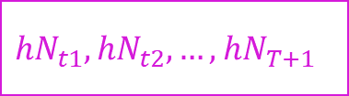

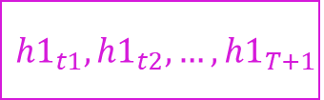
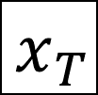

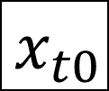
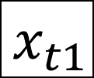
LSTM architecture
$${h1}_{t1},{h1}_{t2},…,{h1}_{T+1}$$
0,
0,
0,
…
LSTM₁
LSTM₁
LSTM₁
Other
Modules
LSTM₂
LSTM₂
LSTM₂
$$\hat{y}$$
LSTM_{N}
LSTM_{N}
LSTM_{N}
$${\hat{y}}_{t1},{\hat{y}}_{t2},…,{\hat{y}}_{T+1}$$
$$x_{t0}$$
$$x_{t1}$$
$$x_{T}$$
$${hN}_{t1},{hN}_{t2},…,{hN}_{T+1}$$

Slide 39
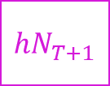



LSTM architecture
0,
0,
0,
…
LSTM₁
LSTM₁
LSTM₁
Other
Modules
$${h1}_{T+1}$$
LSTM₂
LSTM₂
LSTM₂
$$\hat{y}$$
$${h2}_{T+1}$$
LSTM_{N}
LSTM_{N}
LSTM_{N}
$${hN}_{T+1}$$
$$x_{t0}$$
$$x_{t1}$$
$$x_{T}$$

Slide 40



Gated Recurrent Units (GRUs)
Variant of LSTM with less parameters per unit (12 vs 16)
Considered more or less just as accurate, faster to train
More recent applications favor GRUs over LSTMs
But not always, in practice people try both and then pick
pytorch RNN
pytorch LSTM
pytorch GRU

Slide 41


Questions?
Bibliography - Amari, S. I. (1972). Learning patterns and pattern sequences by self-organizing nets of threshold elements. IEEE Transactions on computers, 100(11), 1197-1206. [RNNs] - Cho, K., Van Merriënboer, B., Bahdanau, D., & Bengio, Y. (2014). On the properties of neural machine translation: Encoder-decoder approaches. arXiv preprint arXiv:1409.1259. [GRUs] - Hochreiter, S., & Schmidhuber, J. (1997). Long short-term memory. Neural computation, 9(8), 1735-1780. [LSTMs] - Hopfield, J. J. (1982). Neural networks and physical systems with emergent collective computational abilities. Proceedings of the national academy of sciences, 79(8), 2554-2558. [RNNs] - StatQuest, Long Short-Term Memory (LSTM), Clearly Explained, https://www.youtube.com/watch?v=YCzL96nL7j0
Images and videos: unless otherwise stated, I stole them from the Internet. I hope they are not copyrighted, or that their use falls under the Fair Use clause, and if not, I am sorry. Please don’t sue me.

