Slide 1
Concept Bottleneck Models
Alberto TONDA, Ph.D. (Senior permanent researcher, DR)
UMR 518 MIA-PS, INRAE, AgroParisTech, Université Paris-Saclay UAR 3611, Institut des Systèmes Complexes de Paris Île-de-France

Slide 2
Outline
Neural-symbolic approaches
Concept bottleneck models
Concept embedding models
Deep concept reasoner
Experimental evaluation
Conclusions

Slide 3
Neural-Symbolic approaches
Neural-Symbolic (NeSy) combines ML/DL and Symbolic AI
Even if it is called “neural”, also ML
It’s a field, lots of different methods
Idea of combining efficacy (ML) with interpretability (symbolic AI)
Gaining in popularity as DL is showing limits (maybe)
What to do is clear, how to do it, is difficult
ML/DL and Symbolic AI don’t mix very well
Maybe embeddings could help bridge features and symbols

Slide 4
Concept bottleneck models
Features
X
Concepts C
Labels Y

Slide 5
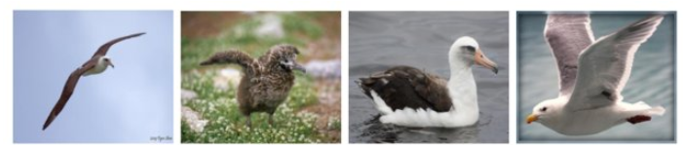
Concept bottleneck models
Laysan Albatross
Rusty Blackbird
Fish Crow
Brewer Blackbird
Shiny Cowbird
...
Features
X
Concepts C
Labels Y
White_Wings: yes/no
Curved_Beak: yes/no
Yellow_Beak: yes/no
Black_Body: yes/no
...

Slide 6
Concept bottleneck models
Classic Artificial Neural Network/Deep Learning
ANN/DL model with a concept bottleneck
…
…
…
…
…
…
…
…
…

Slide 7
Concept bottleneck models
Classic Artificial Neural Network/Deep Learning
ANN/DL model with a concept bottleneck
Each neuron (or group of neurons) in the concept layer corresponds to one concept
…
…
If a neuron (or group of neurons) is «active», the concept is True
…
…
…
…
…
…
…

Slide 8
Concept bottleneck models
Concepts for explanations
«I think this is a Laysan Albatross because I detected white wings (White_Wings=True), black body (Black_Body=True), the beak is not curved (Curved_Beak=False) ...»
ANN/DL model with a concept bottleneck
…
…
…
…
…

Slide 9








Concept bottleneck models
Concepts for interventions
Domain Expert
round
red
“DICE”
squared
cold
CONCEPTS

Slide 10
Concept bottleneck models
Concepts for interventions
Domain Expert
round
red
“DICE”
squared
cold
CONCEPTS

Slide 11
Concept bottleneck models
Concepts for interventions
Domain Expert
round
red
“DICE”
squared
cold
CONCEPTS

Slide 12

Concept bottleneck models
Concepts for interventions
Domain Expert
round
red
“APPLE”
squared
cold
CONCEPTS

Slide 13

Concept bottleneck models
after interventions
task performance
before interventions
number of interventions

Slide 14
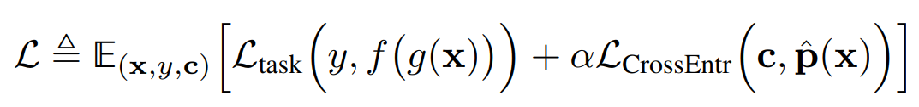
Concept bottleneck models
How to train concept bottleneck models in practice?
Modify the loss function to take into account concepts
Force neurons to be «active» when the concept is True
In training, access to «real» values of concepts; in test no need
Open questions and issues
Concept bottleneck hinders predictive performance (Y)
What does it mean to have an «active» concept? > 0.5?

Slide 15
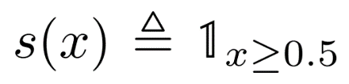
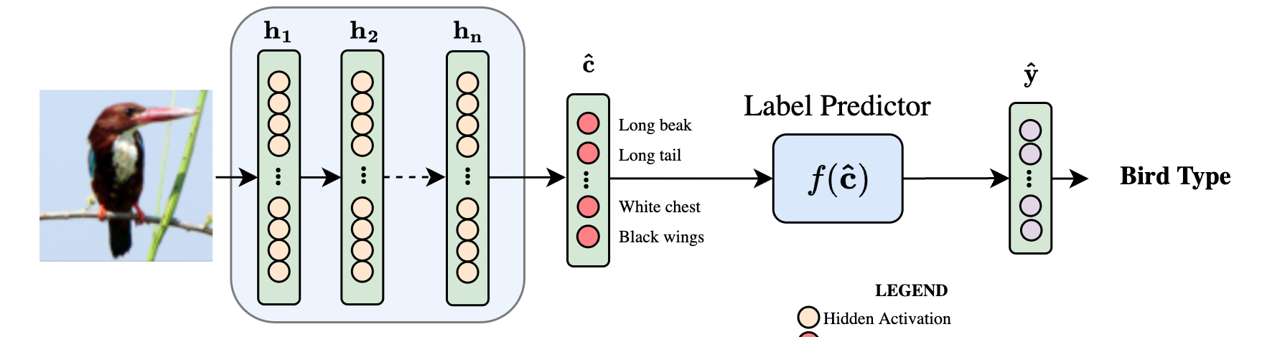
Concept bottleneck models
Boolean bottleneck

Slide 16

Concept bottleneck models
Fuzzy bottleneck

Slide 17
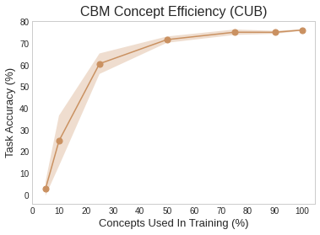
Concept bottleneck models
Fuzzy bottleneck

Slide 18
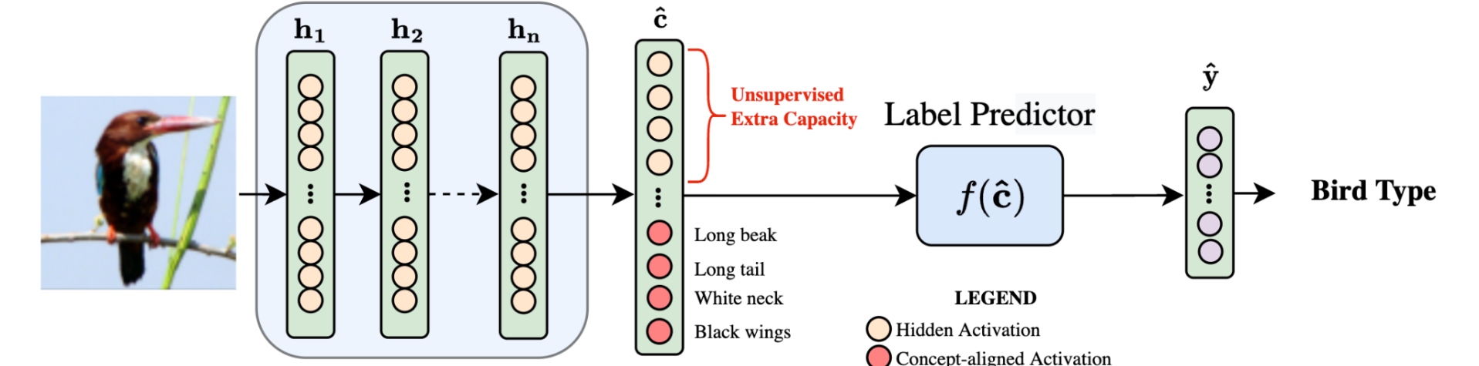
Concept bottleneck models
Hybrid bottleneck

Slide 19
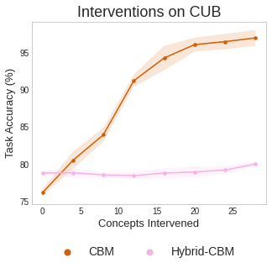
Concept bottleneck models
Hybrid bottleneck

Slide 20
Concept bottleneck models
Hybrid bottleneck

Slide 21

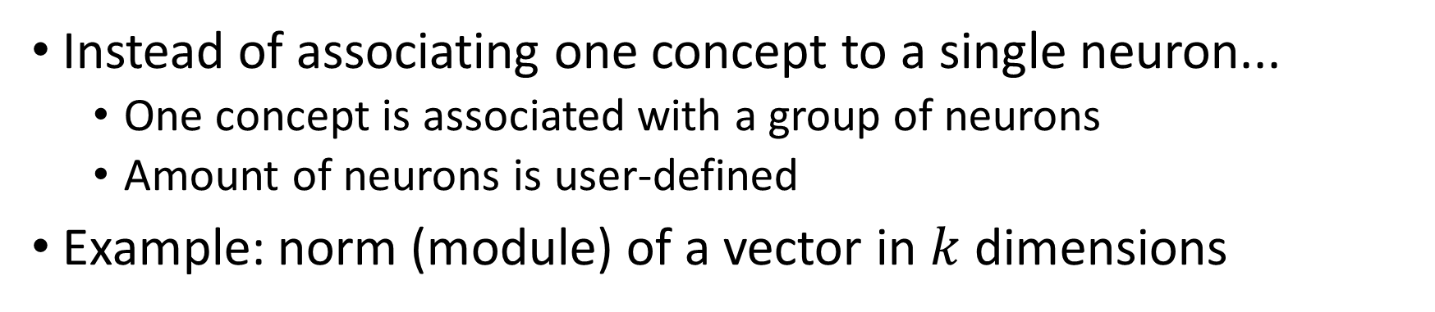
Concept embedding models
Instead of associating one concept to a single neuron...
One concept is associated with a group of neurons
Amount of neurons is user-defined
Example: norm (module) of a vector in $k$ dimensions
n₂
$$\vec{v}=(n_{1},n_{2})$$
n₁

Slide 22


Concept embedding models
Instead of associating one concept to a single neuron...
One concept is associated with a group of neurons
Amount of neurons is user-defined
Example: norm (module) of a vector in $k$ dimensions
n₂
n₂
${\left\|\vec{v}\right\|}_{1}≅1$: True
$$\vec{v}=(n_{1},n_{2})$$
n₁
n₁
${\left\|\vec{v}\right\|}_{1}≅0.5$: False

Slide 23
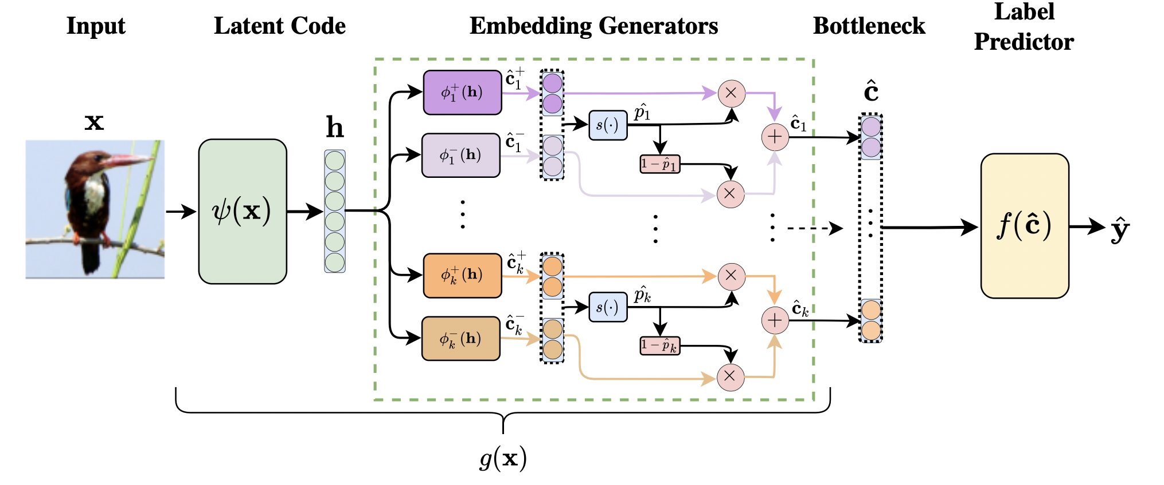
Solution: Concept Embedding Models
ZARLENGA ET AL. (NeurIPS 2022)
Notes:
In order to overcome the limitations of SOTA CBMs, we proposed CEMs. Our approach has 2 key novelties: (i) first we represent each concept with a fully supervised embedding and (ii) second we proposed an efficient algorithm to enable simple human interventions on concept embeddings.

Slide 24
Solution: Concept Embedding Models
Notes:
In order to overcome the limitations of SOTA CBMs, we proposed CEMs. Our approach has 2 key novelties: (i) first we represent each concept with a fully supervised embedding and (ii) second we proposed an efficient algorithm to enable simple human interventions on concept embeddings.

Slide 25
Solution: Concept Embedding Models
Notes:
In order to overcome the limitations of SOTA CBMs, we proposed CEMs. Our approach has 2 key novelties: (i) first we represent each concept with a fully supervised embedding and (ii) second we proposed an efficient algorithm to enable simple human interventions on concept embeddings.

Slide 26
Solution: Concept Embedding Models
Notes:
In order to overcome the limitations of SOTA CBMs, we proposed CEMs. Our approach has 2 key novelties: (i) first we represent each concept with a fully supervised embedding and (ii) second we proposed an efficient algorithm to enable simple human interventions on concept embeddings.

Slide 27
Solution: Concept Embedding Models
ℒ_{concepts}
Notes:
In order to overcome the limitations of SOTA CBMs, we proposed CEMs. Our approach has 2 key novelties: (i) first we represent each concept with a fully supervised embedding and (ii) second we proposed an efficient algorithm to enable simple human interventions on concept embeddings.

Slide 28
Solution: Concept Embedding Models
Notes:
In order to overcome the limitations of SOTA CBMs, we proposed CEMs. Our approach has 2 key novelties: (i) first we represent each concept with a fully supervised embedding and (ii) second we proposed an efficient algorithm to enable simple human interventions on concept embeddings.

Slide 29
Solution: Concept Embedding Models
Notes:
In order to overcome the limitations of SOTA CBMs, we proposed CEMs. Our approach has 2 key novelties: (i) first we represent each concept with a fully supervised embedding and (ii) second we proposed an efficient algorithm to enable simple human interventions on concept embeddings.

Slide 30
Solution: Concept Embedding Models
Notes:
In order to overcome the limitations of SOTA CBMs, we proposed CEMs. Our approach has 2 key novelties: (i) first we represent each concept with a fully supervised embedding and (ii) second we proposed an efficient algorithm to enable simple human interventions on concept embeddings.

Slide 31
Solution: Concept Embedding Models
ZARLENGA ET AL. (NeurIPS 2022)
Notes:
In order to overcome the limitations of SOTA CBMs, we proposed CEMs. Our approach has 2 key novelties: (i) first we represent each concept with a fully supervised embedding and (ii) second we proposed an efficient algorithm to enable simple human interventions on concept embeddings.

Slide 32
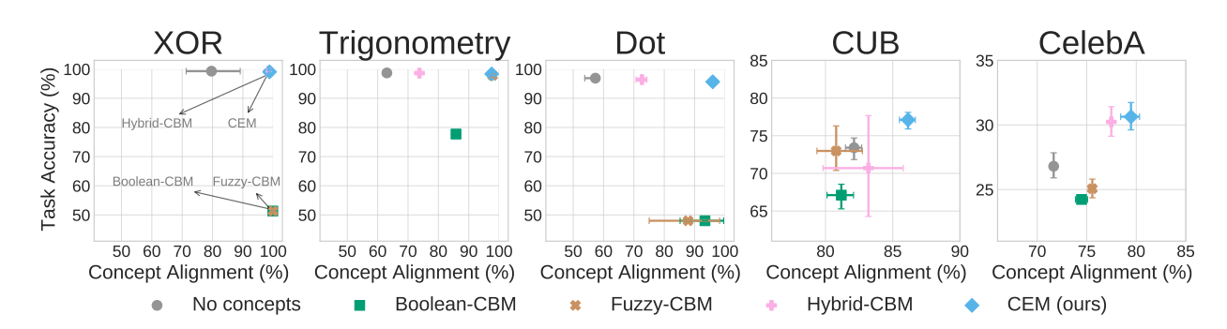
Experimental evaluation of CEM

Slide 33
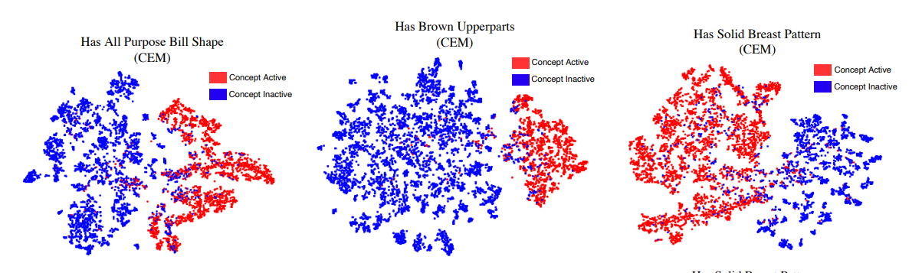
Concept embeddings
Plots with t-SNE of the concept embedding

Slide 34
Concept embedding models: issues
This tells us whether the concept is active
This is still a black box

Slide 35
Concept embedding models: issues
In principle, extract rules from concept activity...
...but not all concepts are relevant for a prediction!

Slide 36
Concept embedding models: issues
CEMs are better than other CBMs
Better performance on tasks
Better concept alignment
Interventions are easy to perform and improve results
Explainability could be improved
It’s possible to extract rules from CEMs, but lots of concepts
Ideally, rules should be compact (few concepts)
Can we do better than a CEM?

Slide 37
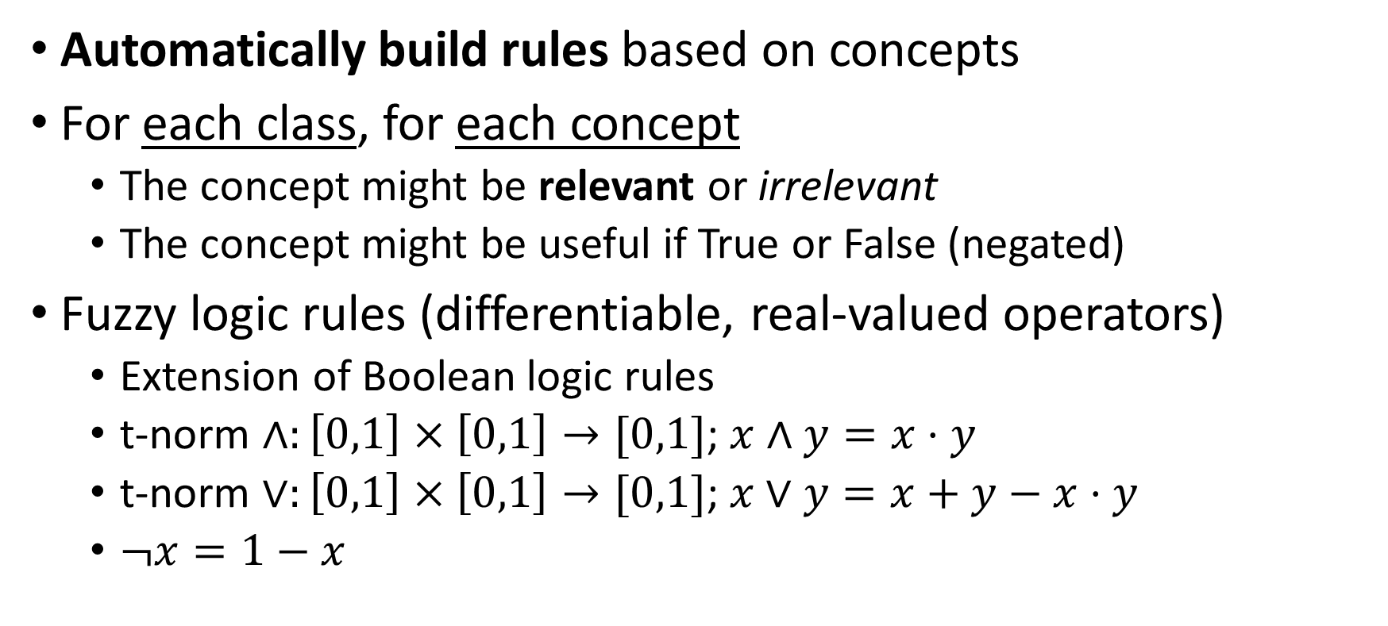
Deep concept reasoner
Automatically build rules based on concepts
For each class, for each concept
The concept might be relevant or irrelevant
The concept might be useful if True or False (negated)
Fuzzy logic rules (differentiable, real-valued operators)
Extension of Boolean logic rules
t-norm $∧:\left[0,1\right]×\left[0,1\right]→[0,1]$; $x∧y=x⋅y$
t-norm $∨:\left[0,1\right]×\left[0,1\right]→[0,1]$;$x∨y=x+y−x⋅y$
$¬x=1−x$

Slide 38
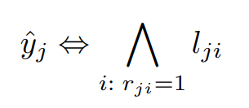
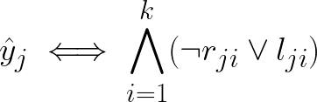
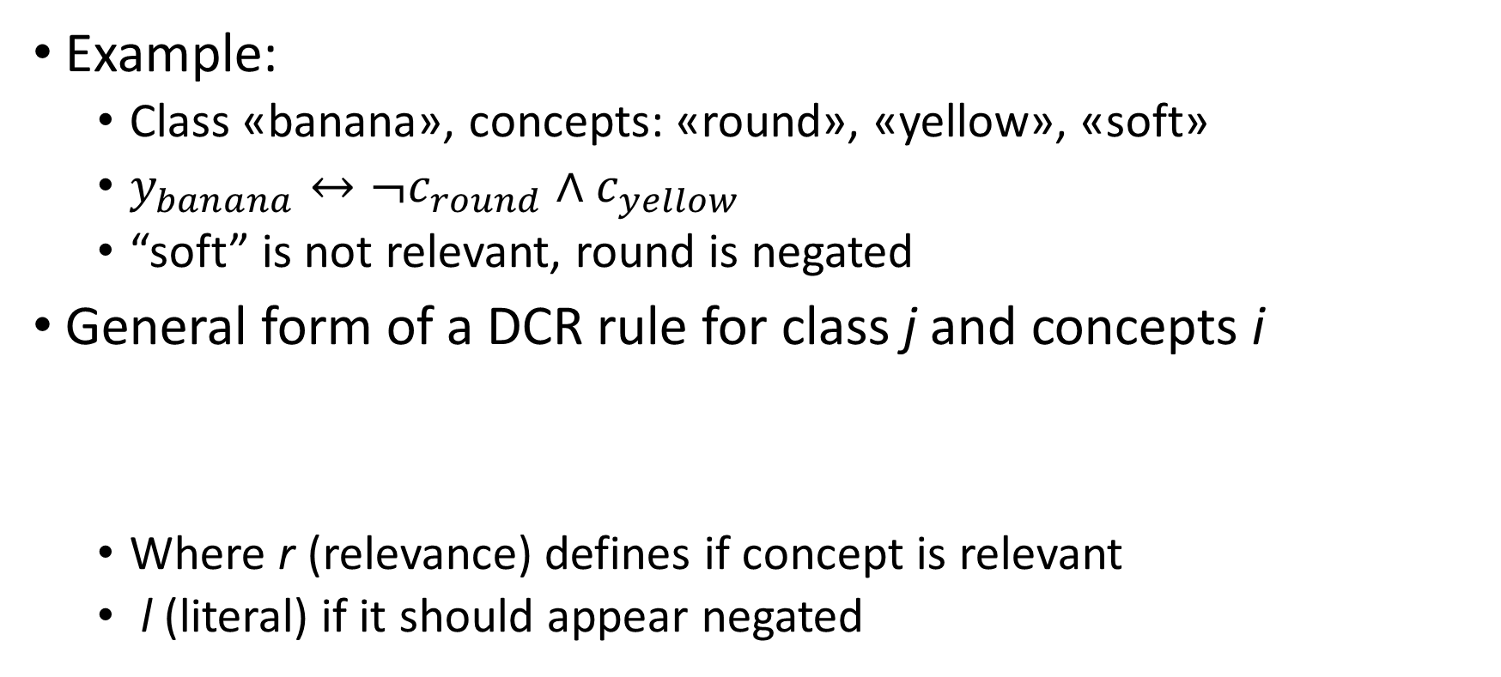
Deep concept reasoner
Example:
Class «banana», concepts: «round», «yellow», «soft»
$y_{banana}↔¬c_{round}∧c_{yellow}$
“soft” is not relevant, round is negated
General form of a DCR rule for class j and concepts i
Where r (relevance) defines if concept is relevant
l (literal) if it should appear negated

Slide 39
Deep concept reasoner
Example:
Class «banana», concepts: «round», «yellow», «soft»
$y_{banana}↔¬c_{round}∧c_{yellow}$
“soft” is not relevant, round is negated
General form of a DCR rule for class j and concepts i
Where r (relevance) defines if concept is relevant
l (literal) if it should appear negated
For IRRELEVANT (r=0) concepts, the whole expression goes to 1

Slide 40
Deep concept reasoner
Example: banana

Slide 41
Deep concept reasoner

Slide 42
Deep concept reasoner
Concept TRUTH DEGREE
Concept EMBEDDINGS

Slide 43
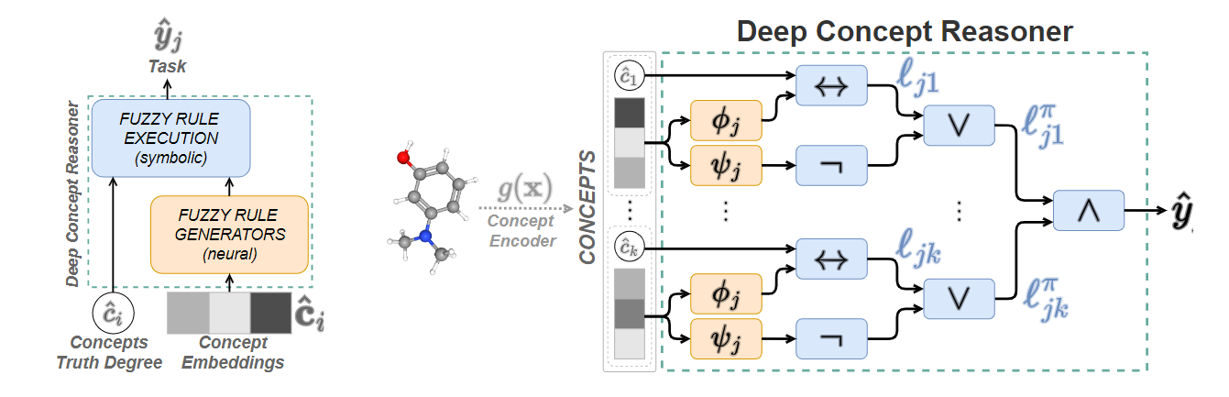
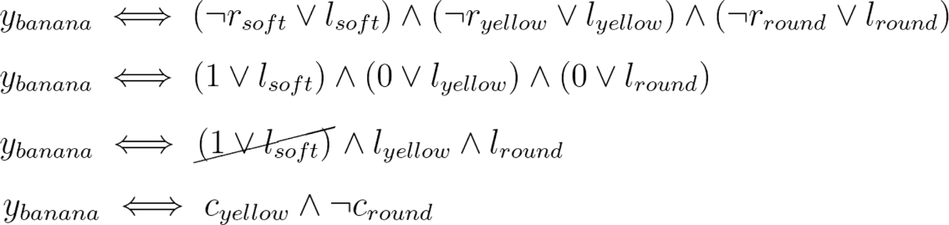
Deep concept reasoner

Slide 44
Deep concept reasoner

Slide 45
Deep concept reasoner
Literal (l_{ij})
Relevance (r_{ij})

Slide 46
Deep concept reasoner
Literal (l_{ij})
Relevance (r_{ij})

Slide 47

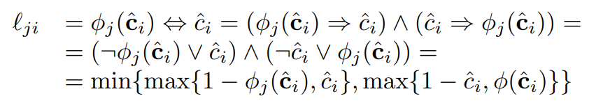
Deep concept reasoner

Slide 48


Deep concept reasoner

Slide 49
Deep concept reasoner
They are the same for all concepts of the same class (training)
Relevance (r_{ij})

Slide 50
Deep concept reasoner
In test, apply all rules for all classes, and apply softmax
Relevance (r_{ij})

Slide 51
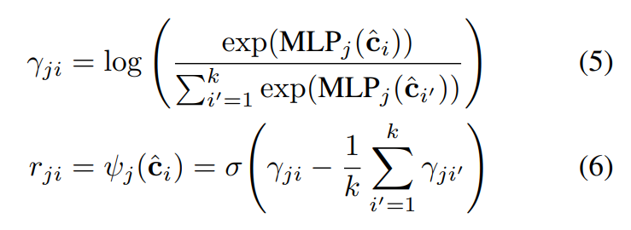


Deep concept reasoner
Activation function of $ψ_{j}$ (relevance) enforces parsimony
How strongly is a concept activated with respect to the others?
log-softmax

Slide 52
Deep concept reasoner
Activation function of $ψ_{j}$ (relevance) enforces parsimony
User-defined parameter to regulate number of concepts per rule

Slide 53
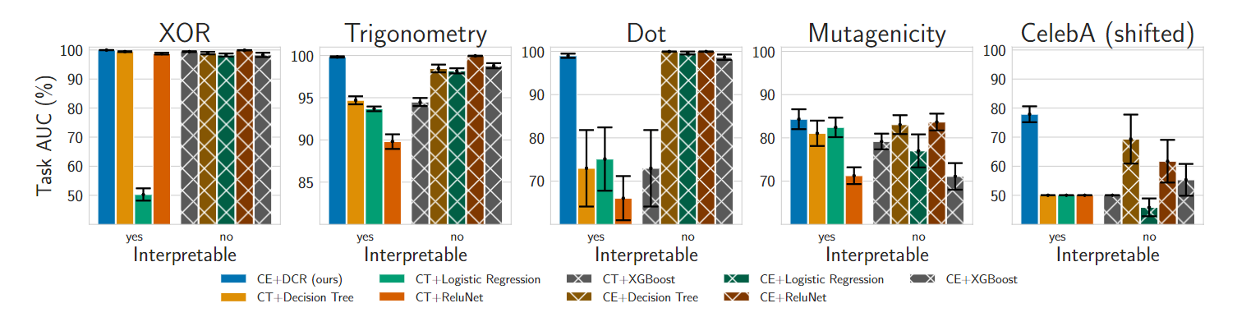
Experimental evaluation

Slide 54
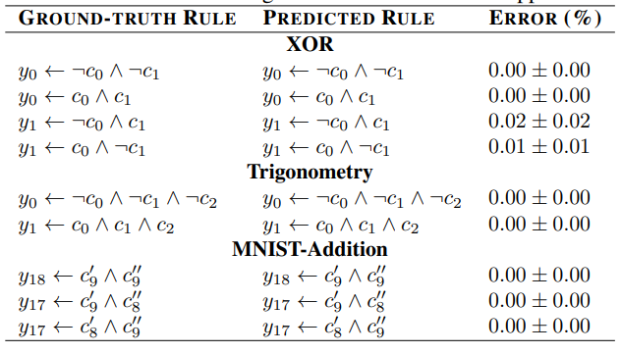
Experimental evaluation

Slide 55
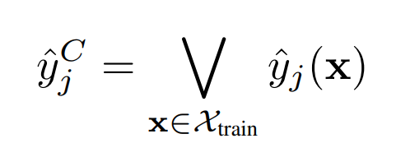
Conclusions
DCR is good for local explanations
You can try for global explanations
Aggregate local explanations for samples of the same class
“Booleanize” local fuzzy rules and join them with “or”
Obvious limitation: concept-based datasets

Slide 56


Questions?
Bibliography - Koh, P. W., Nguyen, T., Tang, Y. S., Mussmann, S., Pierson, E., Kim, B., & Liang, P. (2020, November). Concept bottleneck models. In International conference on machine learning (pp. 5338-5348). PMLR. - Espinosa Zarlenga, M., Barbiero, P., Ciravegna, G., Marra, G., Giannini, F., Diligenti, M., ... & Jamnik, M. (2022). Concept embedding models: Beyond the accuracy-explainability trade-off. Advances in Neural Information Processing Systems, 35, 21400-21413. [CEM] - Barbiero, P., Ciravegna, G., Giannini, F., Zarlenga, M. E., Magister, L. C., Tonda, A., ... & Marra, G. (2023, July). Interpretable neural-symbolic concept reasoning. In International Conference on Machine Learning (pp. 1801-1825). PMLR. [DCR]
Images and videos: unless otherwise stated, I stole them from the Internet. I hope they are not copyrighted, or that their use falls under the Fair Use clause, and if not, I am sorry. Please don’t sue me.

