Slide 1
This is an example of a title, it should be bigger!
Alberto TONDA, Ph.D. (Senior permanent researcher, DR)
UMR 518 MIA-PS, INRAE, AgroParisTech, Université Paris-Saclay UAR 3611, Institut des Systèmes Complexes de Paris Île-de-France

Slide 2
This is a new thing
Ciao
Ciaooooooooooooooo

Slide 3
Autoencoders

Slide 4
Variational Autoencoders

Slide 5
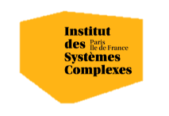

Questions?
Bibliography - Chan S. Tutorial on Diffusion Models for Imaging and Vision, 2024, arXiv
Images and videos: unless otherwise stated, I stole them from the Internet. I hope they are not copyrighted, or that their use falls under the Fair Use clause, and if not, I am sorry. Please don’t sue me.

