Slide 1
Regularization
Alberto TONDA, Ph.D. (Senior permanent researcher, DR)
UMR 518 MIA-PS, INRAE, AgroParisTech, Université Paris-Saclay UAR 3611, Institut des Systèmes Complexes de Paris Île-de-France

Slide 2
Outline
Regularization
L1/L2 regularization
Dropout
Batch normalization
Regularization in pytorch

Slide 3
Regularization?
An ally in the battle to fight against overfitting
Neural network researchers noticed a correlation with overfitting
Parameters or neuron outputs with large absolute values
If parameter values represent “knowledge”
High values mean hyperspecialized neurons
If for some reason they are not activated, everything after fails
Ideally, we would like knowledge to be more spread out
“More paths”, redundancy

Slide 4
L1/L2 regularization
We would like the network to fit the data, but also not parameter values much larger than others in same module
What can we do?

Slide 5
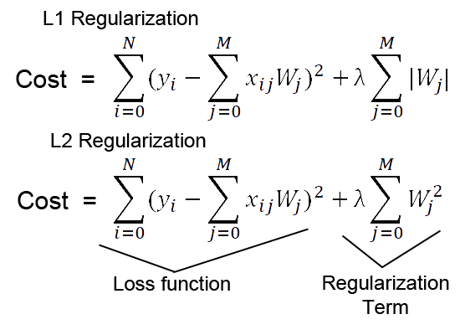
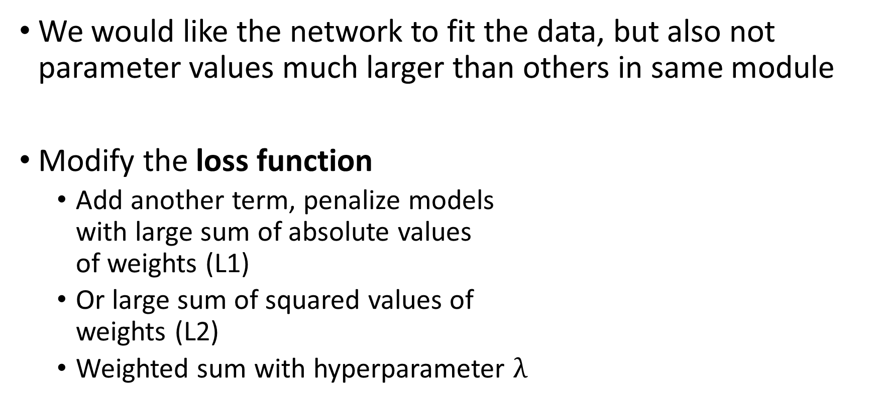
L1/L2 regularization
We would like the network to fit the data, but also not parameter values much larger than others in same module
Modify the loss function
Add another term, penalize models with large sum of absolute values of weights (L1)
Or large sum of squared values of weights (L2)
Weighted sum with hyperparameter $λ$

Slide 6
Dropout
Popular technique (for a while)
Active only during the training process
During forward pass, randomly set input tensor element to zero
This also impacts backward pass and gradient updates
Only parameter is a probability, applied to each tensor element
Can also be seen as setting neuron output to zero
Can be applied (or not) independently to each module

Slide 7
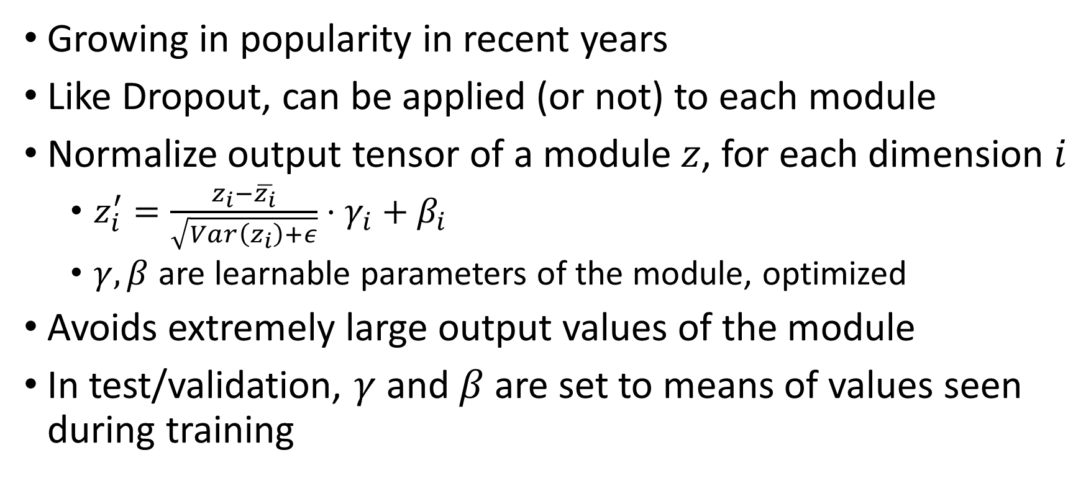
Batch normalization
Growing in popularity in recent years
Like Dropout, can be applied (or not) to each module
Normalize output tensor of a module $z$, for each dimension $i$
$z_{i}^{′}=\frac{z_{i}−\overline{z_{i}}}{\sqrt{Var\left(z_{i}\right)+ε}}⋅γ_{i}+β_{i}$
$γ, β$ are learnable parameters of the module, optimized
Avoids extremely large output values of the module
In test/validation, $γ$ and $β$ are set to means of values seen during training

Slide 8
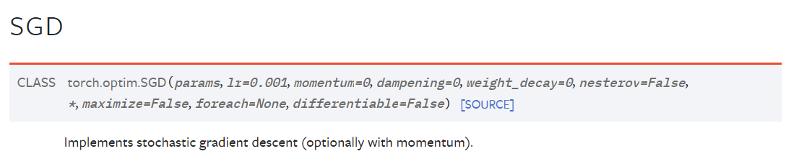
pytorch utils
Pytorch implements regularization as additional modules
torch.nn.Dropout()
torch.nn.BatchNorm1d(), 2d(), 3d() # horrible naming convention
model.train() and .eval() to activate/deactivate reg. modules
L2 regularization is an optimizer option, weight_decay

Slide 9


Questions?
Bibliography
Images and videos: unless otherwise stated, I stole them from the Internet. I hope they are not copyrighted, or that their use falls under the Fair Use clause, and if not, I am sorry. Please don’t sue me.

